Slide 1
Data 606 Capstone Project: Maryland’s Statewide Vehicle Accidents Analysis
Under Supervision of:
Dr. Chaojie Wang By:
Suresh Ganta

Slide 2
Introduction and Problem Statement:
The Maryland Statewide Vehicle Crashes dataset is a comprehensive collection of data on vehicle crashes that occurred in the state of Maryland. This dataset contains information on over 400,000 crashes that took place between 2015 and 2020, including details such as the date and time of the crash, the location, the type of vehicles involved, and the severity of the crash.
This dataset is an invaluable resource for anyone interested in studying vehicle safety and accident prevention in Maryland. By analyzing this data, researchers and policymakers can gain insights into the causes of accidents and develop strategies to reduce their frequency and severity.

Slide 3
Data Source and Description
Observations were drawn from Maryland open date website.
Data Source: https://opendata.maryland.gov/Public-Safety/Maryland-Statewide-Vehicle-Crashes/65du-s3qu
Dataset Shape: 878343 rows and 55 columns

Slide 4
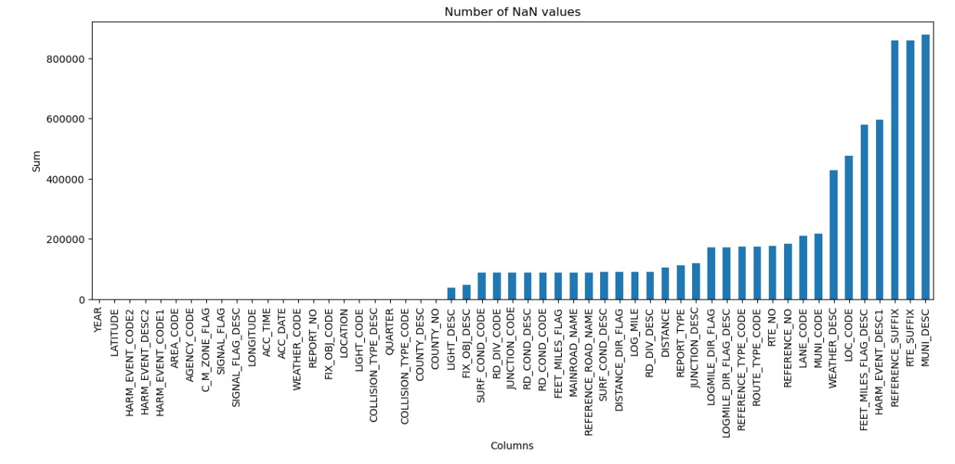
Data Preprocessing
The below Figure represents the number of null values in each column

Slide 5
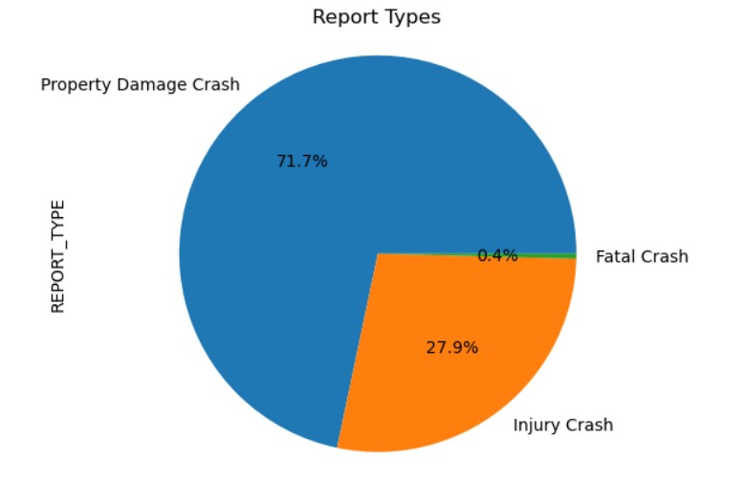
Data Preprocessing
The figure represents the report types distribution (target variable). From the plot we can observe that 72% of accidents are property damage crashes which are highest among other two.

Slide 6
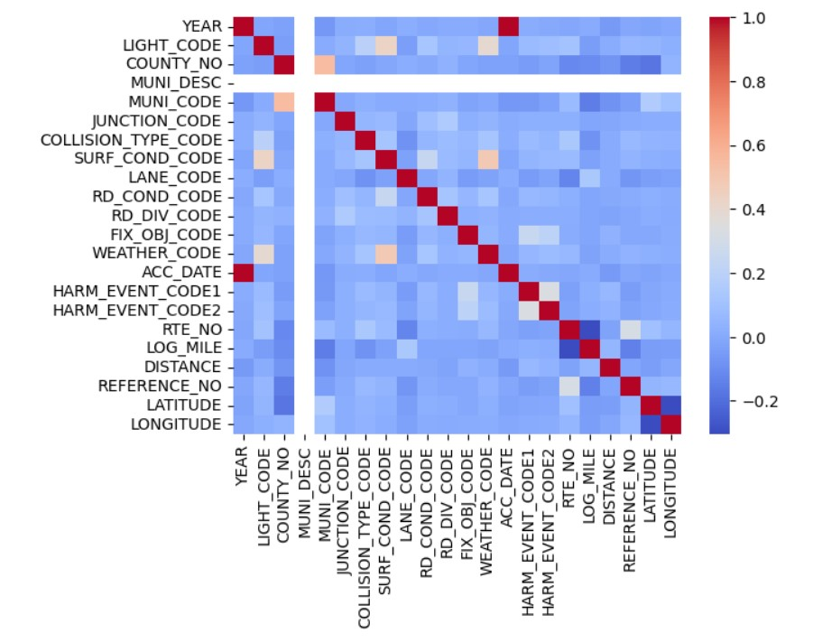
Data Preprocessing
The below Figure represents the correlation between each column. Acc_date and year are highly correlated as we can see from the correlation diagram.

Slide 7
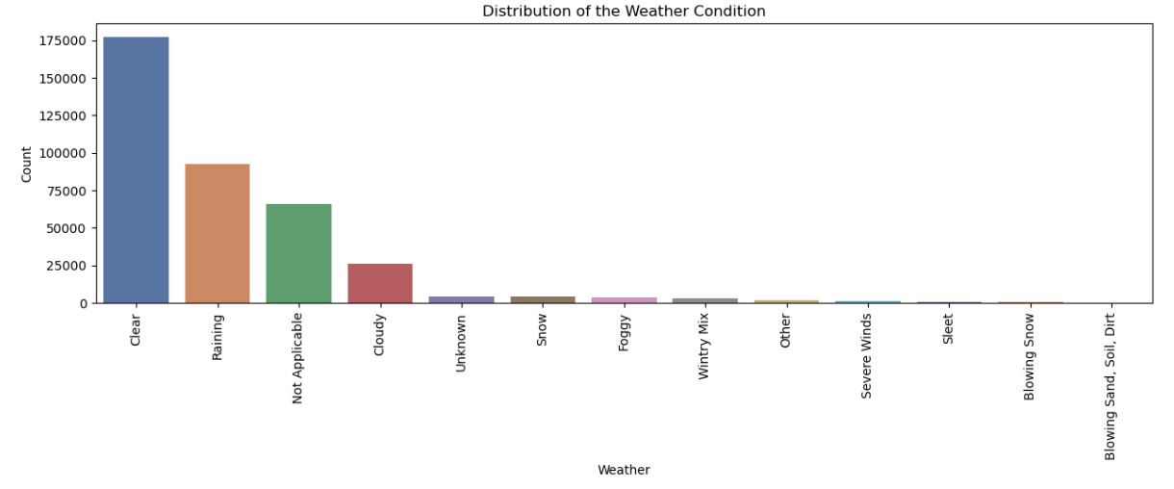
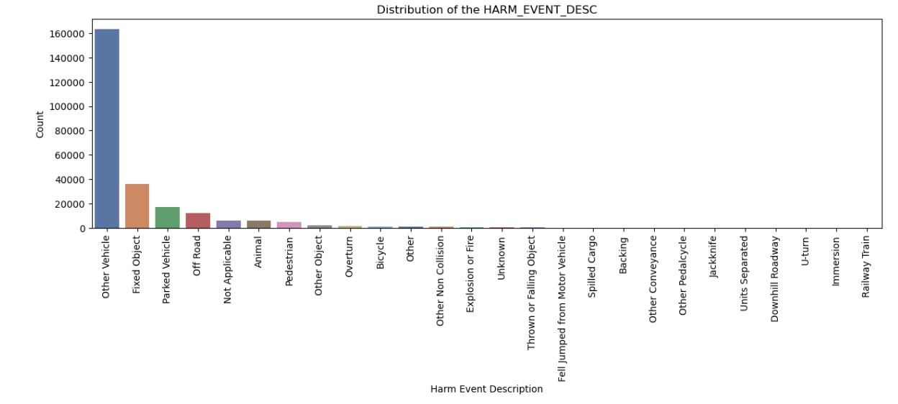
Exploratory Data Analysis
The plot explains the distribution of weather condition. From the plot we can observe most accidents occurred in clear weather
The plot shows harm event description. From the chart we can observe that most accidents occurred with other vehicle.

Slide 8
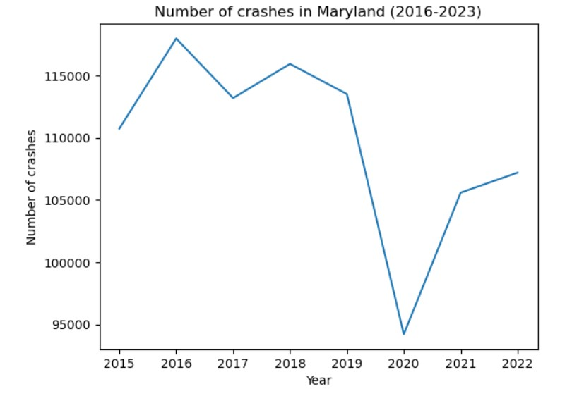
Exploratory Data Analysis
The Diagram briefs number of accidents occurred each year. We can observe peak in 2016 and lowest number of crashes in 2020.

Slide 9
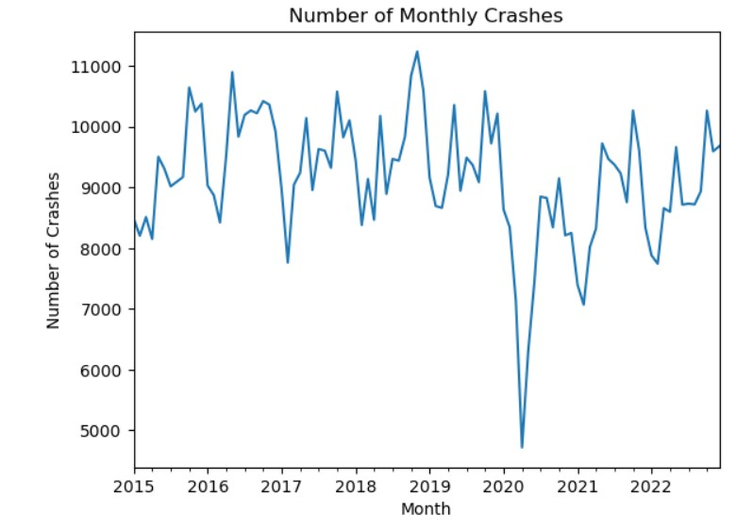
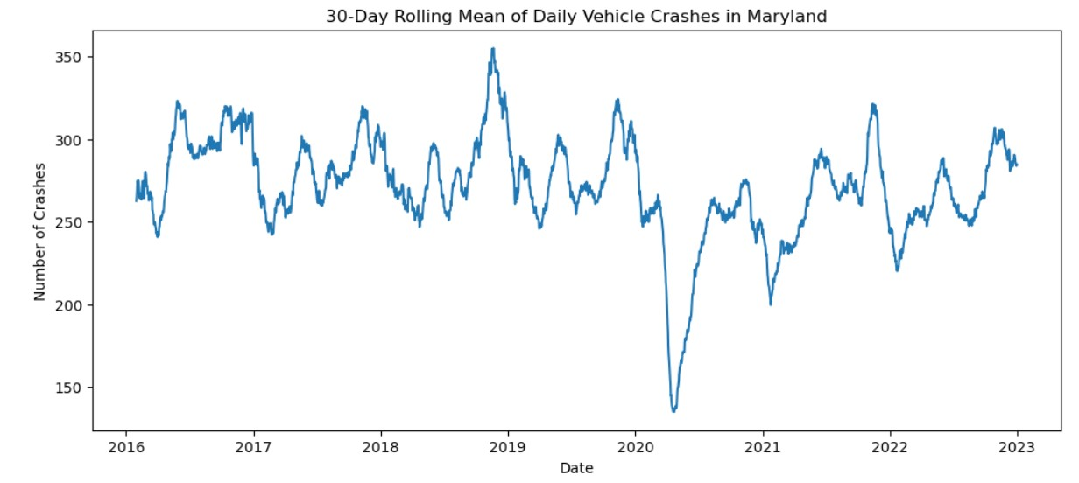
Exploratory Data Analysis
The diagrams briefs number of accidents occurred each month on monthly and 30 day rolling mean basis.

Slide 10
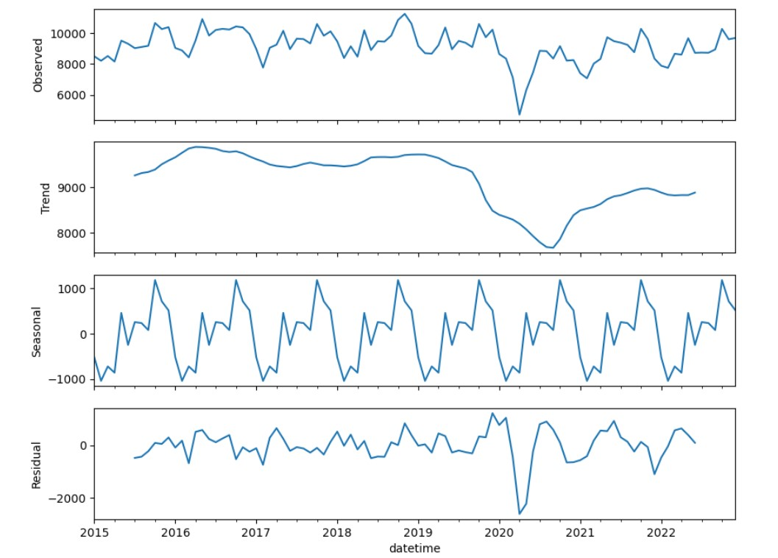
Exploratory Data Analysis
Time Series Analysis
The first subplot shows the observed time series of monthly crashes, indicating a seasonal variation and overall increasing trend.
The second subplot shows the trend component of the decomposition, representing long-term changes smoothed to remove shorter-term fluctuations, revealing a clear increasing trend in crashes over time.
The third subplot shows the seasonal component of the decomposition, indicating a consistent pattern of higher crashes in summer months and lower crashes in winter months.
The fourth subplot shows the residual component of the decomposition, representing the unexplained variation in the data, which appears to have no clear pattern or trend, indicating most of the variation can be explained by the trend and seasonal components.

Slide 11
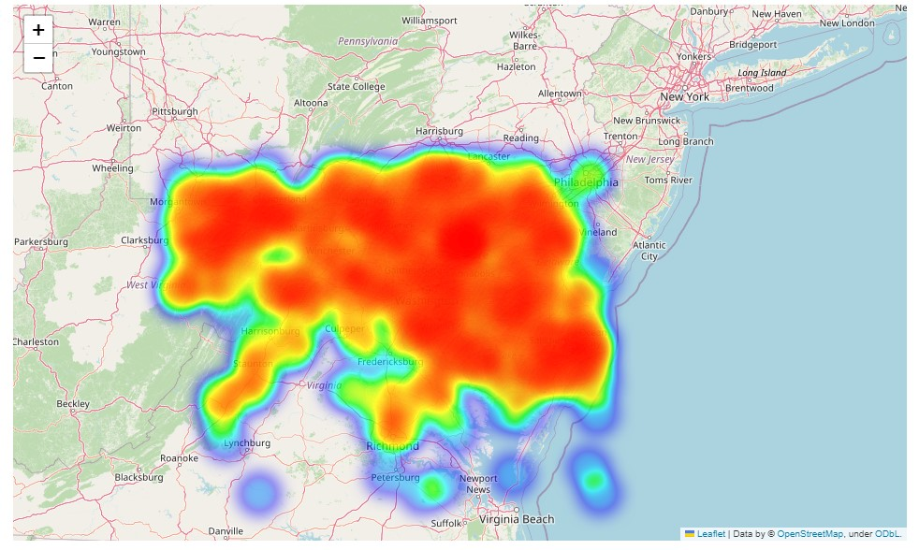
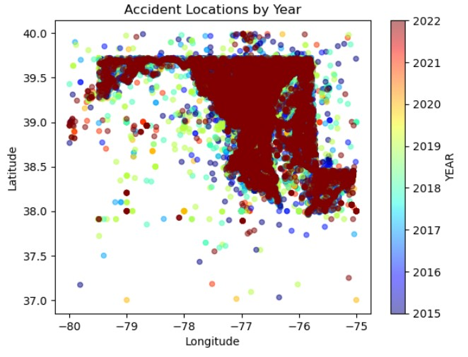
Exploratory Data Analysis
Geospatial Analysis
The below plots uses maps and heatmaps to analyze the spatial distribution of crashes across the state.

Slide 12
Feature Modeling
Features used for Modeling:
LIGHT_CODE
WEATHER_CODE
SURF_COND_CODE
HARM_EVENT_CODE1
HARM_EVENT_CODE2
RD_COND_CODE
Target Variable: REPORT_TYPE

Slide 13
Feature Modeling
Models Used:
Logistic Regression
Decision Tree Classifier
Random Forest Classifier
Gradient Boosting Classifier

Slide 14
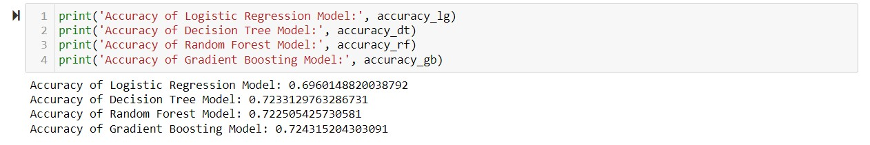
Model output
From the above accuracy results gradient boosting method performed better than other models with accuracy of 72.43%.

Slide 15
Conclusion
The Maryland Statewide Vehicle Crashes dataset provides valuable information for researchers, policymakers, and law enforcement agencies to better understand patterns and trends related to vehicle crashes in Maryland. The dataset contains a wealth of information about the circumstances surrounding each crash, including the date and time, location, and severity of the crash, as well as the types of vehicles involved, and the number and type of injuries sustained.
This data can be used to identify areas where additional safety measures are needed, to assess the effectiveness of existing safety programs and policies, and to develop targeted interventions aimed at reducing the number of vehicle crashes and injuries in Maryland.

Slide 16
Future Improvements
Adding more detailed information about the causes of crashes, such as driver behavior, road conditions, and weather conditions.
Incorporating data from other sources, such as hospital records and emergency response data, to provide a more comprehensive view of the impact of vehicle crashes.
Providing more detailed information about the types of injuries sustained in each crash, including information about the severity of injuries and the long-term health outcomes of crash victims.
Improving data quality and consistency by standardizing data collection methods and ensuring that all data fields are consistently populated.

Slide 17
Thank You

