Slide 1

Microbusinesses forecasting in the US
Under Supervision: Dr. Chaojie (Jay) Wang
By: Sushruta Shetty

Slide 2
What are Microbusinesses?
Type of small business that employs fewer than 10 people.
Includes solopreneurs, freelancers, side hustlers and many business owners who operate out of a single location
Why Microbusinesses Data?
“Microbusiness have Macro effect...”
As per an article Stanford Social Innovation Review…
Small enterprises provide an avg. of 38% of their owners’ household incomes.
Additional incomes provide pathways by which families can exit poverty.
Majority of these jobs offer wages at or above the federal minimum wage.

Slide 3
Data Sourcing:
3 datasets used:
Microbusiness Activity Index:
How active and healthy is a community’s performance with respect to microbusinesses?
Developed by economists at the UCLA Anderson Forecast in partnership with GoDaddy Venture Forward, the Microbusiness Activity Index tracks dozens of factors that impact the success of online microbusinesses – all captured in one composite score.​ The score is made up of three subindices: infrastructure, participation, and engagement.
​
Microbusiness Industry and Commerce:
Provides statewide insight into the online commercial activity trends of microbusinesses in the US.
Identifies the top 3 industry categories within the community, the average traffic we can observe, and the average microbusiness age, measured in months.
Microbusiness Density:
Comprehensive insight into the quantity and distribution of active microbusinesses across the country statewide.

Slide 4
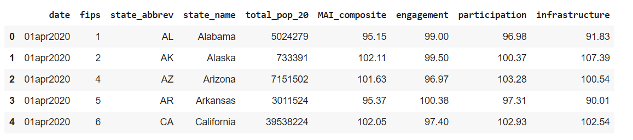
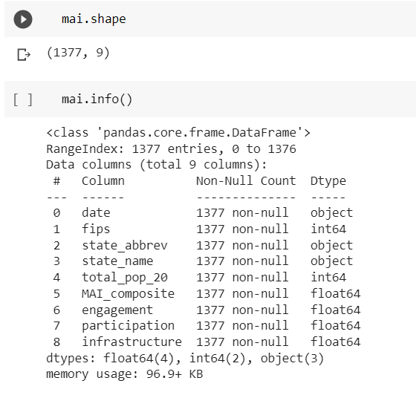
Microbusiness Activity Index:
Dataset:
Shape and Info:

Slide 5
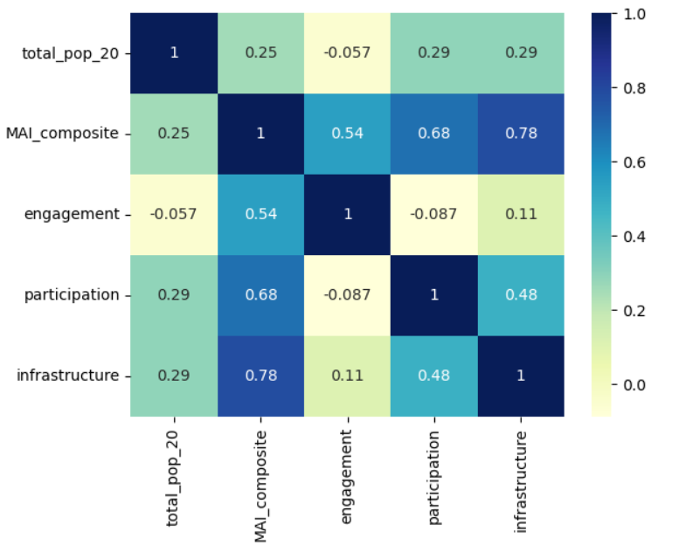
Infrastructure: measures how prepared a community is to use the internet, in terms of necessary physical and intellectual infrastructure.
Participation: measures the number of online microbusinesses and operators in the community.
Engagement: measures how active websites are in the community.

Slide 6
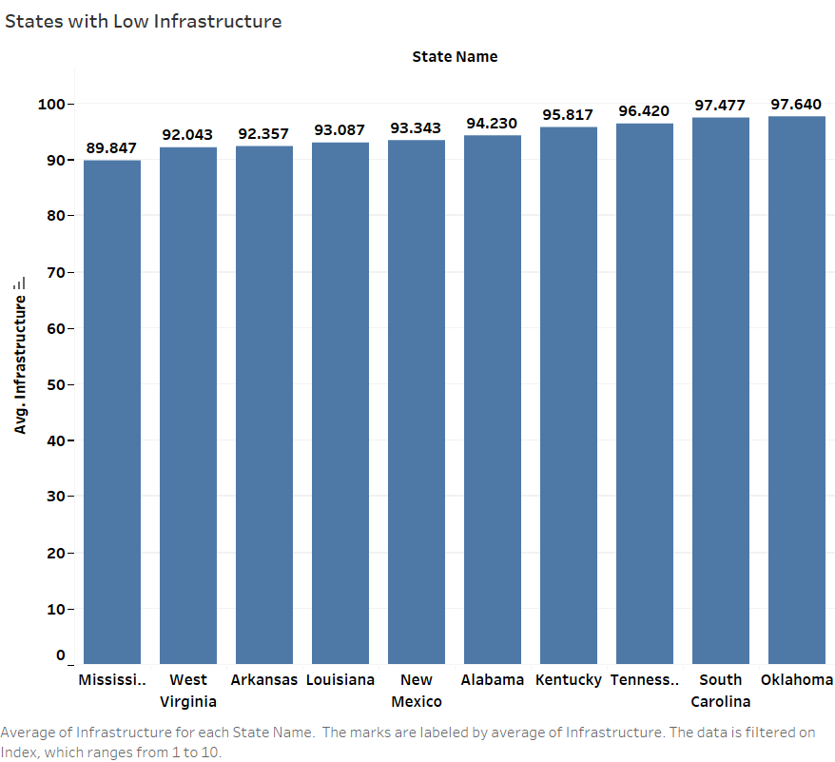
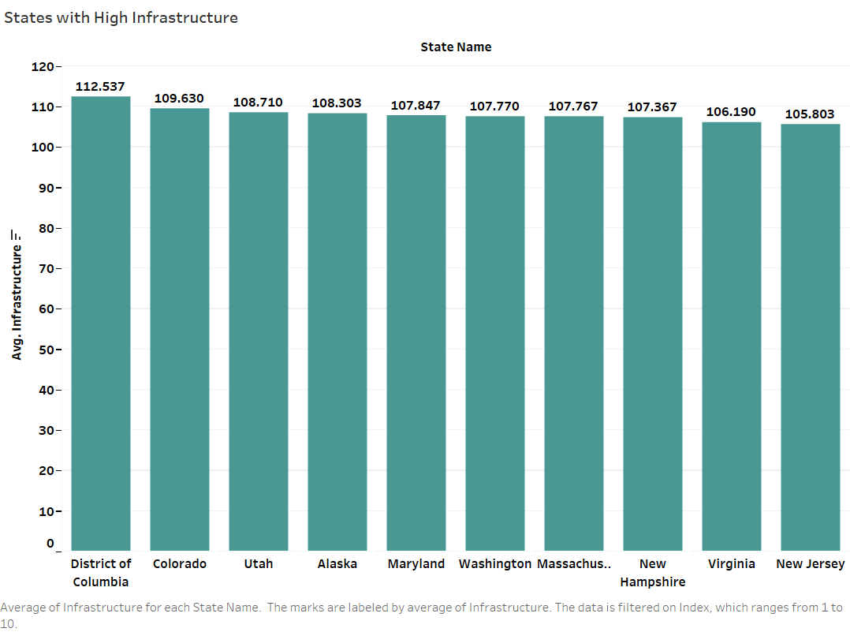
Infrastructure:

Slide 7
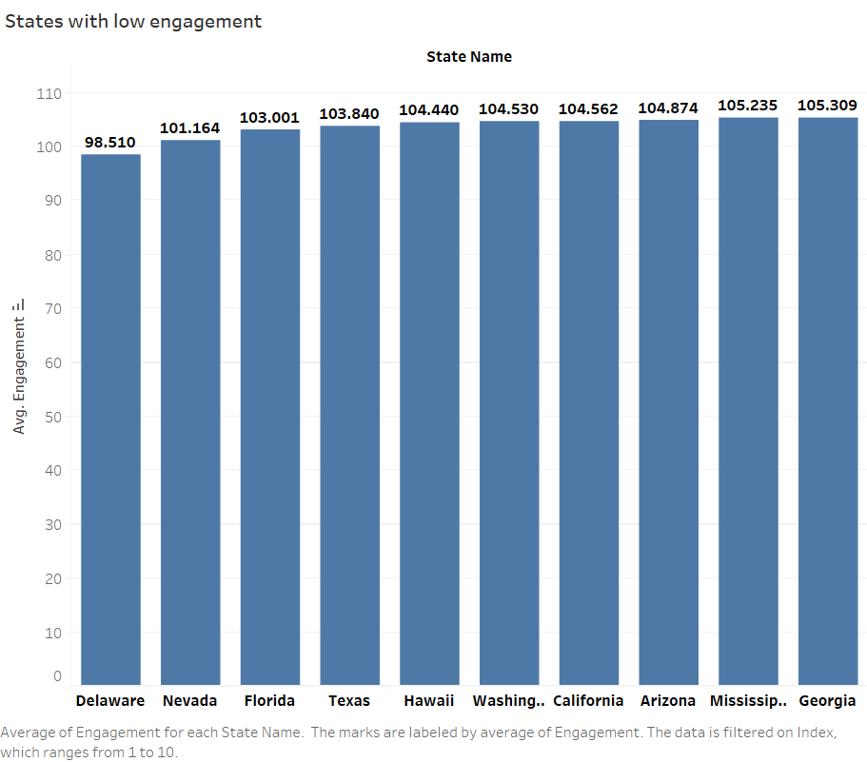
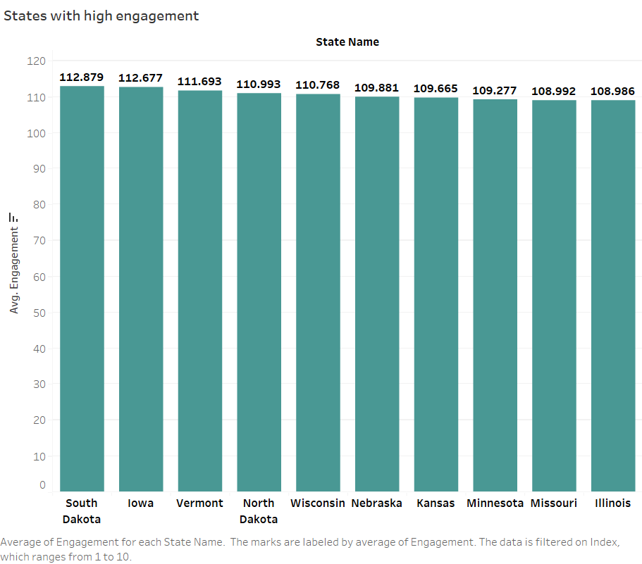
Engagement:

Slide 8
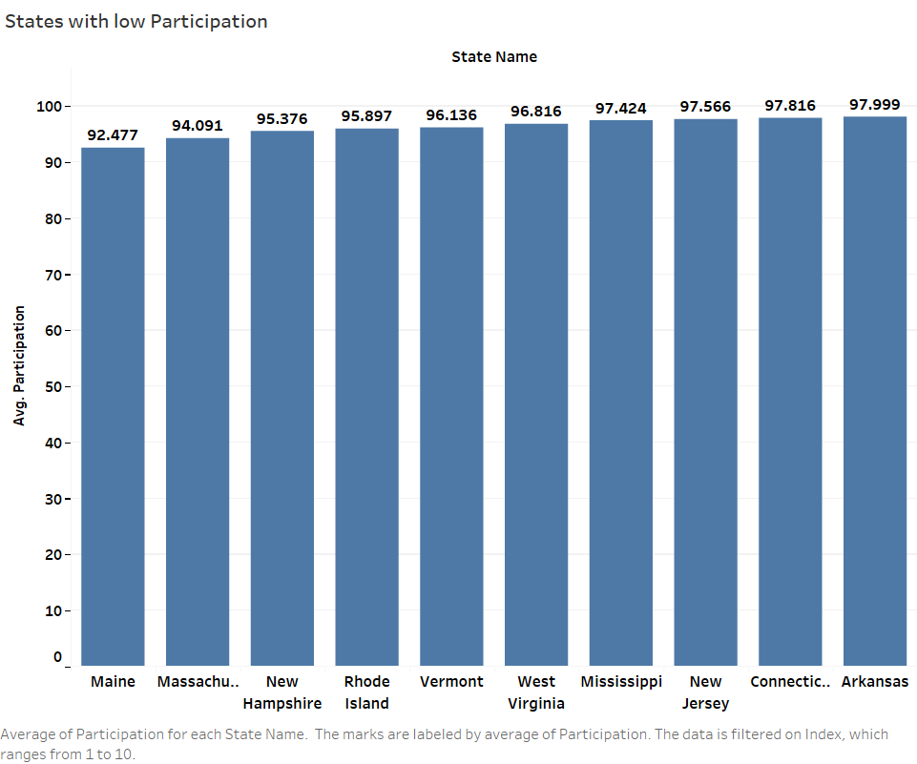
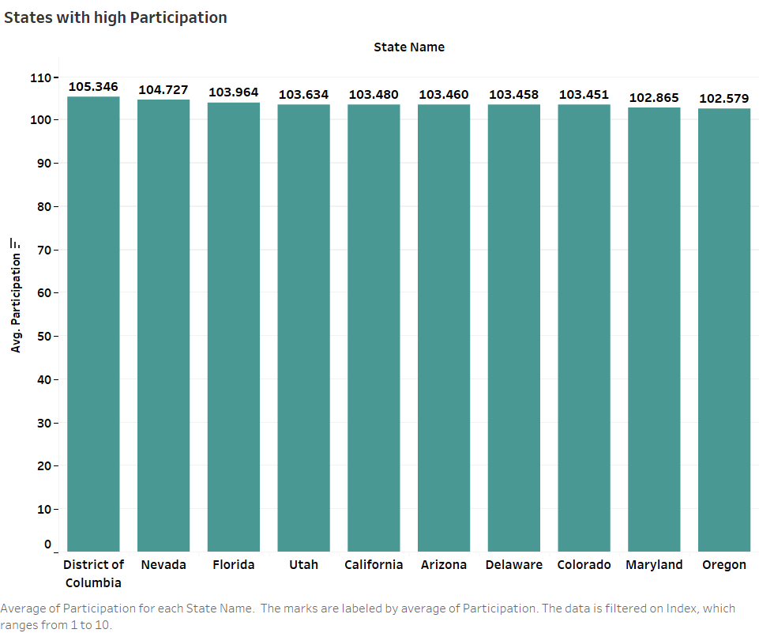
Participation:

Slide 9
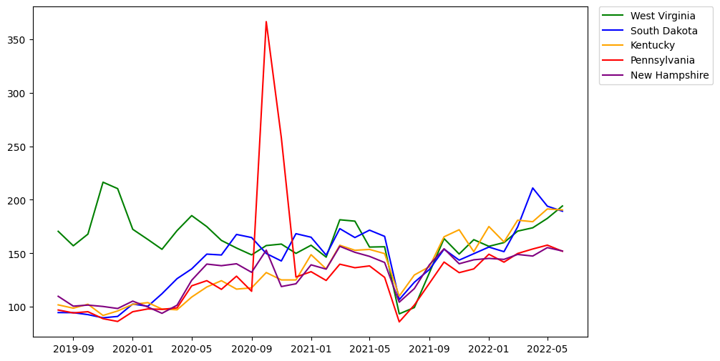
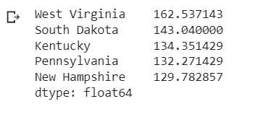
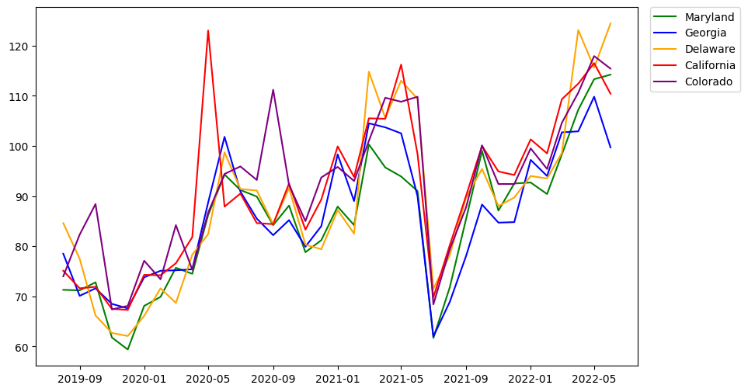
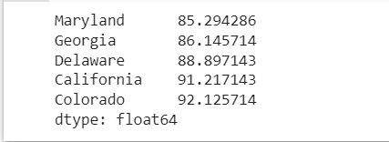
Microbusiness Industry and Commerce:
State wise Average Traffic:

Slide 10
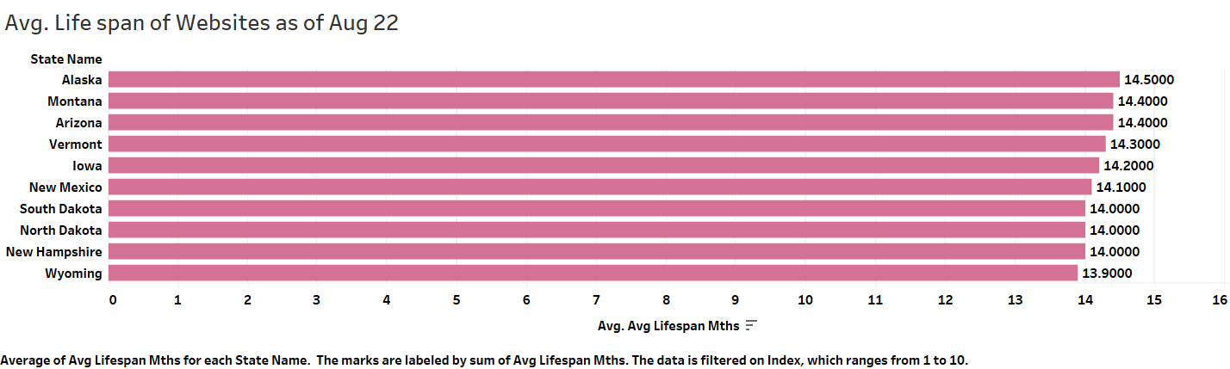
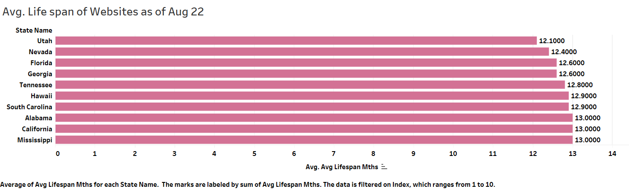
Life Span of websites:

Slide 11
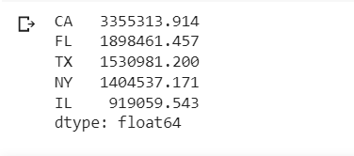
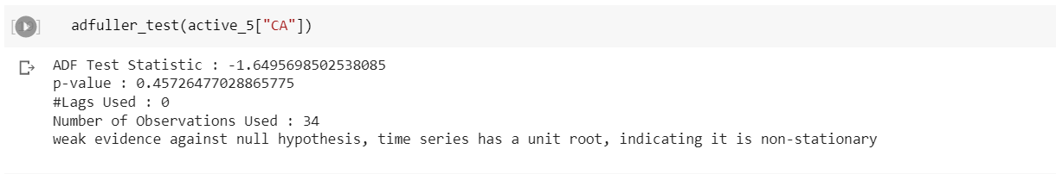
Microbusiness Density:
Top 5 states with highest avg of active websites (Aug’18 – Jun’22):
Timeseries forcasting for CA:

Slide 12
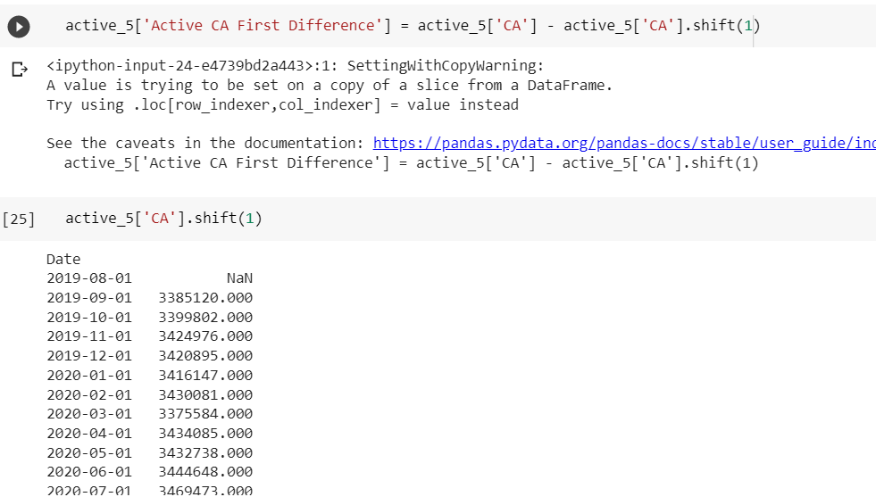
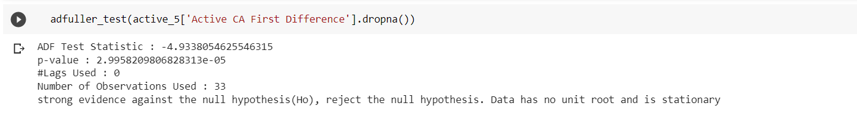
Differencing to make data stationary:

Slide 13
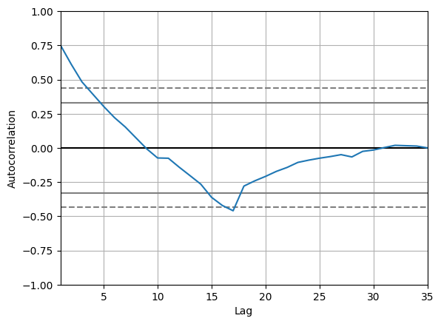
Autocorrelation of active websites data for CA:

Slide 14
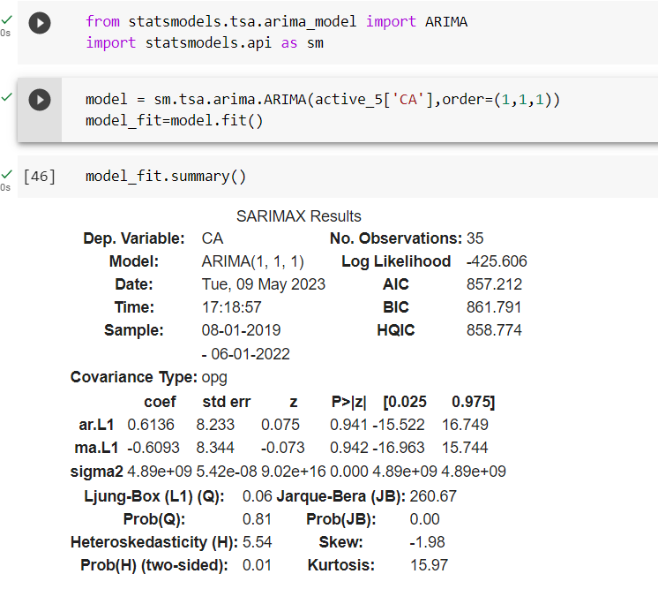
ARIMA model for time series forecasting:

Slide 15
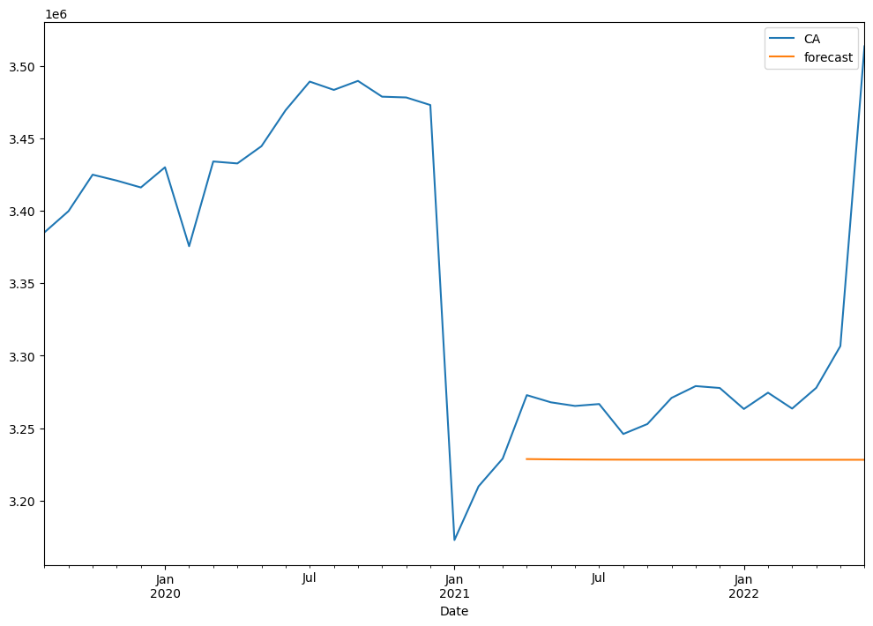
ARIMA model forecast predict

Slide 16
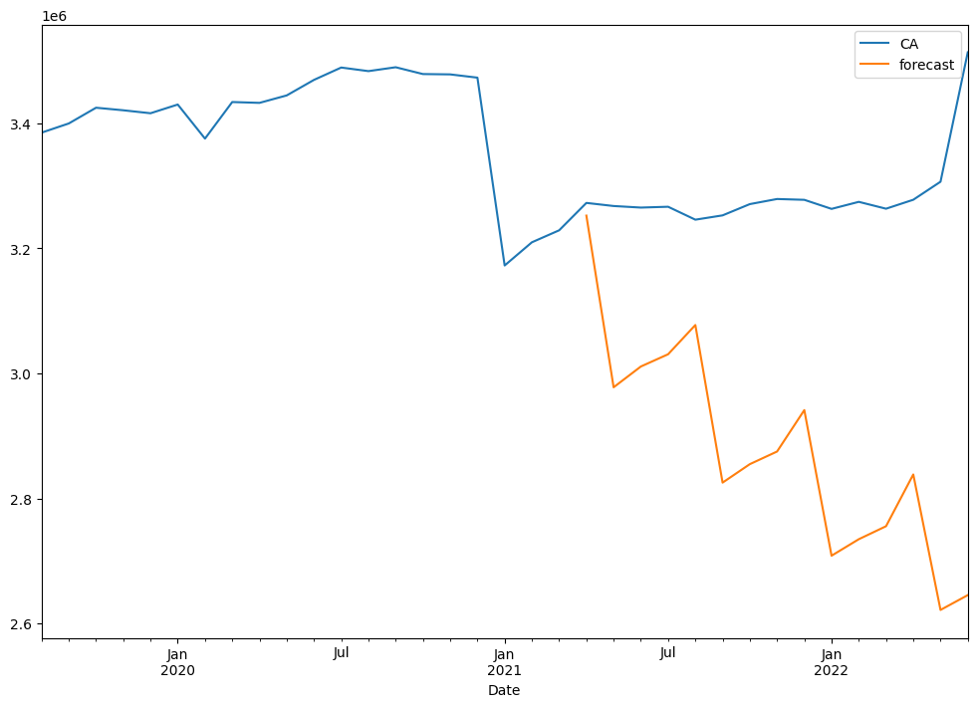
SARIMA model forecast predict

Slide 17
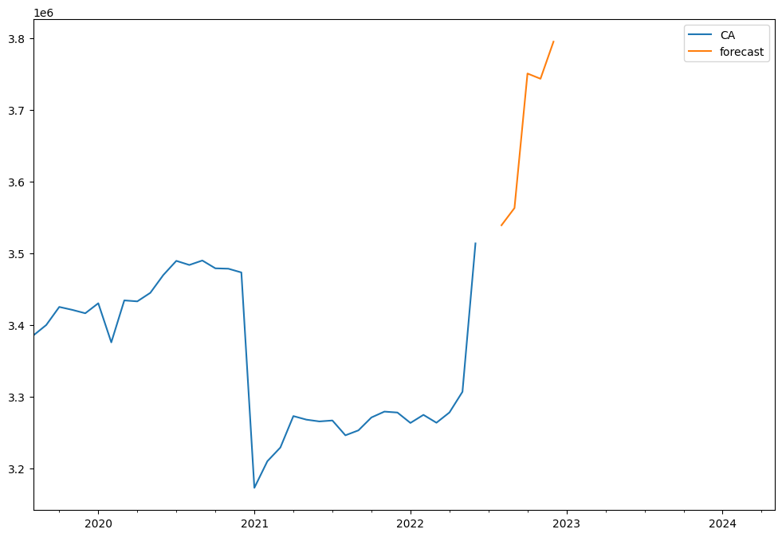
Future forecasting:

Slide 18
Thank you

