Slide 1
New York Taxi fare prediction based on the demand
BY
SUSRINIVAS NETTEM
SPRING 2023

Slide 2
OVERVIEW
INTRODUCTION
MOTIVATION
DATASET
ANALYSIS
PREDICTION AND COMPARISION OF MODELS
CONCLUSION

Slide 3
INTRODUCTION
More than 100,000 automobiles are currently on the road in NYC, an increase of 63,000 over the previous several years.
on the other hand, taxi trips have decreased from 11 million to 8.5 million annually while the number of trips in app-based vehicles has climbed from 6 million to 17 million annually.
The NYC Yellow Cab company consequently made the decision to focus more on data.
In addition, there are apps like Uber, OLA, Lyft and others.
How do these apps operate? After all, the fixed price is not an arbitrary assumption.

Slide 4

Motivation
Estimating taxi trip costs under multiple dynamic factors, such as time of day, which have an impact on the traffic situation and the starting point in a large metropolis, is challenging for both individuals and enterprises.
The aim of this project is to predict the fare amount for a taxi ride in New York City, given the pickup, drop-off locations, time and no of passengers for the pickup.
I compared different machine learning models in this project based on RMSE value and found the best model for predicting the data
Machine learning models used :
1. Linear Regression
2. Decision Tree Regressor
3. Random Forest
4. Light Gradient Boosting Machine
5. Gradient Boosting Regressor

Slide 5
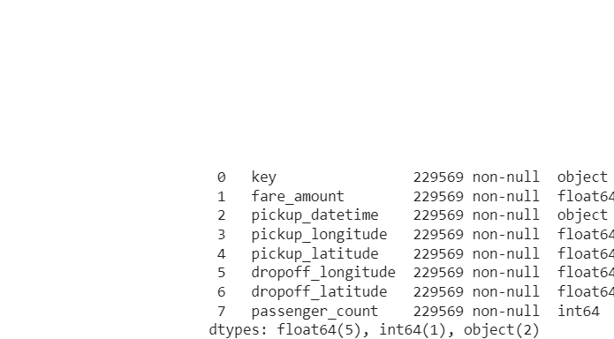
DATASET
Downloaded dataset from Kaggle - https://www.kaggle.com/competitions/new-york-city-taxi-fare-prediction/data
Dataset contains 229569 rows and 8 columns
Our target variable is taxi fare which depends on several factors such as distance, time travelled, no of passengers and traffic.
The evaluation metric for this competition is the root mean-squared error or RMSE. RMSE measures the difference between the predictions of a model, and the corresponding ground truth.
We need to filter our dataset as to get better predictions such as fare greater than minimum ride of taxi, no of passengers and the distance

Slide 6
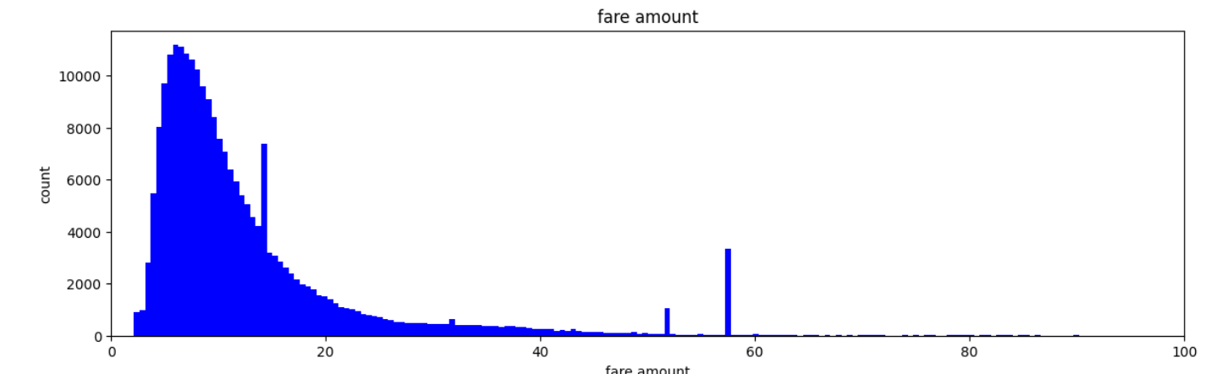
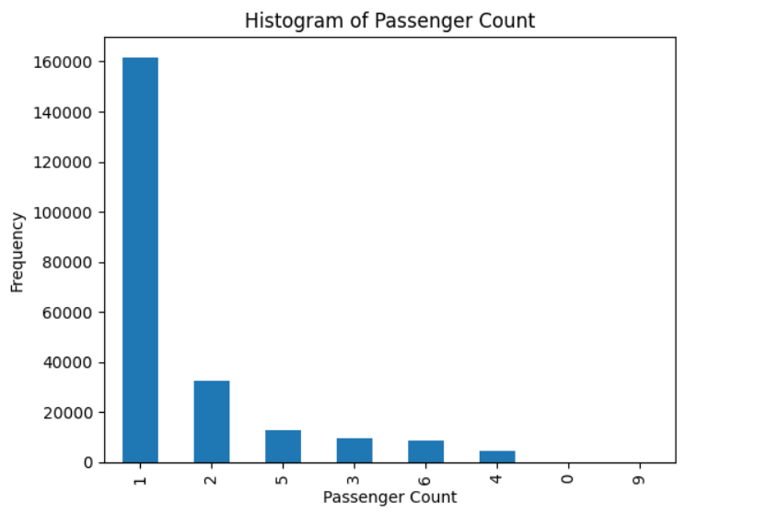
Analysis of data

Slide 7
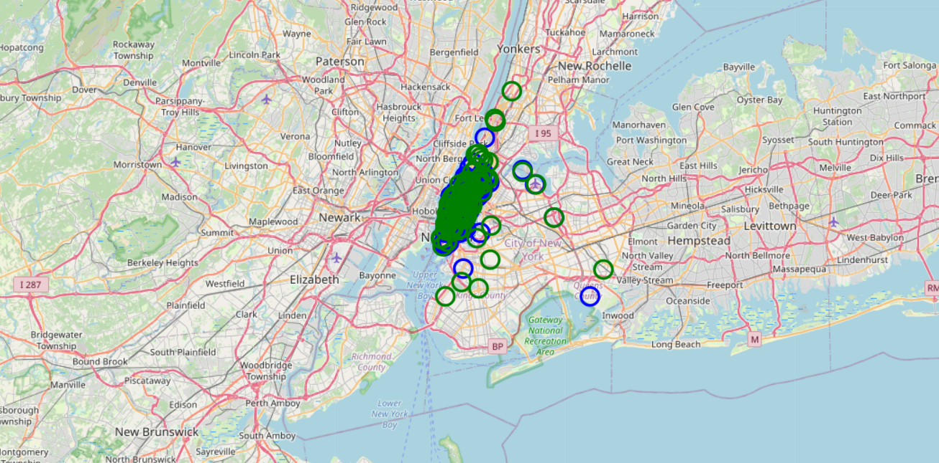
New York city pick up and drop off locations

Slide 8
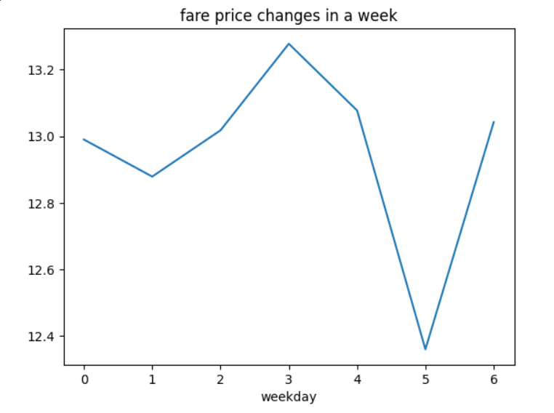
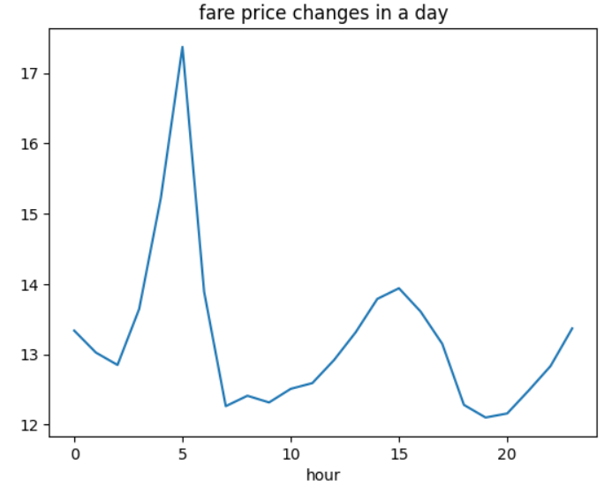

Slide 9

Formula to find distance between 2 points
The haversine distance is the angular distance between two points on the surface of a sphere.
As the Earth is spherical, the haversine formula provides a good approximation of the distance between two points on the earth surface with less that 1% error on average

Slide 10
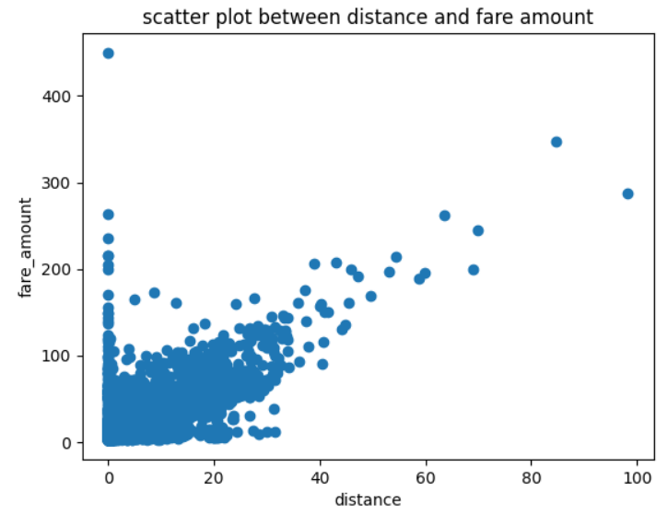

Slide 11
PREDICTION AND COMPARISION OF MODELS
Model | RMSE value
Linear regression | 4.882
Decision tree Regression | 5.164
Random Forest | 5.773
Light Gradient Boosting Machine | 4.120
Gradient Boosting Regressor | 3.648

Slide 12
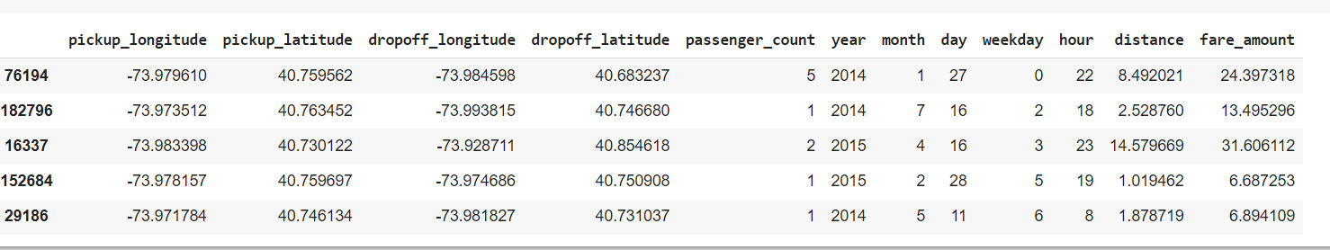

Slide 13
CONCLUSION
Calculated distance between pick up and drop off locations using haversine formula
Compared different machine learning models using RMSE value and determined Gradient Boosting Regressor as the best model for predicting taxi fare based on demand

Slide 14


