Slide 1
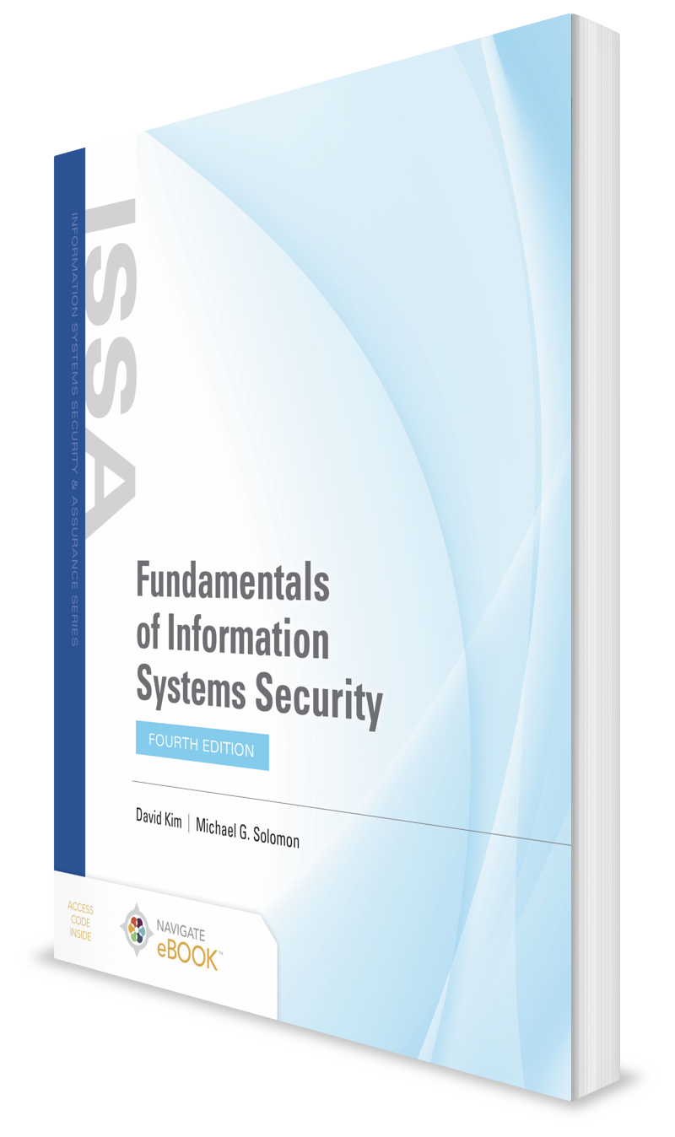
Emerging Technologies Are Changing How We Live
CHAPTER 2

Slide 2
Learning Objective(s) and Key Concepts
Learning Objective(s)
Key Concepts
Explain information systems security and its effect on people and businesses.
The evolution of the Internet of Things (IoT) from the late 1990s to present
The impact that the Internet and IoT have on personal and business life
How brick-and-mortar businesses transform into e-business models with e-commerce and an IoT strategy
How IP mobility is driving an IoT world
New challenges created by IoT

Slide 3
Drivers for the Evolution of the Internet of Things (IoT)
Internet Protocol (IP)-based networking is globally adopted
Connectivity is everywhere
Smaller and faster computing
Cloud computing is growing
Data analytics feed the growth

Slide 4
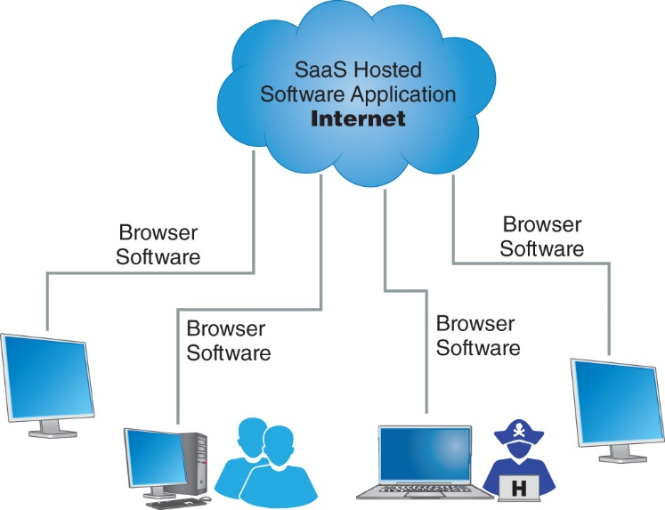
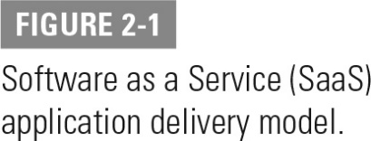
Evolution of IoT
Internet service providers (ISPs)
Radio frequency identification (RFID)
Application service providers (ASPs)
Software as a Service (SaaS)

Slide 5
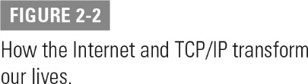
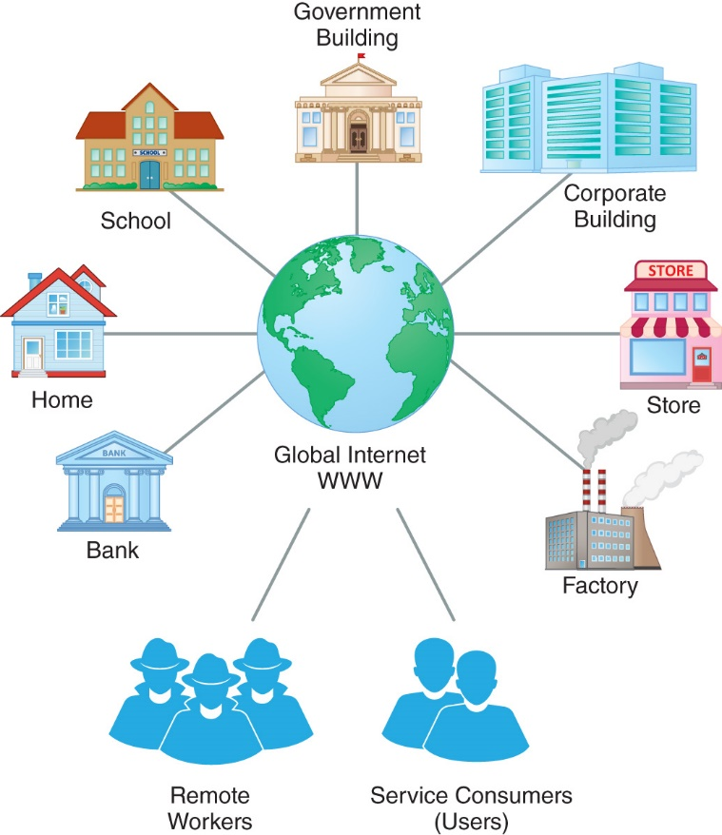
How the Internet and Transmission Control Protocol/Internet Protocol (TCP/IP) Transform Our Lives

Slide 6
IoT’s Impact on Human and Business Life
The Internet has changed our day-to-day lives
Personally
Socially
Professionally
Use the Internet to:
Check weather, news, and social media sites at home
Check business emails at work

Slide 7
How People Like to Communicate
Real-time communications
Occurs instantaneously
Store-and-forward communications
Acceptable delay in transmitting communication

Slide 8
IoT Applications That Impact Humans
Health monitoring and updating
Home security and smart home control systems
Online calendars
Near real-time tracking and monitoring via global positioning systems (GPS)
Online banking, bill paying, and financial transactions
Online e-commerce purchases
Automobiles with smart computers and always-on Wi-Fi Internet access

Slide 9
IoT’s Impact on Business
Retail stores
Virtual workplace
Remote sensors
Traffic-monitoring applications
Business-to-consumer (B2C) service delivery model
Anything as a Service (AaaS) IoT applications

Slide 10
Evolution from Brick and Mortar to E-Commerce (1 of 2)
E-commerce
Sale of goods and services on the Internet
Business-to-consumer (B2C)
Customers purchase goods and services directly from their website
Business-to-business (B2B)
Businesses conduct sales with other businesses
Payment Card Industry Data Security Standard (PCI DSS)
Protects private customer data

Slide 11
Evolution from Brick and Mortar to E-Commerce (2 of 2)
Internet business challenges:
Growing the business through the Internet
Changing an existing conventional business into an e-business
Building secure and highly available websites and e-commerce portals
Building a web-enabled customer-service strategy
Finding new customers with Internet marketing

Slide 12
E-Business Strategy Elements
E-commerce solution
Internet marketing strategy
E-customer service-delivery strategy
Payment and credit card transaction processing

Slide 13
Why Businesses Must Have an Internet and IoT Marketing Strategy
Must remain competitive
Brick-and-mortar business model out of date in global market
Customers require continuous access to information, products, and services

Slide 14
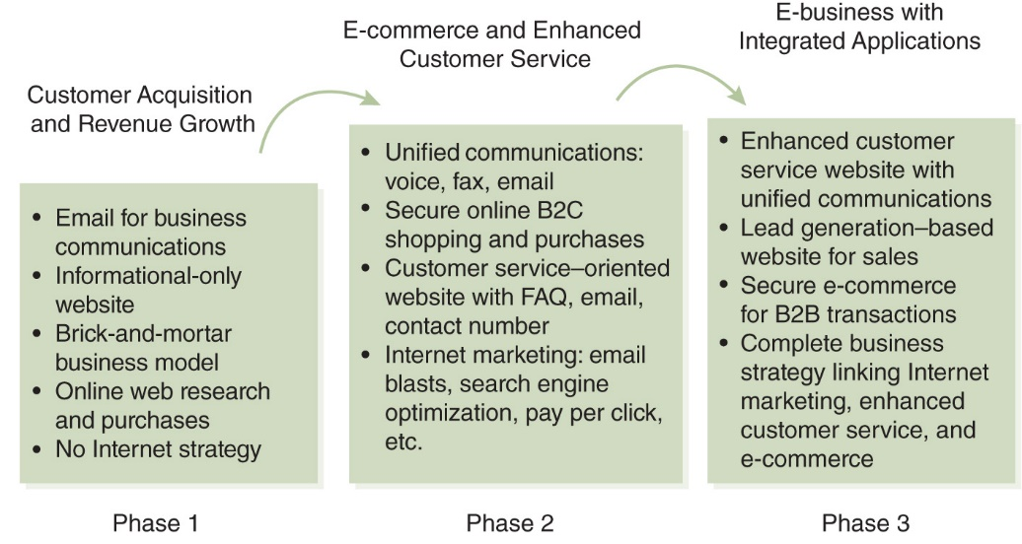
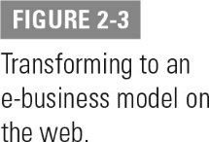
Transforming to an E-Business Model on the Web

Slide 15
IP Mobility
Personal communication devices and mobile phones are powerful
Cell phones are used to extend mobility
Smartphones, tablets, and wearable smart devices match the power and flexibility of small computers
Tablets and smartphones fill need for lightweight portable devices

Slide 16
Mobile Users and Bring Your Own Device
Employees and contractors use personal devices to connect to the office network
Bring Your Own Device (BYOD) opens the door to considerable security issues
Mobile device users expect mobility and freedom from desktop computers
Issues with mobile computing:
Network speed
Usability
Security

Slide 17
Mobile Applications
Limited web browsers cannot run some traditional applications
Bad interface design causes application failure on mobile devices
Many users from multiple domains found uses for mobile applications
Medical applications were a good fit for mobile applications

Slide 18
IP Mobile Communications (1 of 3)
4G and 5G networks provide true IP communications
Mobile IP enables user to:
Move between local area network (LAN) segments and stay connected without interruption
Maintain a connection to the network as long as the mobile device stays within network coverage

Slide 19
IP Mobile Communications (2 of 3)
Mobile node (MN)
Connects to FA
Home agent (HA)
Assigns COA to MN
Foreign agent (FA)
Sends COA to HA
Care of address (COA)
Local address for the MN
Correspondent node (CN)
Sends message to MN

Slide 20
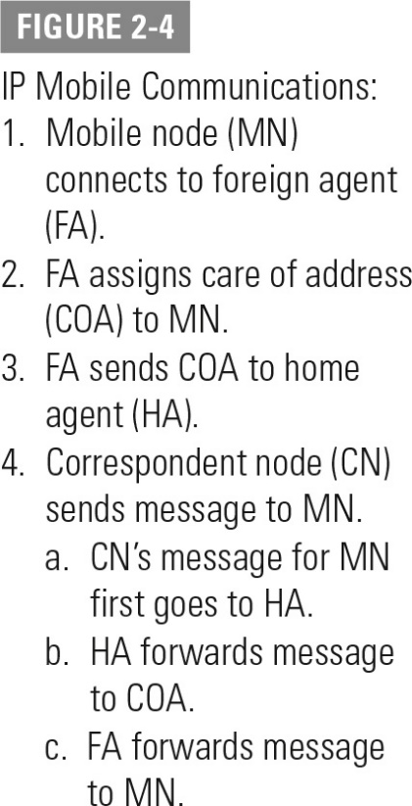
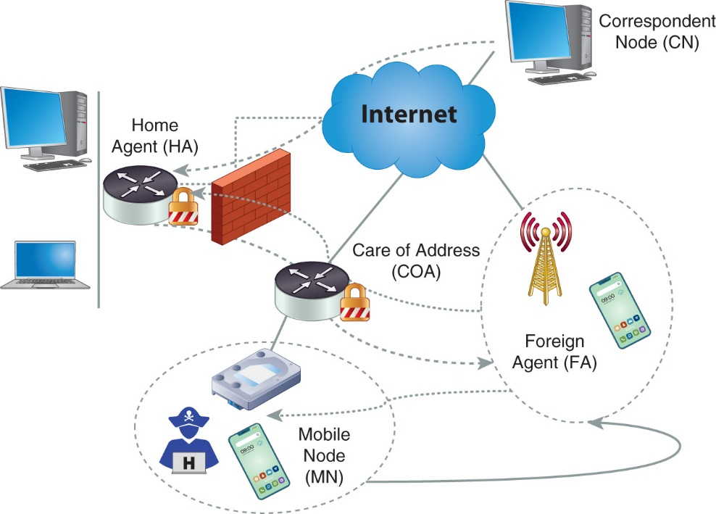
IP Mobile Communications (3 of 3)

Slide 21
New Challenges Created by the IoT
Security
Privacy
Interoperability and standards
Legal and regulatory compliance
E-commerce and economic development issues

Slide 22
Security (1 of 2)
IoT devices, such as sensors or consumer items, deployed in large quantities
IoT devices are ubiquitous and can have wide reach into the user or household population
IoT devices not maintained or updated allow vulnerabilities
IoT device upgrades can be difficult to distribute and deploy

Slide 23
Security (2 of 2)
No owner visibility of how many IoT devices connect to the Internet
IoT devices usually not physically secure
Environmental IoT devices capture readings and measurements in the open

Slide 24

Privacy
Privacy challenges must be addressed by manufacturers and defined in the right-of-use and software End-User Licensing Agreement (EULA):
Privacy policy statement
Definition of data, metadata, or analytical data use and rights
Ability for a user to provide consent to a manufacturer’s or application service provider’s privacy policy statement
Determine the domain of privacy

Slide 25

Interoperability and Standards (1 of 2)
Internet Engineering Task Force (IETF) ensures interoperability and standards can be pursued for IoT solutions
Interoperability has significant financial impacts if not properly addressed
Goal is to bring down the cost of IoT devices and supporting applications so they are affordable

Slide 26
Interoperability and Standards (2 of 2)
Some manufacturers want to design and deploy proprietary IoT devices and solutions
Cost factors to implement functional, operational, technical, and security capabilities into IoT devices and applications
Time-to-market risk
Technology outdated risk
A void in interoperability and standards for IoT devices can create an environment of bad IoT devices

Slide 27

Legal and Regulatory Compliance (1 of 2)
Properly handling and protecting sensitive data, and ensuring its confidentiality
Privacy data is subject to the privacy laws of state you live in as well as state that the IoT hosting company resides in
IoT vendor or solutions provider required to adhere to security control requirements and data protection laws
Current liability laws and protection may or may not address IoT devices connected to the public Internet

Slide 28
Legal and Regulatory Compliance (2 of 2)
Who is collecting data?
Who is collecting behavior patterns?
Are they selling this data?
Do they have the right to sell it?
Is there liability associated with the data?

Slide 29
E-Commerce and Economic Development Issues
Infrastructure resources
Foundational investments
Technical and industrial development
Policy and regulatory definitions

Slide 30
Summary
The evolution of the Internet of Things (IoT) from the late 1990s to present
The impact that the Internet and IoT have on personal and business life
How brick-and-mortar businesses transform into e-business models with e-commerce and an IoT strategy
How IP mobility is driving an IoT world
New challenges created by IoT

