Slide 1

MARYLAND STATEWIDE VEHICLE CRASHES – PREDICTING SEVERITY OF INJURY
By
Ujwala Namineni – OI46298

Slide 2
INTRODUCTION
The dataset used in this project is the Maryland Statewide Vehicle Crashes dataset, which was obtained from https://opendata.maryland.gov/ This dataset contains information on vehicle crashes that occurred in Maryland state between 2015 and 2022. The dataset is composed of three sub-datasets, which are:
Maryland Statewide Vehicle Crashes: https://opendata.maryland.gov/Public-Safety/Maryland-Statewide-Vehicle-Crashes/65du-s3qu
Person Details: https://opendata.maryland.gov/Public-Safety/Maryland-Statewide-Vehicle-Crashes-Person-Details-/py4c-dicf
Vehicle Details: https://opendata.maryland.gov/Public-Safety/Maryland-Statewide-Vehicle-Crashes-Vehicle-Details/mhft-5t5y

Slide 3
PROBLEM STATEMENT
Predicting the severity of the injury after the accident: This project aims to develop a machine-learning model that predicts the severity of injuries sustained by individuals involved in vehicle crashes in Maryland. Predicting the severity by the deployment of the model.

Slide 4
DATASET
The vehicles and persons datasets are merged on ‘VEHICLE_ID’.
The obtained dataset and crashes dataset are merged on ‘REPORT_NO’.
After preprocessing, the shape of the dataset is (619031, 22).

Slide 5
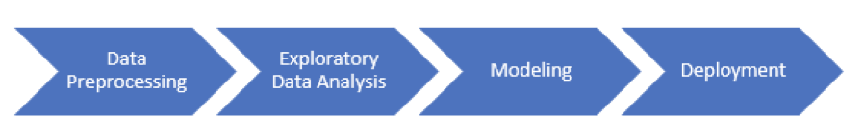
PROCESS

Slide 6




TOOLS USED

Slide 7
DATA PREPROCESSING
To create a comprehensive dataset, we combined data from the three sub-datasets and selected a subset of relevant columns for our analysis.
Cleaned and pre-processed data using Python.

Slide 8
EXPLORATORY DATA ANALYSIS
Visualized data using Tableau.
Link for my Tableau public account is Profile - ujwala.namineni1131 | Tableau Public
The frequency of accidents is influenced by various factors such as road surface conditions, weather conditions, county, and road division type.

Slide 9
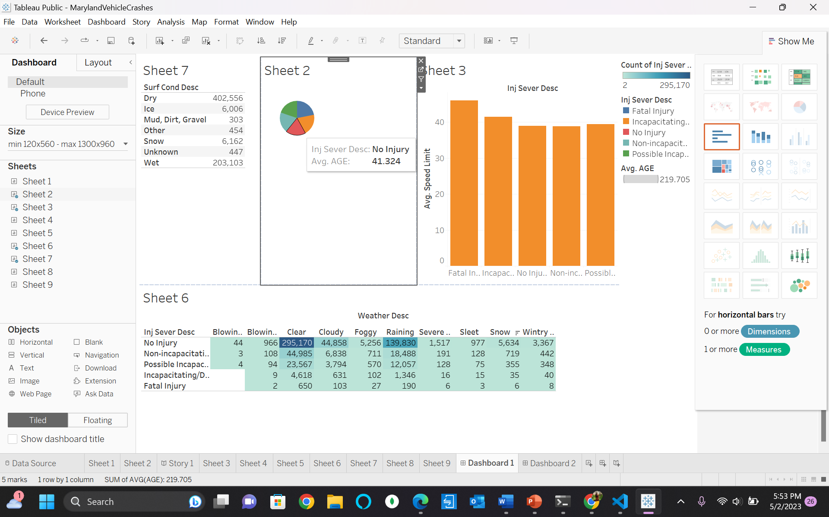
DASHBOARD - 1

Slide 10
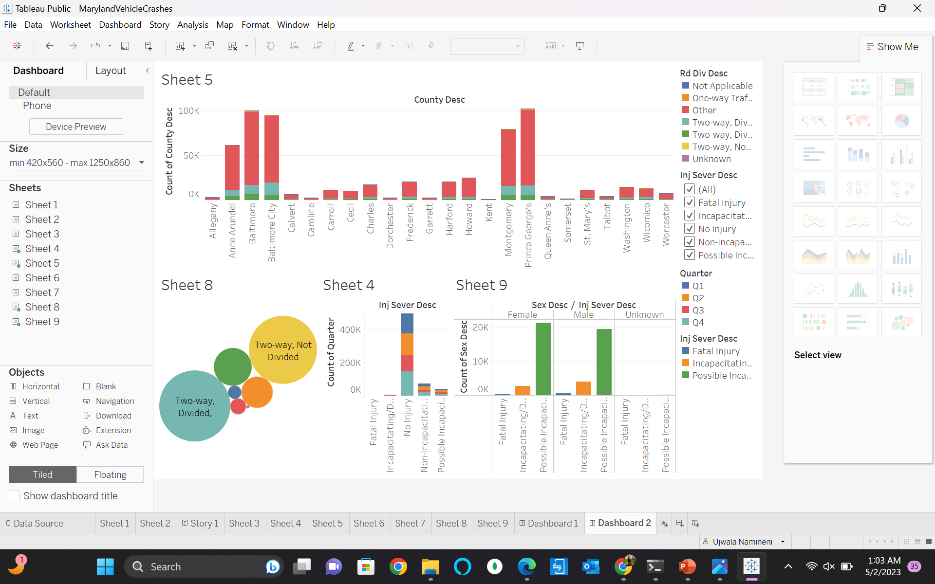
DASHBOARD - 2

Slide 11
MODELING
Used a Storage account in Microsoft Azure to store the CSV file of the dataset after preprocessing.
Used Azure Machine Learning workspace and Azure ML studio to create different types of pipelines of the machine learning models.
Developed machine learning models using Microsoft Azure, including logistic regression, decision tree, and random forest regression.
Among the models, logistic regression performed the best for this data, achieving an accuracy of 80.25%.

Slide 12
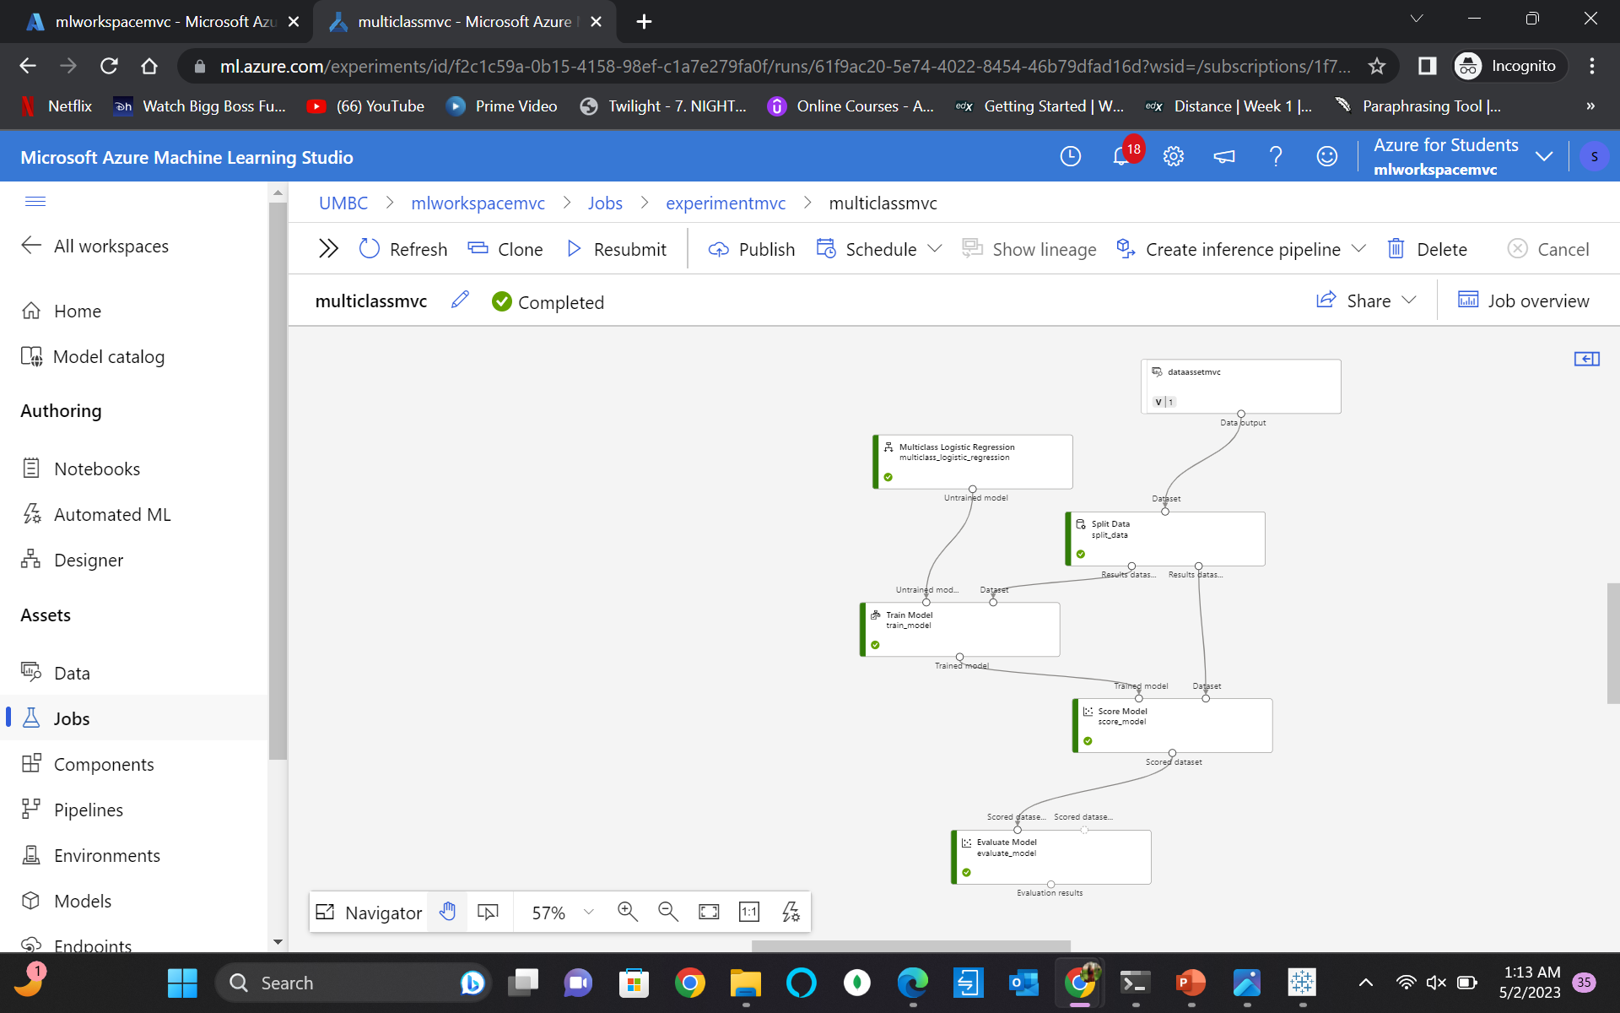
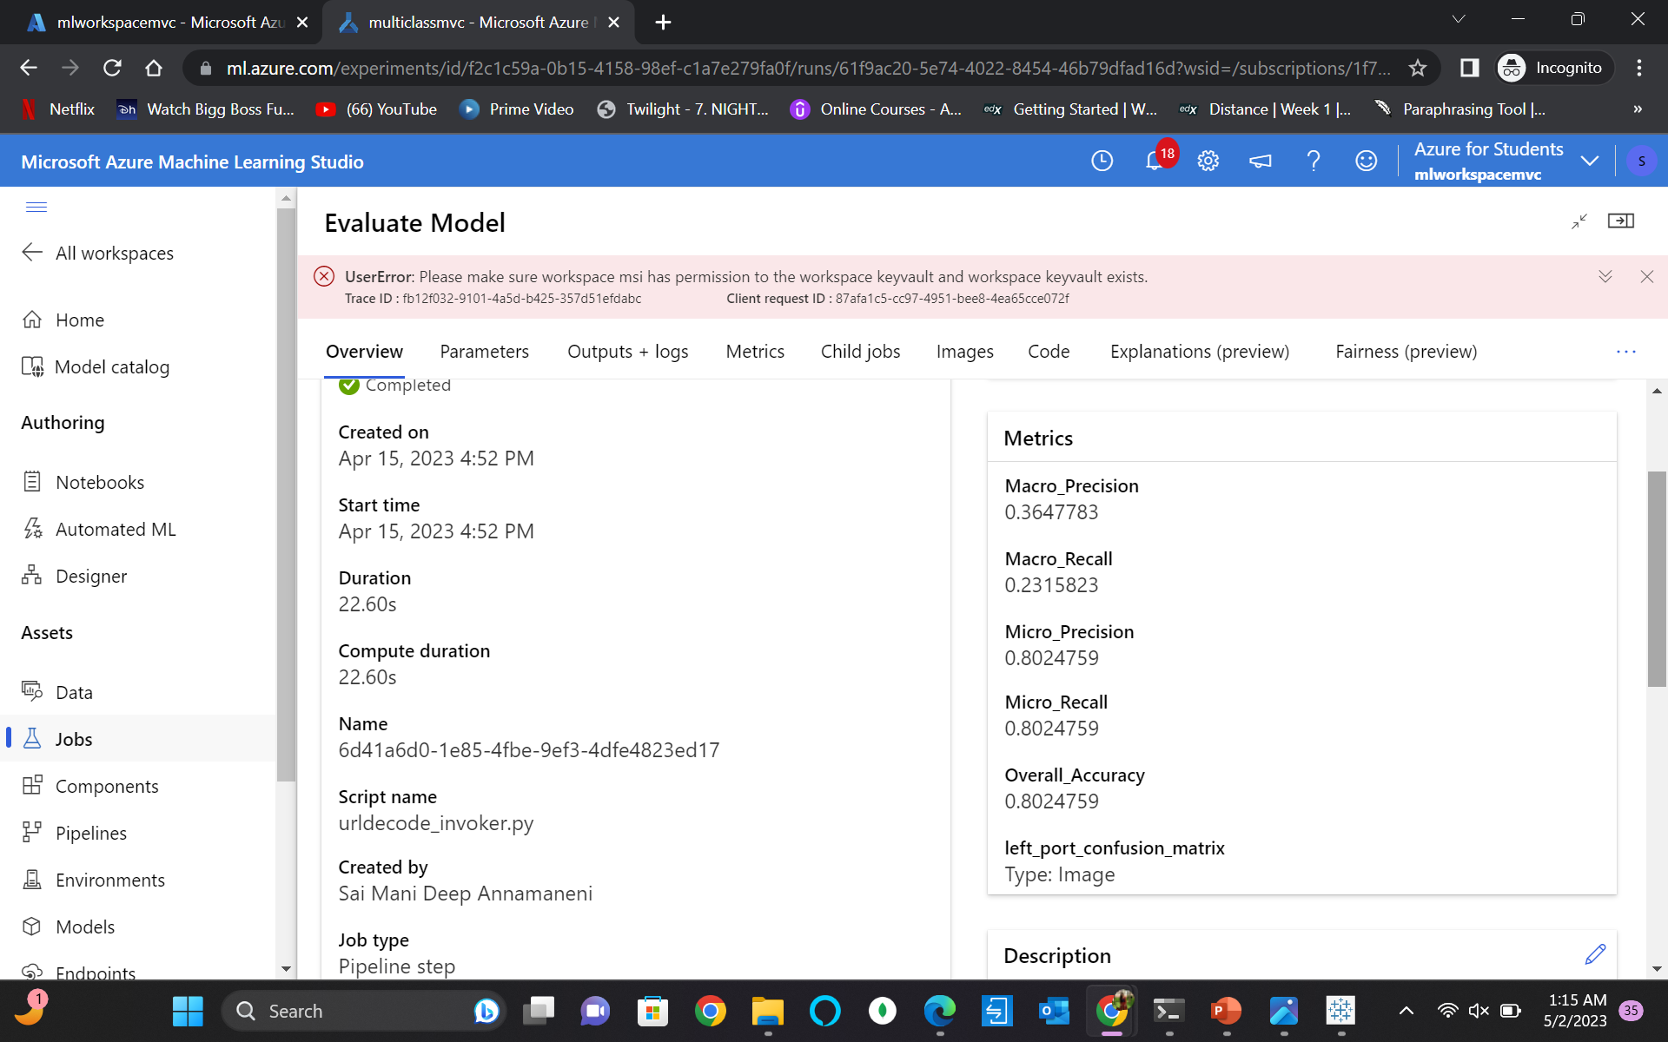
Logistic Regression

Slide 13
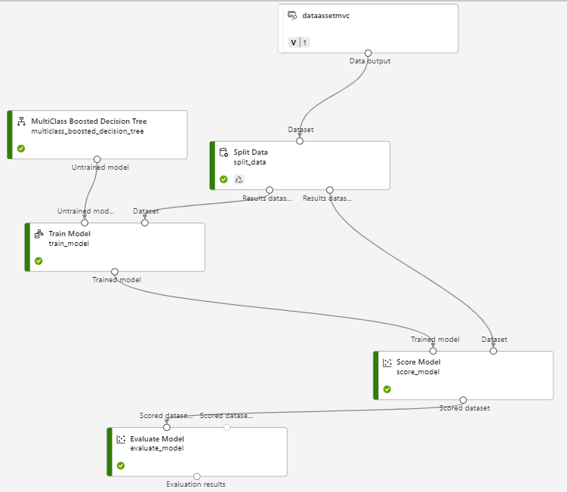
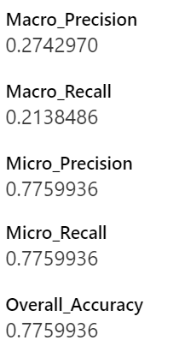
Decision Tree algorithm

Slide 14
DEPLOYMENT
Developed a web application using Streamlit and Python.
Implemented a web page via the 'app.py' file.
Integrated the machine learning model into the web page.
Defined a function to predict whether a person is injured or not.
The page is created in localhost ( http://localhost:8501/ ).

Slide 15
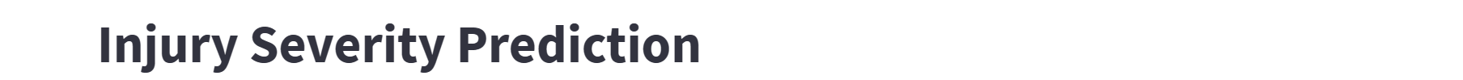
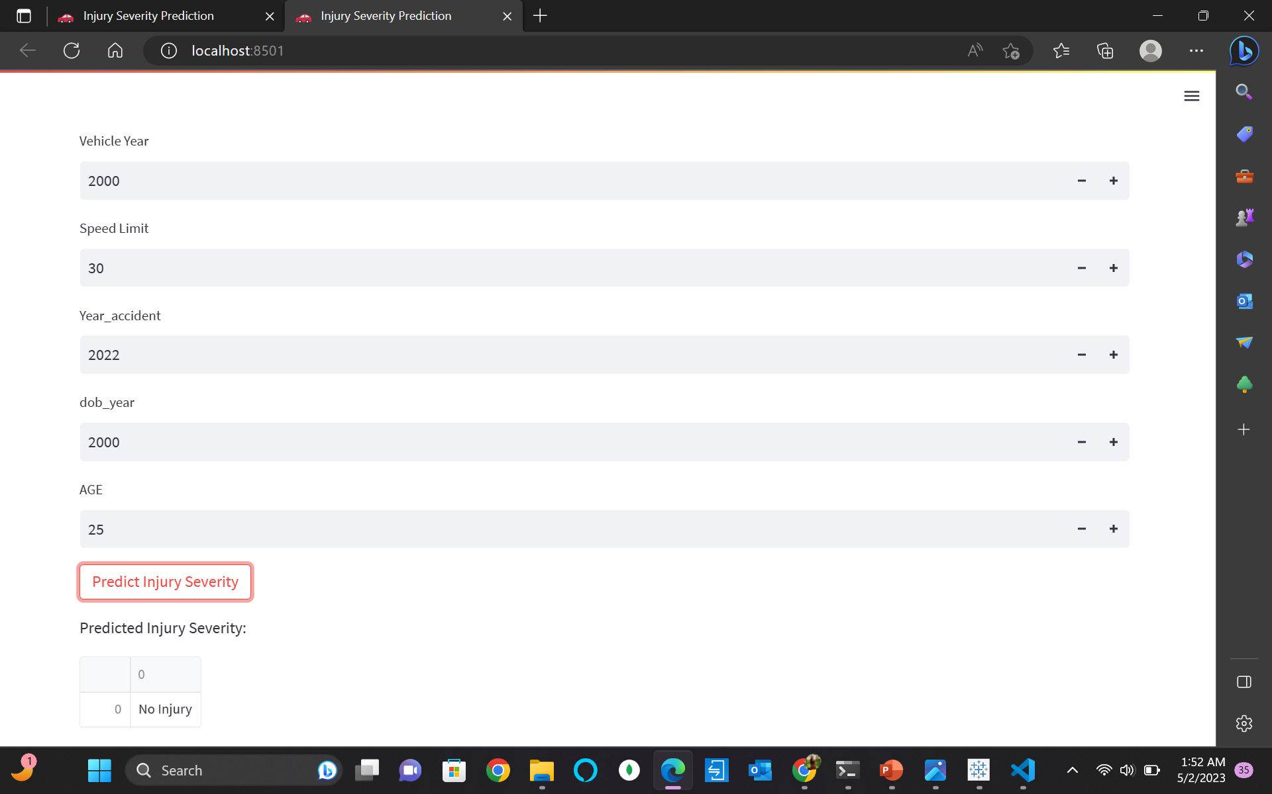

Slide 16
CHALLENGES
To ensure accurate and reliable data analysis, it is crucial to validate data integrity and avoid merging duplicate entries or introducing additional rows due to improper merging practices.
Developing web pages with Microsoft Azure web services is complex and requires technical expertise.
Using Streamlit, Working with many categorical features can make predicting target variables complex.

Slide 17
THANK YOU

