Slide 1
Coffee Review Analysis
Analyzing Coffee Reviews to Discover the Optimal Coffee
Spring 2023
- Nicholas Ho

Slide 2
Introduction
Coffee is a popular drink worldwide with the industry is estimated to be valued in the hundreds of billions of dollars.
Such a large industry can be an opportunity to analyze consumer trends for the purposes of maximizing profits. This project seeks to analyze reviews in order to determine what makes one coffee better than the rest.

Slide 3
Objectives
Determine what factors are involved in developing a successful coffee
What aspects of coffee have the largest impact on rating and price?
Which regions produce the best coffee?
Does price and rating have a correlation?

Slide 4
Data
Dataset found on Kaggle was created by scraping the website www.coffeereviews.com for reviews between the dates Dec-2017 and Nov-2022
Target values include
Price
Rating
The most impactful features will be the numeric-typed features
acidity (float64) - 1-10 scale
aroma (float64) - 1-10 scale
body (float64) - 1-10 scale
flavor (float64) - 1-10 scale
aftertaste (float64) - 1-10 scale

Slide 5
Data
There are several non-numeric features
Blind assessments
Notes
Bottom Line (summary of the coffee)
These text-based features can be converted into numeric values by using sentiment analysis. After conversion, it can be used in regression.

Slide 6
DATA
Biases in the Dataset
Ratings are skewed high
Poor ratings are not included on the website due to the philosophy of focusing on the positive side of Coffee instead of highlighting the underperforming.
The bar for coffee standards have been rising. The quality of coffee samples has been improving over the years causing ratings to increase overall.
These two facts results in the majority of data points being focused on the high end of ratings which may result in training a biased predictor.

Slide 7
Cleaning
Convert Dates from string type to dateTime type
Convert price and quantity to a standardized value (USD/grams)
Used current conversions from Google Finance (3/29/2023 rates)
Convert text values to numeric values using VADER lexicon-based sentiment analysis
First remove special symbols, then apply a polarity score to each text (-1 to 1)
Lexicon based analyzers breaks texts down into individual tokens, meaning they require no greater context. This makes it a good general solution.
Lastly Drop any unneeded columns

Slide 8
Regression
Lasso Regression – A penalized regression method that is useful when dealing with a large number of features.
Uses coefficients to decrease the effects that’s unrelated variables have on predicting the label.
This can be a bad thing in cases where some coefficients are driven so low that the features no longer impact the label
Can be a result of insufficient training, datasets with little correlation, or large outliers
Lasso Score (coefficient of determination): 0.02147

Slide 9
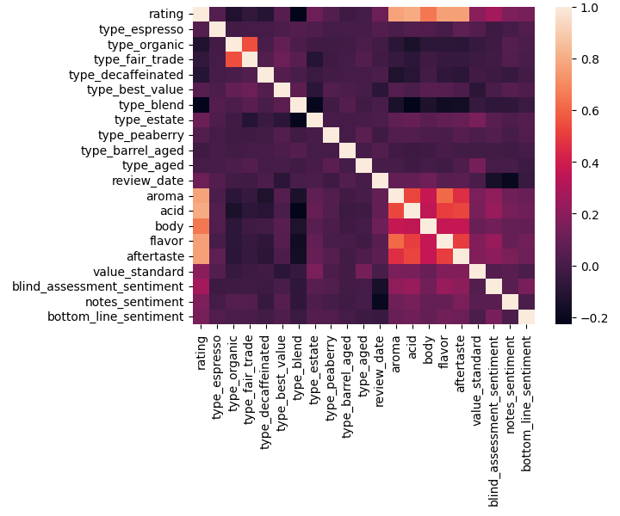
Feature Reduction
Features such as Aroma, Acid, Body, Flavor, and Aftertaste had the greatest effect on the rating.
Reduced Features Lasso Score: -0.00655

Slide 10
Regression
Ridge Regression – Similar to Lasso, but does not entirely eliminate features.
Ridge Score: 0.99393
Reduced Features Ridge Score: 0.99995
Decision Tree
Decision Tree Score: 0.98373
Reduced Features Decision Tree Score: 0.99994
Random Forest
Random Forest Score: 0.98751
Reduced Features Random Forest Score: 0.99979
Result:
The Ridge model is the most accurate predictor.
Reducing the number of features produces more accurate results.

Slide 11
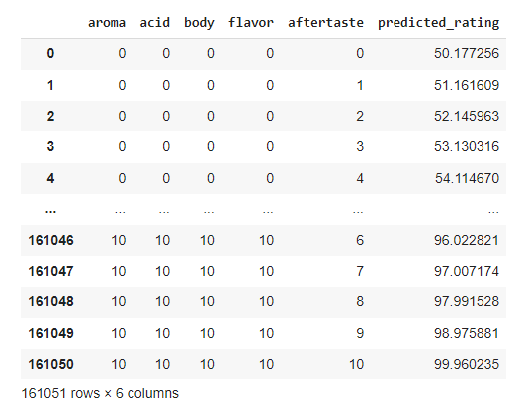

Simulation
Using the best Predictor, simulate data to find combination that yields the highest Rating

Slide 12
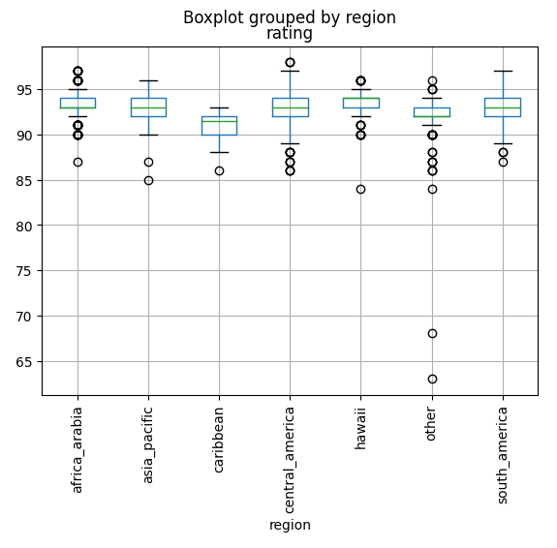
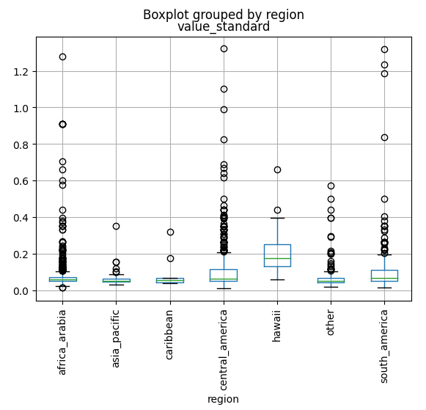
Statistics by Region
Central America and south America produces some of the highest rated coffee beans.
Hawaii produces the coffee beans with the highest value. (USD/gram)

Slide 13
Conclusions
Tests on the predictors and the correlation matrix shows that most of the features on the dataset have little to no impact on rating. When the feature set is reduced, near 100% accuracy can be achieved.
Sentiment analysis did not prove useful in this case. This could be a result of the skewed dataset, inconsistency of reviewers and difficulties around nuances with coffee terminology.
The best regions to grow coffee are Central America, South America, and Hawaii.
A new rating system will need to be implemented for better analysis to account for the skewed data

