Slide 1
US Air Pollution Prediction and Forecasting using Machine Learning Models
BY
Pragathi Vunnam
Spring 2023

Slide 2
Agenda
Introduction
Motivation
Analysis
Prediction and Comparison of proposed models
Forecasting
Conclusion

Slide 3
Introduction
1.Air pollution is the contamination of air due to the presence of substances in the atmosphere 2.There are many different types of air pollutants, such as gases (including ammonia, carbon monoxide, sulphur dioxide, nitrous oxides, methane, carbon dioxide 3.Air pollution can cause diseases, allergies, and even death to humans; it can also cause harm to other living organisms such as animals and food crops, and may damage the natural environment Why this project One of the largest difficulties facing the globe today is air pollution The health of the world may also be damaged. it becomes crucial to lessen air pollution and raise awareness of these issues.

Slide 4
Questions to Answer
1.which state has highest air pollution.
2.which Model is best for prediction.
3.Analysing the future air pollution quality in U.S.

Slide 5
Dataset
This dataset contains data of air pollution of diiferent states in u.s
this dataset has 147679 rows × 29 columns
it is a time series data. this dataset has data from 2000-01-01 to 2010-06-06.
Includes four major pollutants (Nitrogen Dioxide, Sulphur Dioxide, Carbon Monoxide and Ozone).

Slide 6
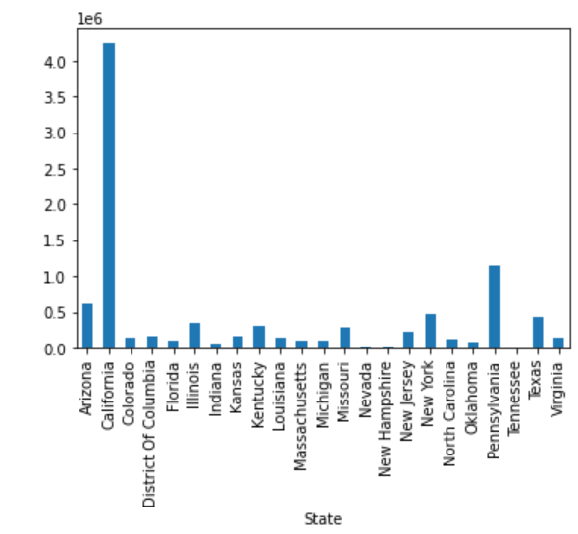
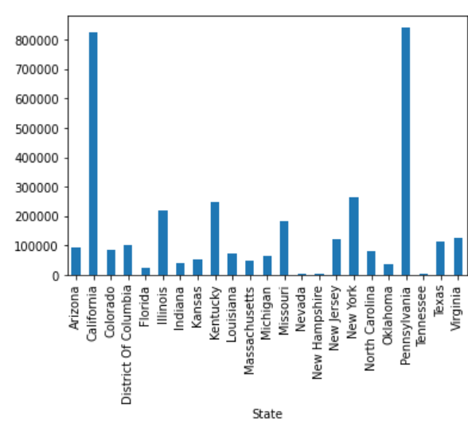
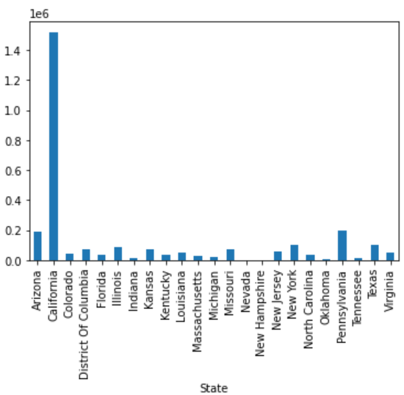
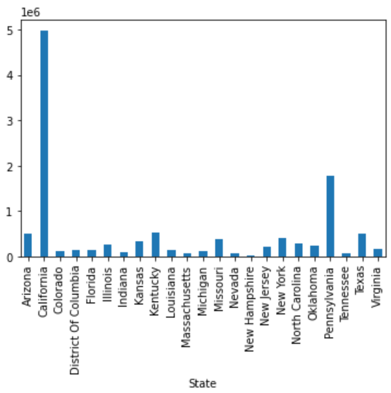
Analysis
NO2
SO2
CO
O3

Slide 7
Prediction and Comparision of Models
Regression Models: regression analysis is a set of statistical processes for estimating the relationships between a dependent variable and one or more independent variables
Model | RMSE Value
Linear | 5.03829
Logistic | 11.54298
Decission Tree | 2.46484
Random Forest | 2.42041

Slide 8
Time Series Models:
ARIMA:ARIMA models are generally denoted as ARIMA (p,d,q) where p is the order of autoregressive model, d is the degree of differencing, and q is the order of moving-average model.
Model | RMSE Value
Auto Regression | 8.1295
Moving Average | 8.1266
ARIMA | 8.5125

Slide 9
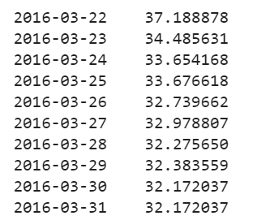
Forecasting
Date
AQI
Forecasted Air Quality Index values of california state for next 10 days using moving average model

Slide 10
Conclusion
california has highest air pollution
Random Forest is the best model for prediction in Regression models
Moving Average is the best model for prediction in Time Series Models
Forecasted the next 10 days Air Quality Index of California

Slide 11


