Slide 1


Maryland Statewide Vehicle Crashes (2015-2022)using Machine Learning
THOMAS NGUYEN
Data 606 summer 2023 – Capstone project
Dr. chaojie (jay) wang
Notes:
My project is on Predicting crash severity on Maryland Statewide Vehicle Crashes from the years 2015 thru 2022 using machine learning.

Slide 2


Content
Abstract
Overview Data Source
Pre-processing & EDA
Machine Learning models
Conclusion
Notes:
Content overview of my presentation:
Abstract - little overview of what my project is a background
Overview of the data source and where I got it from
Some of my steps for preprocessing and EDA
Machine learning models
Conclusions

Slide 3
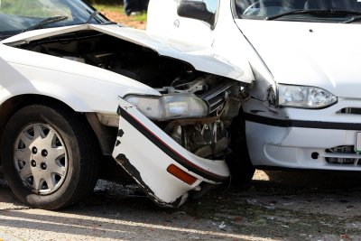
Abstract
In the state of Maryland, vehicle crashes have risen a significant amount each year. Tens of thousands of collisions reported on average in the state of Maryland. Incidents that occurred in the statewide vehicle dataset examines factors like location, weather conditions, and time contributing the causes of crashes and trends. With modern technology, assessing the severity of crashes and vehicles involved, we can aim to identify potential risk that occurred in different counties of Maryland. The main objective of this project is to provide and predict the types and severity of crashes in the state of Maryland using ML. Predictions will help audiences understand the nature of accidents that occurred through various types of accidents.
Notes:
Maryland and Vehicle crashes have risen significantly each year when data was obtained in 2015
Tens of thousands of collisions are reported
Location, conditions, areas, weather are some of the major key factors that are involved with accidents
With modern technology, we can assess the severity of crashes and vehicles involved and hopefully reduce the risk of another accident in MD.
Main objective with this project is to provide and predict the types of severity of crashes in different counties of MD using ML.

Slide 4
INTRODUCTION
Maryland, located in the Mid-Atlantic region of the United States, is known for its diverse landscapes, scenic mountains, bustling city, and high volume of traffic. The state economy thrives on varies industries like healthcare, technology, biotechnology, and many innovation and research. Given the high volume of individuals across many industries, commuting between counties in Maryland may result in many accidents throughout all times of the day.
According to Insurify, Gardner and Vohra who are data experts in vehicle, property, and insurance specialist demonstrated that Maryland ranks sixth-highest in at-fault accident on record. This is 19% higher than national average and the number of people killed in traffic accident is 1 in 10,870.
In the state of Maryland, on average there are 115,555 car accidents each year over five-year period. This is one of the highest percentage of car crashes on highways and county roads.
Notes:
-Maryland is known for its diverse landscapes, scenic mountains, bustling city, and high volume of traffic and crazy drivers on the daily.
According to Insurify (Data experts in vehicle, property, and insurance specialist Gardner and Vohra mentioned that
-Maryland ranks 6th highest in at-fault accidents on record which is 19% higher than national average.
-1 in 10,870 people have been killed in traffic within Maryland.
On average, there are over 115,000 car accidents each year over 5-year period. This is one of the highest percentage of car crashes on highway and county roads

Slide 5

Overview of Data Source
The crash data for Maryland is obtained from https://opendata.maryland.gov/. Crash data in Maryland are reported from January 2015 through December 2022. The dataset contains total of 56 columns and 878343 entries. The dataset is downloaded as a CSV file.
Data Source: https://opendata.maryland.gov/Public-Safety/Maryland-Statewide-Vehicle-Crashes/65du-s3qu
Notes:
Maryland crash dataset is obtained from opendata
Crash reports are from first Quarter Q1 of Jan 2015 thru last Quarter Q4 Dec 2022.
Dataset contains total of 56 columns and over 800,000 records
Dataset is downloaded in form of CSV file.

Slide 6
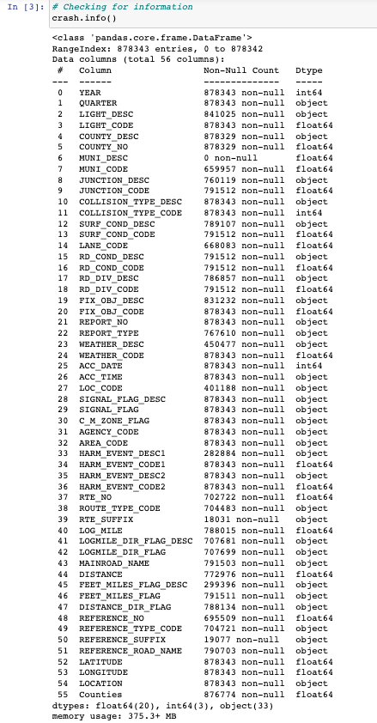
Pre-processing
Maryland Statewide Vehicle Dataset
(878343, 56)
Notes:
Maryland statewide vehicle dataset

Slide 7
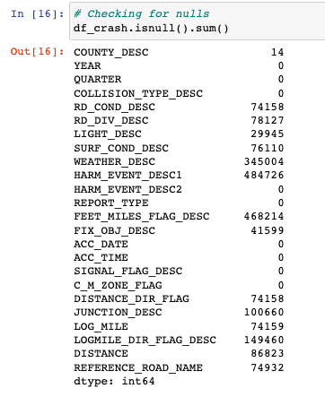
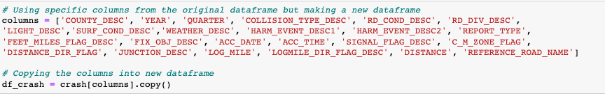
Pre-Processing continue..
Notes:
Only selecting the columns to use that is appliable when trying to predict and compare our classification models
Check for null values

Slide 8
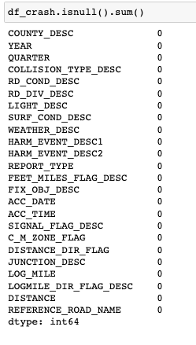
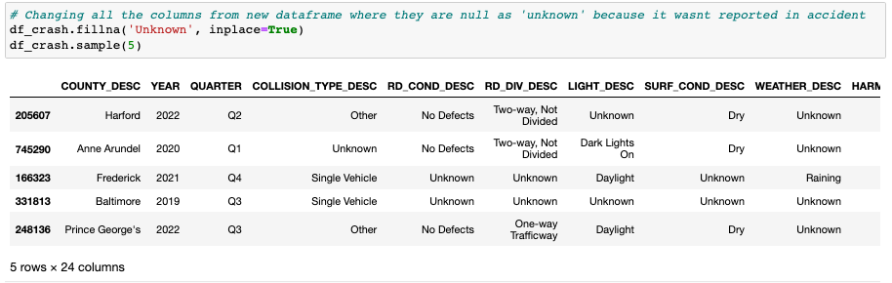
Continue.
Notes:
Replacing those null values with unknown

Slide 9
EDA – Exploratory Data Analysis
Given the data source, there are few questions in my analysis that I would like to address:
What is the number of crashes that occurred for each county?
Number of crashes for each year?
Does inclement weather condition impact more crashes?
Notes:
With the data source, after I cleaned and manipulated my dataset I wanted to answer a few questions.

Slide 10
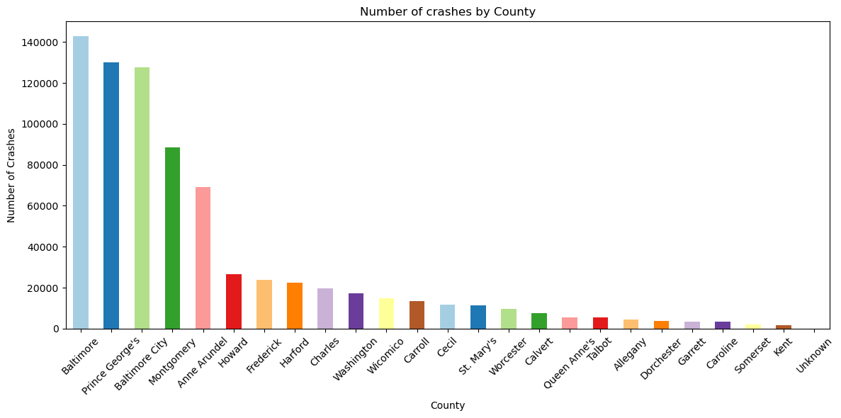
Notes:
Crashes that occurred for each county in Maryland.
Population and the number of crashes.
Population Density

Slide 11
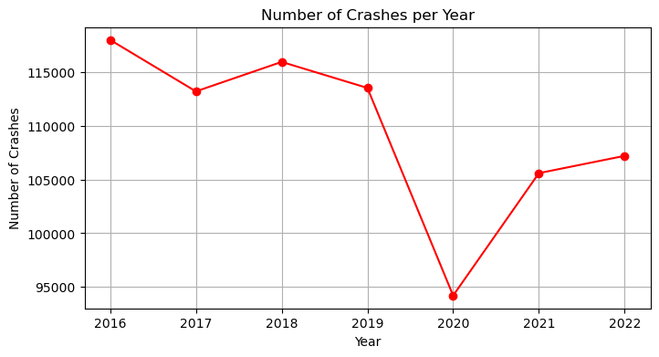
Notes:
Number of crashes per year

Slide 12
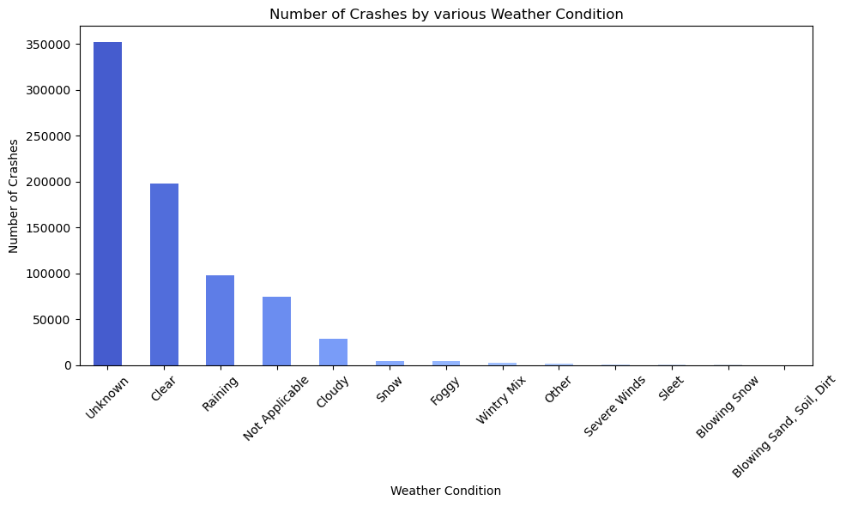
Notes:
Inclement weather conditions vs crashes

Slide 13
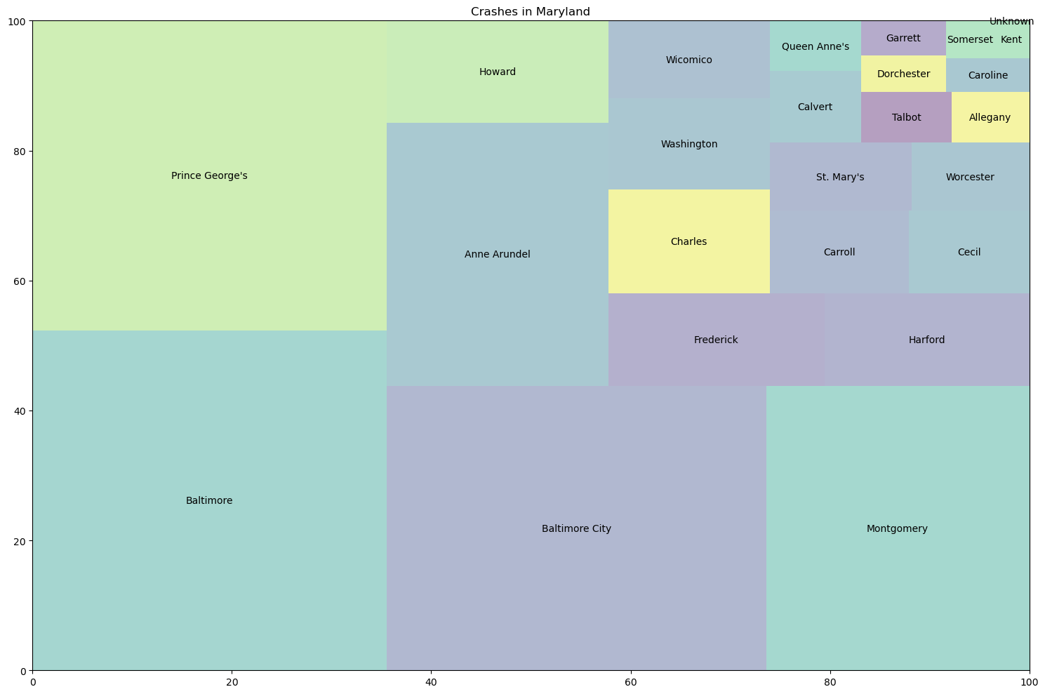
Notes:
Counties in Maryland with the most crashes

Slide 14
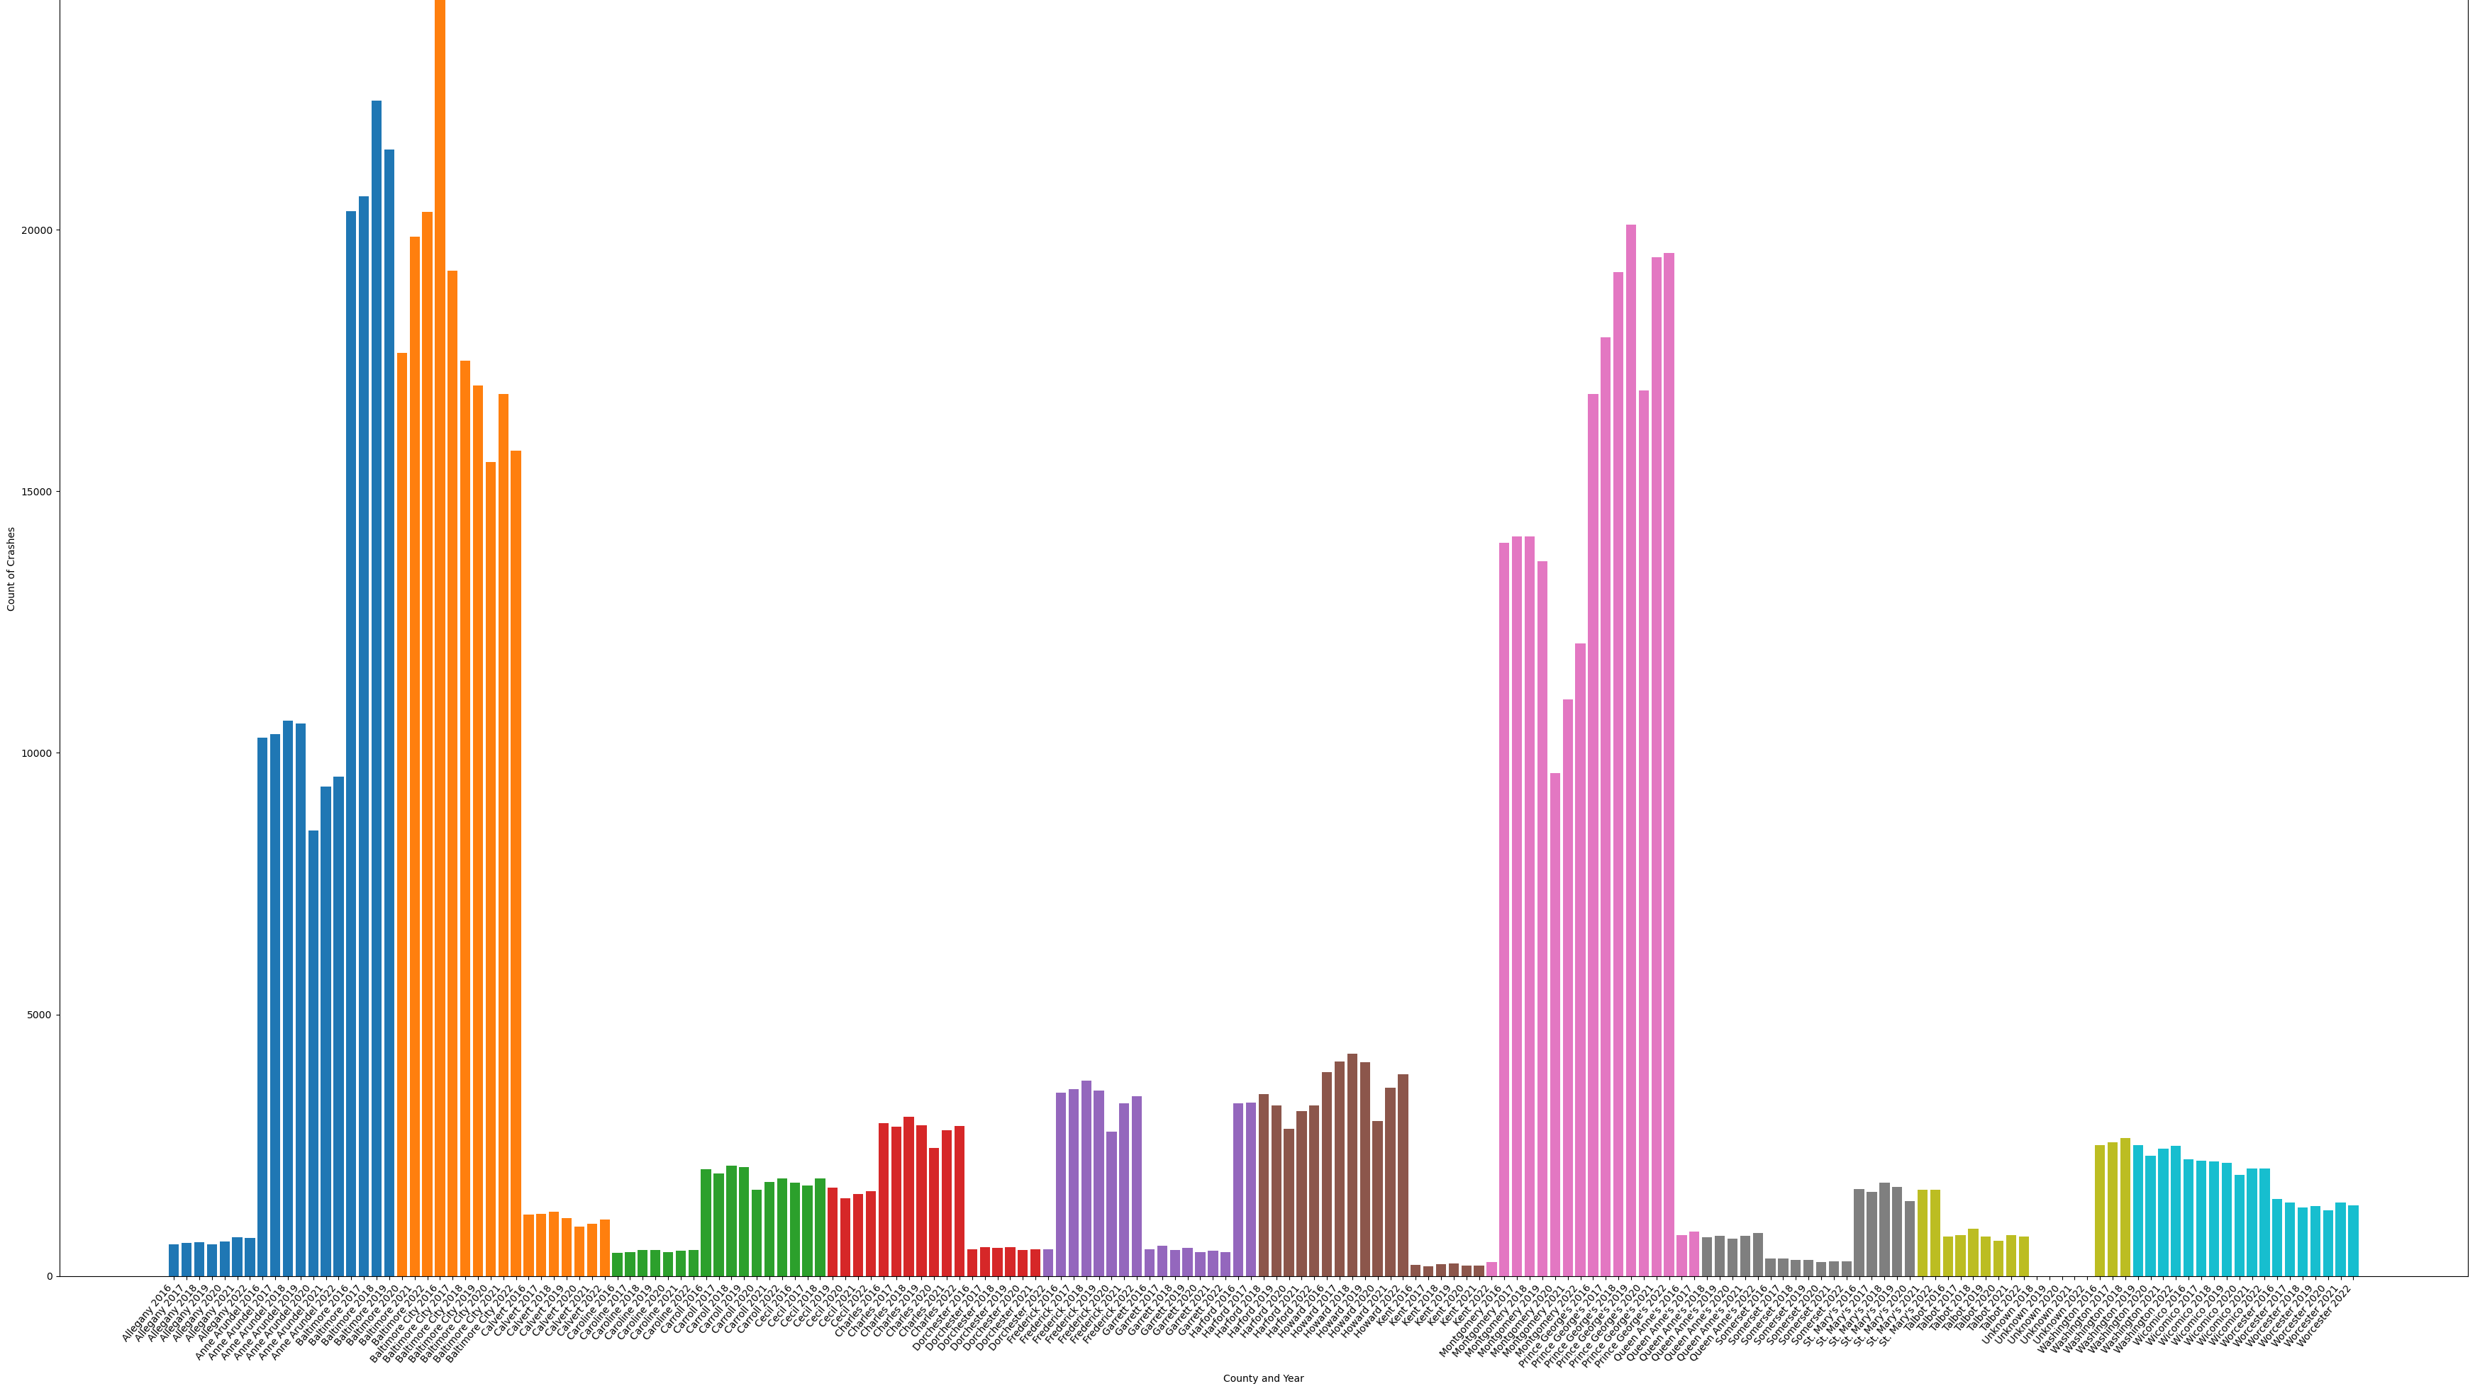
Notes:
Crashes by county and year.
Per year from 2016 to 2022, stack bar chart for the county.

Slide 15
Links to Visualization
https://github.com/tnguye53/Thomas_Data606/blob/main/docs/visualization/county_crashes.png
1
https://github.com/tnguye53/Thomas_Data606/blob/main/docs/visualization/crashes_per_year.png
2
https://github.com/tnguye53/Thomas_Data606/blob/main/docs/visualization/weather_crashes.png
3
https://github.com/tnguye53/Thomas_Data606/blob/main/docs/visualization/md_crashes.png
4
https://github.com/tnguye53/Thomas_Data606/blob/main/docs/visualization/crashes_per_county_year.png
5

Slide 16
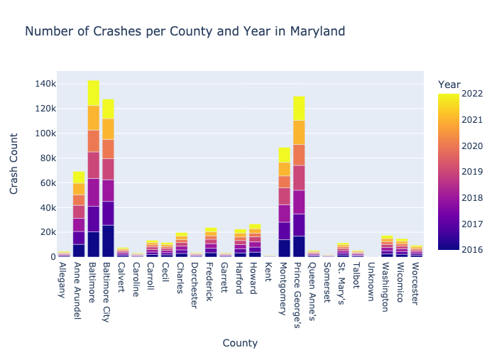
Plotly express Visualization for Maryland Crashes
Notes:
Bar plot

Slide 17
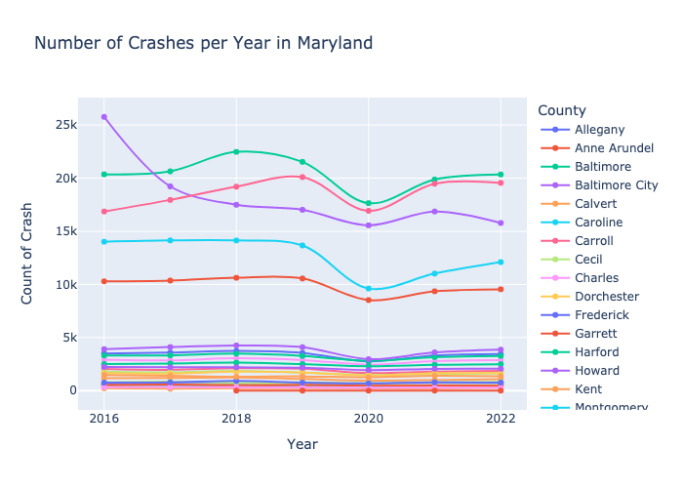
Notes:
Line plot

Slide 18
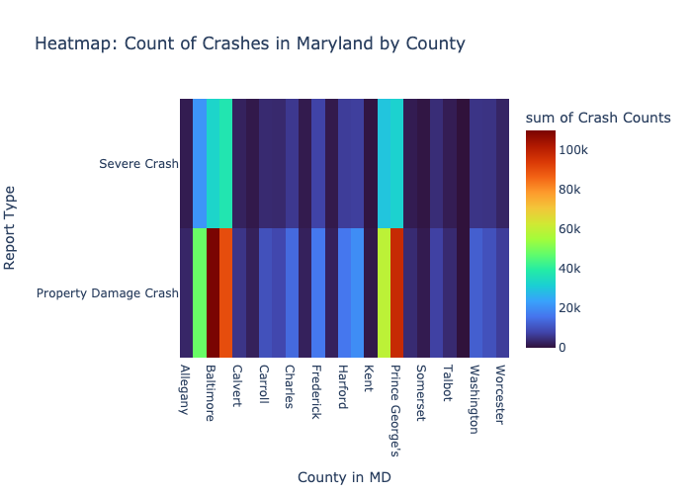
Notes:
Heat map

Slide 19

Interactive graphs using Plotly express
bar_plot.html - file:///Users/628993/Documents/UMBC/Data%20606/bar_plot.html
heatmap_plot.html - file:///Users/628993/Documents/UMBC/Data%20606/heatmap_plot.html
line_plot.html - file:///Users/628993/Documents/UMBC/Data%20606/line_plot.html

Slide 20
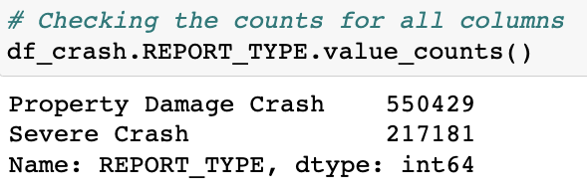

Machine Learning models
Features and Target Variables
Notes:
Features and target variables

Slide 21
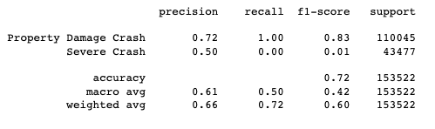
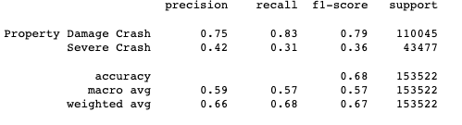
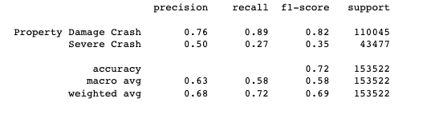
Technique & Models – Crash Severity Classification
Logistic Regression:
Decision Tree:
Random Forest:
Notes:
Based on our performance of the Linear Regression, the accuracy of 72% is considered a good score and random forest classification.
Both have a accuracy score of 72%
Decision tree classification is on the weaker side
If we want to compare our model then we will compare with ROC curve

Slide 22
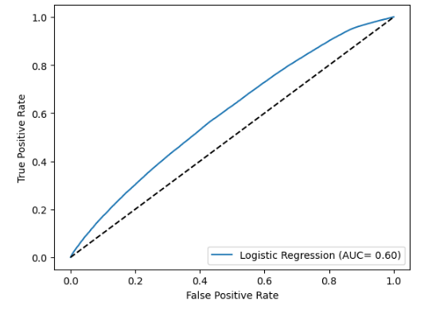
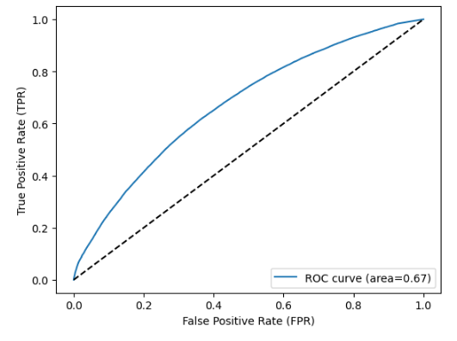
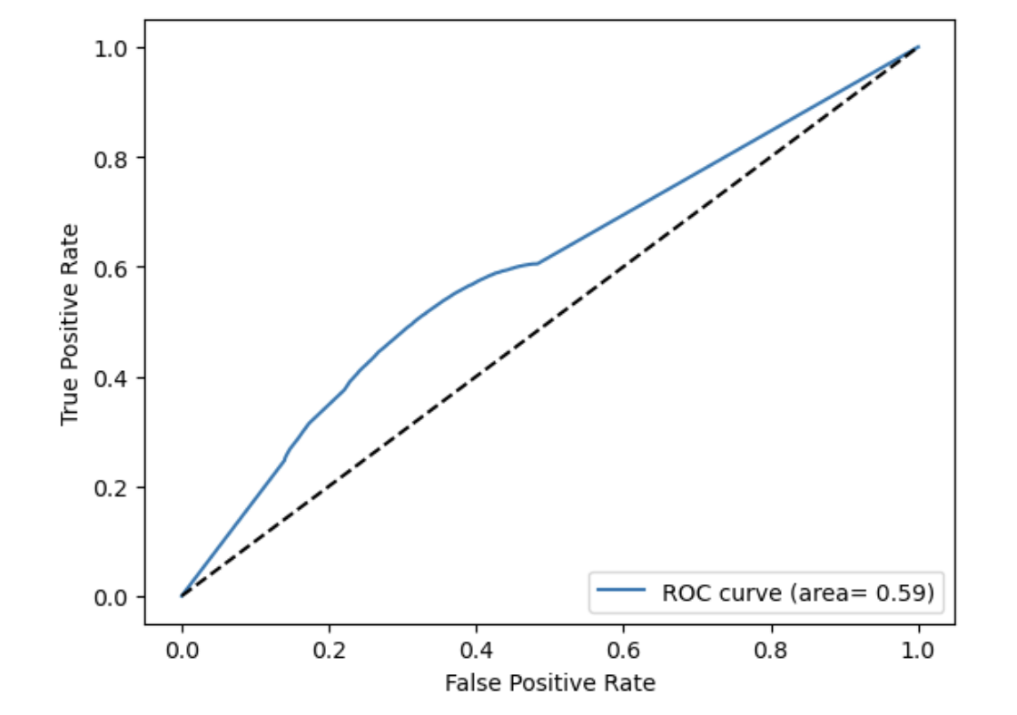
ROC Curve
Logistic Regression:
Random Forest:
Decision Tree:
Notes:
Based on the results for the ROC (Receiver Operating Characteristic) curve, the results shows the trade-off between the True positive and false positive.
AUC (Area under the curve) represents the single value representing the overall performance of the model.
From the results, random forest performs the best with the highest AUC, followed by logistic regression and decision tree has the lowest AUC among the three models.

Slide 23
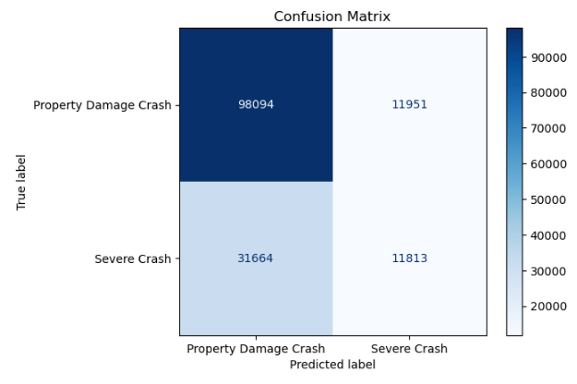
Confusion Matrix
Notes:
I used a Confusion matrix to evalute the performance our classification model which provides the breakdown of the predictions and the actual outcomes for each class.
Based on the results from confusion matrix:
- 98103 represent number of instances correctly predicted as 'Property Damage Crash' (True Negatives).
- 11942 represent the number of instances incorrectly predicted as 'Severe Crash' when they should be 'Property Damage Crash' (False Positives).
- 31805 represent the number of instances incorrectly predicted as 'Property Damage Crash' when they should be 'Severe Cash' (False Negatives).
- 11672 represent the number of instances correctly predicted as 'Severe Crash' (True Positives).
In Summary:
- The confusion matrix correctly predicted 'Property Damage Crash' with count of 98103 (True Negatives).
- The model made false positive predictions because it classified 'Severe Crash' when they were 'Property Damage Crash' with count of 11942 (False Positives).
- The model false negative prediction because it classified 'Property Damage Crash' when they were 'Severe Crash' incorrectly with count of 31805 (False Negatives).
- the confusion matrix correctly predicted 'Severe Crash' with count of 11672 (True Positives).
Change the labels = from 0 and 1. Property damage and severe.
Color scale.

Slide 24
CONCLUSION
Based on the overall results, random forest model and ROC curve value of .67 suggest that it provides a better discrimination compared to logistic regression and decision tree.
Although, logistic regression and random forest classification have the same accuracy of .72 (72%), comparing the ROC curve of .67 (67%) a higher ROC curve indicates a better distinction between positive and negative classes. The model provides a higher probability of correctly classifying 'Severe Crash' as positive instances.
Random Forest classification model is the better model to proceed with as it has higher ROC curve value indicating better overall performance in the target variable.
Next Steps:
Think of other ML and analysis to perform with the dataset
Explore new features that could improve performance and accuracy

Slide 25

Thank you Questions, Comments, or feedback?

