Slide 1

Decoding Infant Cries using CNN
Manideep Akam – HL35331

Slide 2
Introduction
Objective: Understanding and interpreting infant cries for effective infant care and early health issue detection.
Dataset: DonateaCry Corpus - comprehensive infant cry sounds dataset with varying health conditions. – 457 records
Methodology: Audio processing, feature extraction, and modelling with convolutional neural networks.
Impact: Valuable insights for healthcare professionals, caregivers, and researchers.
Benefits: Improve early health issue detection, develop effective intervention strategies, and enhance infant well-being.

Slide 3
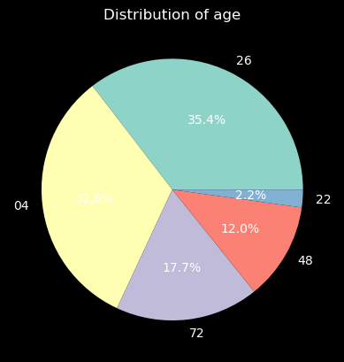
EDA
04 - 0 to 4 weeks old
48 - 4 to 8 weeks old
26 - 2 to 6 months old
72 - 7 month to 2 years old
22 - more than 2 years old

Slide 4
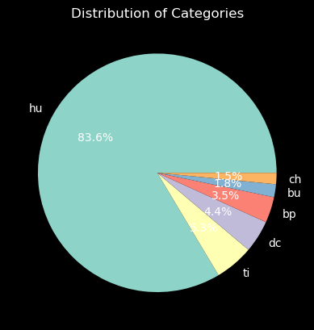
EDA
hu - hungry
bu - needs burping
bp - belly pain
dc - discomfort
ti – tired
ch - cold/hot

Slide 5
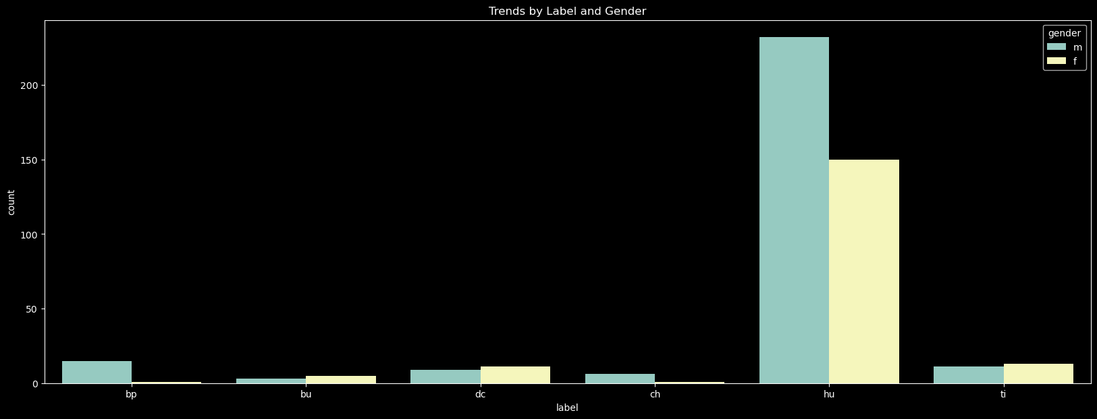
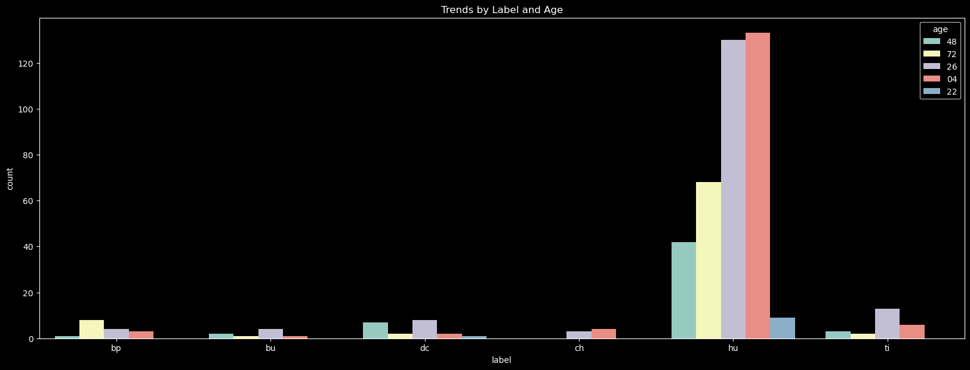
EDA

Slide 6
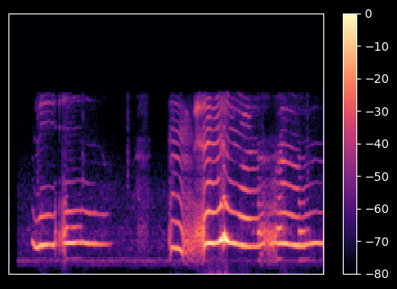
Feature Extraction
Librosa
Melspectrogram

Slide 7
Results
Model | Accuracy
Simple CNN | 77.17
CNN with multiple convolution layers | 70.65
CNN with Dropout Regularization | 77.17
CNN with Learning Rate Scheduler | 76.08
CNN with class_weight | 72.82
One vs Remaining | 77.17

Slide 8
Future Directions
Preprocessing data to get needed portion of audio
Incorporate additional data from Environment sound classification dataset
How other machine learning algorithms like SVM and Random forests work for this dataset and pre-trained models
Deployment through Steamlit

