Slide 1

Using Machine Learning to Analyze Airbnb Price
Victoria Borsetti
Data Science Capstone
Summer 2023

Slide 2
Table of Contents
Title | Page
Overview | 3
Method | 8
Results | 16
Streamlit Tool | 19
Conclusion | 21

Slide 3
Overview

Slide 4

Purpose
Problem Statement
For Airbnb investors, it is difficult to perceive market fluctuations and monitor the supply and demand of comparative homes to ensure a competitive yet profitable daily cost.
Impact
Profit loss on homes priced too low
Low booking rate on homes priced too high
Poor investment management (based on investor’s strategy)
Goal
Build a tool that uses machine learning to analyze appropriate daily cost based on current Airbnb data.

Slide 5

Data Source
Kaggle: Inside Airbnb – NYC
Timeframe: All Airbnb listings in New York City on June 3, 2022
Size: 88MB
Shape: 37,410 records, 74 fields
Link: https://www.kaggle.com/datasets/dominoweir/inside-airbnb-nyc?select=listings+2.csv
Additional Source
New York City MTA: NYC Transit Subway Entrance And Exit Data
Size: 457kB
Shape: 1,868 records, 34 fields
Link: https://data.ny.gov/widgets/i9wp-a4ja

Slide 6
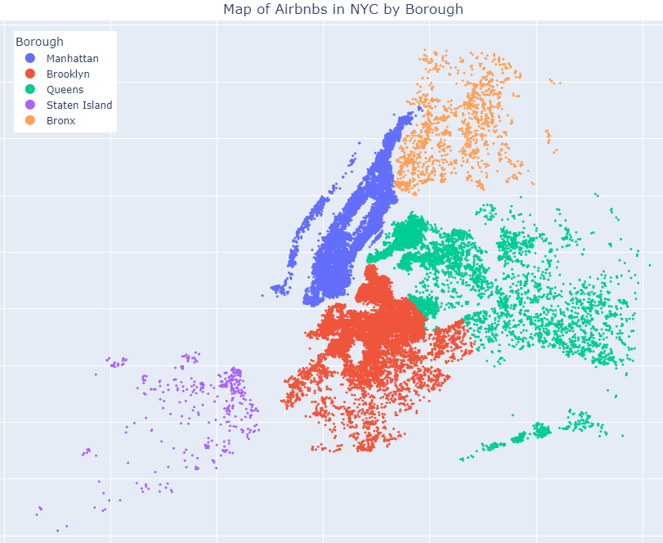
Data Map
The dataset contains 37,410 datapoints. Plotting longitude and latitude shows Airbnbs in all five boroughs of NYC.
Borough | Record Count
Manhattan* | 15,855
Brooklyn | 13,954
Queens | 5,824
Bronx | 1,376
Staten Island | 401
Total | 37,410
*Includes datapoints appearing in NJ

Slide 7
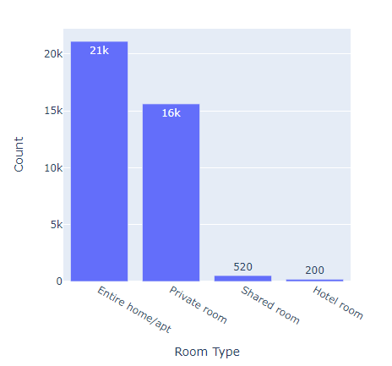
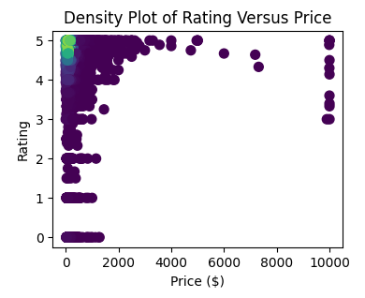
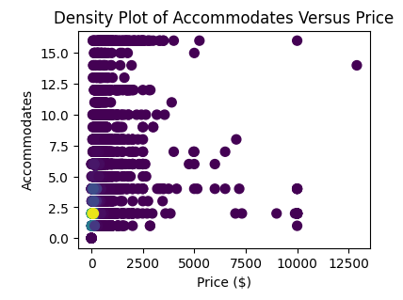
Key Data Exploration
Boxplots, histograms, and tables proved less helpful than density visualization for this highly skewed dataset.
Hot spot showing density of low-priced and high-rated homes
Hot spot showing density of 2-occupancy homes
Most frequent room types are entire home and private room

Slide 8
Method

Slide 9
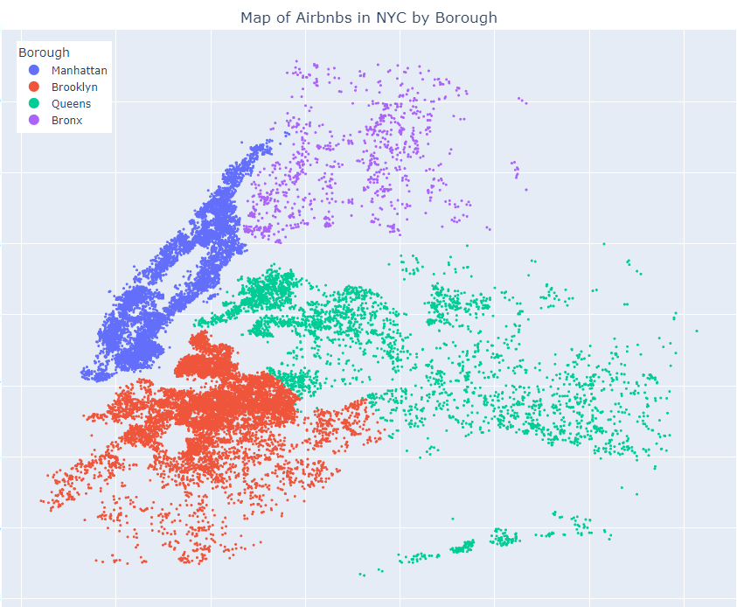
Data Cleansing – Removal of Records
Specific datapoints were removed as they were not useful for predicting price.
# | Observation | Solution
1 | Price is right skewed | 3k outliers removed using 1.5x interquartile range
2 | Price = 0 | 32 records removed (inactive)
3 | Overall Rating = 0 | 472 records removed (automated review by Airbnb)
4 | High frequency of low review counts | 14k records removed with less than 3 reviews
5 | Sparse data in Staten Island | 401 records removed
6 | NJ included in data | 548 records removed
*Final dataset reduces 37,410 to 20,851 records

Slide 10
Encode Categorical Columns
Field | Mapping | Method
Room Type (string) | Entire home = 4 Hotel room = 3 Private Room = 2 Shared Room = 1 | Label encoding in order of desirability as these fields contain some information about importance within their values. This is suitable for machine learning.
Bathroom Type (string) | Private = 1; Shared = 0
Superhost (boolean) | True = 1; False = 0
Borough (string) | 1 for yes, 0 for no | One-hot encoding as this column is not ordinal.
Neighborhood (string) | Numbered 0 to 193 | Random label encoding using sklearn because one-hot would create excessive columns (non-ordinal).
Property Type (string) | Numbered 0 to 61

Slide 11
Natural Language Processing
The most common amenities:
The “amenities” field contains a list of extra items and features offered by the Airbnb.
3,776 unique amenity items
NLP on most frequent items found in the list was performed on the “amenities” column
A new column for each of the common items was added to the dataframe in a one-hot encode fashion (1 if yes, 0 if no)
Top Items | Frequency
Wifi | 20,599
Essentials | 19,441
Heating | 19,827
Kitchen | 18,378
Air conditioning | 17,212
TV | 15,808
Fridge | 13,785
Cooking | 12,445
Washer | 8,886
Hot tub | 583

Slide 12
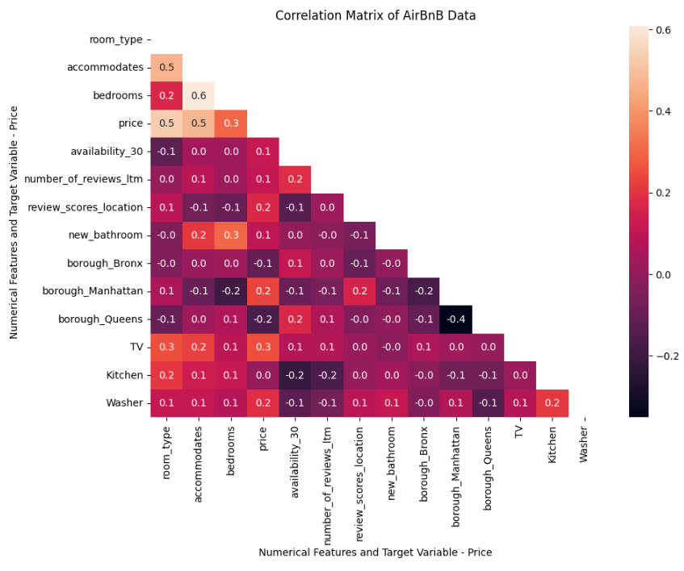
Normalization & Feature Selection
All independent variables normalized to 0-1 range.
Multicollinearity removed based on correlation matrix.
Model fit using linear regression for model selection.
The resulting correlation matrix shows no alarming relationships between remaining features.

Slide 13
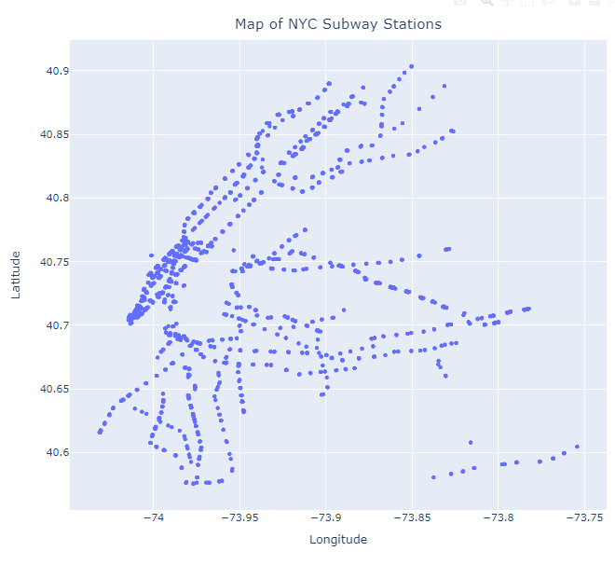
Add in Subway Station Location Data
Add Airbnb convenience measure:
For each Airbnb, add a field that contains calculated distance in feet to closest subway station.
If this distance is within 2,000ft, add a flag for “accessibility” = 1, otherwise 0

Slide 14
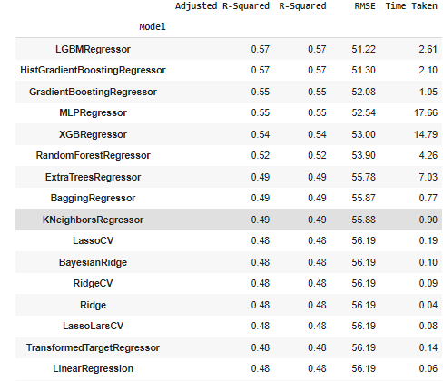
LazyPredict
LazyPredict was used to give a first approximation to the optimal machine learning models to use for this dataset.
The best RMSE would be built using an LGBM Regressor

Slide 15
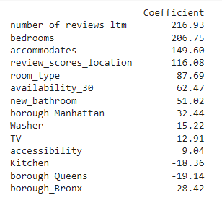
Final Features
The features that influenced price the most and their importance:
Observations
14 total features
As expected, number of people the Airbnb accommodates, bedrooms, and bathrooms were drivers of price.
A TV, Washer and Kitchen were amenities that affect price.
Since booking rate was not an option, number of reviews in the last 12 months and availability in the next 30 days gave a glimpse into how in-demand an Airbnb is.

Slide 16
Results

Slide 17
Results
After each step, some models improved while others worsened
At the final stage when all features were complete, the LGBM Regression model performed best
Final RMSE reveals an average error of $49.96 per day for an Aibnb
# | Step Name | RMSE on Regression Models
Step # | Step Name | Linear | Polynomial | LGBM
1 | Encode & Normalize | 53.52 | 51.31 | 45.27
2 | Feature Selection & Removal of Multicollinearity | 56.18 | 53.44 | 51.22
3 | Add Amenities Features | 55.12 | 51.87 | 49.77
4 | Reselect Features and Normalize | 55.25 | 52.31 | 50.15
5 | Add Subway Station & Reselect Features | 55.15 | 52.60 | 49.96

Slide 18
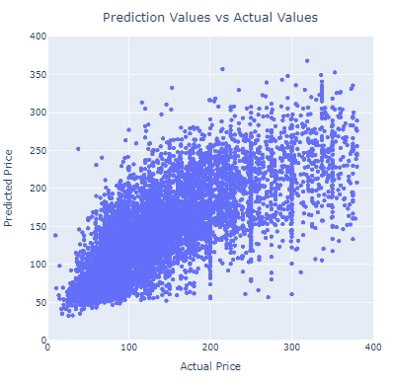
LightGBM Regressor Model
The best performing model produced an error of $49.96 per day for an Airbnb.
This is higher than ideal error
There were many lessons learned related to this data

Slide 19
Streamlit Tool

Slide 20
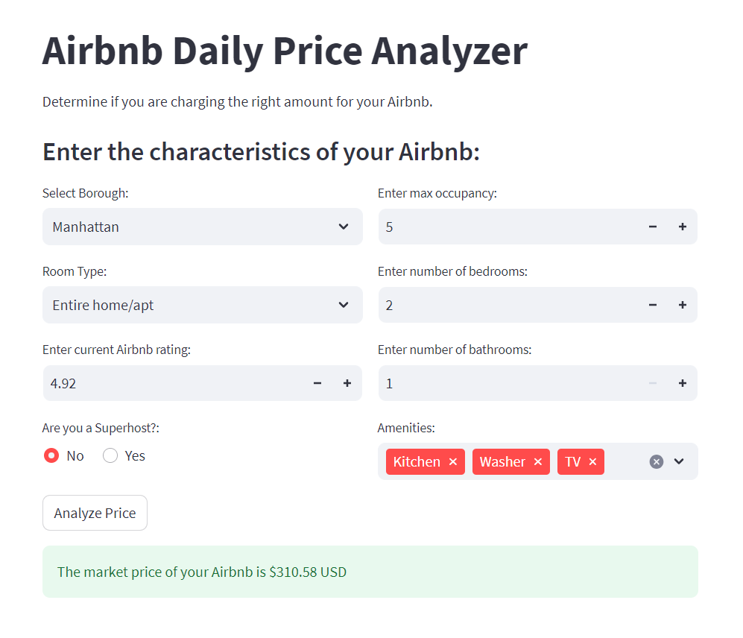
Streamlit Tool
Specifications
Built using a simplified model with fields most relevant and accessible to users
User populates all fields in form and clicks “Analyze Price”
Tool uses inputs to predict price based on the ML model
Try it out! Analyzer

Slide 21
Conclusion

Slide 22
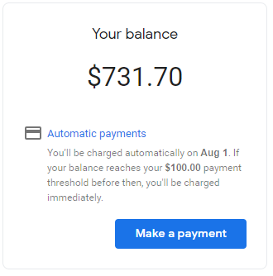
Lessons Learned
Google Maps API is not free!! Use small data samples to test approach.
Real Estate prices are predictable, but the “eye of the beholder” effect plays a roll.
Streamlit has infinite possibilities for deploying machine learning tools publicly.

Slide 23
Future Research
Successfully import LGBMRegressor into Streamlit. Currently the model is using linear regression due to issues with requirements.txt for Streamlit
In order to make this tool useful, more data is required to make it more accurate
This dataset is missing booking rate or any type of measure of how often it is booked vs available
Research into other ML Airbnb projects revealed the need to have data that reflects grandeur. One project attained an RMSE of $20. This would include square footage, a pretty view, height of building, floor of apartment, esthetics, etc.
Unknowns like large variations in other fees including cleaning and admin fees from Airbnb could affect accuracy of this model
Add other insights to the tool that display comparable listings, a range of prices (aggressive/competitive) so that investors can tailor to their renting strategy
Scrape data weekly to get most up-to-date listing information
Marry listing information with other market influencers such as real estate, stock market, etc.

