Slide 1
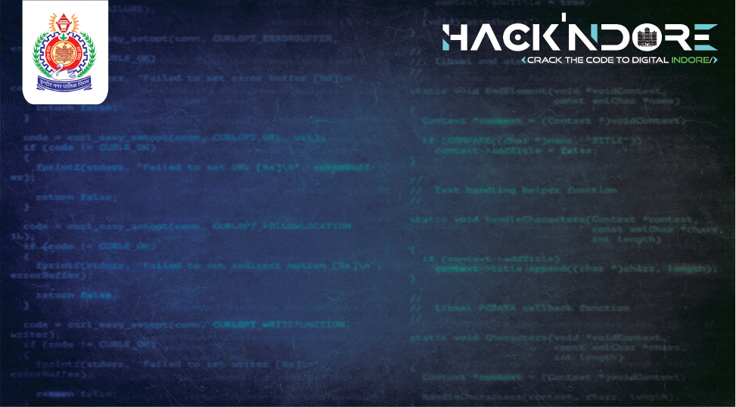
PROBLEM STATEMETNTS
Enhanced Asset Management for Municipal Corporations
DATA DRIFTERS
Vanshika Rathore
Ayusman Bhargav
Sakshi Jha
Vivek Vyas

Slide 2
Overview
Asset management is a systematic process of developing, operating, maintaining, upgrading, and disposing of assets cost-effectively. It involves balancing costs, opportunities, and risks against the desired performance of assets to achieve organizational objectives.
ASSET MANAGEMENT
Asset Creation
Asset Maintenance
Asset creation involves gathering and organizing data related to physical or digital assets, which can include attributes like location, condition, and specifications
Direct problem allocation involves identifying issues with assets and assigning them to specific workers or teams for resolution. This approach streamlines maintenance processes, ensuring prompt attention and efficient problem-solving.

Slide 3
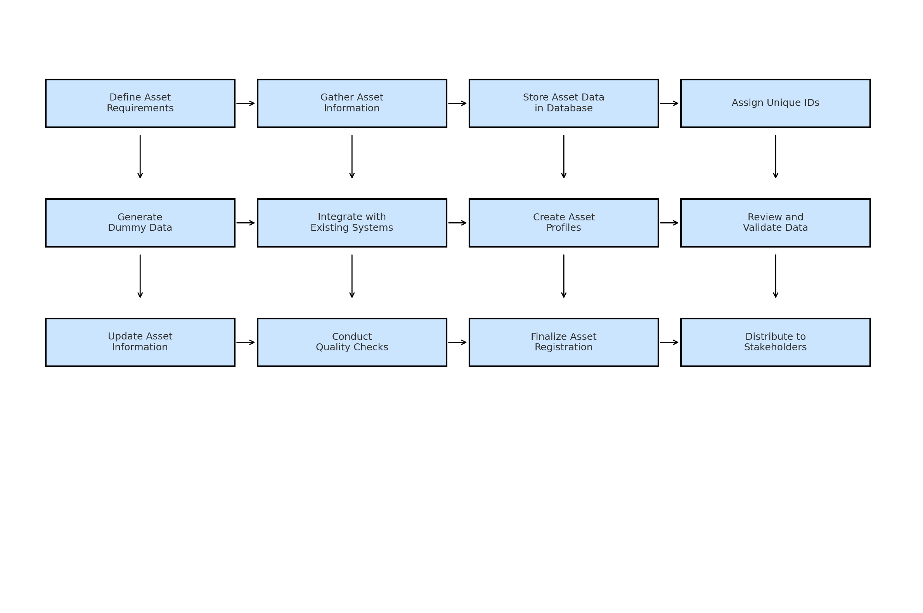

Purpose:
Simulation and Testing: Use dummy data to test systems without affecting real-world data integrity.
Training: Train personnel on tools using non-sensitive data.
Prototyping: Develop and test new software features using dummy data.
Creating Dummy Data:
Data Attributes: Select relevant attributes for assets such as:
Asset ID
Type
Location
Condition
Maintenance history
Specifications

Slide 4
Data Generation: Use tools like Excel or specialized software to generate realistic dummy data. For example:
Asset ID: Unique identifiers for each asset (e.g., B001 for bridges, R002 for roads).
Asset Type: Categories like roads, bridges, water systems, or buildings.
Location: Geographic coordinates or regional identifiers.
Status: Current condition or maintenance needs (e.g., Good, Needs Repair).
Example: Infrastructure Asset Data
Asset ID Type Location Status Last Inspection Maintenance Due
R001 Road Region A Good 2024-07-01 2025-07-01
B002 Bridge Region B Needs Repair 2024-06-20 2024-12-15
B003 Building Region C Good 2024-07-15 2025-01-10
Visualization of Data:
Charts and Graphs: Use visual tools to represent data trends, such as maintenance schedules, asset condition changes, and geographic distribution.
Dashboards: Create interactive dashboards that provide real-time updates and insights into asset status and prioritize maintenance tasks.

Slide 5
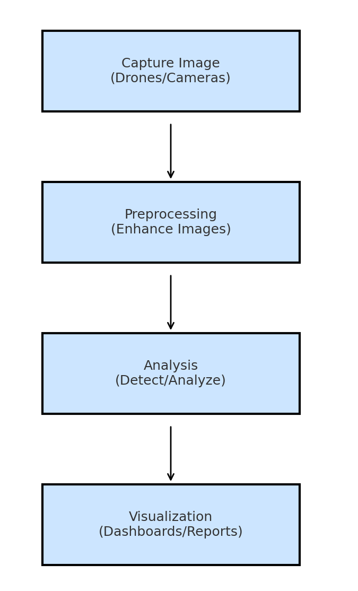
Introduction to Image Processing:
IMAGE PROCESSING
Image processing analyzes images to extract information, essential for monitoring infrastructure assets like roads, bridges, and utilities.
Applications:
Condition Monitoring: Assess asset conditions to identify damage or wear.
Inventory Management: Verify asset presence and status.
Documentation: Maintain visual records for auditing and compliance.
Techniques:
Object Detection: Identify infrastructure components (e.g., signs, structures).
Image Enhancement: Improve image quality for analysis.
Pattern Recognition: Detect anomalies in asset conditions.
Tools:
Technical Stack
OpenCV: Library for image processing tasks.
Machine Learning: Automate image analysis.
Python: Language for implementing processing techniques.
Workflow Example:
.
.
Capture: Use drones/cameras for images.
Preprocess: Enhance images for clarity.
Analyze: Detect and classify conditions.
Visualize: Report findings in dashboards.
Case Study: Bridge Monitoring
Objective: Monitor bridge conditions.
Process: Capture and enhance images, detect issues, and report for maintenance

Slide 6
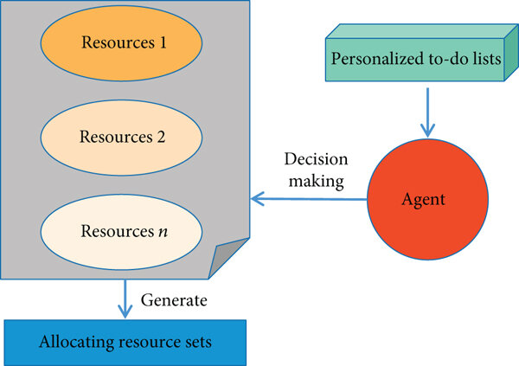
^{ASSET MAINTENANCE}
^{Purpose:}
Increased Efficiency: Speeds up identification and assignment of tasks, ensuring quicker resolutions.
Clear Accountability: Assigns specific responsibilities, enhancing tracking and accountability.
Improved Communication: Facilitates direct communication among involved parties.
Prioritization: Prioritizes tasks based on urgency and impact.
^{Workflow:}
Issue Identification: Detect issues via sensors, user reports, or inspections.
Automated System: Log and classify issues automatically by severity and type.
Task Assignment: Allocate tasks to suitable workers based on expertise, availability, and location.
Solution Generation: Suggest solutions or troubleshooting steps using past data.
Execution and Feedback: Workers execute tasks, update the system, and provide feedback for improvement.

Slide 7
Technology and Tools:
CMMS (Computerized Maintenance Management System): Software that helps in managing maintenance tasks, tracking work orders, and assigning tasks efficiently.
Mobile Applications: Enable workers to receive, update, and complete tasks directly from their mobile devices, even in remote locations.
IoT and Sensors: Continuously monitor infrastructure conditions and automatically trigger maintenance alerts when issues arise, such as structural stress or environmental changes.
AI and Machine Learning: Analyze historical data to predict potential failures and suggest optimal maintenance strategies, reducing reactive maintenance needs.
Example: Maintenance of Public Roads
Scenario: A city uses IoT sensors embedded in roads to monitor surface conditions.
Detection: Sensors detect abnormal wear patterns or potholes in a specific area.
Allocation: The CMMS automatically assigns the task to a nearby maintenance crew with expertise in road repair.
Solution Generation: The system suggests repair methods and materials based on similar past incidents and current conditions.
Execution: The crew follows the suggestions, resolves the issue, and logs the solution in the system for future reference.
Conclusion:
Direct problem allocation enhances infrastructure maintenance efficiency by ensuring that issues are promptly identified, assigned, and resolved. By leveraging technology, government agencies can reduce downtime, improve infrastructure performance, and extend the lifespan of public assets.

Slide 8
TECHNICAL STACKS
Our Asset Management System is designed to efficiently track and manage assets across various categories, such as vehicles, equipment, and parks. This system leverages a modern, robust, and scalable technical stack to deliver an intuitive and responsive user experience. Below is an overview of the technologies used:
Frontend:
HTML: Structures web page content and layout, providing the foundational framework for the user interface.
CSS: Styles HTML elements to improve visual appeal and usability, ensuring responsive design across devices.
JavaScript: Adds interactivity and dynamic behavior, enabling real-time UI updates and handling user interactions seamlessly.
Backend:
Python: Powers backend logic and data management, utilizing frameworks like Flask or Django for efficient API development and maintainable code.
Database:
MongoDB: A NoSQL database storing asset data in a flexible, document-oriented format, efficiently handling large volumes of unstructured data and supporting complex, real-time queries.

Slide 9
KEY CONCEPTS
Asset Tracking:
Real-time monitoring of assets, including their location, condition, and utilization.
Categorization:
Organizes assets into categories such as vehicles, equipment, and parks for easy management and reporting.
Centralized Data:
Maintains a single source of truth for all asset-related data, ensuring accuracy and consistency.
Lifecycle Management:
Tracks the entire lifecycle of assets, from acquisition to disposal, optimizing usage and reducing costs.
Scalability:
Designed to grow with the organization's needs, accommodating additional assets and users without significant rework.

Slide 10
Advantages of the Asset Management System
Improved Efficiency:
Automates asset tracking and management processes, reducing manual work and minimizing errors.
Cost Savings:
Optimizes asset utilization, reduces downtime, and prevents unnecessary purchases by providing insights into asset performance and needs.
Enhanced Decision-Making:
Offers data-driven insights through dashboards and reports, enabling better strategic planning and operational decisions.
Compliance and Risk Management:
Ensures compliance with industry regulations and standards, and reduces risks associated with asset management through accurate records and audit trails.
User-Friendly Interface:
Provides an intuitive and responsive interface, ensuring easy access and management of asset data for all users.
Real-Time Updates:
Offers up-to-date information on asset status and activities, enabling proactive maintenance and issue resolution.

Slide 11
Conclusion
In conclusion, our Asset Management System provides a comprehensive solution for managing assets across various categories with efficiency and precision. By leveraging modern technologies such as HTML, CSS, JavaScript, Python, and MongoDB, the system delivers a powerful and scalable platform that supports real-time tracking, centralized data management, and enhanced decision-making capabilities.
This leads to significant cost savings, improved operational efficiency, and robust compliance with industry standards.With its user-friendly design and ability to grow with your organization, our Asset Management System is an invaluable tool for optimizing asset utilization and driving strategic business outcomes. Thank you for considering our solution, and we look forward to supporting your asset management needs.

Slide 12
