Slide 1

Sprocket Central Pty Ltd
Data analytics approach
Muhammad Usman Khan

Slide 2
Agenda
Introduction
Data Exploration
Model Development
Interpretation

Slide 3
Introduction
Problem Outline
Approach for Customer Analysis
Sprocket Central Pty Ltd is a long-time customer of KPMG that specialises in selling high-quality bikes and affordable cycling accessories to cyclists.
The Company is targeting 1000 new Customers to drive the most value for the organisation.
Sprocket Central Pty Ltd marketing team is looking to boost business by analysing their existing customer dataset to determine customer trends and behaviour.
Age Distributions
Number of bike purchased in Previous 3 years
Job industry segmentation
Wealth Segmentation
Cars Owner Segmentation in each sate
Customer Profile

Slide 4
Data Exploration
Data Quality issue highlights in Transaction, Customer demographics and Customer address Data sets

Slide 5
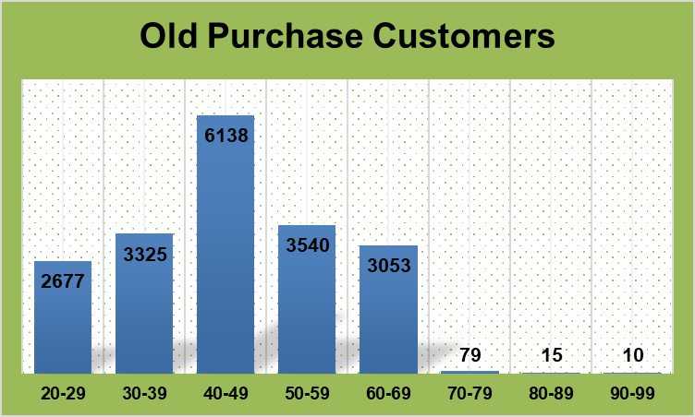
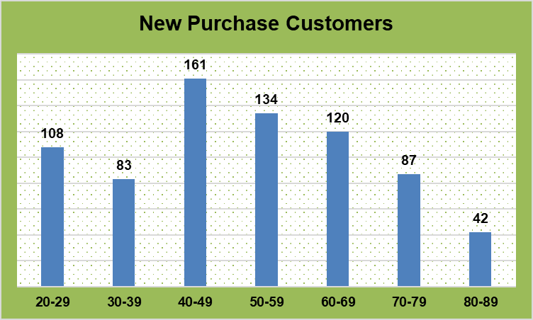
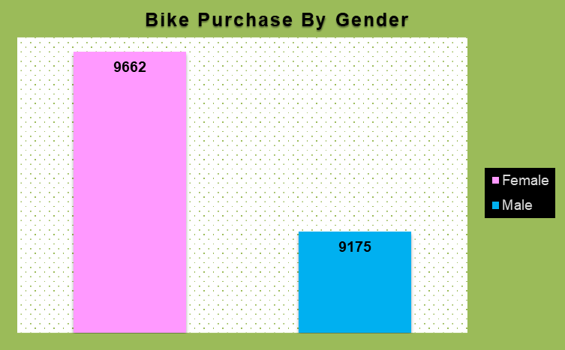
Data Exploration
Bike Related Purchase Based on Age And Gender of customers
Highest Bike buying customers are between 40-49 age group.
In the new purchase customer Graph people age between 40-49 and 50-59 are the highest bike purchasers.
In the Bike purchase by gender Females are the highest bike purchasers.
The visualisation shows high purchase numbers between middle aged group and Females which declares them as Potential Customers.

Slide 6
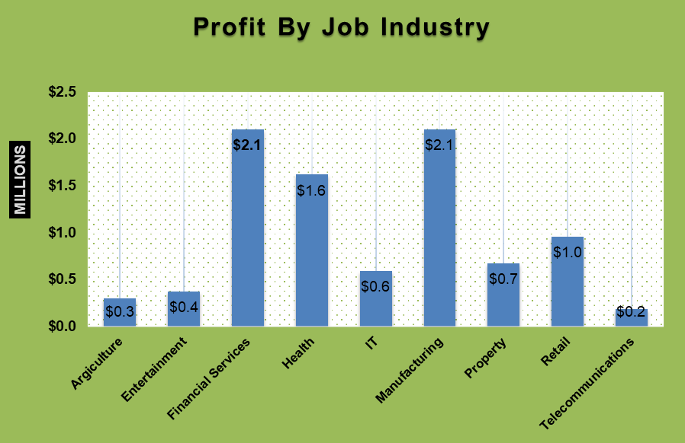
Data Exploration
Top Performing Job industries sectors Related to Max Profit and Bike Purchasing
Top 3 industry contributing to highest profit are: Financial Services, Health, Manufacturing .
The job industries sectors are within city commute, which is reason of high bike purchase.
Agriculture, Entertainment, IT, Property, Retail and Telecommunications have returned less than $1Millon in profits.

Slide 7
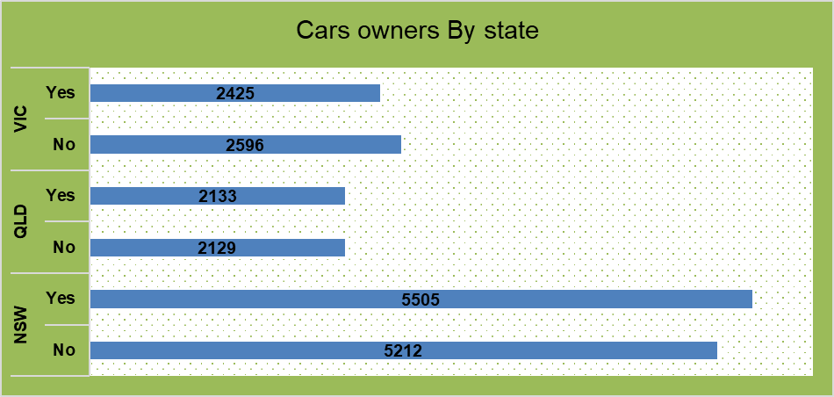
Data Exploration
No of Cars owned in each State
States namely NSW, QLD, VIC could be premium markets which have potential.
NSW has almost the equal no of bike Purchasers who owns cars and who don’t have no cars which indicates high potential of market growth.

Slide 8
Model Development
Customer Classification – Targeting high Value Customers
High values customers who will be targeted from new list.
Mostly high value customers are female as compared to males
Working in Health, Financial, Manufacturing industry sector.
Aged between 38-49.
Who are based in NSW, VIC.

Slide 9
Interpretation
Summary Table of High Valued customers
Here are some high valued customers which come under Classification of Platinum Customers.

Slide 10
Thank You!

Slide 11
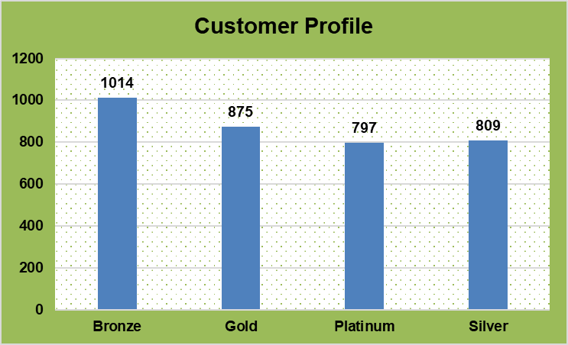
Appendix
CFM Analysis Customer Profile Segmentation

