Slide 1
The Command Pattern
Encapsulating Invocation

Slide 2
Command Pattern
Encapsulates method invocation
Purpose:
Crystallize pieces of computation so that the objects invoking the computation do not have to worry about how to do things - they just use the crystallized method!
Can also do some “wickedly smart” things with these encapsulated methods like save them for logging or reuse them to implement “undo”

Slide 3
The Command Pattern Example
Aplication
Menu
*
MenuItem
<<interface>>
Command
+add(doc: Document)
+add(item: menuItem)
+click()
+execute()
*
Document
command.excecute()
+open()
+close()
PasteCommand
OpenCommand
+cut()
+copy()
+execute()
+execute()
+paste()
document.paste()
doc=new Document();
application.add(doc);
doc.open();

Slide 4
Motivation Example
Program a Remote Control that can be used to control the devices in the house
Requirements:
Remote control features seven programmable slots
Each slot can be assigned to a different household device
Each slot has a corresponding on/off button
Remote has a global undo button that undoes the last button pressed.
A set of vendors classes are provided to give you an idea of the interfaces of the objects that need to be controlled from the remote.

Slide 5
A Pictorial View
On and off buttons for each of the seven slots
These two control device 1
Vendor Classes
On
Off
CeilingLight
on()
off()
dim()
Seven slots to program
Each slot contains a different device and is controlled via the buttons.
FaucetControl
openValue()
closeValue()
TV
on()
off()
setInputChannel()
setVolume()
Thermostat
setTemperature()
Hottub
circulate()
jetsOn()
jetsOff()
setTemperature()
Global “undo” button

Slide 6
Observations, anyone?
Expectation: see a bunch of classes with on() and off() methods --> common interface
Instead: each vendor class has its own API: dim(), setTemperature(), setVolume(), setDirection()
Observation:
Separation of concerns: remote should know how to interpret button presses and make requests, but it really should not know anything about home automation or how to turn on a hot tub.
Any issues? If the remote is dumb, how do we design a remote so that it can invoke an action - turn on a light?
Requirement: There will be more vendor classes in the future - design must accommodate for that

Slide 7
Enter – The Command Pattern!
Command Pattern allows you to decouple the requester of an action from the object that actually performs the action
Requester == remote control, Object == vendor classes
How does it work?
Introduce "command objects" into your design. A command object encapsulates a request to do something (like turn on a light) on a specific object (say, the living room light).
Every time a remote button is pressed, its corresponding command object goes to work!
Remote does not have any idea what the work is, it just has a command object that knows how to talk to the right object to get the work done.
Here the remote is decoupled from the object!

Slide 8

A Diner Example A Brief Introduction to the Command Pattern
Order
(1) You, the Customer give the Waitress your Order
(2) The Waitress takes the Order, places it on the order counter and says “Order up!”
(3) The Short-Order Cook prepares your meal from the Order.

Slide 9
Ordering in Objectville
Start Here
Order
createOrder()
takeOrder()
The Waitress takes the Order, and when she gets around to it, she calls its orderUp() method to begin the Order’s preparation.
The customer knows what he/she wants and creates an order
The Order has all the instructions needed to prepare the meal. The Order directs the Short Order Cook with methods like makeBurger()
The Short Order Cook follows the instructions of the Order and produces the meal
Order

Slide 10
The Objectville Diner Objects and Responsibilities
Order Slip: encapsulates a request to prepare a meal
Waitress: take the Order Slips and invoke the orderUp() method on them
The Short Order Cook: has the knowledge required to prepare the meal!

Slide 11
From the Diner to the Command Pattern
The Command object provides one method, execute(), that encapsulates the actions and can be called to invoke the actions on the Receiver.
public void execute {
receiver.action1 ();
receiver.action2 ();
}
action1()
action2()
The actions and the Receiver are bound together in the command object
Receiver
(1) createCommandObject()
The client is responsible for creating the command object. The command object consists of a set of actions on a receiver
execute()
create Command object
Start here
Command
The client calls setCommand() on an Invoker object and passes it the command object, where it gets stored until it is needed
Client
(2) setCommand()
(3)
setCommand()
Loading the Invoker
The client creates a command object.
The client does a setCommand() to store the command object in the invoker.
Later… the client asks the invoker to execute the command.
Invoker
At some point in the future the Invoker calls the Command object’s execute() method.
execute()
execute()
…which results in the actions being invoked on the Receiver
Command
action1()
action2()
action1(), action2()
Receiver

Slide 12
Simple Remote Control: 1 slot, 1 button
SimpleRemoteControl
<<interface>>
-slot: Command
Command
+buttonWasPressed()
slot.excecute()
+execute()
LightOnCommand
LightOffCommand
GarageDoorOpenCommand
+light: Light
+light: Light
+garageDoor: GarageDoor
+execute()
+execute()
+execute()
light.on()
GarageDoor
Light
+up()
garageDoor.up()
+down()
+on()
+stop()
+off()
+lightOn()
+lightOff()

Slide 13
Coding Our Command Object
Command Interface:
public interface Command {
public void execute();
}
Simple. All we need is one method called execute()
Implementing a Command to turn the light on
public class LightOnCommand implements Command {
private Light light;
public LightOnCommand(Light light){
this.light = light;
}
public void execute() {
light.on();
}
}
The constructor is passed the specific light that this command is going to control. When execute() gets called, this light object is the Receiver of the request.
The execute method calls the on() method on the receiving object, which is the light that we are controlling.

Slide 14
Using the Command Object
public class SimpleRemoteControl {
private Command slot;
public SimpleRemoteControl() { }
public void setCommand(Command command) {
slot = command;
}
public void buttonWasPressed() {
slot.execute();
}
}
We have one slot to hold our command, which will control one device.
Method for setting the command the slot it’s going to control. This could be called if the client wanted to change the behavior of the remote button.
This method is called when the button is pressed. All we do is take the current command bound to the slot and call its execute() method.

Slide 15
Simple test to use the Remote Control
public class RemoteControlTest {
public static void main (String[] args) {
SimpleRemoteControl remote = new SimpleRemoteControl();
Light light = new Light();
LightOnCommand lightOn = new LightOnCommand(light);
remote.setCommand(lightOn);
remote.buttonWasPressed();
}
}
Client
Invoker: be passed a command object that can be used to make requests.
create a Light Object
the Receiver of the request.
create a command and pass it to the Receiver
pass the command to the Invoker
simulate the button being pressed.

Slide 16
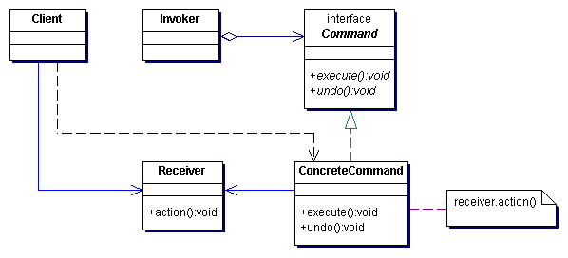
The Command Pattern Defined
The Command Pattern encapsulates a request as an object, thereby letting you parameterize other objects with different requests, queue or log requests, and support undoable operations.
Asks the command to carry out the request
Declares an interface for executing an operation.
Creates a ConcreteCommand object and sets its receiver
Defines a binding between a Receiver object and an action.
Implements Execute by invoking the corresponding operation(s) on Receiver.
Knows how to perform the operations associated with carrying out a request. Any class may serve as a Receiver.

Slide 17
Applicability
Use the Command pattern when you want to
Parameterize objects by an action to perform: a callback function.
Specify, queue, and execute requests at different times.
Support undo.
The Command's execute() operation can store state for reversing its effects in the command itself.
The Command interface must have an added unexecute() operation that reverses the effects of a previous call to execute()
Support logging changes so that they can be reapplied in case of a system crash.
By augmenting the Command interface with load() and store() operations, you can keep a persistent log of changes.
Recovering from a crash involves reloading logged commands from disk and reexecuting them with the execute() operation.

Slide 18
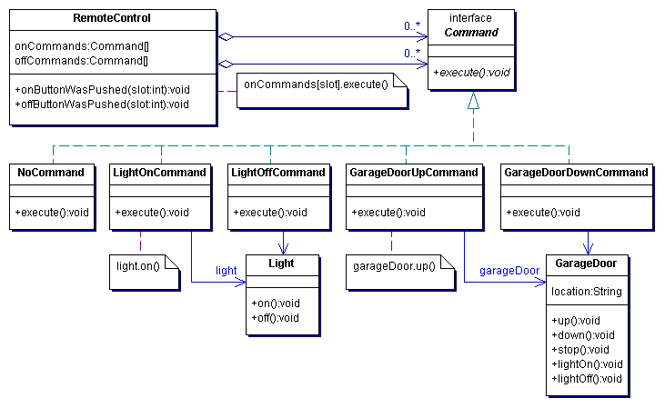
The Remote Control Example

Slide 19
Implementing the RemoteControl
This time around the remote is going to handle seven On and Off Commands which we will hold in the corresponding array.
public class RemoteControl {
private Command[] onCommands;
private Command[] offCommands;
public RemoteControl() {
onCommands = new Command[7];
offCommands = new Command[7];
Command noCommand = new NoCommand();
for (int i = 0; i < 7; i++) {
onCommands[i] = noCommand;
offCommands[i] = noCommand;
}
}
public void setCommand(int slot, Command onCommand, Command offCommand) {
onCommands[slot] = onCommand;
offCommands[slot] = offCommand;
}
public void onButtonWasPushed(int slot) {
onCommands[slot].execute();
}
public void offButtonWasPushed(int slot) {
offCommands[slot].execute();
}
...
In the constructor all we need to do is instantiate the on and off arrays.
The setCommand() method takes a slot position and an On and Off command to be stored in that slot. It puts these commands in the On and Off array for later use.
When an On or a Off button is pressed, the hardware takes care of calling the corresponding methods

Slide 20
Implementing the Commands
An instance of the stereo we are going to control is passed to constructor.
public class LightOffCommand
implements Command {
private Light light;
public LightOffCommand(
Light light) {
this.light = light;
}
public void execute() {
light.off();
}
}
public class
StereoOnWithCDCommand
implements Command {
private Stereo stereo;
public StereoOnWithCDCommand
(Stereo stereo) {
this.stereo = stereo;
}
public void execute() {
stereo.on();
stereo.setCD();
stereo.setVolume(11);
}
}
The LightOffCommand works exactly like the LightOnCommand, except that we are binding the receiver to a different action: the off() command.
To carry out this request we need to call three methods on the stereo: first, turn it on, then set it to play the CD, and finally set the volume to 11 !

Slide 21
Testing the Code
Create all the devices
public class RemoteLoader {
public static void main(String[] args) {
RemoteControl remoteControl = new RemoteControl();
Light livingRoomLight = new Light("Living Room");
LightOnCommand livingRoomLightOn =
new LightOnCommand(livingRoomLight);
LightOffCommand livingRoomLightOff =
new LightOffCommand(livingRoomLight);
remoteControl.setCommand(0, livingRoomLightOn,
livingRoomLightOff);
remoteControl.onButtonWasPushed(0);
remoteControl.offButtonWasPushed(0);
}
}
Create all the Command objects
Load the command objects
Ready to roll! Test out the remote!

Slide 22
The NoCommand?
NoCommand is a null object.
In the remote control, we didn’t want to check to see if a command was loaded for every slot.
public void onButtonWasPushed(int slot) {
if (onCommands[slot] != null ){
onCommands[slot].execute(); }
}
To get around it, we introduce a "NoCommand" object
public class NoCommand implements Command {
public void execute() { };
}
Fixing the RemoteControl constructor:
Command noCommand = new NoCommand();
for (int i=0; i < 7; i++ ){
onCommands[i] = noCommand;
off Commands[i] = noCommand;
}

Slide 23
Adding the Undo Feature
When commands support undo, they have an undo() method that mirrors the execute() method. Whatever execute() last did, undo() reverses it
public interface Command {
public void execute();
public void undo();
}
Implement the undo() method in the LightOnCommand
public class LightOnCommand implements Command {
public LightOnCommand (Light light){
this.light = light;
}
public void execute(){
light.on();
}
public void undo(){
light.off();
}
}
execute() turns the light on so undo turns it off. Reverse for LightOffCommand.

Slide 24
Updating the RemoteControl class
To add support for the undo button
public class RemoteControl {
private Command[] onCommands;
private Command[] offCommands;
private Command undoCommand;
public RemoteControl() {
onCommands = new Command[7];
offCommands = new Command[7];
Command noCommand = new NoCommand();
for (int i = 0; i < 7; i++) {
onCommands[i] = noCommand;
offCommands[i] = noCommand;
}
undoCommand = noCommand;
}
This is where we will stash the last command executed for the undo button
Just like the other slots this is initialized to a NoCommand.

Slide 25
RemoteControl Class
public void setCommand(int slot, Command onCommand, Command offCommand) {
onCommands[slot] = onCommand;
offCommands[slot] = offCommand;
}
public void onButtonWasPushed(int slot) {
onCommands[slot].execute();
undoCommand = onCommands[slot];
}
public void offButtonWasPushed(int slot){
offCommands[slot].execute();
undoCommand = onCommands[slot];
}
public void undoButtonWasPushed() {
undoCommand.undo();
}
public String toString() {
// code here }
}
When the button is pressed we take the command and first execute it; then we save a reference to it in the undoCommand instance variable.
We do this for both “on” and “off” commands.
When the undo button is pressed, we invoke the undo() method of the command stored in the undoCommand. This reverses the operation that was last executed.

Slide 26
Using State to Implement Undo
public class CeilingFan {
public static final int HIGH = 3;
public static final int MEDIUM = 2;
public static final int LOW = 1;
public static final int OFF = 0;
String location;
int speed;
public CeilingFan(String location) {
this.location = location;
speed = OFF; }
public void high() {
speed = HIGH;
System.out.println(location + " ceiling fan is on high"); }
public void medium() {
speed = MEDIUM;
System.out.println(location + " ceiling fan is on medium"); }
public void low() {
speed = LOW;
System.out.println(location + " ceiling fan is on low"); }
public void off() {
speed = OFF;
System.out.println(location + " ceiling fan is off"); }
public int getSpeed() {
return speed; }
}
Holds local state
Set the speed of the ceiling fan.
Can get the current speed.

Slide 27
Adding Undo to Ceiling Fan Commands
public class CeilingFanHighCommand implements Command {
private CeilingFan ceilingFan;
private int prevSpeed;
public CeilingFanHighCommand(CeilingFan ceilingFan) {
this.ceilingFan = ceilingFan;
}
public void execute() {
prevSpeed = ceilingFan.getSpeed();
ceilingFan.high();
}
public void undo() {
if (prevSpeed == CeilingFan.HIGH) {
ceilingFan.high();
} else if (prevSpeed == CeilingFan.MEDIUM) {
ceilingFan.medium();
} else if (prevSpeed == CeilingFan.LOW) {
ceilingFan.low();
} else if (prevSpeed == CeilingFan.OFF) {
ceilingFan.off();
}
}
}
Added local state to keep track of the previous speed of the fan.
In execute(), before we change the speed we need to first record its previous state, just in case we need to undo our actions.
To undo, we set the speed of the fan back to its previous state.

Slide 28
Using the Macro Command
Executing multiple commands with one
Push one button to dim the lights, turn on the stereo and the TV and set the to DVD.
public class MacroCommand implements Command {
private Command[] commands;
public MacroCommand (Command[] commands){
this.commands = commands;
}
public void execute(){
for (int i = 0; i < commands.length; i++){
commands[i].execute();
}
}
}
Take an array of Commands and store them in the MacroCommand
When the macro gets executed by the remote, execute those commands one at a time.

Slide 29
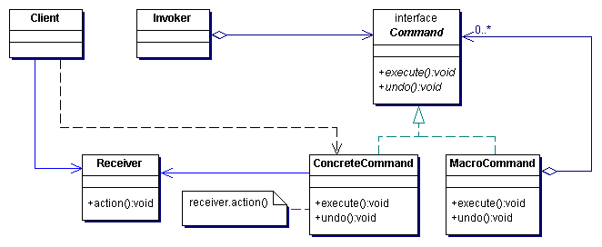
Macro Command
Composite Pattern
Composite of commands

Slide 30
More Uses - Queuing Requests
Commands provide a mechanism to package a piece of computation and pass it around as a first-class object.
Imagine a job queue:
Add commands to the queue on one end, and on the other end sits a group of threads
Threads run the following script:
Remove command from the queue
Call its execute method
Wait for the call to finish
Discard the command object and retrieve the new one.
Here job queues are totally decoupled from the objects that are doing the computation.

Slide 31
More Uses: Logging Requests
Semantics of some applications require that we log all actions and be able to recover after a crash by re-invoking those actions.
The Command Pattern can store these semantics with the addition of two new methods: store() and load().
In Java we could use serialization to implement this.
How does it work?
As execute commands, we store a history of them on disk
When a crash occurs, we reload the command objects and invoke their execute() methods in batch and in order.

Slide 32
Summary
The Command pattern decouples an object making a request from one that knows how to perform it.
A Command object is at the center of this decoupling and encapsulates a receiver with an action (or set of actions)
An invoker makes a request of a Command object by calling its execute() method, which invokes those actions on the receiver.

Slide 33
Summary
Invokers can be parameterized with the Commands, even dynamically at runtime.
Commands may support undo by implementing an undo method that restores the object to its previous state before the execute() method was last called.
Macro commands are a simple extension of Command that allow multiple commands to be invoked.
Commands may also be used to implement logging and transactional systems.

