Slide 1
The State Pattern
A LITTLE KNOWN FACT:
The strategy and the state patterns were twins at birth.
As you now know the strategy pattern went on to create a wildly successful business around interchangeable algorithms.
State, however took perhaps the noble path of helping objects control their behavior by changing their internal state.

Slide 2
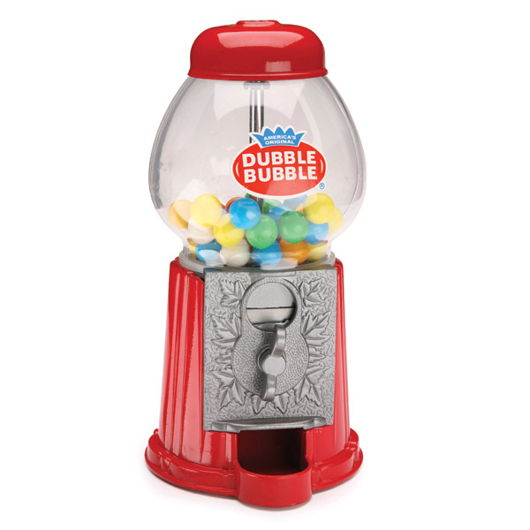
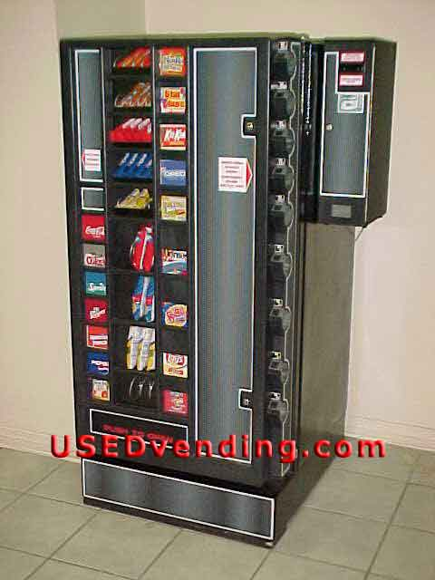

Slide 3
The State of Things
Today people are building Java into real devices – like a gumball machine!
Here is one way that perhaps a gumball machine controller needs to work
Has Quater
turns crank
Inserts
quater
ejects
quater
No Quater
Gumball Sold
[ gumballs>0 ]
dispense gumball
[ gumballs=0 ]
Out of Gumballs

Slide 4
State Machines 101
First, gather up your states:
Create an instance variable to hold the current state and define values for each state:
Now we gather up all the actions that happen in the system.
Out of
Gumballs
Has
Quarter
Gumball
Sold
No
Quarter
final static int SOLD_OUT = 0;
final static int NO_QUARTER = 1;
final static int HAS_QUARTER = 2;
final static int SOLD = 3;
int state = SOLD_OUT;
Here’s each state represented by a unique integer
We hold the current state in an instance variable.
Turns crank
Ejects quarters
Inserts quarters
dispense

Slide 5
State of Things (contd.)
Now we create a method that acts as a state machine. For each action, we use conditionals to determine what behavior is appropriate in each state.
For example, for insert quarter action:
public void insertQuarter() {
if (state == HAS_QUARTER) {
System.out.println("You can't insert another quarter");
} else if (state == NO_QUARTER) {
state = HAS_QUARTER;
System.out.println("You inserted a quarter");
} else if (state == SOLD_OUT) {
System.out.println("You can't insert a quarter, the machine is sold out");
} else if (state == SOLD) {
System.out.println("Please wait, we're already giving you a gumball");
}
}
You can exhibit the appropriate behavior for each state.
Or transition to another state.

Slide 6
Gumball Implementation
public class GumballMachine {
final static int SOLD_OUT = 0;
final static int NO_QUARTER = 1;
final static int HAS_QUARTER = 2;
final static int SOLD = 3;
int state = SOLD_OUT;
int count = 0;
public GumballMachine(int count) {
this.count = count;
if (count > 0) state = NO_QUARTER;
}
public void insertQuarter() {
if (state == HAS_QUARTER) {
System.out.println("You can't insert another quarter");
} else if (state == NO_QUARTER) {
state = HAS_QUARTER;
System.out.println("You inserted a quarter");
} else if (state == SOLD_OUT) {
System.out.println("You can't insert a quarter, the machine is sold out");
} else if (state == SOLD) {
System.out.println("Please wait, we're already giving you a gumball");
}
}
public void ejectQuarter() { }
public void turnCrank() { }
public void dispense() { }
// other methods
The insertQuarter() method – specifies what to do if a quarter is inserted.
Represent the methods for each action - customer tries to turn the crank etc.

Slide 7
You knew it was coming….
A change request: Gumball machine works great but need to take it to the next level
Turn gumball buying into a game!
10% of the time when the crank is turned, the customer gets two gumballs instead on one!
Draw a state diagram for a Gumball machine that handles the 1 in 10 contest. In this contest 10% of the time the Sold state leads to two balls being released, not one.

Slide 8
1 in 10 Gumball Game
turns crank
we have a winner
Has Quater
inserts
turns crank
quater
no winner
ejects
quater
No Quater
Gumbal Sold
Winner
dispense
[ gumballs>0 ]
gumball
dispense
2 gumballs
[ gumballs=0 ]
Out of Gumbals
[ gumballs=0 ]
[ gumballs>0 ]

Slide 9
The messy STATE of things….
Modifications to your well-thought out Gumball machine code:
public class GumballMachine {
final static int SOLD_OUT = 0;
final static int NO_QUARTER = 1;
final static int HAS_QUARTER = 2;
final static int SOLD = 3;
final static int WINNER = 4;
public void insertQuarter() {
// insert quarter code here
}
public void ejectQuarter() {
// eject quater code here
}
public void turnCrank() {
// turn crank code here
}
public void dispense() {
// dispense code here
}
// other methods
First you need to add a new WINNER state here. That isn’t too bad…..
… but then, you’d have to add a new conditional in every method to handle the WINNER state. That’s a lot of code to modify!
turnCrank() will get especially messy, because you have to add code to check whether you have a WINNER and then switch to the WINNER state or the SOLD state.
This isn’t good. While the first design was “good”, it isn’ t going to hold up to modifications.

Slide 10
The new design!
New plan: instead of maintaining the existing code, we are going to rework the design to encapsulate the state objects in their own classes and then delegate to the current state when an action occurs.
Define a State interface that contains a method for every action in the Gumball Machine
Implement a State class for every state of the machine. These classes will be responsible for the behavior of the machine when it is in the corresponding state.
We are going to get rid of all the conditional code and instead delegate to the state class to do all the work.

Slide 11
Defining the State Interfaces and Classes
<<Interface>>
Here’s the interface for all the states. The methods map to actions that could happen in the Gumball machine.
State
+ insertQuater()
+ ejectQuater()
+ turnCrank()
+ dispense()
SoldState
SoldOutState
NoQuaterState
HasQuaterState
+ insertQuater()
+ insertQuater()
+ insertQuater()
+ insertQuater()
+ ejectQuater()
+ ejectQuater()
+ ejectQuater()
+ ejectQuater()
+ turnCrank()
+ turnCrank()
+ turnCrank()
+ turnCrank()
+ dispense()
+ dispense()
+ dispense()
+ dispense()
public class GumballMachine {
final static int SOLD_OUT = 0;
final static int NO_QUARTER = 1;
final static int HAS_QUARTER = 2;
final static int SOLD = 3;
…and we map each state directly to a class

Slide 12
Implementing the State Classes
public class NoQuarterState implements State {
GumballMachine gumballMachine;
public NoQuarterState(GumballMachine gumballMachine) {
this.gumballMachine = gumballMachine;
}
public void insertQuarter() {
System.out.println("You inserted a quarter");
gumballMachine.setState(gumballMachine.getHasQuarterState());
}
public void ejectQuarter() {
System.out.println("You haven't inserted a quarter");
}
public void turnCrank() {
System.out.println("You turned, but there's no quarter");
}
public void dispense() {
System.out.println("You need to pay first");
}
public String toString() {
return "waiting for quarter";
}
}
First, we implement the State interface
If someone inserts a quarter, we print a message saying that the quarter was accepted and then change the machine’s state to the HasQuarterState.

Slide 13
Reworking the Gumball Machine
public class GumballMachine {
State soldOutState;
State noQuarterState;
State hasQuarterState;
State soldState;
State state = soldOutState;
int count = 0;
public GumballMachine(int numberGumballs) {
soldOutState = new SoldOutState(this);
noQuarterState = new NoQuarterState(this);
hasQuarterState = new HasQuarterState(this);
soldState = new SoldState(this);
this.count = numberGumballs;
if (numberGumballs > 0) {
state = noQuarterState;
}
}
In the GumballMachine, we update the code to use the new classes rather than the static integers.
This now holds a State object and not an integer.
All the State objects are created and assigned in the constructor.

Slide 14
Reworking the Gumball Machine (con't)
public void insertQuarter() {
state.insertQuarter();
}
public void ejectQuarter() {
state.ejectQuarter();
}
public void turnCrank() {
state.turnCrank();
state.dispense();
}
void setState(State state) {
this.state = state;
}
void releaseBall() {
System.out.println("A gumball comes rolling out the slot...");
if (count != 0) { count = count - 1; }
}
void refill(int count) {
this.count = count;
state = noQuarterState;
}
These methods are now VERY EASY to implement! We just delegate to the current state.

Slide 15
State Diagram
Has Quater
turns crank
Inserts
quater
ejects
quater
No Quater
Gumbal Sold
[ gumballs>0 ]
dispense gumball
[ gumballs=0 ]
Out of Gumbals

Slide 16
Check out the SoldState
public class SoldState implements State {
GumballMachine gumballMachine;
public SoldState(GumballMachine gumballMachine) {
this.gumballMachine = gumballMachine;
}
public void insertQuarter() {
System.out.println("Please wait, we're already giving you a gumball");
}
public void ejectQuarter() {
System.out.println("Sorry, you already turned the crank");
}
public void turnCrank() {
System.out.println("Turning twice doesn't get you another gumball!");
}
public void dispense() {
gumballMachine.releaseBall();
if (gumballMachine.getCount() > 0) {
gumballMachine.setState(gumballMachine.getNoQuarterState());
} else {
System.out.println("Oops, out of gumballs!");
gumballMachine.setState(gumballMachine.getSoldOutState());
}
}
Here’s where the work begins.

Slide 17
Check out the HasQuaterState
public class HasQuarterState implements State {
GumballMachine gumballMachine;
public HasQuarterState(GumballMachine gumballMachine) {
this.gumballMachine = gumballMachine;
}
public void insertQuarter() {
System.out.println("You can't insert another quarter");
}
public void ejectQuarter() {
System.out.println("Quarter returned");
gumballMachine.setState(gumballMachine.getNoQuarterState());
}
public void turnCrank() {
System.out.println("You turned...");
gumballMachine.setState(gumballMachine.getSoldState());
}
public void dispense() {
System.out.println("No gumball dispensed");
}
}

Slide 18
Check out the SoldOutState
public class SoldOutState implements State {
GumballMachine gumballMachine;
public SoldOutState(GumballMachine gumballMachine) {
this.gumballMachine = gumballMachine;
}
public void insertQuarter() {
System.out.println("You can't insert a quarter, the machine is sold out");
}
public void ejectQuarter() {
System.out.println("You can't eject, you haven't inserted a quarter yet");
}
public void turnCrank() {
System.out.println("You turned, but there are no gumballs");
}
public void dispense() {
System.out.println("No gumball dispensed");
}
}

Slide 19
What have we done so far….
Localized the behavior of each state into its own class
Removed all the troublesome if statements that would have been difficult to maintain
Closed each state for modification, yet left the Gumball Machine open for extension by adding new state classes
Created a code base and class structure that maps more closely to what is needed and is easier to read and understand.

Slide 20
The State Behavior….
When an action is called it is delegated to the current state!
No
Quarter
No
Quarter
turnCrank()
Gumball
Machine
currentState
Has
Quarter
turnCrank()
currentState
Has
Quarter
Gumball
Machine
Sold
Sold
SoldOut
SoldOut

Slide 21
The State Behavior….
TRANSITION TO SOLD STATE
No
Quarter
No
Quarter
turnCrank()
dispense()
turnCrank()
Gumball
Machine
currentState
Has
Quarter
Gumball
Machine
Has
Quarter
currentState
Sold
Sold
In this case the turnCrank() method is being called when the machine is in the HasQuarter state, so as a result the machine transitions to Sold state.
SoldOut
The machine enters a Sold state and a gumball is dispensed.
SoldOut

Slide 22
The State Pattern Defined
The State Pattern allows an object to alter its behavior when its internal state changes. The object will appear to change its class.
The Context can have a number of internal states.
defines a common interface for all concrete states; the states all implement the same interface so they are interchangeable.
Context
<<Interface>>
state : State
State
setState(State)
1
1
handle()
request()
Many concrete states are possible.
state.handle()
ConcreteStateA
ConcreteStateB
Whenever the request() is made on the Context it is delegated to the state handle.
handle()
handle()
ConcreteStates handle requests from the Context. Each ConcreteState provides its own implementation for a request. In this way, when the Context changes state, its behavior will change as well.

Slide 23
Wait a sec….
What is this diagram familiar to?
In fact, the class diagram for the State is EXACTLY the same that for the Strategy pattern.

Slide 24
State vs Strategy
State
Strategy
Set of behaviors encapsulated in state objects; at any time the context is delegating to one of those states. Over time, the current states changes across the set of state objects to reflect the internal state of the context, so the context’s behavior changes over time. Client knows very little, if anything, about the state objects.
Client usually specifies the strategy object that the context is composed with. While the pattern provides the flexibility to change the strategy object at runtime, there is typically one strategy object that is most appropriate for a context object.
Notes:
24

Slide 25
State vs Strategy
State
Strategy
Alternative to putting lots of conditionals in your context -- you can simply change the state object in the context to change its behavior!
Flexible alternative to subclassing – if you use inheritance to define the behavior of a class, you are stuck with it even if you need to change it. With Strategy you can change the behavior by composing with different objects!

Slide 26
Gumball 1 in 10 Game!
What do you need to do to now implement the 1 in 10 Gumball game?

Slide 27
Summary (1/2)
The State pattern allows an object to have many different behaviors that are based on its internal state.
Unlike a procedural state machine, the State pattern represents state as a full-blown class.
The Context gets its behavior by delegating to the current state object it is composed with.
By encapsulating each state into a class, we localize any changes that will need to be made.
The State and Strategy patterns have the same class diagram but differ in their intent.

Slide 28
Summary (2/2)
Strategy pattern typically configures Context classes with a behavior or algorithm.
State pattern allows a Context to change its behavior as the state of the Context changes.
State transitions can be controlled by the State classes or by the Context classes.
Using the State pattern will typically result in a greater number of classes in your design.
State classes may be shared among Context instances.

