Slide 1
AI Workforce Transformation
PRESENTED BY
Decision Analytics Portfolio Project
Sahil Saurav
GitHub: DATADUDE07
End-to-end analytical framework for enterprise AI adoption strategy across 29 workforce roles · 145 tasks · $373M annual labour cost
29
$373M
$61M
~94%
Roles Analysed
Total Labour Cost
Annual Savings
Year-1 ROI
Python
pandas
NumPy
SQLite
matplotlib
openpyxl
Decision Analytics · Workforce Strategy · AI Adoption

Slide 2
Agenda
AI Workforce Transformation — Portfolio Overview
01
Project Overview & Business Problem
07
Scenario Analysis (Conservative / Moderate / Aggressive)
02
Dataset Architecture & Schema Design
08
Sensitivity Analysis & Robustness
03
AI Classification Framework
09
Key Visualisations
04
AI Adoption Priority Score (AAPS)
10
Recommendations & Implementation Roadmap
05
Workforce & Cost Analysis
11
Limitations, Risks & Next Steps
06
SQL Analysis — 15 Business Queries
Sahil Saurav | GitHub: DATADUDE07 | AI Workforce Transformation Analytics
All data synthetic — illustrative only
2 / 13

Slide 3
01 Project Overview
Business problem, scope, and key deliverables
❝ Which roles / tasks should be automated by AI first, which should be augmented, and what is the estimated financial impact — with quantified risk? ❞
Project Scope
Deliverables
• Simulated enterprise: ~2,932 FTEs, $373M labour cost
4 Synthetic CSV Datasets
• 29 workforce roles across 10 business functions
Raw data with role-logic driven values
• 145 tasks mapped and classified
SQLite Database
• 3 adoption scenarios modelled
15 analytical queries with CTEs & window fns
• 15 SQL analytical queries
AAPS Scoring Model
6-factor weighted score with min-max norm
• 8-sheet Excel executive workbook
• 11 business charts (matplotlib)
3-Scenario Financial Model
Conservative · Moderate · Aggressive
• Full sensitivity analysis (12 perturbations)
11 Business Charts
Matplotlib PNGs — all business-narrative driven
All data is synthetic, derived from public benchmarks:
8-Sheet Excel Workbook
BLS OES · McKinsey · MIT/Stanford · Glassdoor
RAG formatting, embedded charts, exec summary
Sahil Saurav | GitHub: DATADUDE07 | AI Workforce Transformation Analytics
All data synthetic — illustrative only
3 / 13

Slide 4
02 Dataset Architecture
4 synthetic datasets · logic-driven values · reproducible (seed=42)
roles.csv
employees.csv
tasks.csv
ai_assumptions.csv
30 rows
30 rows
≈145 rows
30 rows
• role_id, role_name, function, role_level
• role_id (FK → roles)
• task_id, role_id (FK)
• automation_potential_pct
• avg_annual_salary_usd, num_employees
• total_headcount
• task_name, task_category
• augmentation_potential_pct
• task_repetitiveness_pct, decision_intensity
• total_annual_labor_cost_usd
• time_pct_of_role
• ai_productivity_uplift_pct
• customer_impact, regulatory_sensitivity
• benefits_load_pct (30%)
• automatable (bool)
• implementation_cost_usd
• skill_complexity, ai_maturity_readiness
• productive_hours_per_year
• augmentable (bool)
• ongoing_ai_cost_per_year_usd
• cost_per_productive_hour
• automation_confidence
• scenario_conservative/moderate/aggressive
• ai_tool_available (bool)
• quality_risk_score
Role-level master: 14 columns capturing automation drivers per job function
Workforce economics: salary × 1.30 benefits load; 48-week productive year
Task-level granularity: ~5 tasks per role with classification & confidence
Scenario parameters & AI economics: per-role cost/benefit assumptions
📋 Data Provenance: BLS OES 2023 (salary anchoring) · McKinsey AI Reports (automation benchmarks) · MIT/Stanford GitHub Copilot Studies (productivity uplift) · Oxford Frey & Osborne (task automability framework)
Sahil Saurav | GitHub: DATADUDE07 | AI Workforce Transformation Analytics
All data synthetic — illustrative only
4 / 13

Slide 5
03 AI Classification Framework
Three-tier taxonomy to separate automation, augmentation, and human-only tasks
🤖 FULL AUTOMATION
🤝 AI AUGMENTATION
🧠 LOW AI SUITABILITY
AI replaces the human for this task
AI assists but human decides
Minimal AI benefit — human-centric
Classification Criteria:
Classification Criteria:
Classification Criteria:
✓ automatable = True
✓ augmentable = True
✓ decision_intensity > 0.80 AND
✓ automation_confidence > 0.75
✓ decision_intensity > 0.50 OR
✓ customer_impact > 0.80 OR
✓ human_oversight < 20%
✓ regulatory_sensitivity > 0.50
✓ regulatory_sensitivity > 0.80
✓ quality_risk < 0.40
✓ Human owns the outcome
✓ No production AI tool available
Example roles:
Example roles:
Example roles:
Roles: Data Entry Clerks, AP/AR, Reporting Analysts, QA Engineers
Roles: Financial Analysts, Recruiters, Legal Assistants, Account Managers
Roles: Corporate Counsel, CHRO, Customer Success Directors
Task analysis based on: task_category · automation_confidence · ai_tool_available · time_pct_of_role · decision_intensity Classification persists in tasks_enriched.csv and drives the AAPS scoring framework
Sahil Saurav | GitHub: DATADUDE07 | AI Workforce Transformation Analytics
All data synthetic — illustrative only
5 / 13

Slide 6
04 AI Adoption Priority Score (AAPS)
Transparent, weighted composite score to prioritise roles for AI adoption
AAPS = 0.25 × F1 + 0.25 × F2 + 0.15 × F3 + 0.15 × F4 + 0.10 × (1−F5) + 0.10 × (1−F6)
All factors min-max normalised to [0, 1] · Weights sum to 1.0
Automation Potential
Cost-Saving Potential
Productivity Improvement
F1
Foundation factor — no strategy works without technical feasibility
F2
Business case driver — executive support requires measurable savings
F3
Captures augmentation value — more output per FTE
0.25
0.25
0.15
Implementation Feasibility
Quality / Risk (inverted)
Human Judgment (inverted)
F4
Speed to value — low complexity = faster early wins
F5
High AI error risk in regulated/customer- facing roles reduces priority
F6
Complex judgment resists automation; downward modifier
0.15
0.10
0.10
Sahil Saurav | GitHub: DATADUDE07 | AI Workforce Transformation Analytics
All data synthetic — illustrative only
6 / 13

Slide 7
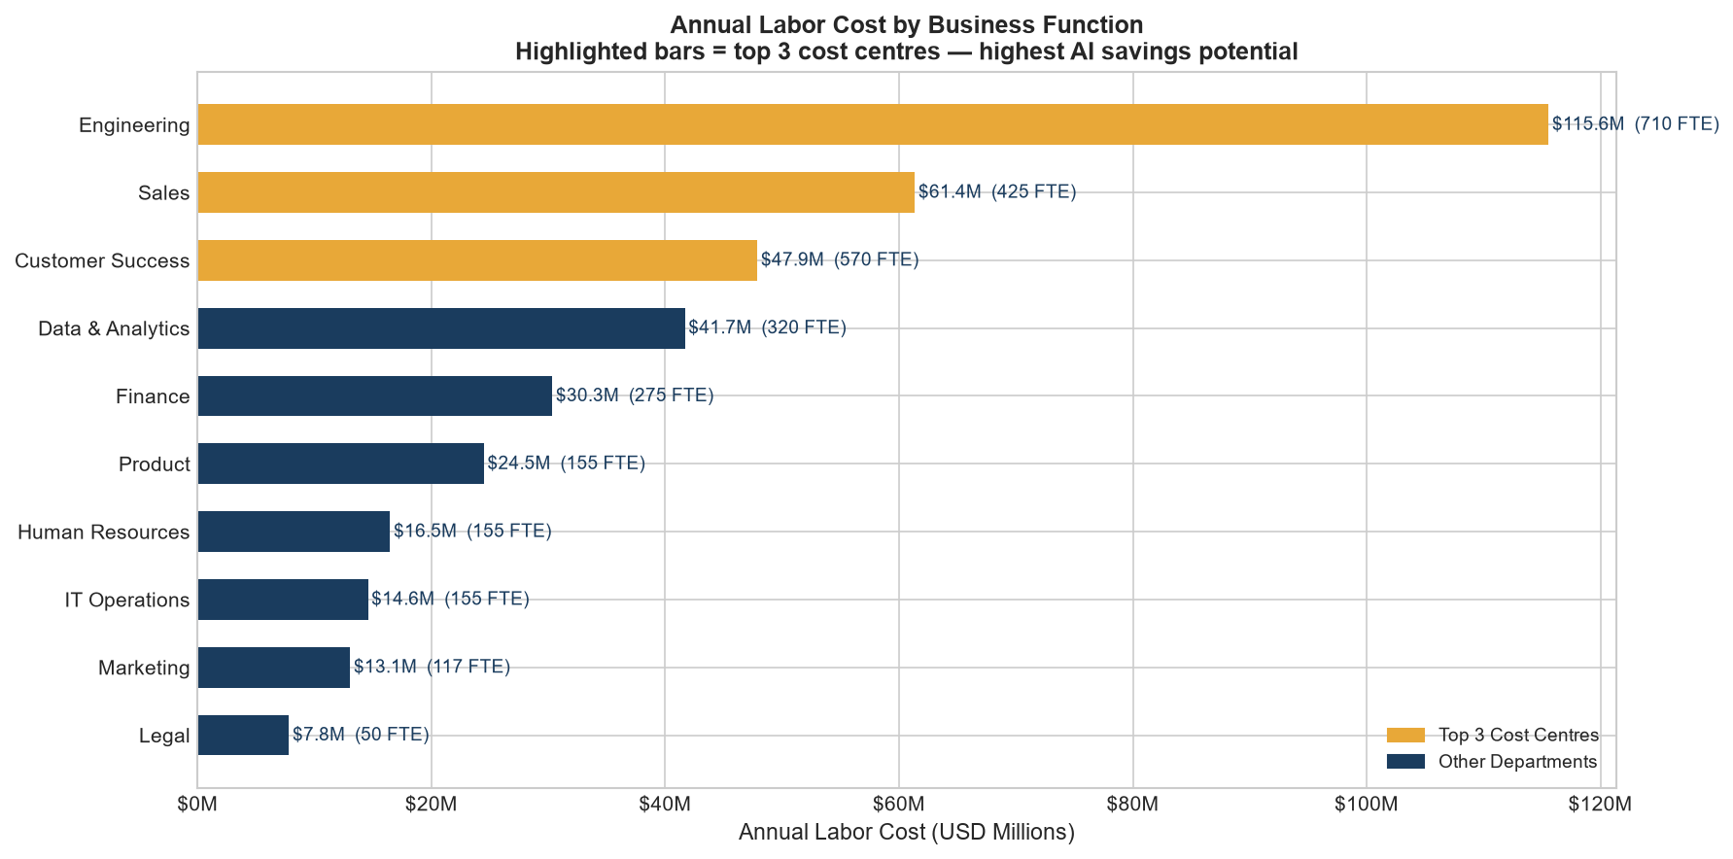
05 Workforce & Cost Analysis
2,932 FTEs · $373M annual labour cost · 10 business functions
2,932
$373M
$127K
$98M
26%
Total FTEs
Annual Labour Cost
Avg Loaded Cost/FTE
Automatable Cost Pool
of Labour Cost Automatable
Key Findings
Engineering
Largest cost pool — $112M 29% of total labour cost
Customer Success
Largest headcount — 312 FTEs High repetitive task ratio
Finance & Ops
High automation readiness Strong AI tooling available
Legal
Low automation suitability 0.92 decision intensity
Benefits Load
30% employer cost applied 48-week productive year
Sahil Saurav | GitHub: DATADUDE07 | AI Workforce Transformation Analytics
All data synthetic — illustrative only
7 / 13

Slide 8
06 SQL Analysis — 15 Business Queries
CTEs · Window Functions · CASE WHEN · UNION ALL · Subqueries · 3-table JOINs
Q1
Labor cost by department
Q9
Scenario savings comparison
GROUP BY, SUM, % share subquery
CTE + UNION ALL
Q2
Top 10 highest-cost roles
Q10
ROI ranking
ORDER BY, LIMIT
CTE + RANK() OVER
Q3
Salary by role level
Q11
Risk-opportunity matrix
GROUP BY, AVG, CASE WHEN ordering
CASE WHEN quadrant classification
Q4
Automation potential by function
Q12
Phase assignment
AVG, CASE WHEN tier labels
NTILE(3) OVER
Q5
Headcount concentration
Q13
Break-even analysis
Window: SUM() OVER()
Subquery filter on payback months
Q6
Automatable cost pool by dept
Q14
Auto vs augment split per domain
3-table JOIN, derived column
Conditional aggregation
Q7
Highest AI opportunity roles
Q15
Top 5 by 3-year NPV
Subquery, composite sort
CTE NPV formula + RANK() OVER
Q8
Productivity before/after AI
CASE WHEN, computed columns
Sahil Saurav | GitHub: DATADUDE07 | AI Workforce Transformation Analytics
All data synthetic — illustrative only
8 / 13

Slide 9
07 Scenario Analysis
Conservative · Moderate ★ · Aggressive — risk-adjusted adoption modelling
CONSERVATIVE
MODERATE ★ RECOMMENDED
AGGRESSIVE
Adoption Rate:
40%
Adoption Rate:
65%
Adoption Rate:
85%
Productivity Mult:
50%
Productivity Mult:
75%
Productivity Mult:
90%
Impl. Cost Mult:
1.20×
Impl. Cost Mult:
1.00×
Impl. Cost Mult:
0.90×
Rollout:
36 mo
Rollout:
24 mo
Rollout:
18 mo
Financial Outcomes
Financial Outcomes
Financial Outcomes
Net Annual Benefit:
$36M
Net Annual Benefit:
$61M
Net Annual Benefit:
$79M
Risk-Adj Benefit:
~$32M
Risk-Adj Benefit:
~$52M
Risk-Adj Benefit:
~$65M
Payback Period:
~24 mo
Payback Period:
~13 mo
Payback Period:
~10 mo
3-Year NPV:
~$79M
3-Year NPV:
~$146M
3-Year NPV:
~$183M
Low friction, board-approved minimum. Higher implementation costs, slower rollout.
Best risk-adjusted efficiency. Recommended scenario — balances speed and safety.
Maximum value capture, compressed timeline. Higher execution risk, change management stress.
Optimal Scenario Criterion: risk_adjusted_net_benefit = net_annual_benefit × (1 − quality_risk_materialisation) → Moderate maximises this ratio
Sahil Saurav | GitHub: DATADUDE07 | AI Workforce Transformation Analytics
All data synthetic — illustrative only
9 / 13

Slide 10
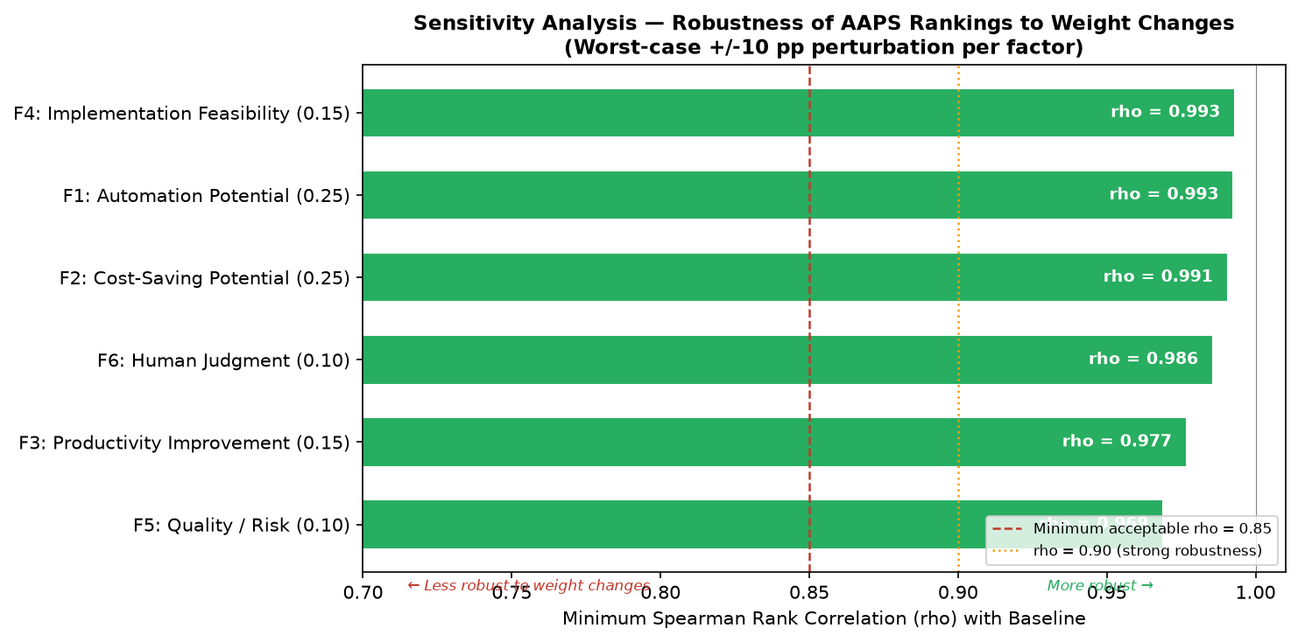
08 Sensitivity Analysis & Robustness
12 weight perturbations · Spearman rank correlation · Rankings confirmed robust
Minimum Spearman ρ across all 12 perturbations: 0.969
Rankings are robust — conclusions hold regardless of reasonable weight disagreements
Methodology
1. Baseline AAPS computed with weights:
F1=0.25, F2=0.25, F3=0.15, F4=0.15, F5=0.10, F6=0.10
2. Each weight shifted ±10 percentage points
while keeping other weights proportional
3. AAPS re-computed for all 29 roles under
each perturbation (12 total experiments)
4. Spearman rank correlation computed between
baseline ranking and each perturbed ranking
✅ Key insight: Increasing F2 (cost saving weight) by 10pp → ρ = 0.975 | Reducing F1 (automation weight) → ρ = 0.969 | Rankings never fall below ρ = 0.969
5. ρ ≥ 0.969 → rankings are stable
Sahil Saurav | GitHub: DATADUDE07 | AI Workforce Transformation Analytics
All data synthetic — illustrative only
10 / 13

Slide 11
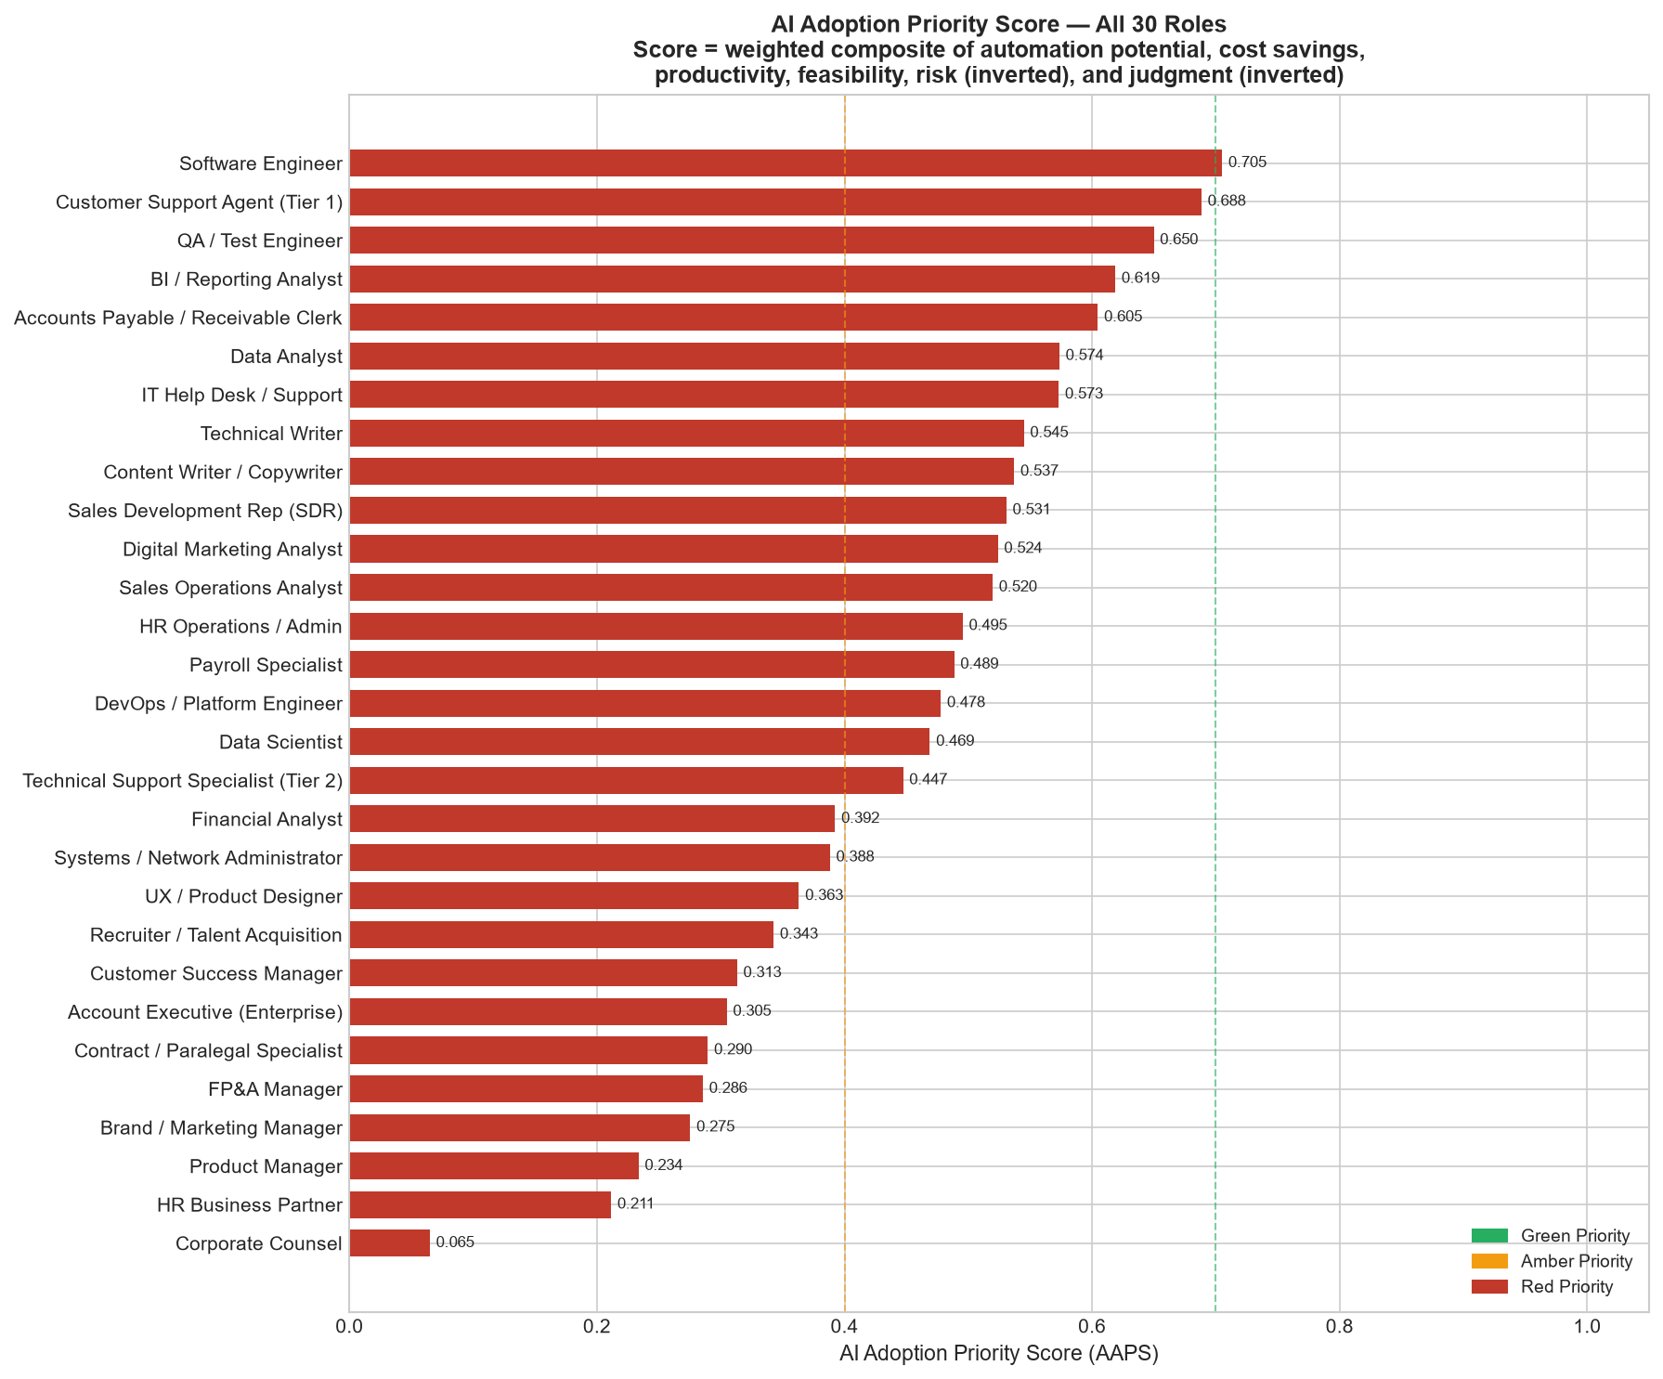
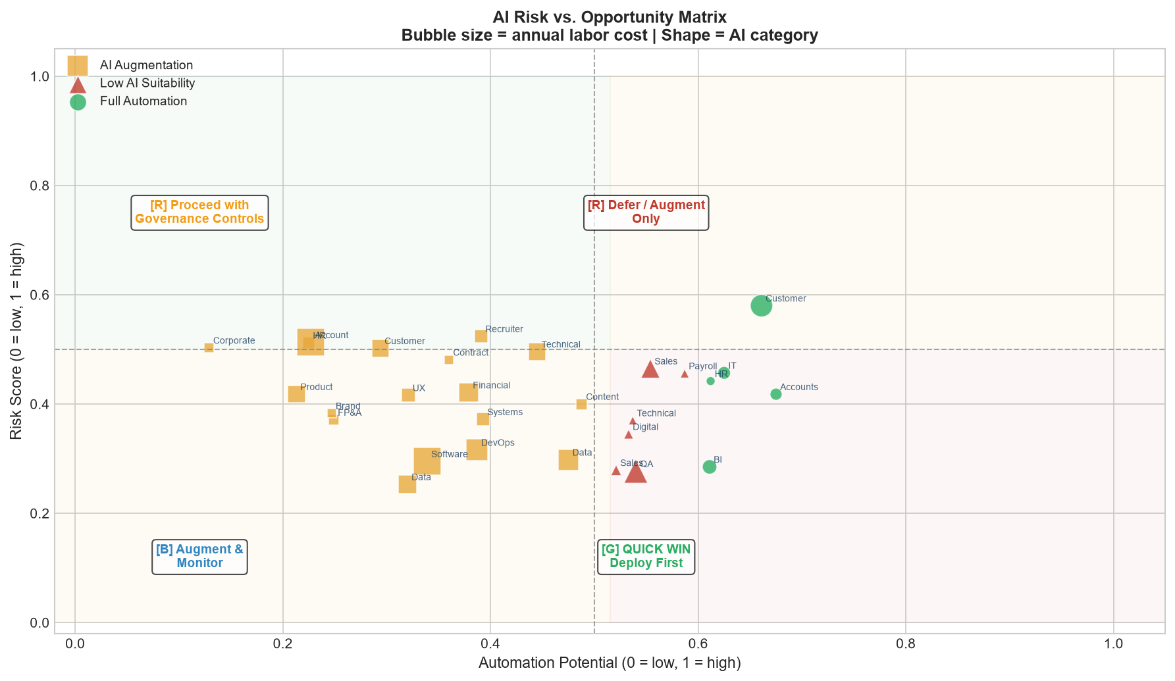
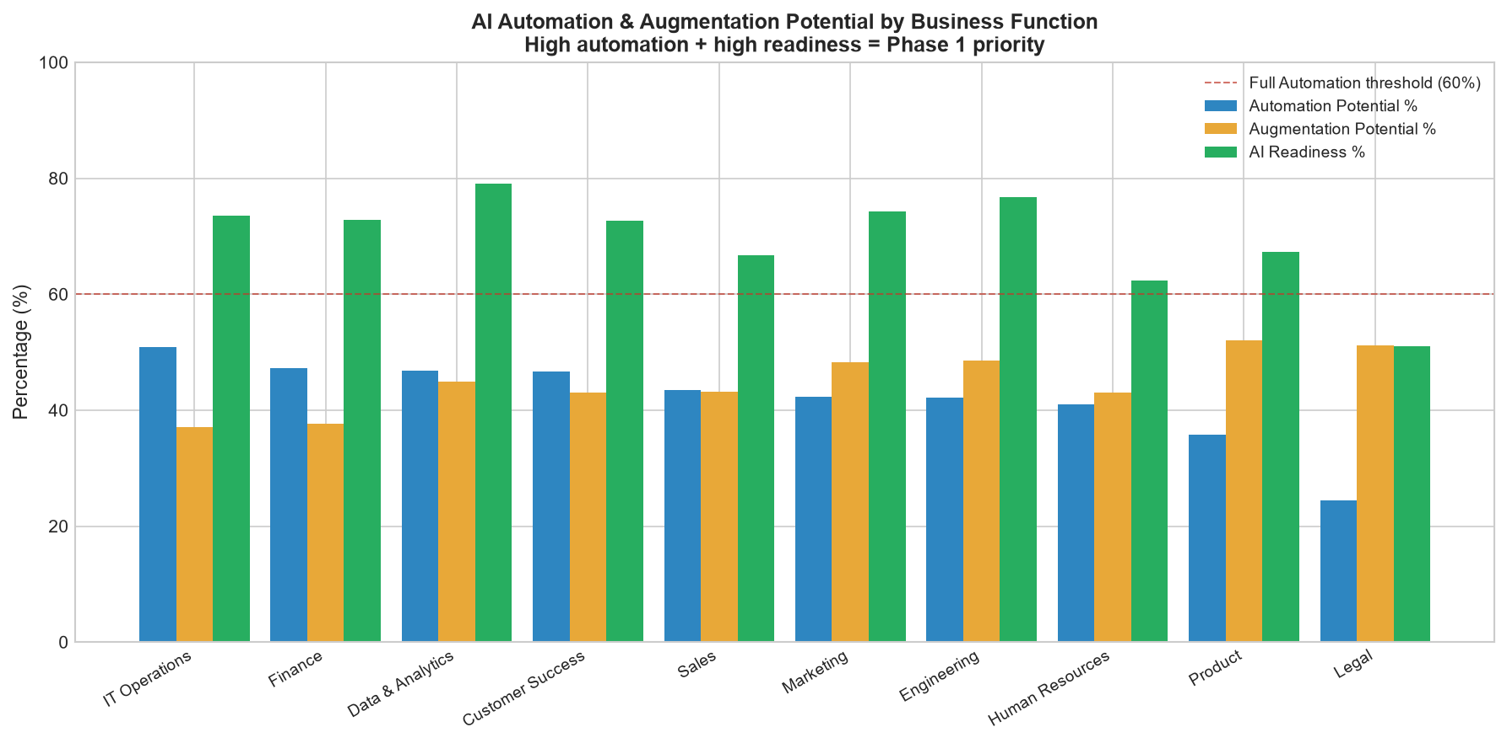
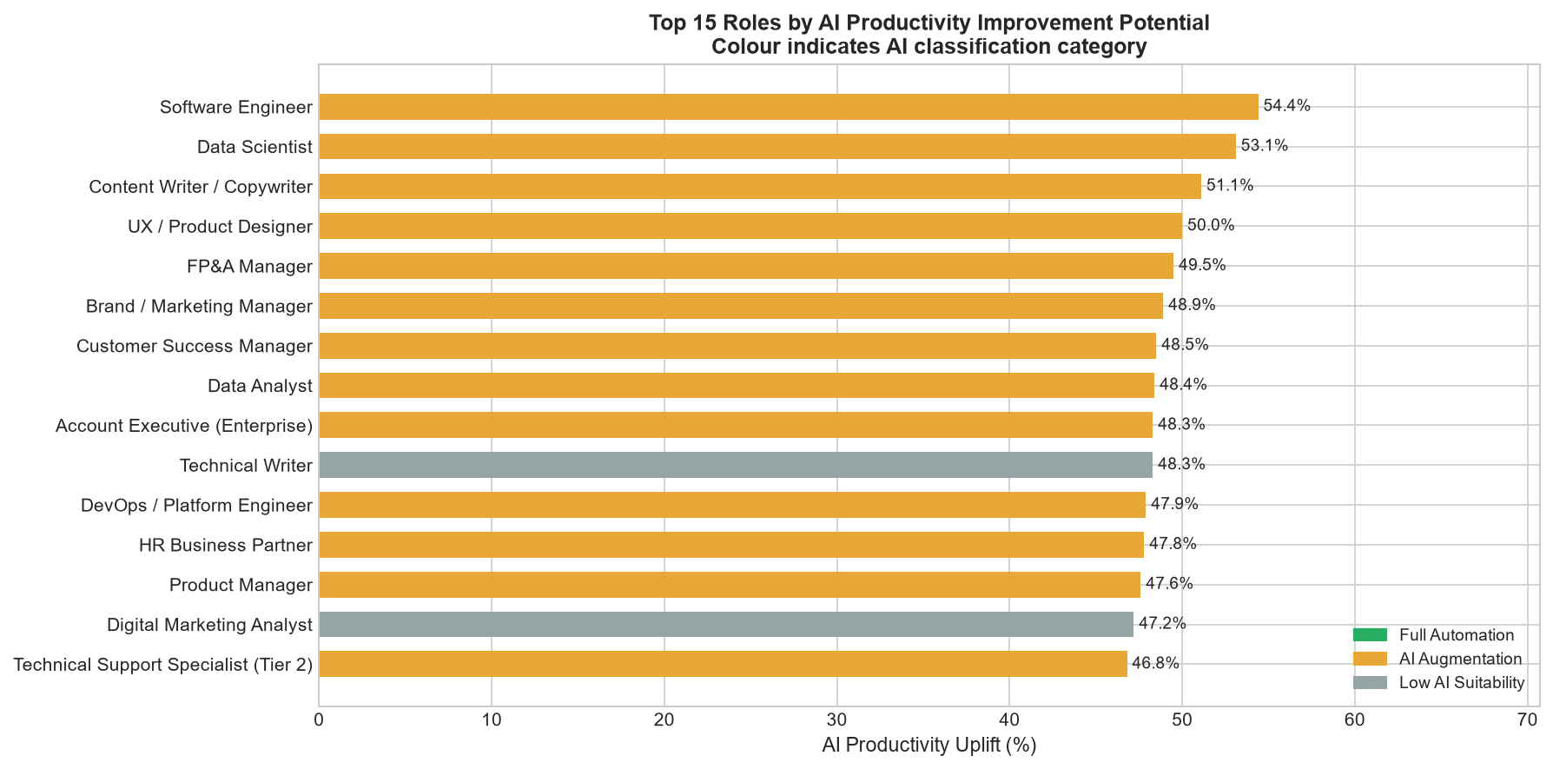
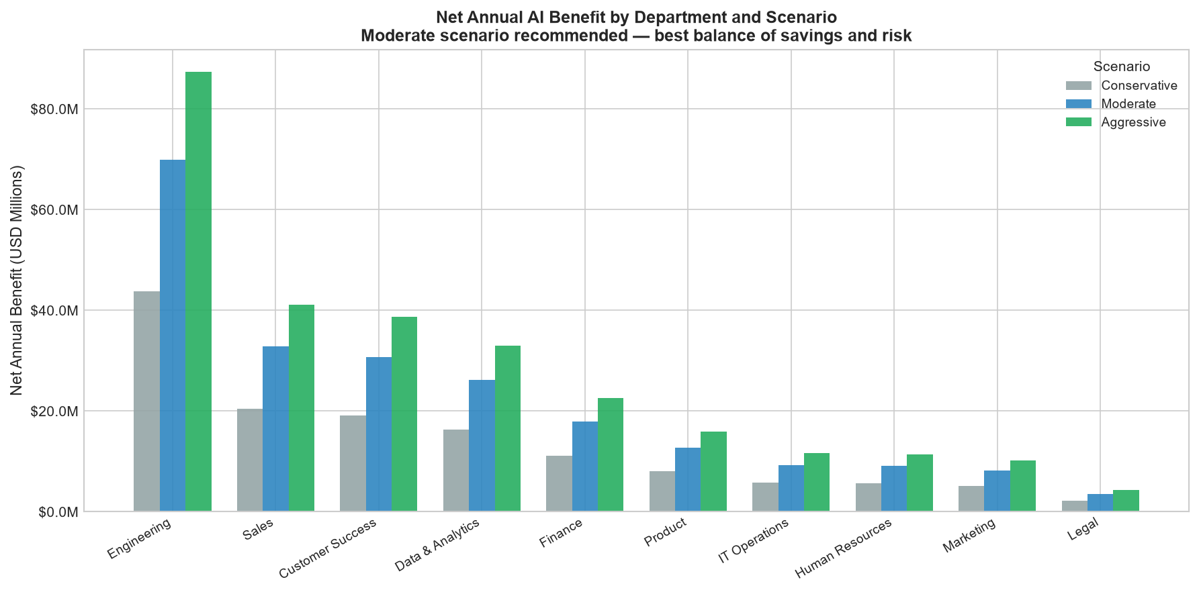
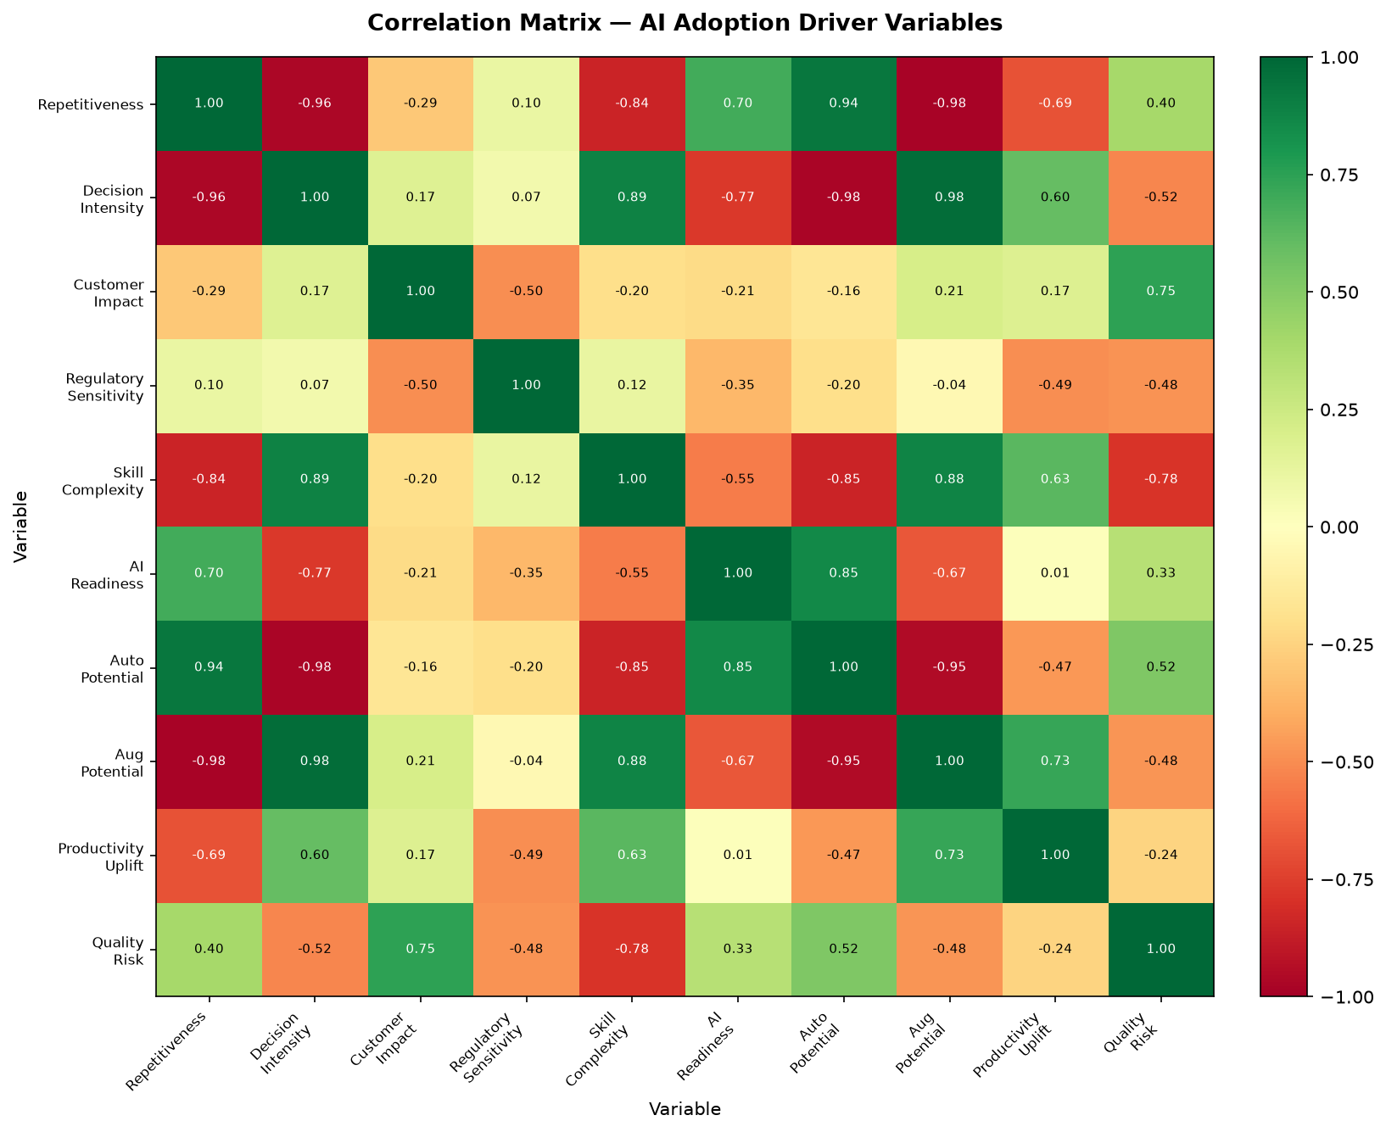
09 Key Visualisations
11 business-narrative charts — each answers a specific analytical question
AAPS Ranking — All 29 Roles (RAG colour coded)
Risk vs AI Opportunity (2×2 matrix quadrant)
Labor Cost by Dept
Automation Potential
Productivity by Role
Scenario Savings
EDA Heatmap
Sahil Saurav | GitHub: DATADUDE07 | AI Workforce Transformation Analytics
All data synthetic — illustrative only
11 / 13

Slide 12
10 Recommendations & Implementation Roadmap
3-phase rollout · 24-month moderate scenario · $61M net annual savings target
PHASE 1 Months 1–8
PHASE 2 Months 9–18
PHASE 3 Months 18–24
Customer Support Agent T1
QA / Test Engineer
Software Engineer
AAPS 0.688
72% repetitive · chatbot-ready
AAPS 0.650
62% repetitive · GitHub Copilot
AAPS 0.705
Copilot · code review · gen AI
AP / AR Clerk
BI & Data Analyst
Data Scientist
AAPS 0.702
88% repetitive · OCR + AI tools
AAPS 0.635
Augmentation + auto-insights
AAPS 0.597
AutoML · feature engineering
Reporting Analyst
Sales Dev Rep (SDR)
Technical Recruiter
AAPS 0.672
65% automatable · BI tools mature
AAPS 0.618
Email/outreach automation
AAPS 0.582
Screening · JD generation
Quick wins: High AAPS, low risk, mature AI tooling available today
Scale-up: AI augmentation focus, parallel change management programmes
Strategic: Highest cost pool, longer change management, governance required
Governance Flags:
Legal/Compliance roles marked Low AI Suitability (regulatory_sensitivity > 0.80) · Customer-facing roles require human-in-the-loop oversight · All Phase 1 roles confirmed: payback < 12 months, risk_score < 0.40
Sahil Saurav | GitHub: DATADUDE07 | AI Workforce Transformation Analytics
All data synthetic — illustrative only
12 / 13

Slide 13
11 Limitations, Risks & Next Steps
Analytical integrity: transparent assumptions, clearly bounded claims
⚠️ Analytical Limitations
🔴 Business Risks
Synthetic Data
Labour Displacement
All headcounts, salaries, potentials are illustrative. Real deployment requires actual HR data.
Legal, reputational & morale risk if workforce transition plan is absent.
Static Model
Quality Degradation
Point-in-time snapshot — AI capability evolves rapidly; some scores may shift within 2 years.
AI errors in regulated roles (Finance, Legal) can create liability.
Productivity Uplift
Cost Overruns
Based on MIT/Stanford/McKinsey benchmarks. Actual gains vary by implementation quality.
IT integration costs are hard to predict. Conservative scenario adds 20% buffer.
Fixed Discount Rate
Vendor Lock-in
NPV uses 10% hurdle rate. Companies with higher WACC will see lower NPVs.
AI tooling costs may escalate; ongoing cost assumptions may be understated.
No Change Mgmt Cost
Regulatory Risk
Change management modelled as a complexity factor only, not as direct cost.
EU AI Act and sector-specific rules may restrict automation in compliance roles.
Real Data Needed to Operationalise:
Actual HR headcount & salary bands · Time-motion studies per role · Historical error rates · Vendor quotes for AI tooling · Change management readiness assessments · Regulatory compliance review
→ Contact for full methodology handoff
Sahil Saurav | GitHub: DATADUDE07 | AI Workforce Transformation Analytics
All data synthetic — illustrative only
13 / 13

Slide 14
Thank You
PRESENTED BY
AI Workforce Transformation: Decision Analytics Portfolio
Sahil Saurav
GitHub: DATADUDE07
29
145
$61M
~94%
ρ=0.969
Decision Analytics Portfolio
Roles Scored
Tasks Analysed
Savings Target
Year-1 ROI
Rank Robustness
Key Resume Bullets:
• End-to-end Decision Analytics pipeline: 29 roles · 145 tasks · $373M labour cost
• AAPS: 6-factor weighted score, Spearman ρ ≥ 0.969 across 12 sensitivity tests
• $61M net annual savings, 13-month payback, $146M 3-year NPV (moderate scenario)
• 15 SQL queries (CTEs, window functions) + 8-sheet RAG-formatted Excel workbook
Sahil Saurav | GitHub: DATADUDE07 | AI Workforce Transformation Analytics
All data synthetic — illustrative only
13 / 13

