Slide 1
Customer Shopping Behavior Analysis
An end-to-end analytics project: Python (pandas) → SQL Server → Power BI. Objective: uncover spending patterns, segments, preferences, and subscription behavior from 3,900 transactions to guide strategy.

Slide 2

Project Snapshot
Dataset
Stack
3,900 transactions · 18 columns · 37 nulls in review_rating
Python (pandas) · SQL Server (SSMS) via SQLAlchemy+pyodbc · Power BI
Goal
Identify patterns to inform subscriptions, loyalty, discounts, and product positioning

Slide 3
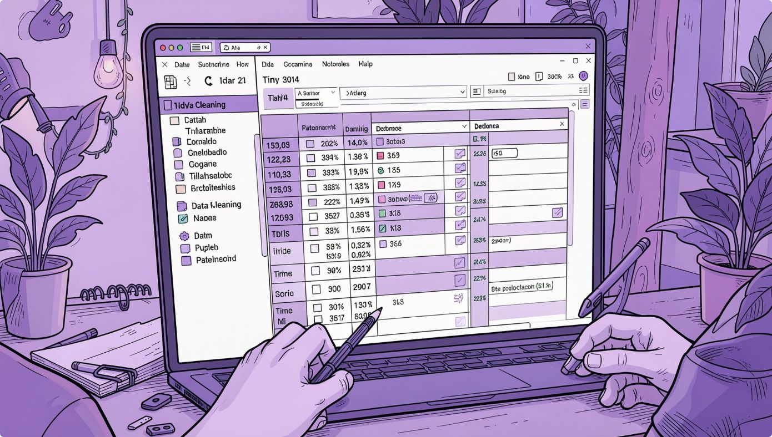
Data Preparation Highlights
Missing Data
37 nulls in review_rating — imputed with category median to preserve patterns.
Column Standardization
Renamed to snake_case (e.g., purchase_amount) for SQL compatibility.
Feature Engineering
age_group via quartile bins; purchase_frequency_days mapped from text cadence.
Redundancy Removed
promo_code_used dropped after confirming it duplicated discount_applied.

Slide 4

Database Integration
Cleaned DataFrame loaded into local SQL Server (customer_behavior database) using SQLAlchemy + pyodbc for structured analysis and reporting.
from sqlalchemy import create_engine from urllib.parse import quote_plus server = r"SAHIL-PC\SQLEXPRESS" database = "customer_behavior" driver = quote_plus("ODBC Driver 17 for SQL Server") engine = create_engine( f"mssql+pyodbc://@{server}/{database}" f"?driver={driver}&trusted_connection=yes" ) df.to_sql("customer", engine, if_exists="replace", index=False)

Slide 5
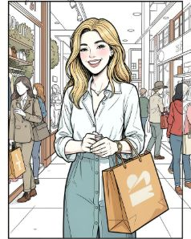
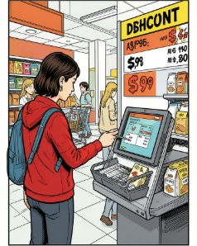
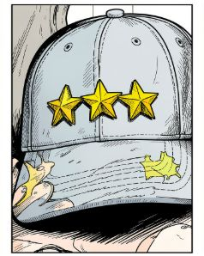
Key Business Questions & Findings (1/2)
Q1: Gender Revenue
Q2: Discount & High Spend
Q3: Top Rated Items
Female: $75,191 · Male: $157,890
839 customers used discounts yet spent ≥ average — valuable target for promotions.
Top 5 avg ratings: Gloves (3.86), Sandals (3.84), Boots (3.82), Hat (3.80), Skirt (3.78)

Slide 6
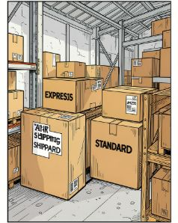
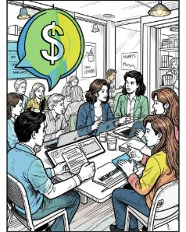
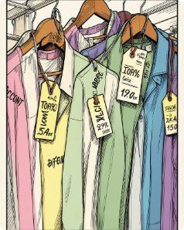
Key Business Questions & Findings (2/2)
Q4: Shipping & Spend
Q5: Subscription Impact
Q6: Discount Rates by Item
Avg purchase: Standard $58.46 · Express $60.48 — Express users spend slightly more.
Subscribers: 1,053 (avg $59.49, total $62,645). Non-subscribers: 2,847 (avg $59.87, total $170,436). Average spend nearly identical.
Top items discounted most: Hat 50.00%, Sneakers 49.66%, Coat 49.07%, Sweater 48.17%, Pants 47.37%

Slide 7
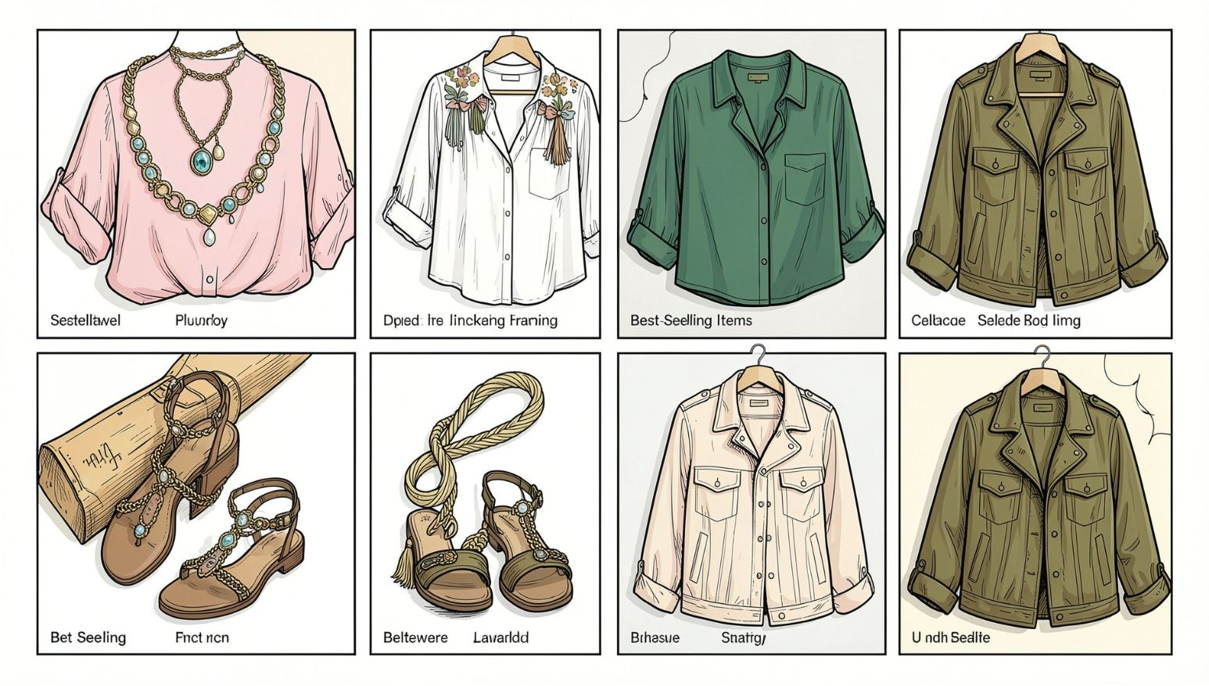
Segmentation & Top Sellers
Top Products by Category (Top 3)
Accessories: Jewelry, Sunglasses, Belt · Clothing: Blouse, Pants, Shirt · Footwear: Sandals, Shoes, Sneakers · Outerwear: Jacket, Coat
Customer Segments
Repeat Buyers & Subscriptions
Loyal: 3,116 · Returning: 701 · New: 83 — Loyal customers represent ~80% of base.
Repeat buyers (>5 previous) — Not Subscribed: 2,518; Subscribed: 958 — many loyal customers are not subscribers.

Slide 8
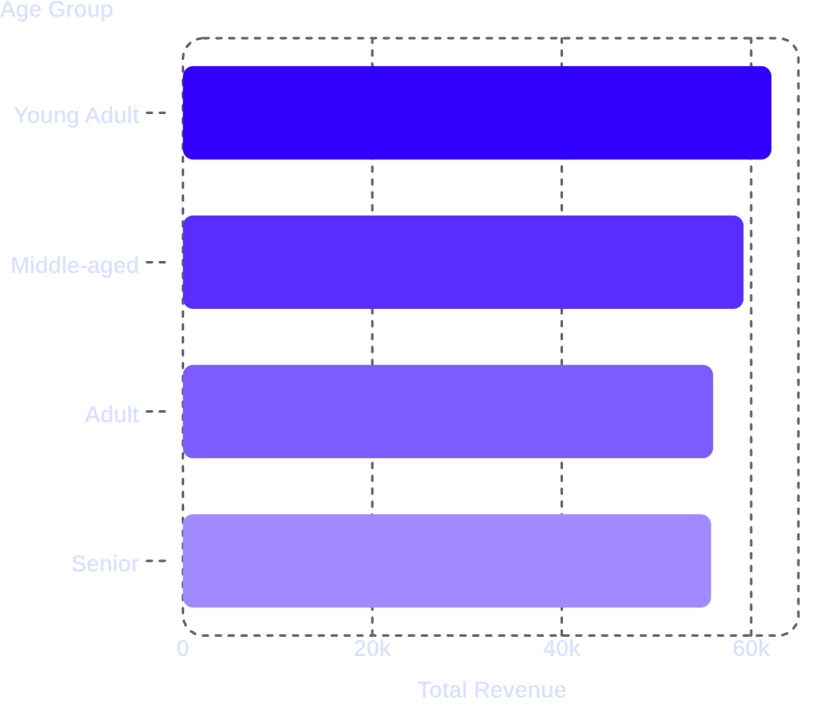
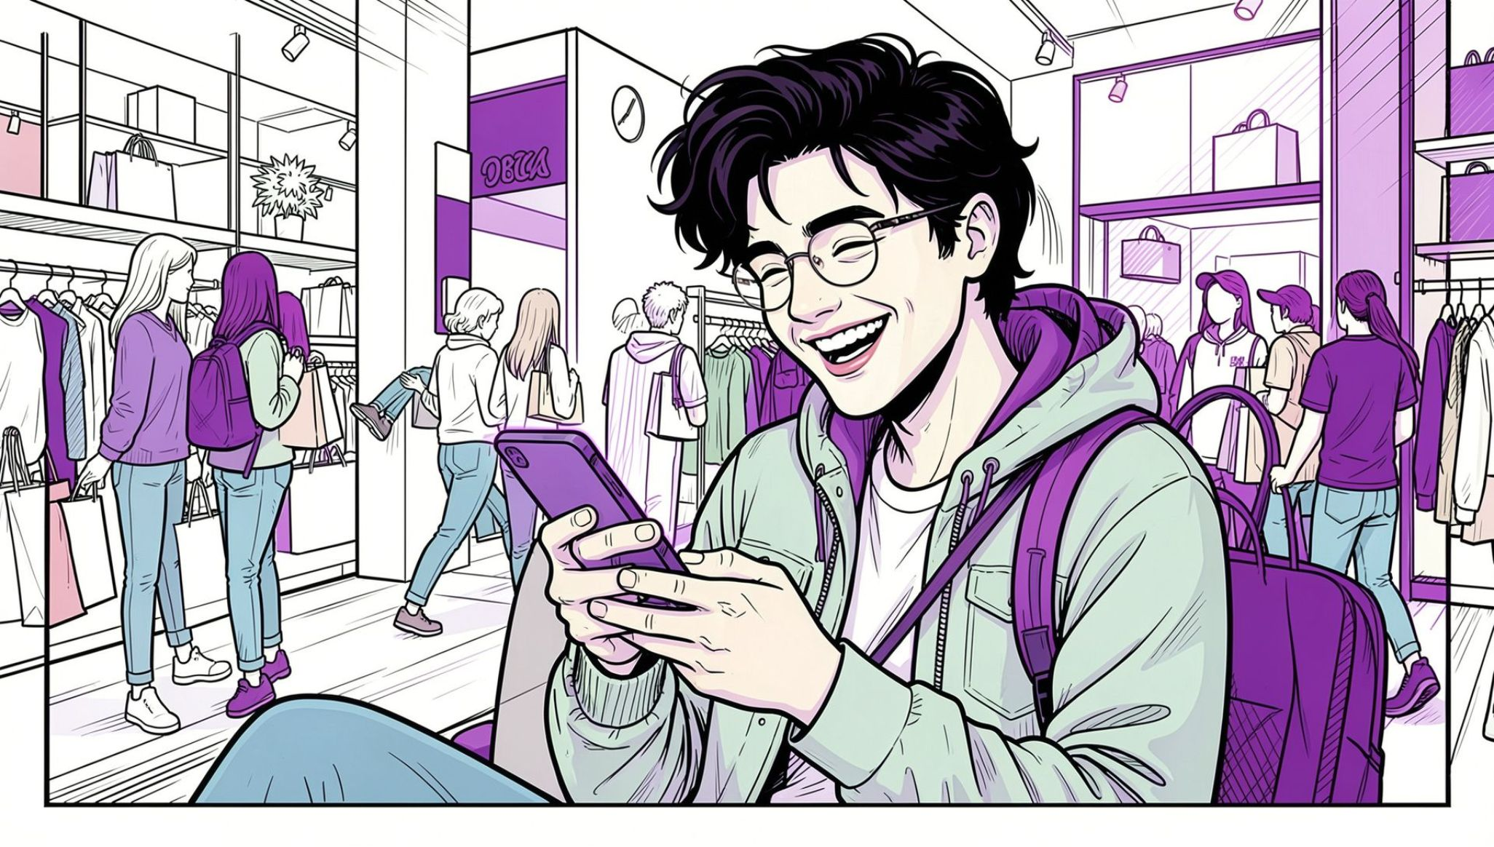
Revenue by Age Group
Revenue distribution is fairly even across age groups; Young Adults lead slightly. Use age-targeted campaigns to nudge preference and conversions.

Slide 9
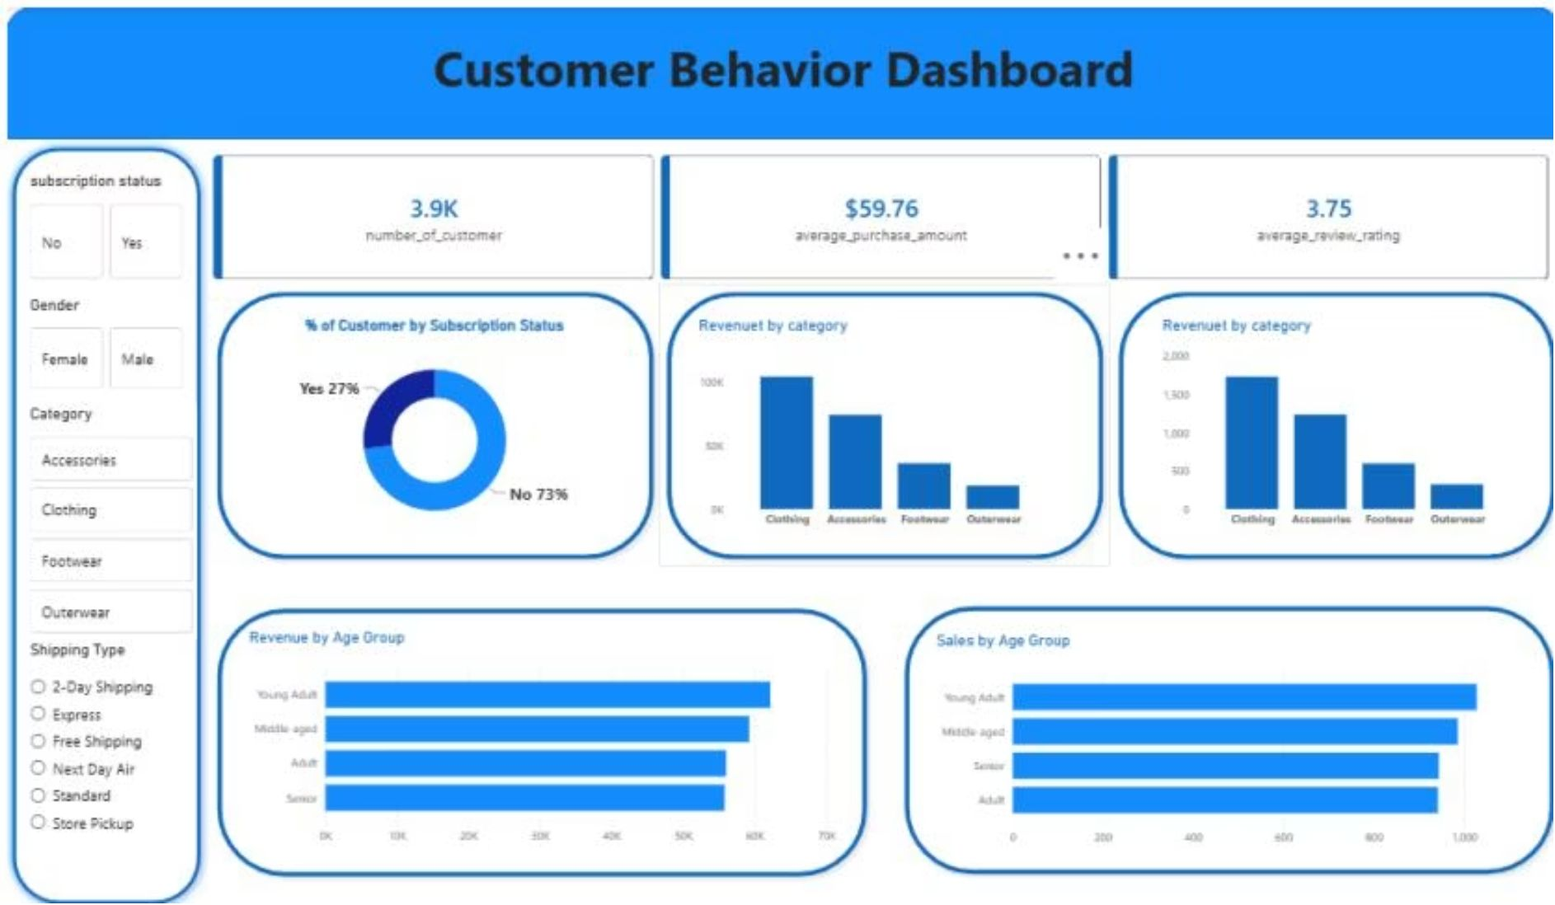
Power BI Dashboard & KPIs
KPI Cards
3.9K
$59.76
3.75
Customers
Avg Purchase
Avg Rating
Interactive slicers: subscription status, gender, category, shipping type. Visuals: donut (27% subscribed), revenue & sales by category and age.

Slide 10
Recommendations & Conclusion
Boost Subscriptions
Strengthen Loyalty Programs
Promote exclusive benefits — only 27% subscribed; subscribers and non-subscribers spend similarly.
Reward repeat buyers to convert Returning → Loyal and retain the 3,116 loyal customers.
Review Discount Strategy
Product & Targeting
Rebalance margin vs. sales — hats and sneakers see discounts in ~50% of purchases.
Highlight top-rated (Gloves, Sandals, Boots) and top-sellers in campaigns; target Young Adults and Express-shipping users.
Complete workflow from Python cleaning → SQL analysis → Power BI dashboard delivered actionable insights to inform subscription growth, loyalty, discounting, and product positioning.

