Slide 1
AI – TOOLS
&
EFFECTIVE PROMPT PRACTICES

Slide 2
Prompt comparision
GPT/Gemini/Claude
Explain climate change
Analyze
Which answer is easiest to understand?
Which gives the best structure?
Which uses examples?
Which answer is too long?

Slide 3
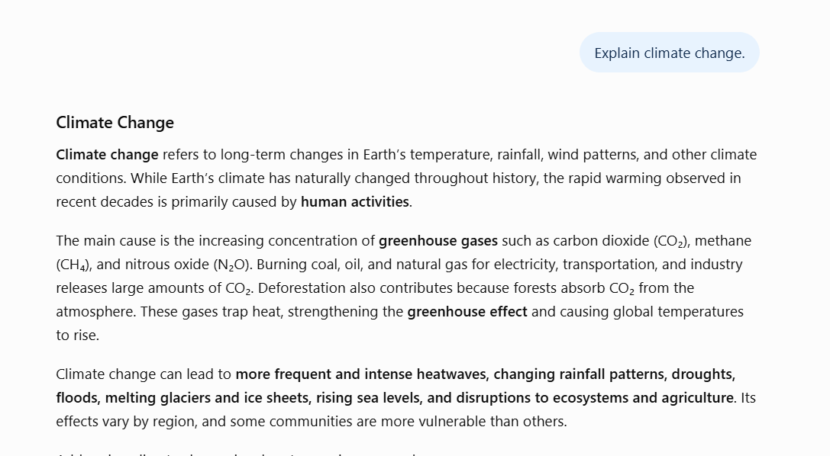
gpt

Slide 4
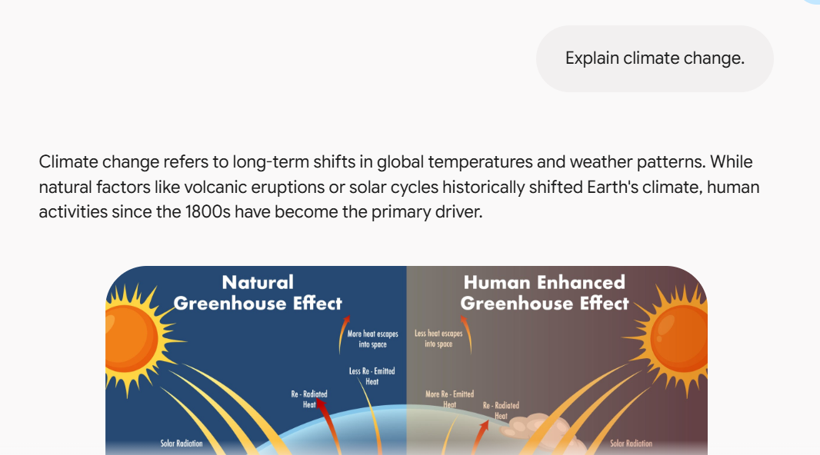
gemini

Slide 5
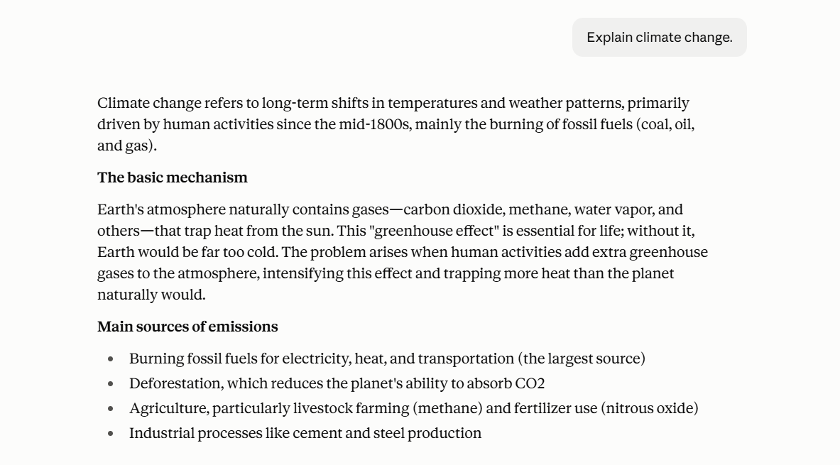
claude

Slide 6
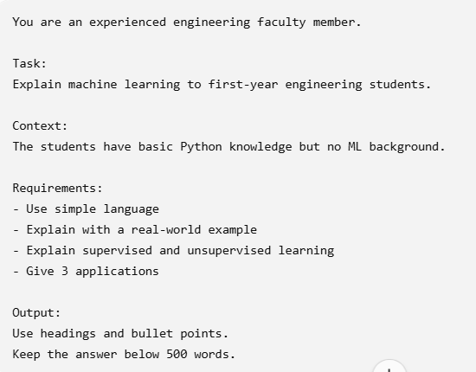
Prompt Anatomy
Role + Task + Context + Constraints + Output Format + Examples

Slide 7
what is NotebookLM?
NotebookLM is Google's AI research and learning assistant.
Instead of asking an AI to answer only from its general knowledge, you can provide your own sources—such as PDFs, documents, websites, slides, or other supported materials—and ask questions about those sources.

Slide 8
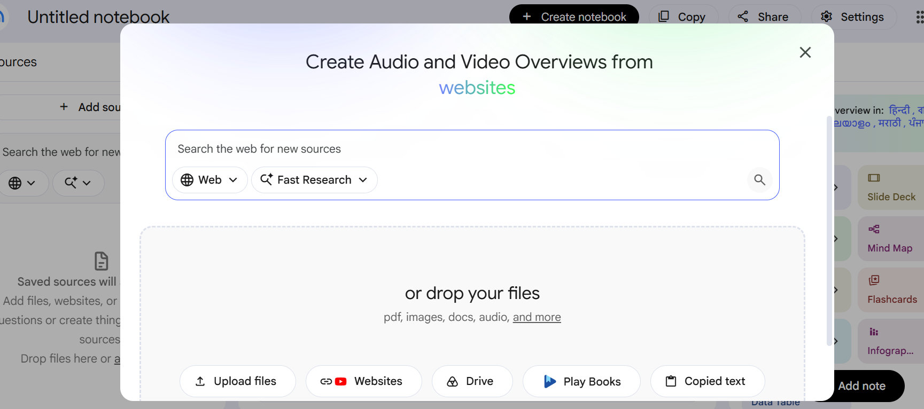
Note Book LM - google

Slide 9
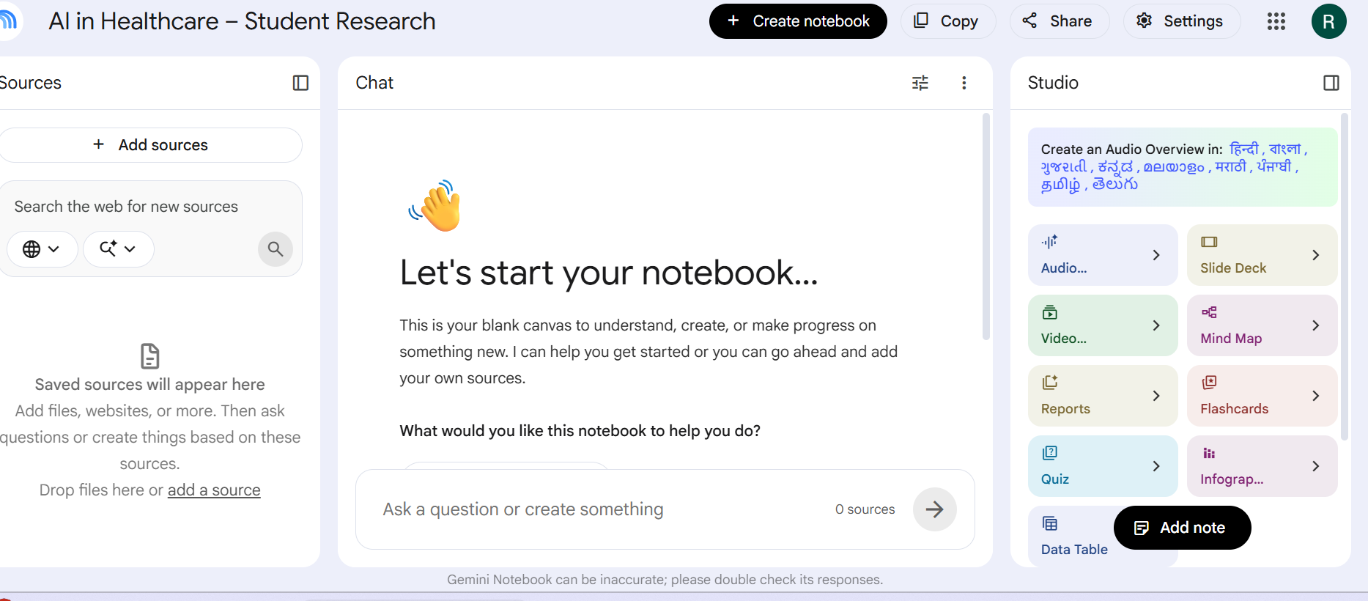

Slide 10
Add your sources.
For example:
Health care documents

Slide 11
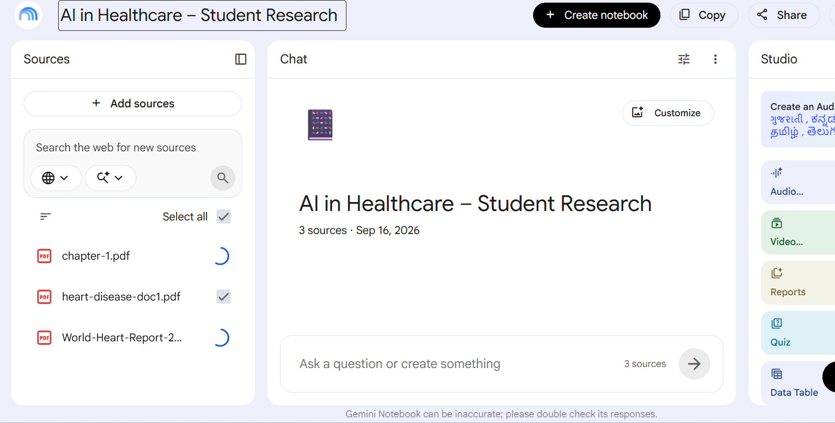

Slide 12
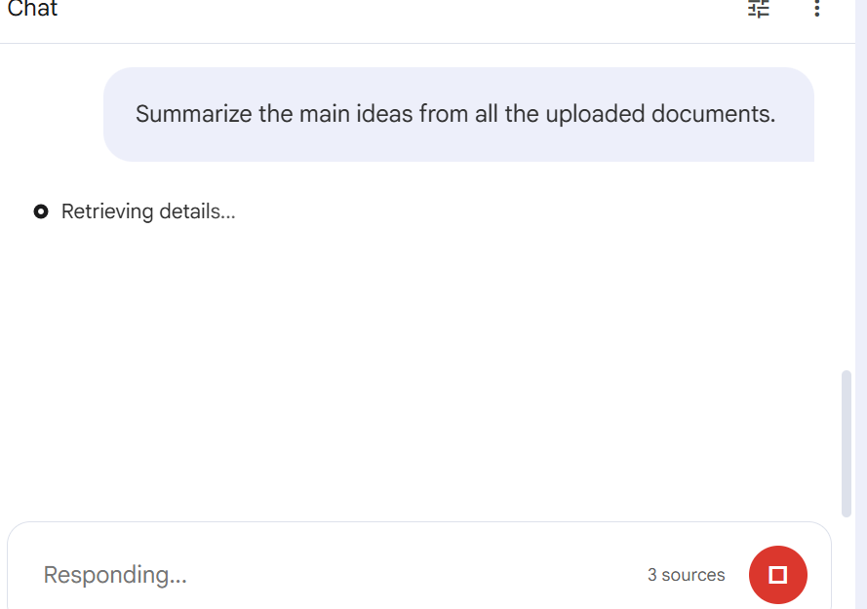

Slide 13
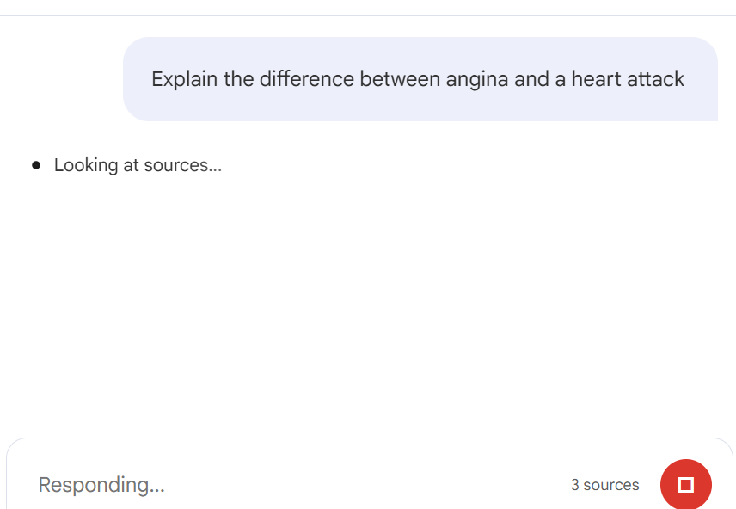

Slide 14
Ask different questions
Teach me this document as if I am a beginner.
Explain each major concept using a simple real-world example.
Create 20 multiple-choice questions from this document.
Include four options and the correct answer.

Slide 15
Create a study guide from the uploaded material.
Include:
1. Important definitions
2. Key concepts
3. Important formulas
4. Real-world examples
5. Common mistakes
6. Frequently asked questions
7. Examination questions
8. Quick revision points

Slide 16
Feature | What it does | Best use
Slide Deck | Converts your source material into a presentation | Teaching / seminars
Mind Map | Visually organizes concepts and relationships | Understanding a topic
Video Overview | Creates a video-style explanation from your sources | Visual learning
Quiz | Generates questions to test understanding | Practice / assessment
Infographic | Converts information into a visual summary | Posters / quick learning
Flashcards | Creates question–answer cards for revision | Exam preparation

Slide 17
https://app.notion.com/ai
https://app.notion.com/ai

Slide 18
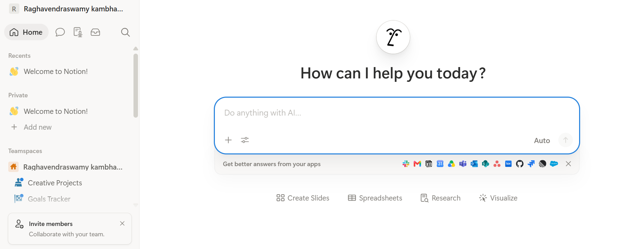

Slide 19
Start a draft:
Create a AI Learning Hub for beginners.
Include the following sections:
1. What is Artificial Intelligence?
2. What is Generative AI?
3. What are Large Language Models?
4. ChatGPT 5. Claude
6. Gemini
7. Prompt Engineering
For each topic provide: -
Simple explanation –
Real-world example
Make the content suitable for first-year engineering students.

Slide 20
Meeting Notes creation using AI command
Prepare content calendar
Explore notion ai different fetures

Slide 21
https://gamma.app/
https://gamma.app/

Slide 22
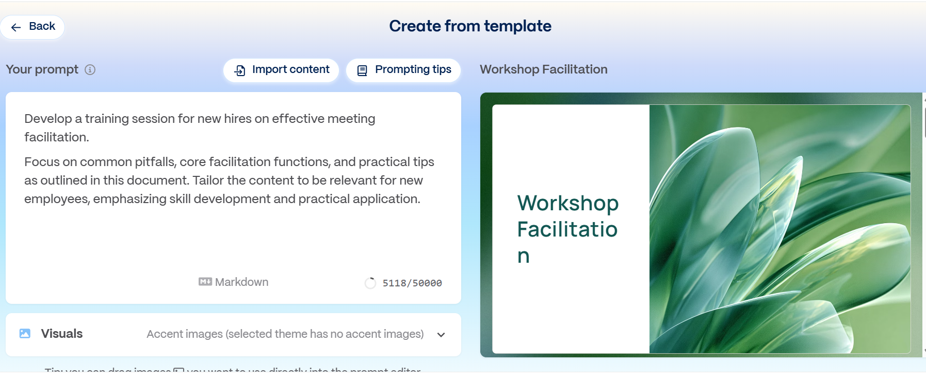

Slide 23
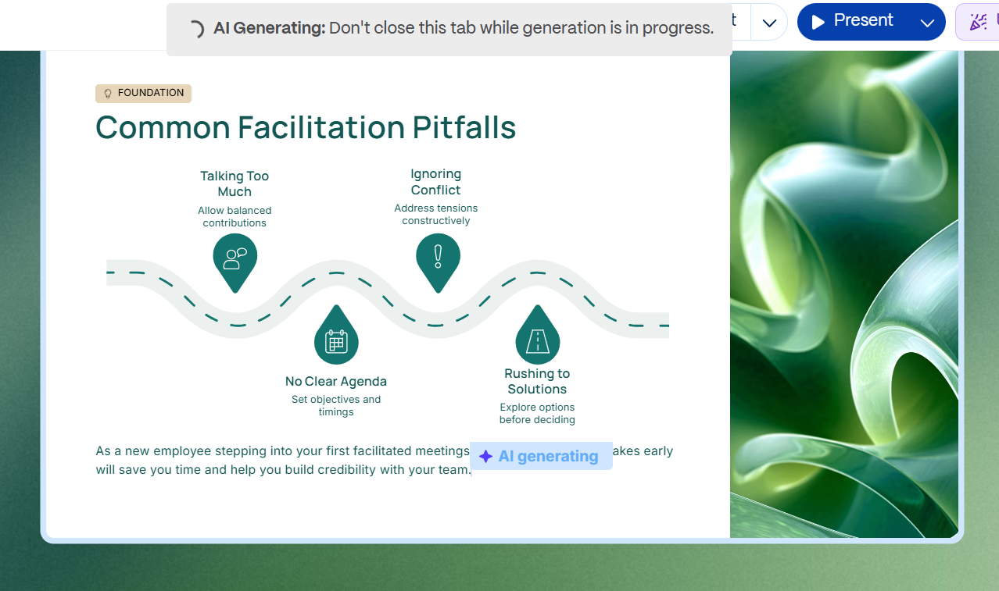

Slide 24
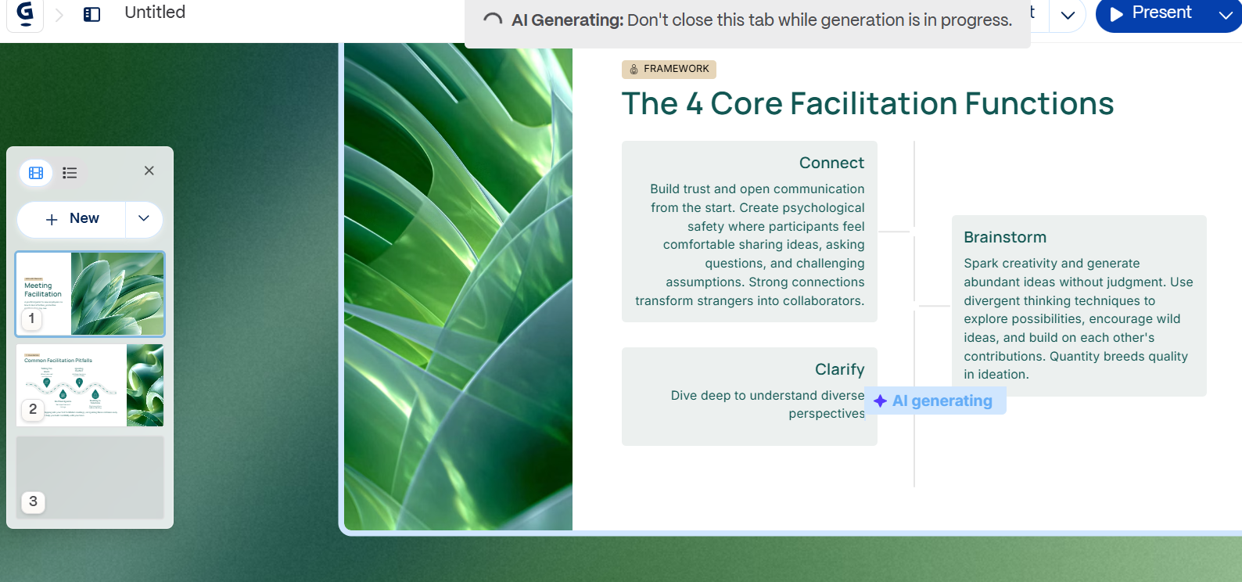

Slide 25
https://www.napkin.ai/
https://www.napkin.ai/

Slide 26
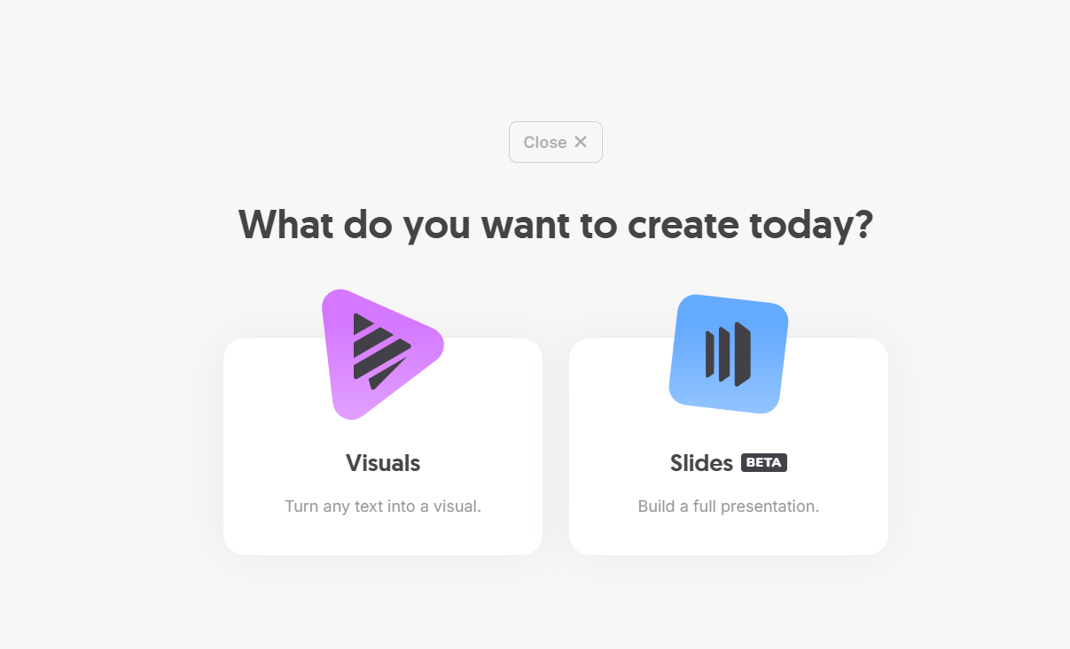

Slide 27
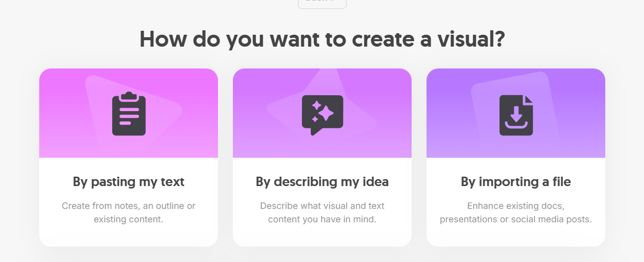

Slide 28
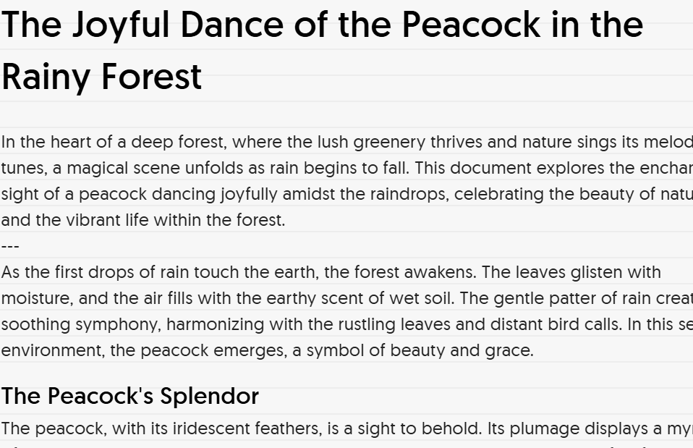
Describing idea

Slide 29
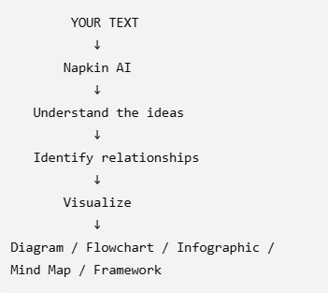

Slide 30
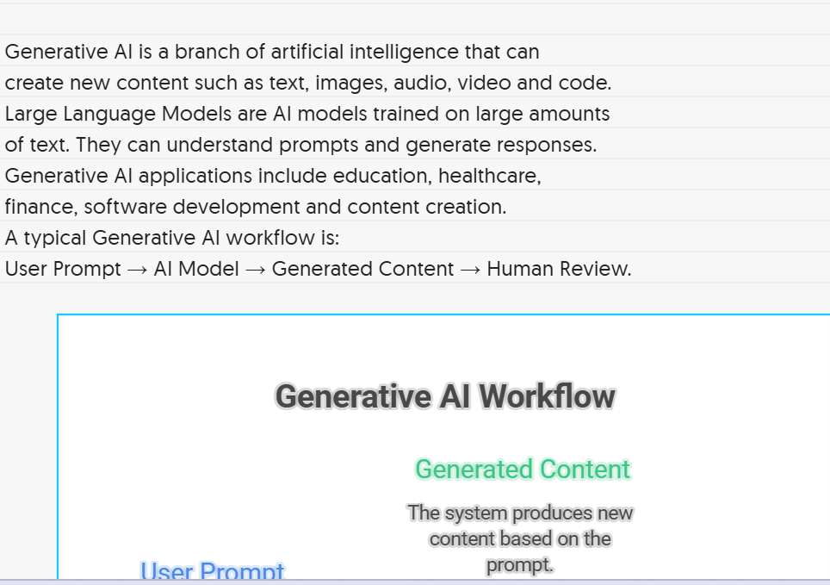

Slide 31
Give to your napkin create images
Modern AI learning requires more than prompt engineering. Students should develop AI fundamentals, prompt engineering, critical thinking, data literacy, Python programming, API knowledge, RAG, AI agents, tool usage and responsible AI skills. They should also learn how to verify AI outputs and build real-world applications.

Slide 32
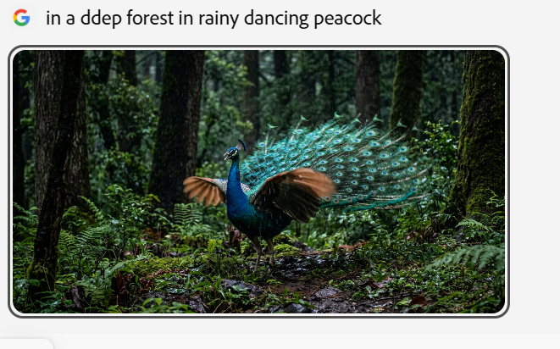
Adobe firefly create images

Slide 33
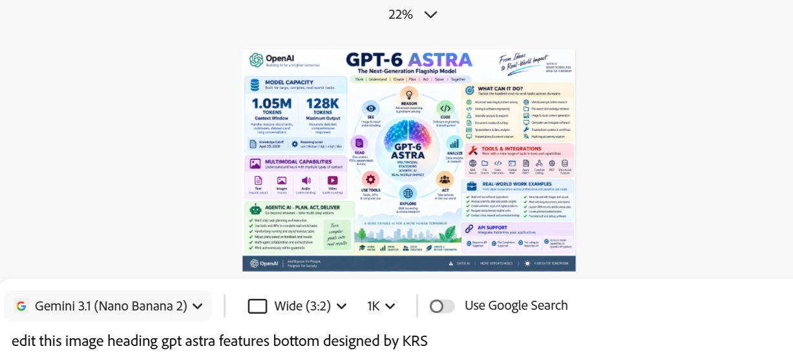
Edit images-adobe firefly

Slide 34
https://elevenlabs.io/app/home
https://elevenlabs.io/app/home

Slide 35
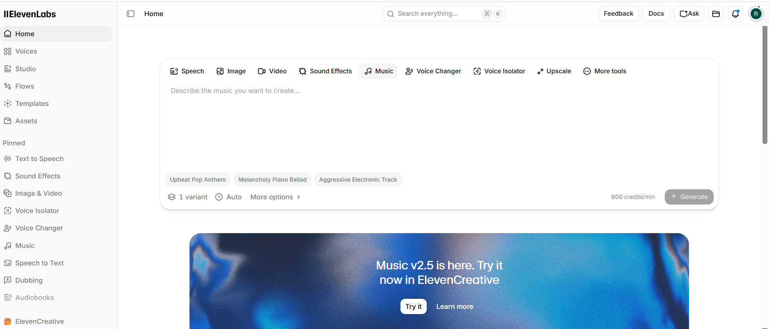

Slide 36
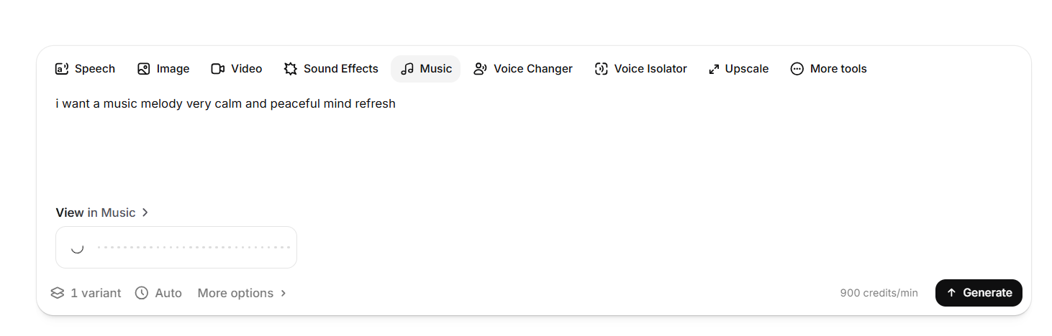

Slide 37
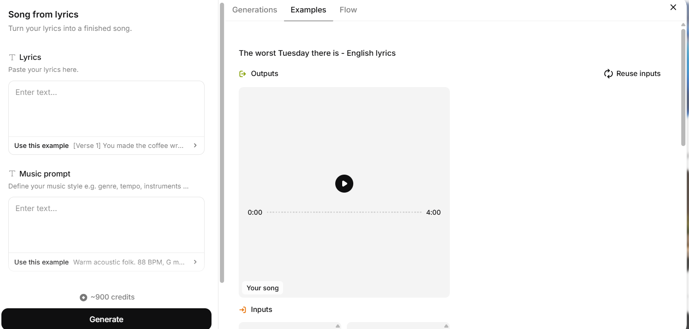

Slide 38
Rai rai raa raa
Rai rai raa raa
Adde leni daanai raa raa
Rai rai raa raa
Rai rai raa raa
Adde leni dheenay raa raa

Slide 39
High-energy Telugu folk-cinematic song with a powerful male lead
vocal and energetic group chants. Fast tempo around 125–135 BPM.
Prominent dappu, thappeta, hand percussion and deep bass drums,
with nadaswaram phrases between vocal sections. Start with a
short percussion intro, build into a catchy chorus, add call-and-
response vocals, then progressively increase the percussion and
energy toward a dramatic climax. Raw village-folk character
combined with modern cinematic production. Festive, energetic,
mass-celebration mood.

Slide 40
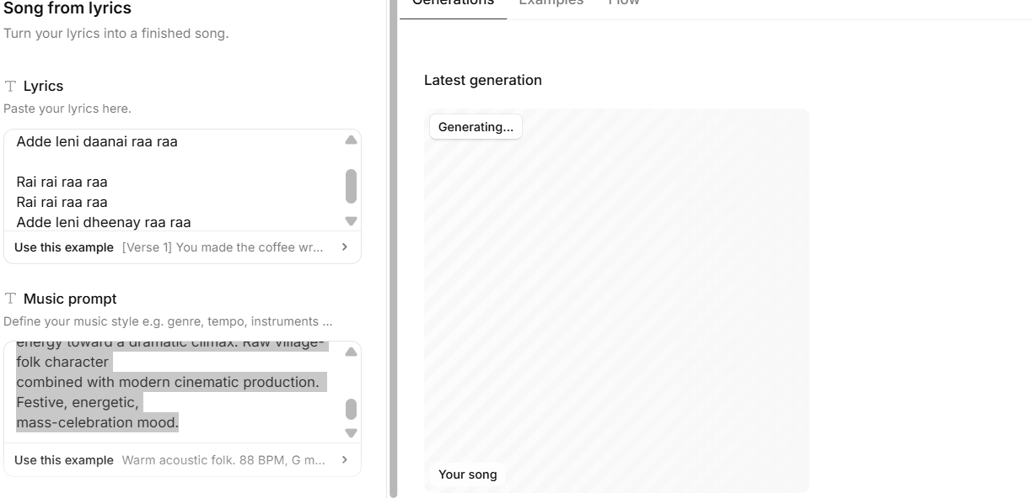

Slide 41
Voice over script
“Artificial Intelligence is changing the way we learn, work, and create. Today, students can use AI to understand difficult concepts, analyze information, write code, create presentations, and build innovative applications. But AI learning is not just about writing prompts. It is about asking the right questions, analyzing the answers, verifying information, and using AI responsibly. The future belongs to those who learn how to work with AI

Slide 42
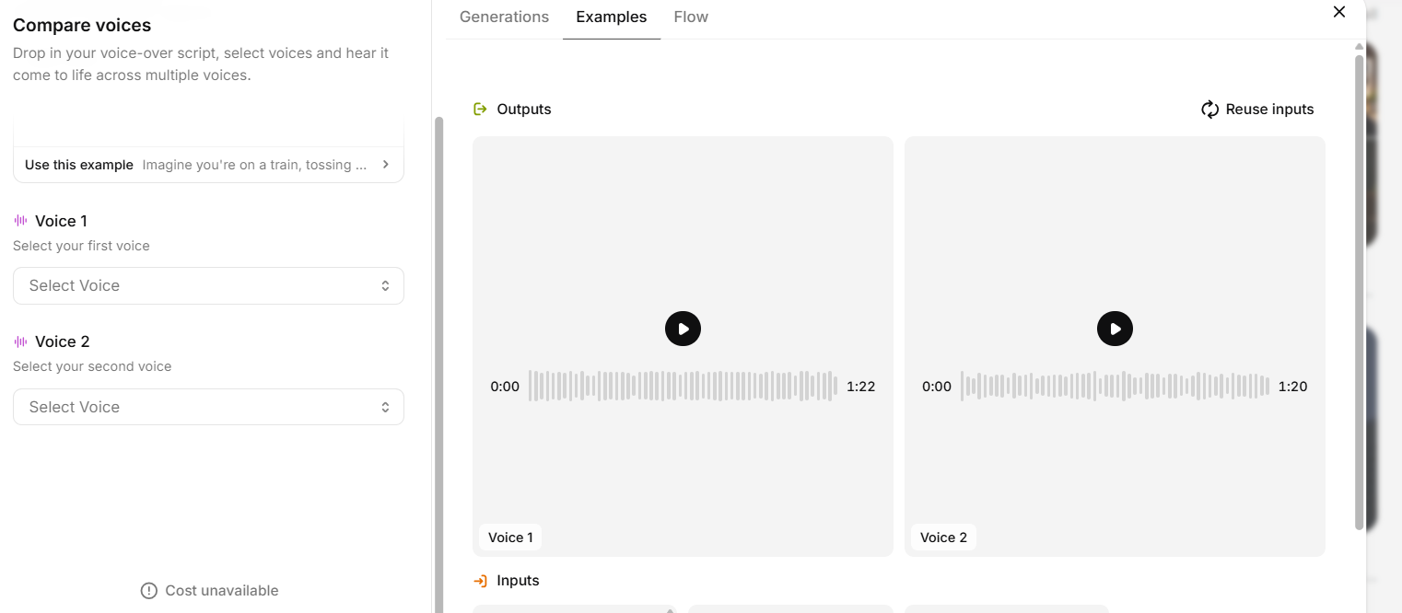
Compare voices

Slide 43
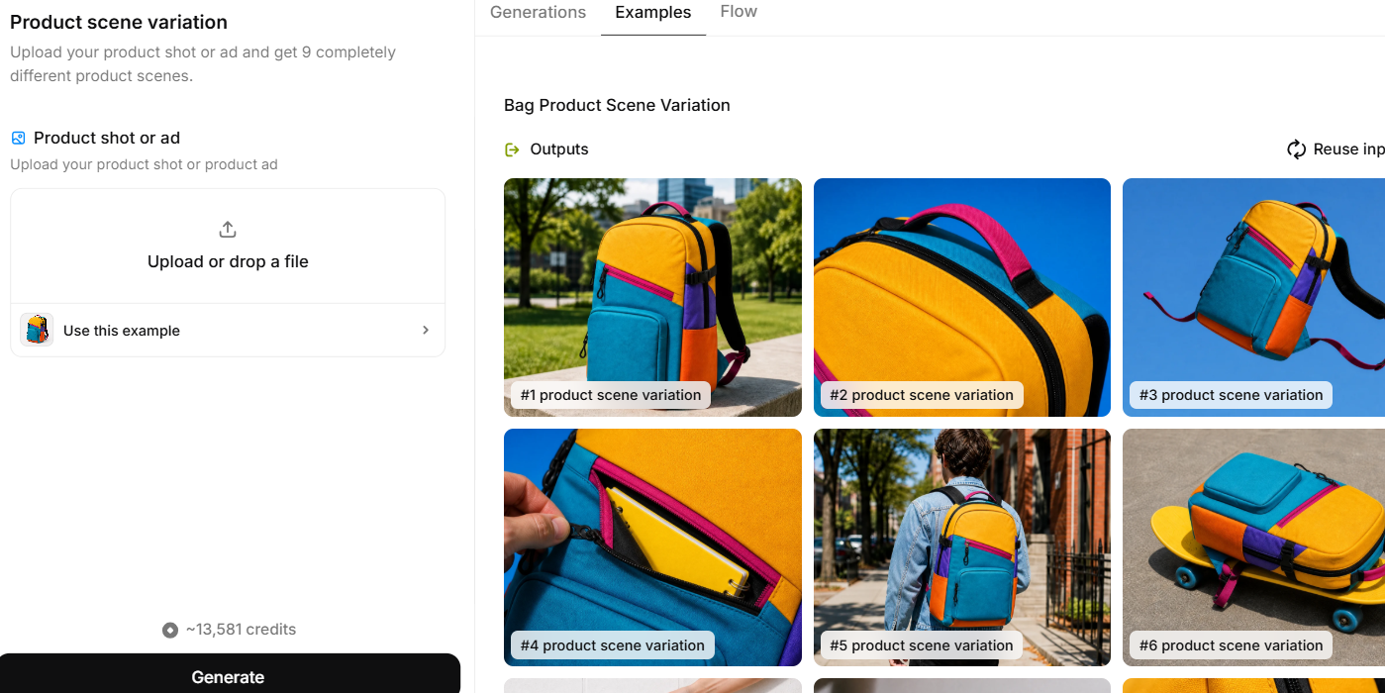
Product scene variation

Slide 44
Text summarizer
AI Summarizer - Free, Fast, and Ad-Free Summarizing Tool
https://www.scribbr.com/text-summarizer/

Slide 45
Humanize ai
https://www.scribbr.com/humanize-ai/

Slide 46
Ai video generator
Synthesia: #1 AI Video Platform for Business
https://www.synthesia.io/

Slide 47
You Tube summary
https://notegpt.io/youtube-video-summarizer
YouTube Video Summarizer with AI - Online Free

Slide 48
Text to sql commands
Free Text to SQL Converter - AI SQL Query Generator
https://aiven.io/tools/text-to-sql

Slide 49
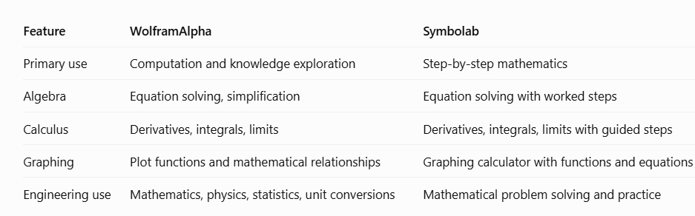

Slide 50
Mathematical /science Tool
Wolfram|Alpha: Computational Intelligence
https://www.wolframalpha.com/

Slide 51
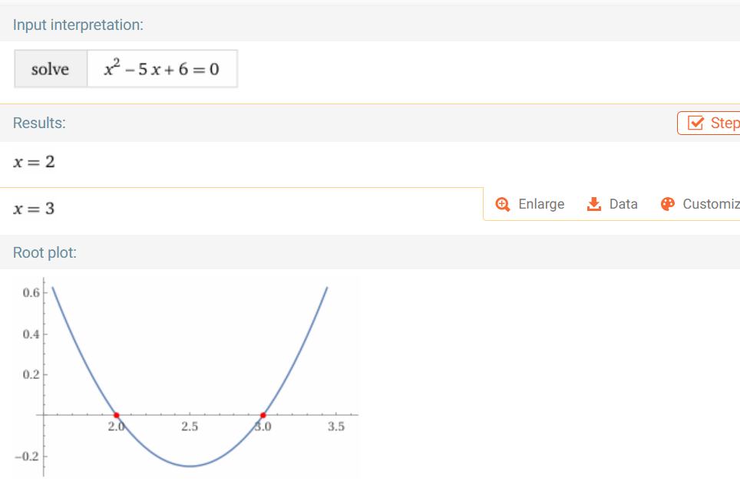

Slide 52
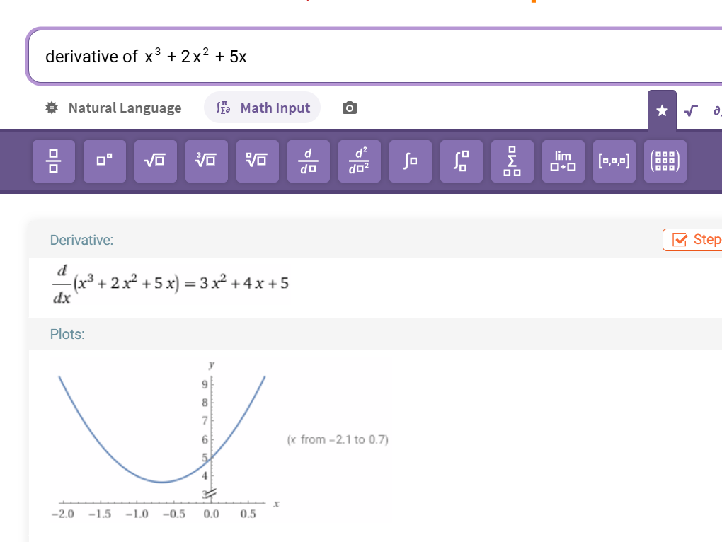

Slide 53
plot x^3 + 2x^2 + 5x and its derivative
Observations
What is the original curve?
What does the derivative represent?
How does the slope change at different values of x?
Where does the function increase or decrease?

Slide 54
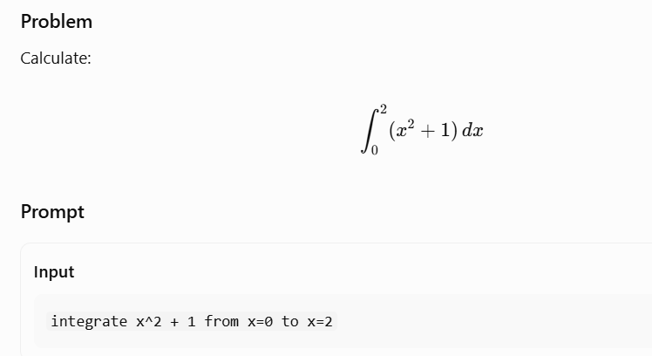
Definite Integration — Area Under a Curve
Engineering mathematics topic: Integral calculus

Slide 55
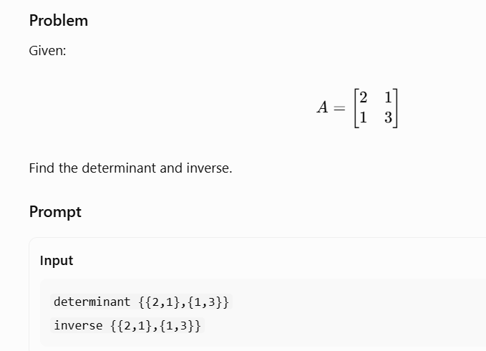

Slide 56
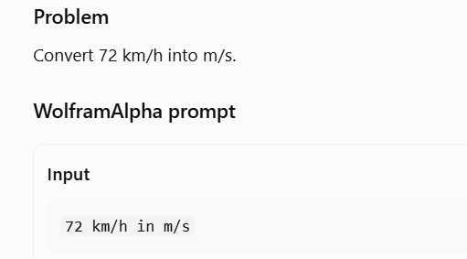
Unit Conversion and Physics
Engineering mathematics topic: Applied mathematics and physics

Slide 57
Challenge
calculate:
90 km/h in m/s
5 m/s in km/h
1000 joules in kilojoules

Slide 58
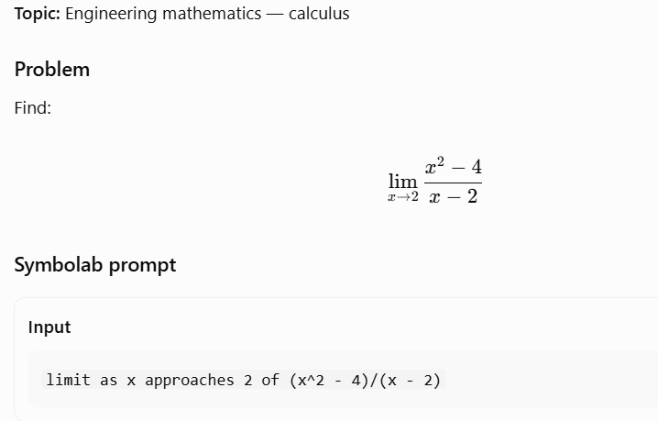

Slide 59
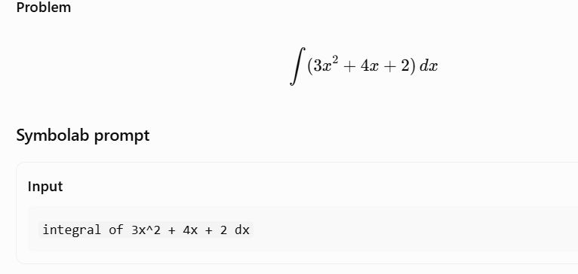

Slide 60
Mathematical/Science Tool
Math Solver - Trusted Online AI Math Calculator | Symbolab
https://www.symbolab.com/

Slide 61
Suno-ai music
Suno | AI Music Generator
https://suno.com/

Slide 62
AI Music generator
≻ Mubert AI Music Generator — Royalty Free Music ✓ Best AI Music Generator
https://mubert.com/

Slide 63
Effective prompt/with upfront
Provide Information Upfront: Including necessary and helpful information at the beginning of your prompt can significantly improve the output.
Without upfront information
Prompt: Write a witty introduction as a speaker about me.
AI's Response: The AI gives a general introduction about itself
because it lacks personal information about the user.
With upfront information
Prompt: [Inserts resume information] Write a witty introduction as a speaker about me.

Slide 64
Effective prompt/with upfront
Summarizing an Article
Without upfront information
Prompt: Summarize the article on Cricket Analytics.
AI's Response: The AI won't be able to generate a summary
because it doesn't know the content of the specific article you'rereferring to.
With upfront information
Prompt: [Inserts article content] Summarize the above article.

Slide 65
Effective prompt/with examples
Write a Python program to calculate the factorial of a givennumber.
Write a Python program to calculate the factorial of a given number. For example, if the input is 5,
the output should be 120.

Slide 66
Effective prompt/response length
Explain the concept of climate change.
Provide an essay-length explanation (800-1000 words) of the concept of climate change.
Create a social media post about our new product [name].
Craft a social media post (maximum 280characters) to promote our new product[name]
Summarize the key findings of the research paper on artificial intelligence.
Summarize the key findings of the research paper on artificial intelligence in four to six
sentences.

Slide 67
Effective prompt/Be Concise and Avoid Multiple Questions
Avoid asking multiple questions in a single prompt; it can lead to confusion and inaccurate responses.
Keep your questions concise and focused on one topic to improve clarity and accuracy.

Slide 68
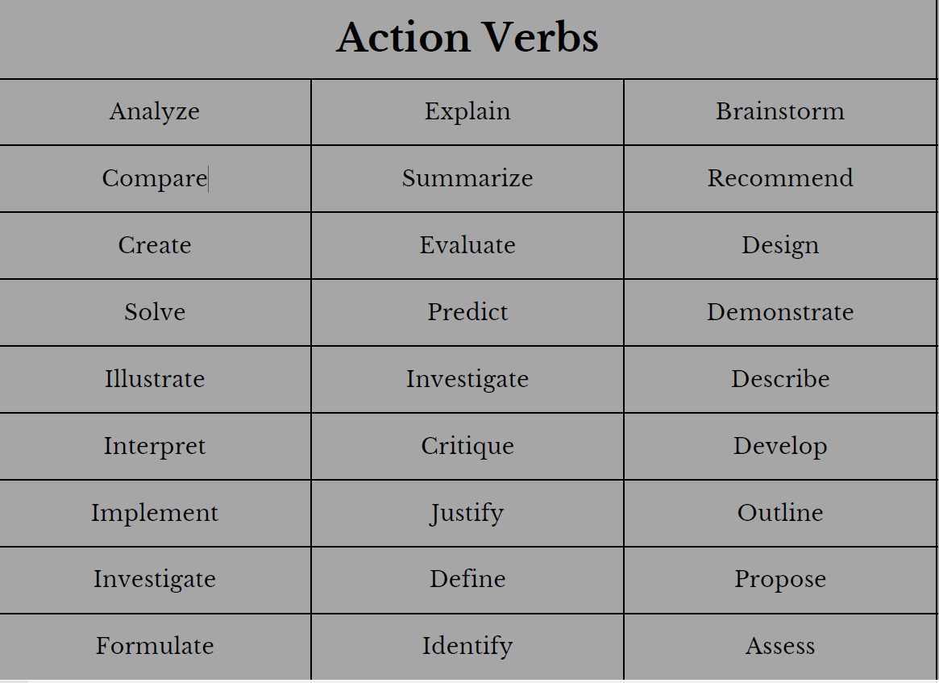
Effective prompt/Using Action Verbs in Prompts

Slide 69
Effective prompt/Tone of Voice in Prompts
Maintaining a consistent tone of voice in your prompts helps convey your brand identity effectively.
Aggressive: "Write a blog on the effect of poverty on the economy in an aggressivetone."
Calm: "Compose a blog post discussing the impact of mindfulness on mental health in acalm and composed tone."
Confident: "Craft an article about personal finance strategies with a confident andauthoritative tone."
Excited: "Write a review of the latest science fiction novel, capturing your excitementand enthusiasm for its imaginative plot."
Formal: "Develop a research paper on the historical significance of the IndustrialRevolution using a formal and scholarly tone."

Slide 70
Effective prompt/"Pretend You Are an Expert"
What exercises should I do to improve my core strength?
Pretend you are a fitness expert. What exercises should I do to improve my core strength?
I'm planning a budget-friendlytrip to Paris. Any tips?
Pretend you are a travel expert. I'm planning abudget-friendly trip to Paris. Any tips?

Slide 71
Effective prompt/Play Devil's Advocate
Use this phrase to get unique and specific answers.
Forces ChatGPT to consider counterarguments.
Deeper analysis of problem statements.
Useful for making more informed decisions

Slide 72
Effective prompt/"Pretend You Are My Consultant"
Treat ChatGPT as a personal consultant.
Provides detailed insights and tailored advice.
Similar to consulting from experts.
Helps in making better decisions.

Slide 73
Prompt engineering
Skill course

Slide 74
What is Prompt Engineering?
Prompt Engineering is the process of designing, structuring, and refining instructions (prompts) that guide a Large Language Model (LLM) to generate accurate, relevant, and useful responses.

Slide 75
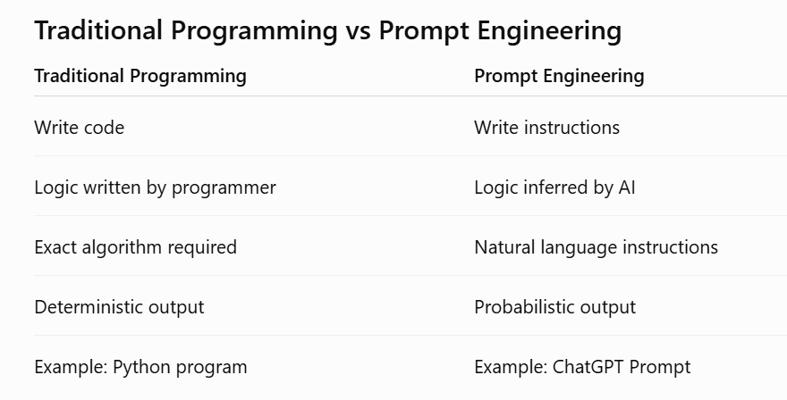

Slide 76
Translate English to French.
Summarize this article.
Write Python code.
Explain Neural Networks.
Generate SQL Query.
Create a PowerPoint outline.

Slide 77
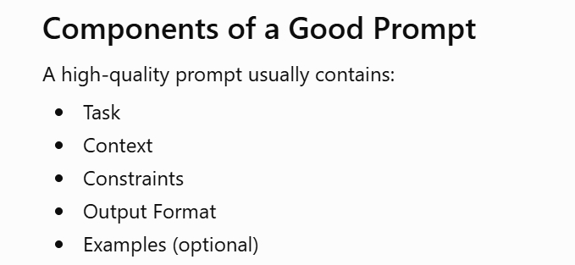

Slide 78
Why Prompt Engineering Matters
Large Language Models are incredibly powerful, but their output quality depends heavily on the prompt.
A weak prompt often produces:
Generic answers
Incorrect assumptions
Missing details
Hallucinations
A strong prompt produces:
Accurate responses
Better reasoning
Structured outputs
Fewer revisions

Slide 79
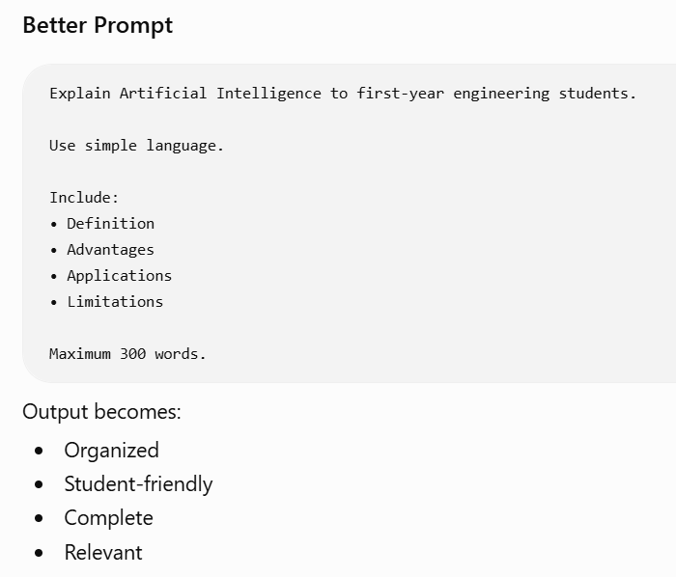
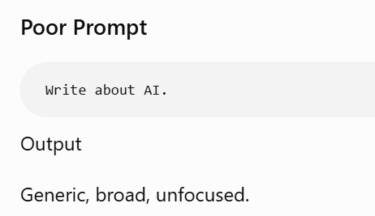

Slide 80
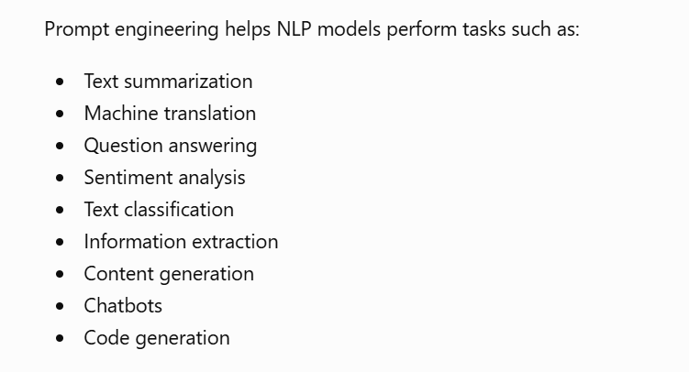

Slide 81
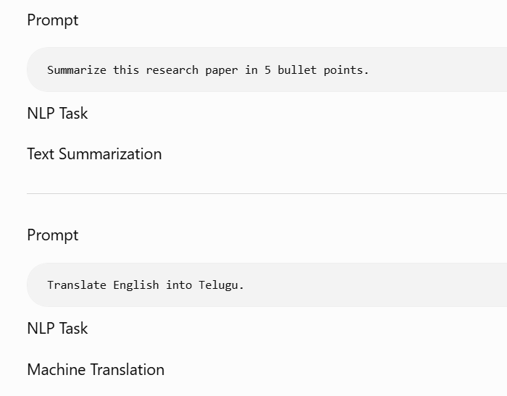
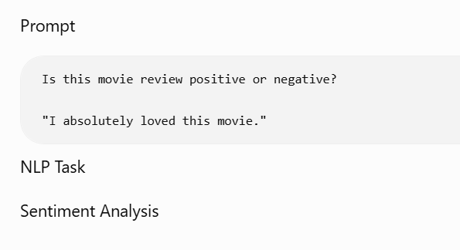

Slide 82
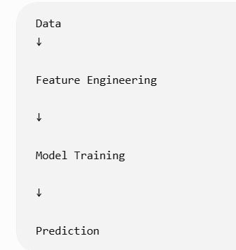
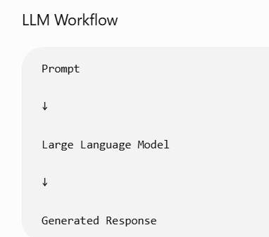
Traditional ML / LLM workflow

Slide 83
Period | Technique | Example
Rule-Based AI | Hard-coded rules | IF question = "Hi" THEN answer = "Hello"
Classical ML | Feature engineering | TF-IDF + SVM for spam detection
Deep Learning | Task-specific fine-tuning | Train an LSTM for sentiment analysis
Pretrained Transformers | Fine-tuning pretrained models | Fine-tune BERT for classification
Modern LLMs | Prompt Engineering | Ask the model in natural language
Advanced Prompting | Zero-shot, Few-shot, Chain-of-Thought, Role prompting | Guide reasoning without retraining

Slide 84
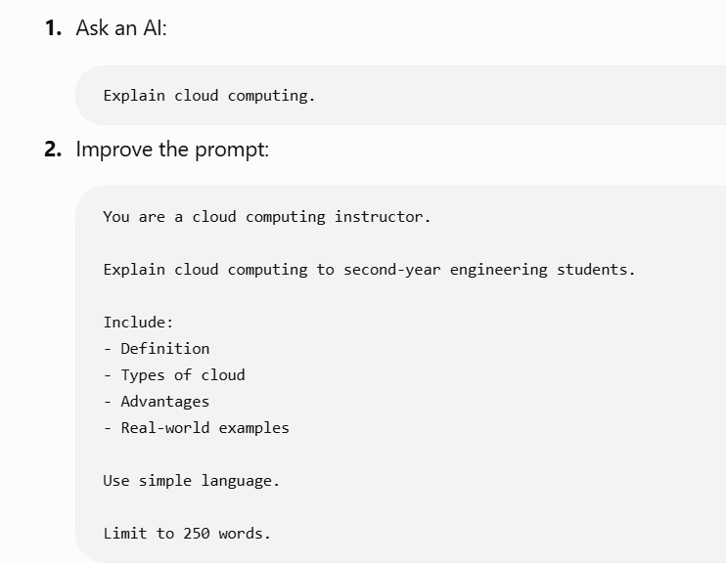

Slide 85
What is a Closed-Ended Prompt?
A Closed-ended Prompt is a prompt that expects a specific, short, objective, or limited answer.
The model has very little freedom to generate creative content.
The answer is usually
One word
One sentence
Yes/No
Number
Fixed list
Multiple Choice
Specific fact

Slide 86
What is the national animal of India?
Which keyword is used to define a function in Python?
Find the square root of 144.
IMPROVED CLOSED PROMPTS:
What does SQL stand for?
Output only the expanded form.
Do not provide any explanation.

Slide 87
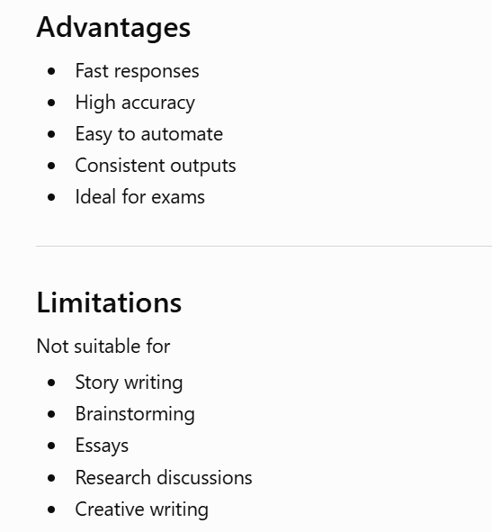

Slide 88
What is an Open-Ended Prompt?
An Open-ended Prompt encourages the AI to generate creative, detailed, descriptive, or analytical responses.

Slide 89
Open-ended prompts
✔ Encourage creativity
✔ Allow detailed explanations
✔ Produce longer responses
✔ Support brainstorming
✔ Enable storytelling

Slide 90
Example 1 – Creative Writing Prompt Write a short story about a robot who dreams of becoming a teacher.
Example 2 – Essay Writing Prompt Discuss the impact of Artificial Intelligence on modern education.

Slide 91
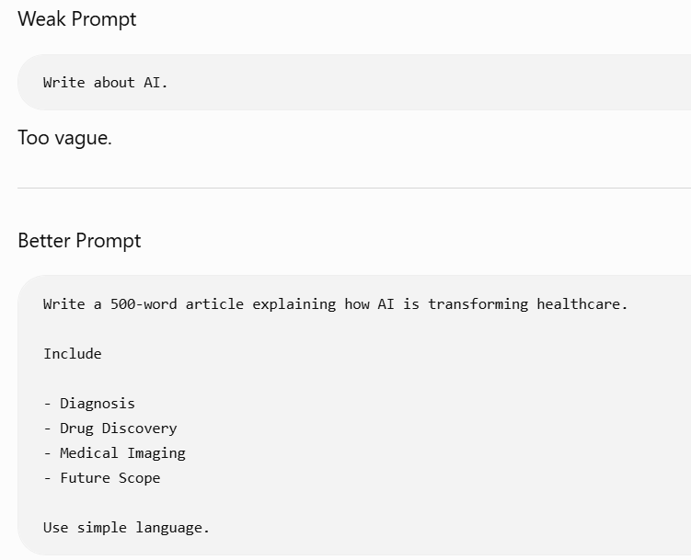
Improving Open Prompts

Slide 92
Feature | Closed-Ended Prompt | Open-Ended Prompt
Expected Response | Specific | Creative or descriptive
Length | Short | Long
Number of Correct Answers | Usually one | Many possible answers
Creativity | Low | High
Evaluation | Easy | Subjective
AI Freedom | Limited | High
Best Use Cases | Facts, quizzes, FAQs | Blogs, reports, brainstorming, stories

Slide 93
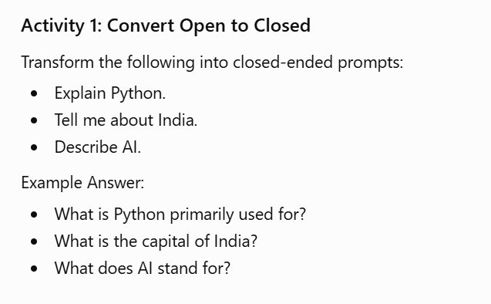

Slide 94
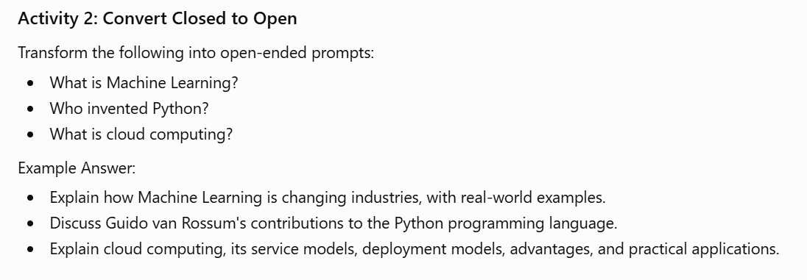

Slide 95
qa
Probing Prompts – Used to understand model behavior, reasoning, and potential biases.
Adversarial Prompts – Used to challenge and stress-test AI models for robustness and safety.

Slide 96
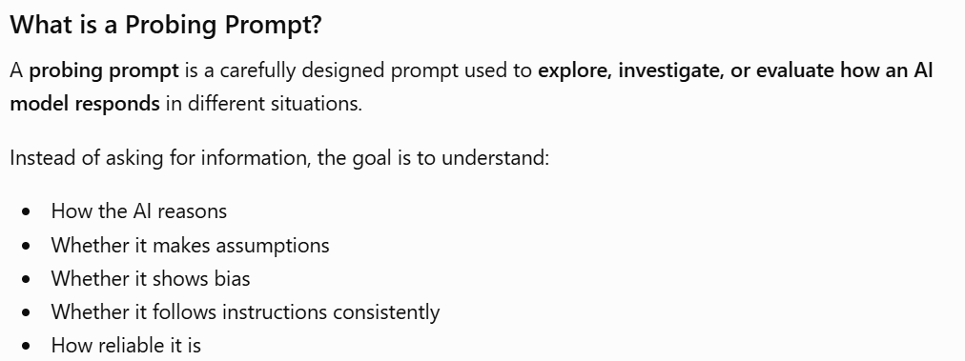

Slide 97


Slide 98


Slide 99


Slide 100


Slide 101
Activity-probing prompt
Explain Machine Learning.
Why is Machine Learning important?
Compare Machine Learning and Deep Learning.
What are the limitations of Machine Learning?

Slide 102
Bias
Example 1 – Occupation Bias
Prompt
Describe a software engineer.
Does the AI assume gender?
Does it mention only one demographic?
Does it present a balanced description?

Slide 103
Educational Bias
Prompt
Can students from rural areas become AI engineers?

Slide 104


Slide 105


Slide 106
Example 1 – Conflicting Instructions
Prompt
Answer in one sentence.
Explain Artificial Intelligence in 500 words.

Slide 107
Example 2 – Ambiguous Prompt
PromptExplain
Java.
"Java" could refer to:The programming language
The Indonesian island
Coffee

Slide 108


Slide 109


Slide 110


Slide 111
Domain | Probing Prompts | Adversarial Prompts
Education | Test explanations and reasoning | Test consistency in grading or tutoring
Healthcare | Check completeness of medical explanations | Ensure the model asks for missing clinical information instead of guessing
Banking | Verify financial reasoning | Test resistance to fraudulent or misleading requests
Software Development | Ask the model to justify code choices | Evaluate behavior with contradictory coding requirements
Customer Support | Assess quality and fairness of responses | Test handling of incomplete or ambiguous customer queries

Slide 112
Feature | Probing Prompt | Adversarial Prompt
Goal | Understand the model's reasoning, assumptions, or biases | Stress-test the model's robustness and safety
Focus | Explanation, justification, consistency | Ambiguity, conflicting instructions, edge cases
Typical Questions | Why? How? Compare. Justify. | What happens if...? Can it handle contradictions?
Used By | Educators, researchers, evaluators | AI developers, QA engineers, security researchers
Primary Outcome | Better understanding of model behavior | Improved reliability, resilience, and safety

Slide 113
Prompt Engineering | Fine-Tuning
No retraining | Requires retraining
Fast | Time-consuming
Low cost | Expensive
Easy to modify | Requires training data
Changes instructions only | Changes model parameters
Best for most applications | Best for specialized domains

Slide 114
What is Artificial Intelligence?
You are a professor teaching first-year engineering students.
Explain Artificial Intelligence.
Include
- Definition
- History
- Applications
- Examples
Maximum 300 words.

Slide 115




