Slide 1
RAG
FOUNDATION

Slide 2
HR PROBLEM UNDERSTANDING
HR_Policies/
│
├── Leave_Policy.pdf
├── Work_From_Home_Policy.pdf
├── Attendance_Policy.pdf
├── Employee_Benefits.pdf
└── Travel_Policy.pdf

Slide 3
A student asks: How many casual leaves can an employee take?
Traditional keyword search looks for:
Casual
Leave
Employee
RAG tries to understand the meaning of the question.

Slide 4
Question: "How many casual leaves can I take?“
Possible relevant chunk:
"Employees are entitled to 12 casual leaves per calendar year."

Slide 5
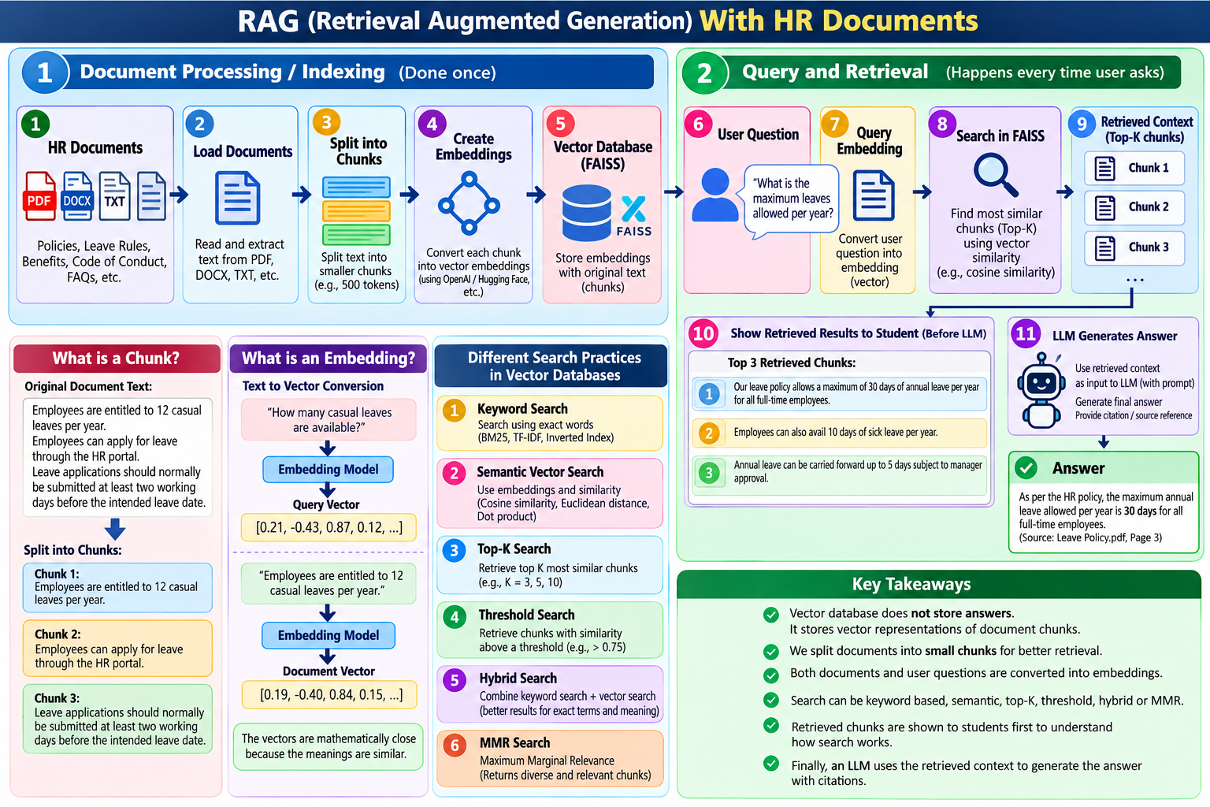

Slide 6
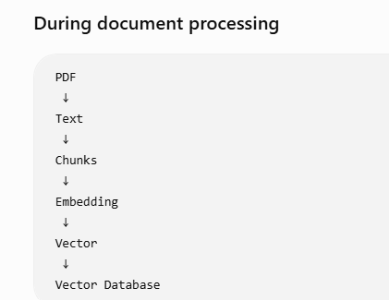
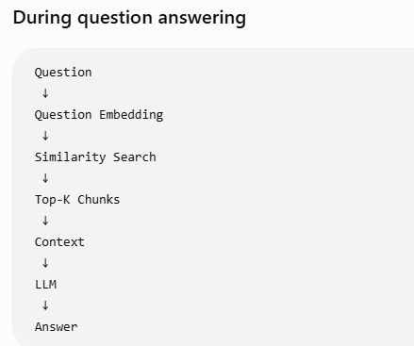

Slide 7
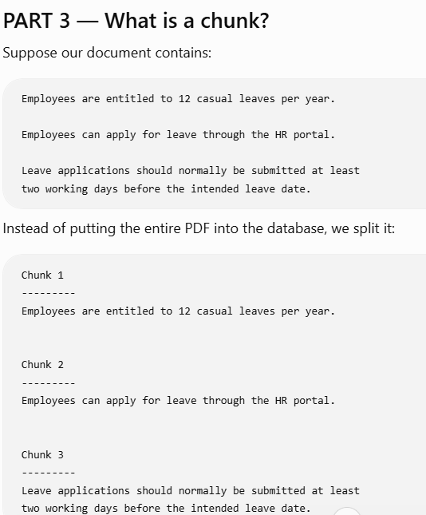

Slide 8
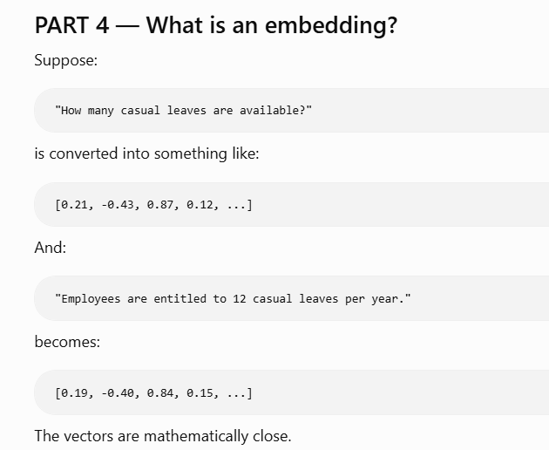

Slide 9
Different search practices
Method 1 — Keyword Search
Method 2 — Semantic Vector Search
Method 3 — Top-K Search
Method 4 — Threshold Search
Method 5 — Hybrid Search
Method 6 — MMR Search

Slide 10
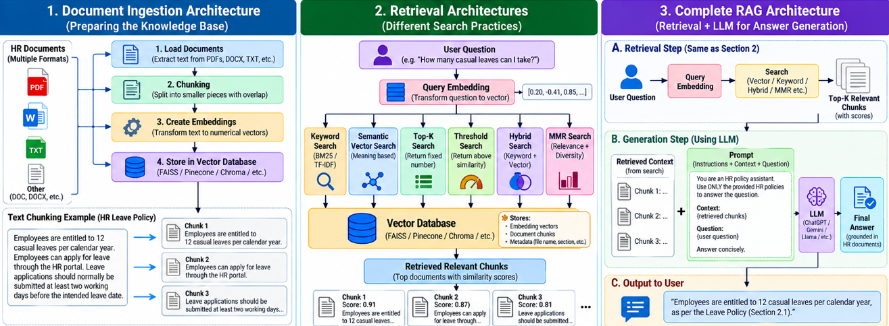

Slide 11
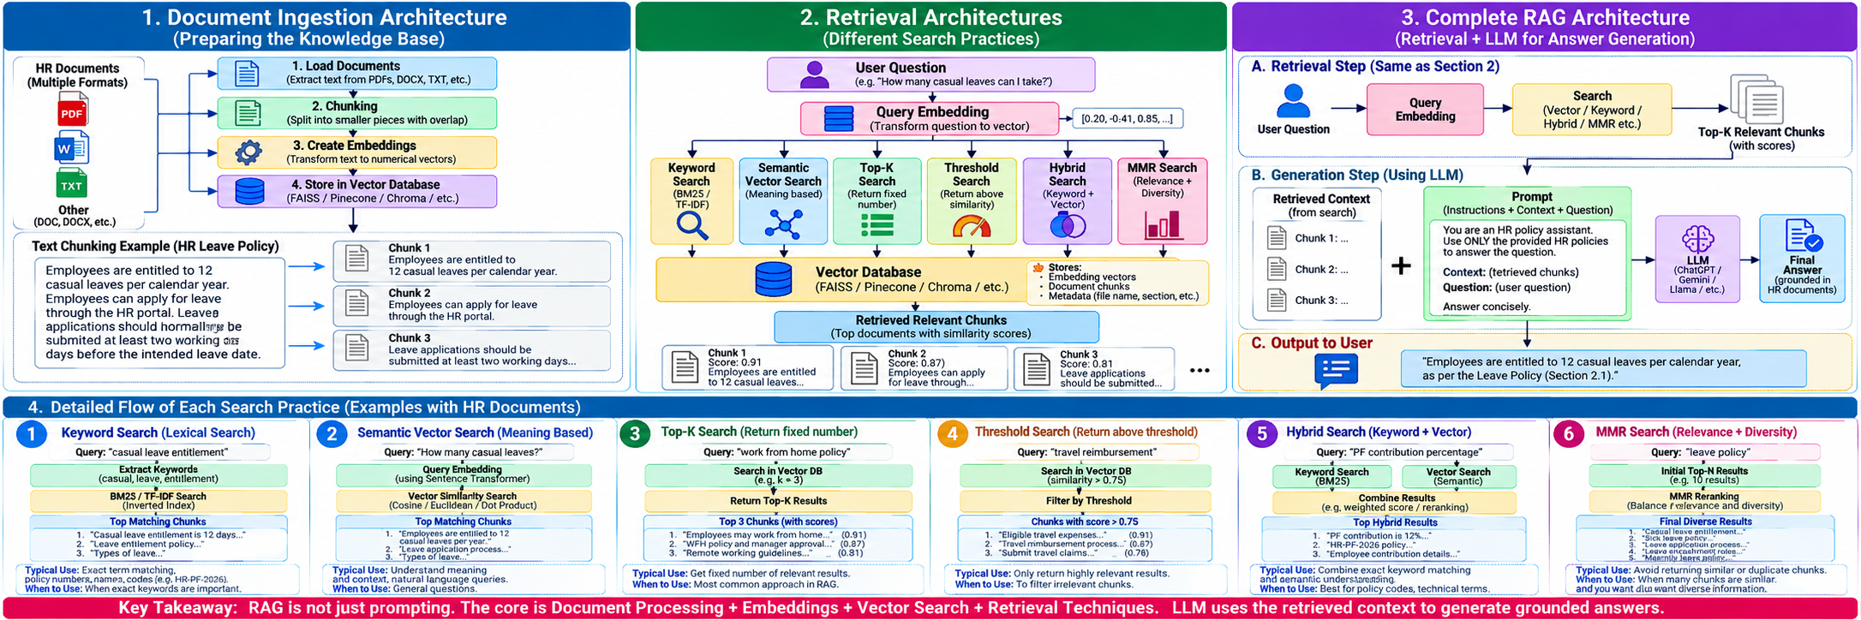

Slide 12
