Slide 1

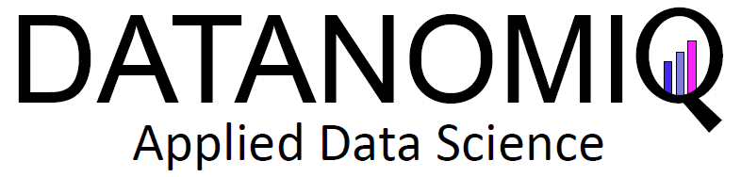
Imbalance datasets: Dealing with the
Minority class
Aakash Chugh
Data Scientist
09.05.2019

Slide 2
About DATANOMIQ
Software as a Service
We build tailor-made cloud solutions as a permanent self-service platform for you enabling direct interaction with our SaaS platform as a self-service.
Business Service
We provide our solutions as a business service. Thereby we provide an ideal entry into big data and analytics without the need for investment in software, maintenance and your own Data Science resources.
Consulting
Discover hidden potentials and new opportunities in purchasing, sales or other functions. DATANOMIQ shows you the specific fields of application for Big Data & Analytics in your company

Slide 3

Agenda
Announcements: DHD and
Job search
Introduction to class
imbalance problem
Some common approaches
Feedback
Use case in python
Advantages of balancing data

Slide 4
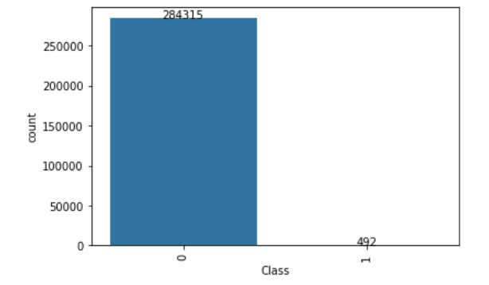

Introduction to Class imbalance problem
Key points:
One class is underrepresented
The problem is that standard learners or classifiers will be biased towards majority class
Overwhelming class are well-classified whereas examples from the minority class tend to be misclassified
How to deal with this?
I thought our results were better

Slide 5
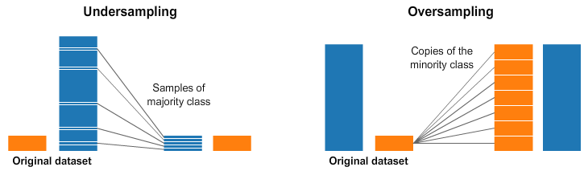


Some common approaches
Weight balancing
Undersampling
Oversampling [Smote,Adasyn]
Hybrid methods
Unsupervised learning

