Slide 1


Text mining and its applications
Aakash Chugh
Data Scientist
05.12.2018

Slide 2
About DATANOMIQ
Software as a Service
We build tailor-made cloud solutions as a permanent self-service platform for you enabling direct interaction with our SaaS platform as a self-service.
Business Service
We provide our solutions as a business service. Thereby we provide an ideal entry into big data and analytics without the need for investment in software, maintenance and your own Data Science resources.
Consulting
Discover hidden potentials and new opportunities in purchasing, sales or other functions. DATANOMIQ shows you the specific fields of application for Big Data & Analytics in your company

Slide 3

Agenda
Feedback
Text mining and
its Importance
Basic text mining
technologies
Surprise element
Use case
Applications of
Text mining

Slide 4
Text mining and its Importance
Sources of textual data:
Research papers & Articles
Social media
Call transcripts
Email to Customer Service
Interviews & Surveys
Blogs, Posts, News etc.
Medical records
Structured
20%
Semi or Unstructured
80%
How to analyse all this?

Slide 5
Basic text mining technologies
Information Extraction
Information Retrival
Natural Language Processing
Clustering
Text Summarization
Figure 1: Inter-relationship among different text mining techniques and their
core functionalities
Source: W. He, “Examining students online interaction in a live video streaming environment using data mining and text mining,” Computers in Human Behavior, vol. 29, no. 1, pp. 90–102, 2013.

Slide 6
Information Extraction
The science of extracting relevant information from large amount of text
Extraction of entities, events and relationships
Entities such as :
Name, Location and organisation
Relevant information but without complete understanding of the text
Notes:
4. Storage is cheap but only the relevant information is stored in databases

Slide 7

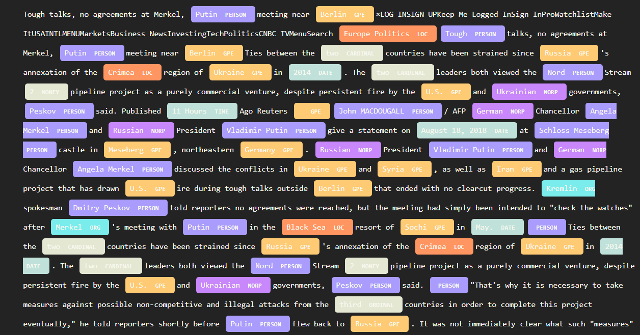
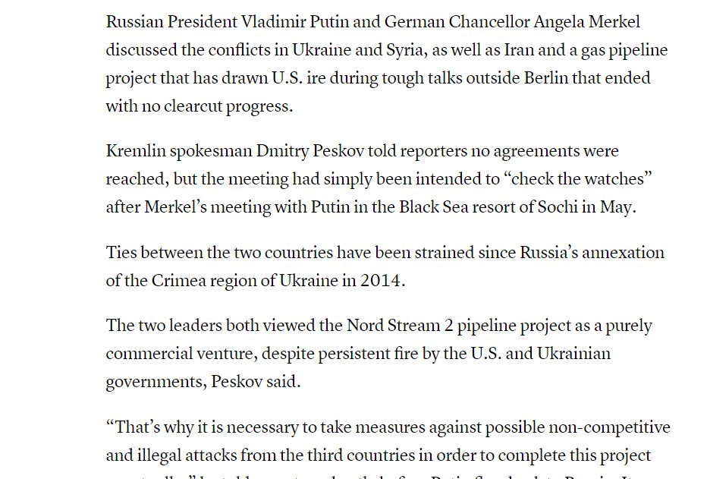
IE: Named Entity Recognition (NER)
NER

Slide 8
Information Retrieval
Understanding the sequence of words and returning the relevant documents
Google and Yahoo search engines
Chatbots leverages this technique for intent classification

Slide 9
Natural Language Processing (NLP)
4
Stemming
Assigning the root forms or word. For eg: the stem of ‘bringing’, ‘brings’ is ‘bring’
Similarity
3
Comparing words, text spans and documents and how similar they are to each other
2
Parts-of-speech (POS)
Tagging
Assigning word types to tokens, like
Verb or noun.
Tokenisation
1
Segmenting text into words, punctuations marks etc
Of course, it‘s more than that !!

Slide 10
Applications of Text Mining
Risk management
Healthcare
- Fetching data from pdfs
Research papers
Corpus of articles to detect new
disease or cure or element
Customer service
Social media data analysis
Chatbots for CS
Speech to text, text to speech
- Sentiment Analysis
Business Intelligence
Fraud detection
Improve KPI’s using textual information
More Infogain
-Invoice fuzzy matching
10

Slide 11
Issues in Text Mining
In preprocessing stage various rules and regulations are defined to standardize the text that makes it efficient for text mining
Real theme or data mislay its importance due to the modification in the text sequence
Multilingual dependencies
Integration of domain knowledge is important
Words having same spelling but different meaning
Different grammatic rules
Source: Text mining: Techniques, Applications and Issues, Ramzan Talib, Muhammad Kashif Hanif, Shaeela Ayesha and Fakeeha Fatima; IJACSA Vol. 7 pp. 414-418

Slide 12
Data Hacker Days 2019
Hackathon
Day 1
Day 2
Day 3
Are you looking for Motivation?
Prize
Certification
Job opportunities
Networking
https://datahackerdays.com/
Task
Workshops
Task

Slide 13


Aakash Chugh
+4917647189852

