Slide 1
Deployment with Azure ML Services
A DATANOMIQ MEETUP

Slide 2
Summary
Why bother using Azureml?
When do you need a web service
I. Train and register the model
II. Implement the registered model as a web service
In this example we use the Housing Price dataset from Kaggle
You can find the full code on github.com/arturzeitler/meetup_2

Slide 3
Why bother using Azureml? My view
Should your company use it as its cloud provider anyway, then:
  You don't have to write the Dockerfile on you own, but might add steps to the provided one (if Microsoft allows those steps) => a bit of help
  Microsoft sets up the web service that predicts new data and makes sure its working => big help

Slide 4
When do you need a web service - IMO
To be able to predict and process data that is sent to the web service at regular intervals
If you have to predict data at regular intervals, there might be easier and cheaper options than running a web service all the time

Slide 5
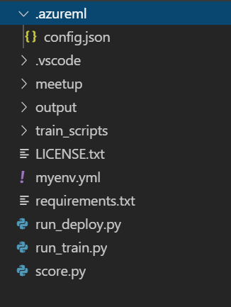
I. Train and register the model
Save your workspace credentials in config.json
Calling run_train.py creates a VM or uses an old one
And puts the contents of train_scripts into a docker container

Slide 6
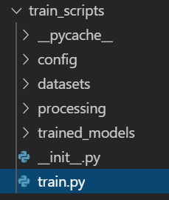
I. Train and register the model
train.py is the entry script of the docker container
It trains the model based on train data in datasets
Such that the model can be registered as a .pkl by run_train.py later on

Slide 7
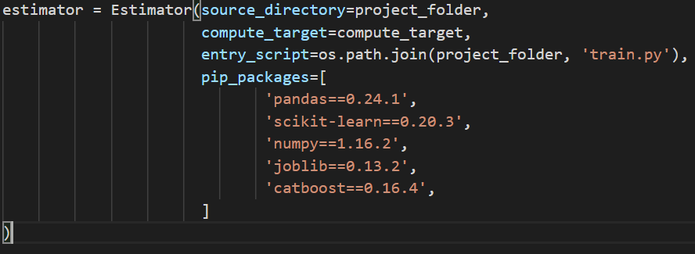
The Estimator class creates the Docker container

Slide 8
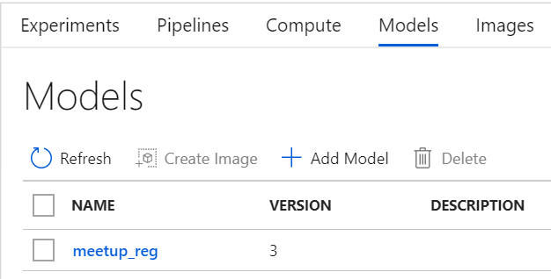
I. Train and register the model
After a successful run of run_train.py we can see a registered model in our Azure Machine Learning Workspace

Slide 9
II. Implement the registered model as a web service
To use the registered model for prediction, azureml enables us to dockerize the model such that it is able to serve http-requests
The data to be predicted is sent as a post request in a json file and the web service than returns the predictions, again as a json file
To establish the web service azureml requires us to have two files: 1. score.py 2. myenv.yml

Slide 10
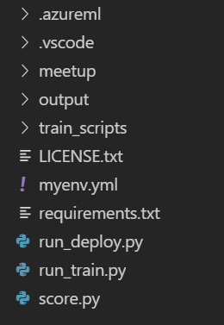
II. Implement the registered model as a web service
To create the web service we call run_deploy.py
score.py dictates how the web service actually receives, predicts and sends back the data
myenv.yml lists the required python packages

Slide 11
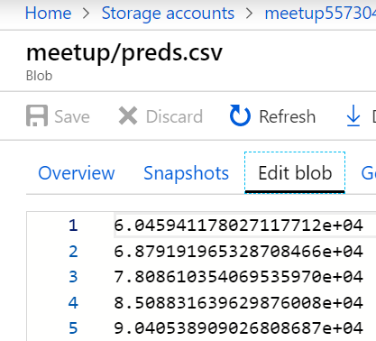
II. Implement the registered model as a web service
After successfully running run_deploy.py the predicted data is sent to the BLOB storage of our Azure account as a csv-file

Slide 12
Some more info
You may be required to store data from your training container to the BLOB that is later on utilized on your test data (eg. Transformation values, values to impute missing data with, etc.). To send this data to the BLOB you could
  1. Specify parameters in the Estimator class (don't)
  2. Use the azure-storage module inside your train-container and inside of it, create an instance of the BlockBlobService class to upload the data (do this)

Slide 13
Thank you, for listening
To get more info check out the azureml documentation and the official examples provided by azure

