Slide 1
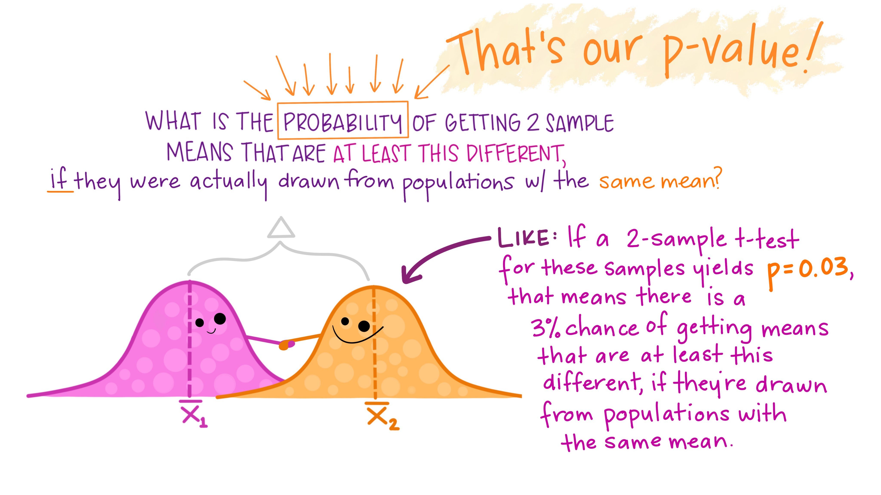

Slide 2
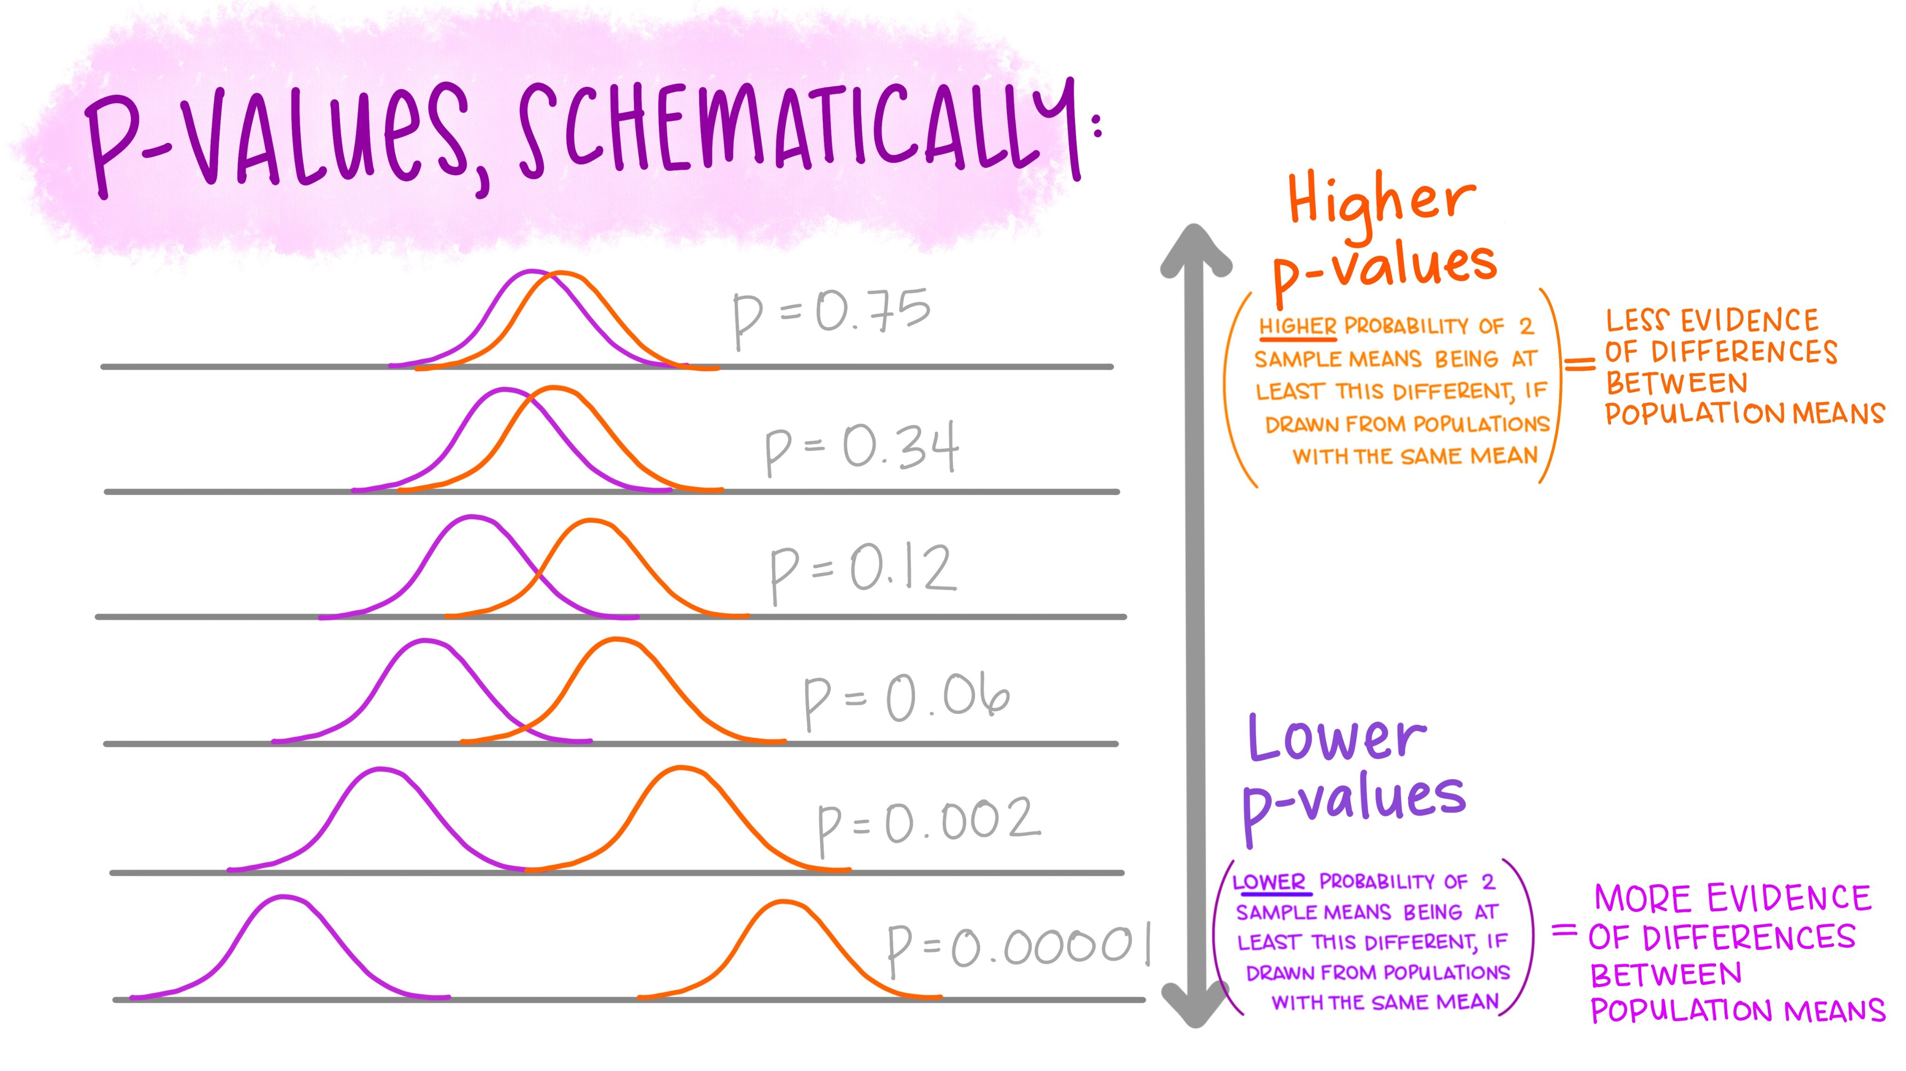

Slide 3
https://twitter.com/allison_horst/status/1216411299875192837?ref_src=twsrc%5Etfw%7Ctwcamp%5Etweetembed%7Ctwterm%5E1216411299875192837%7Ctwgr%5E%7Ctwcon%5Es1_&ref_url=https%3A%2F%2Fwww.t4rstats.com%2Ffollow-some-folks.html

