Slide 1
Customer Tracker Report

Slide 2
Overview
Data were compared from pre and post periods by week. This report shows pecentage change by:
Total (segment)
Total (group)
Week (period)

Slide 3
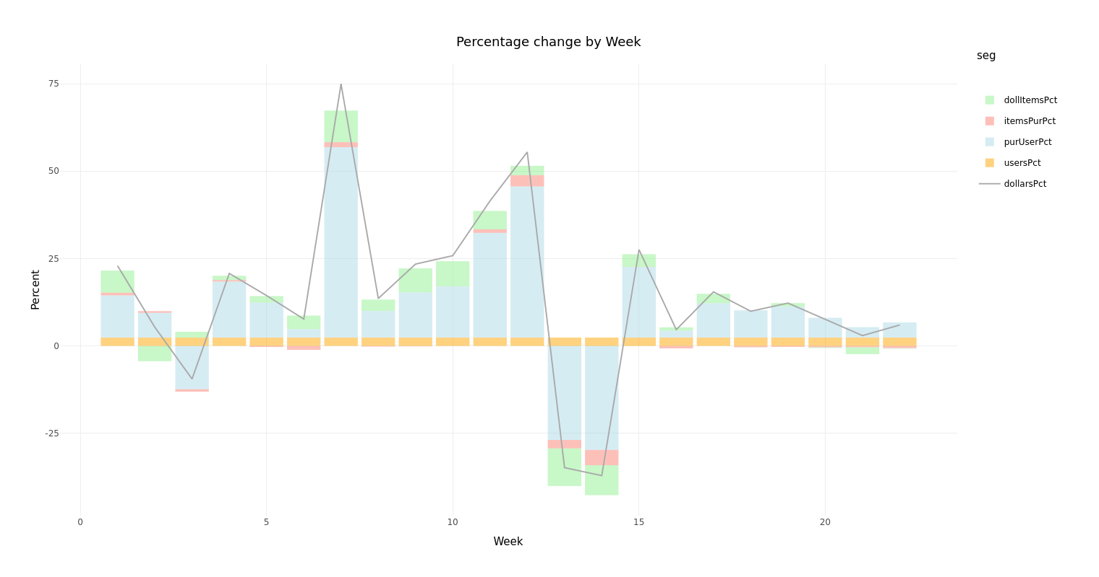
Results

Slide 4
Detail
week | dollarsPct | usersPct | purUserPct | itemsPurPct | dollItemsPct
1 | 22.93 | 2.38 | 12.06 | 0.78 | 6.33
2 | 5.35 | 2.38 | 7.07 | 0.50 | -4.37
3 | -9.46 | 2.38 | -12.38 | -0.71 | 1.66
4 | 20.74 | 2.38 | 16.03 | 0.43 | 1.22
5 | 14.41 | 2.38 | 9.99 | -0.30 | 1.90
6 | 7.68 | 2.38 | 2.38 | -1.13 | 3.91

Slide 5
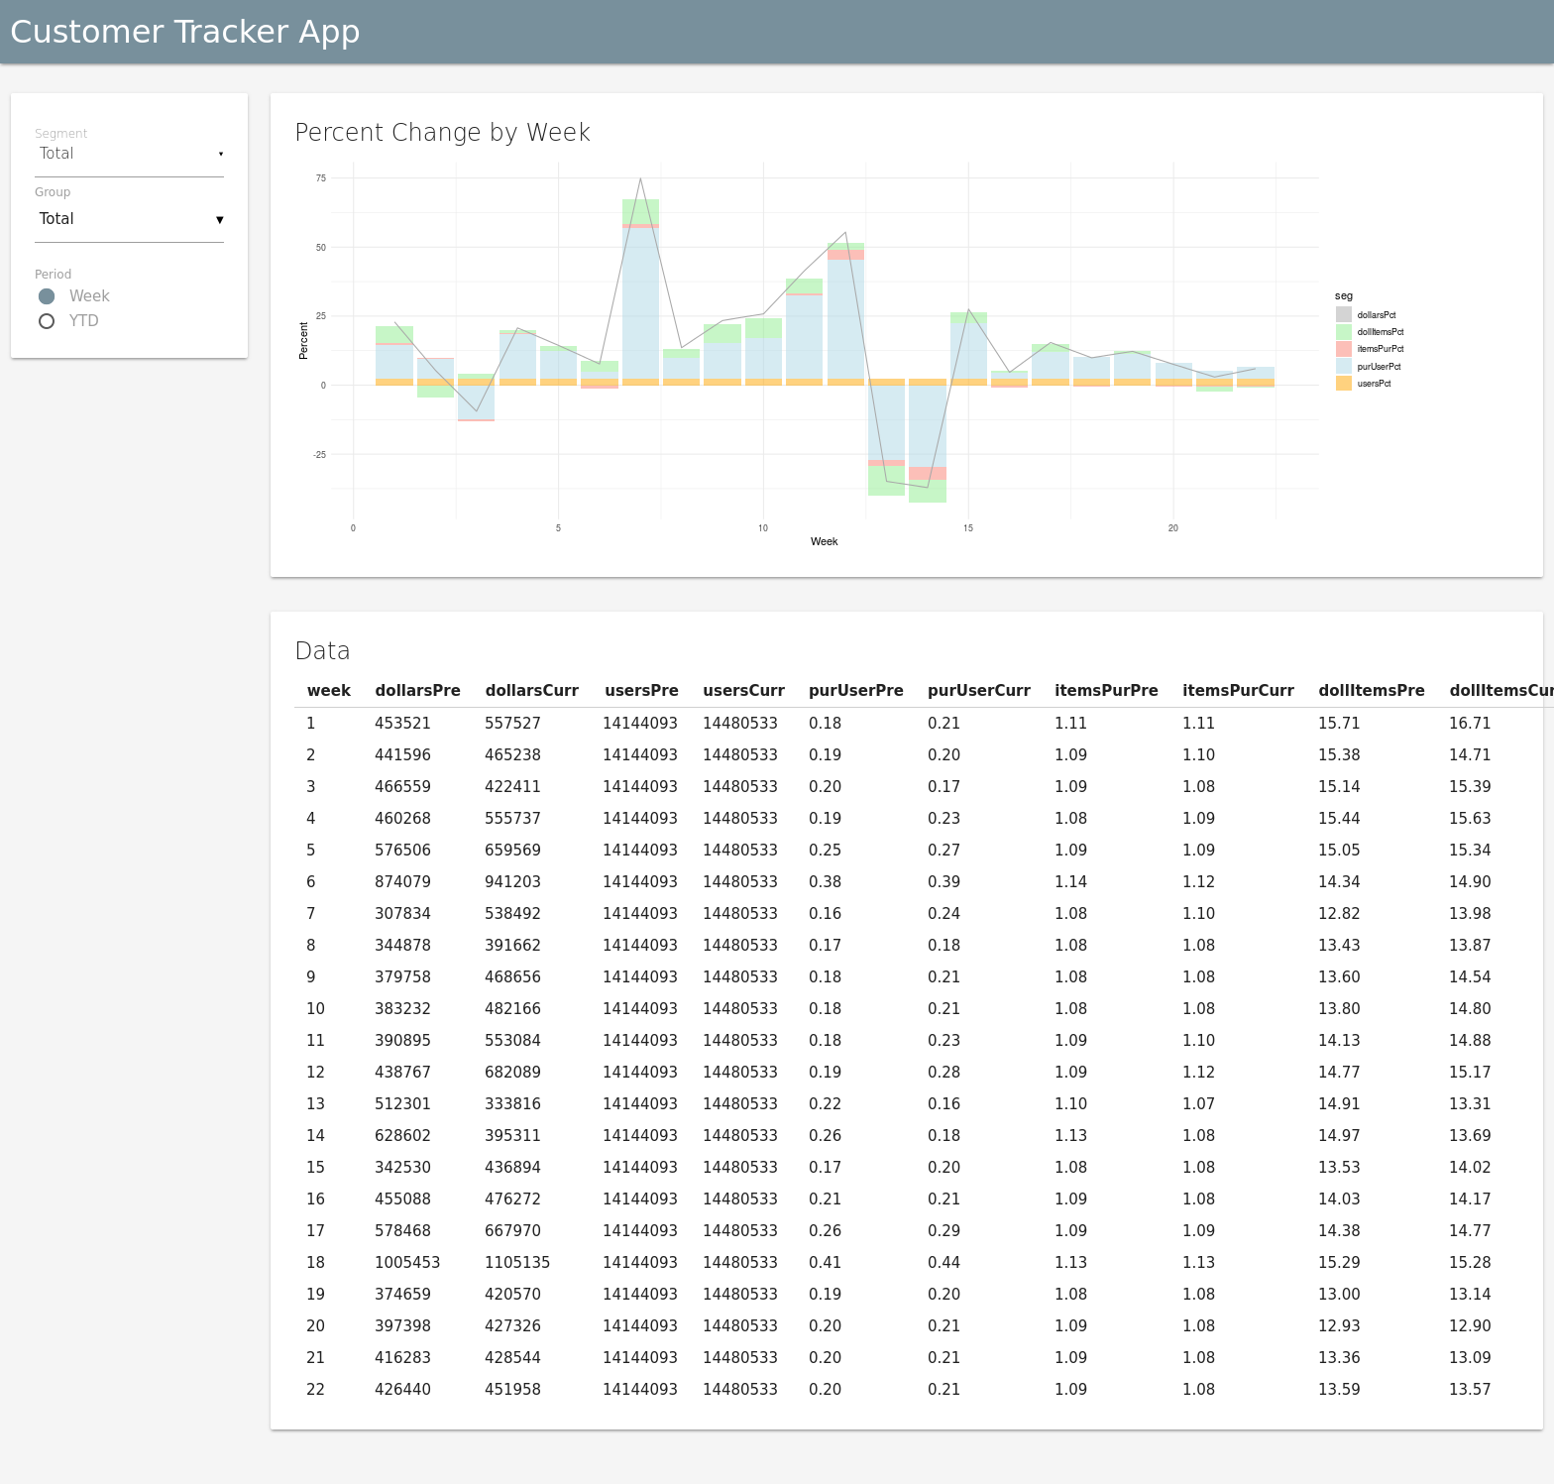
Shiny App
Click to open
Notes:
Click on the image to open the Shiny app in RStudio Connect. Or visit online at http://colorado.rstudio.com/rsc/content/1120/.

