Slide 1
serve_site()
Add-in
public/

Slide 2

serve_site()
Add-in
↩︎ Not your normal “knit to html”!
public/

Slide 3

serve_site()
Add-in
You built it locally! 🎉
public/

Slide 4

serve_site()
Add-in
Drag + Drop public/ to Deploy
You built it locally! 🎉
public/

Slide 5
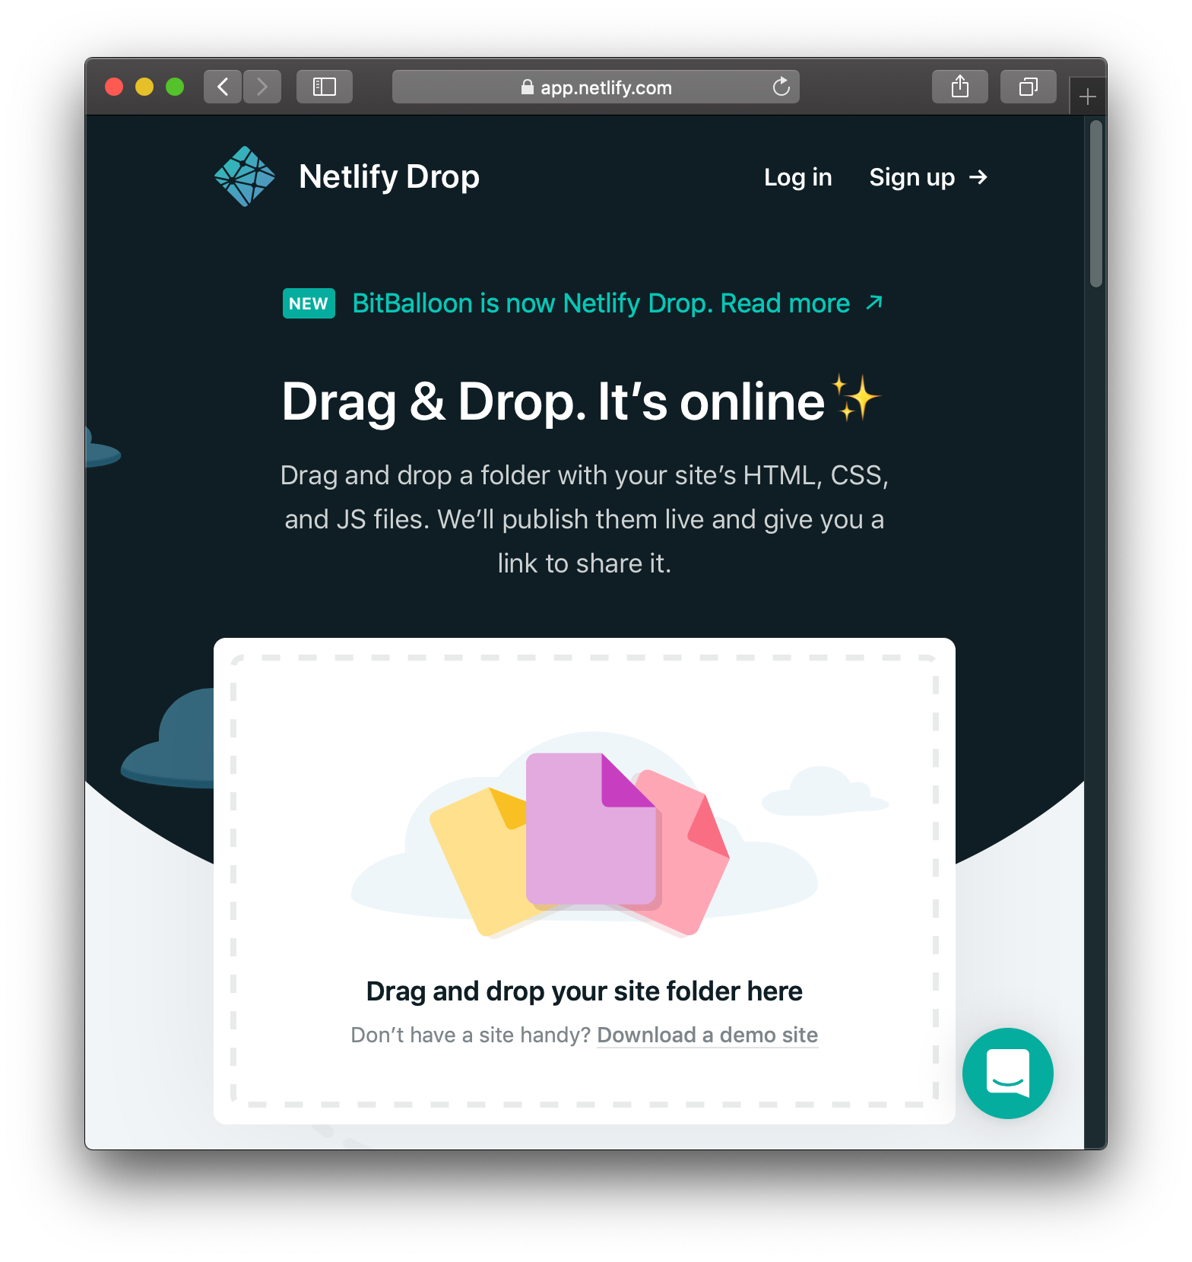
serve_site()
Add-in
Drag + Drop public/ to Deploy
You built it locally! 🎉
public/

Slide 6
serve_site()
Add-in
Drag + Drop public/ to Deploy
You built it locally! 🎉
public/
↪︎ Netlify deploys what you built! 📢

Slide 7

commit + push
to GitHub
Continuous Deployment
serve_site()
Add-in
public/

Slide 8
commit + push
to GitHub
Continuous Deployment
serve_site()
Add-in
You preview it locally! 🎉
public/
public/

Slide 9
commit + push
to GitHub
Continuous Deployment
serve_site()
Add-in
📢 Netlify rebuilds & redeploys every time you push to GitHub! ↪︎
public/
public/

Slide 10
commit + push
to GitHub
Continuous Deployment
serve_site()
Add-in
.gitignore:
.Rproj.user
.Rhistory
.Rdata
.Ruserdata
Blogdown
.DS_Store # Mac OSX
Thumbs.db # Windows
public/ # if using Netlify
public/
public/

