Slide 1
Effects of Major Historical events on S&P500
Team- NEO
Bharat Khandelwal
Dinesh Chandra Gaddam
Phanindra Kumar Kalaga
Prudhvi Chekuri

Slide 2
What is S&P500 ?
The S&P 500 is a stock market index that measures the performance of 500 large-cap U.S. companies listed on stock exchanges.
The index is market-capitalization-weighted, meaning that larger companies have a greater impact on its value.
The S&P 500 includes companies from diverse industries such as technology, healthcare, financial services, consumer discretionary, and industrials.
The S&P 500 is widely regarded as one of the best benchmarks for the performance of the U.S. stock market.

Slide 3
Reason to choose this domain:
Data Science and Statistics has major applications in the field of finance.
We all had inclination towards stock market data as it is interesting topic and S&P500 gives overall picture of the US stock exchange.
Understanding the impact of the negative events on S&P500 can improve our decision making for the future.

Slide 4
Objective:
To measure the impact of negative events on stock market performance. Especially in last 20-year period that encompasses events like Great Recession, Covid-19, and Russia-Ukraine Invasion.
To compare and analyze the volatility of the S&P 500 index during 3 distinct periods: before and after the Great Recession, before and after the onset of the COVID-19 pandemic, and before and after the escalation of the Russia-Ukraine conflict.

Slide 5
DATASET:
Our dataset is available at yahoo finance.
All the data is from (https://finance.yahoo.com/quote/%5EGSPC/history/?guccounter=1)
The dataset consists of 5285 instance(rows) and 6 features(columns).
Features: Date, Open, Close, High, Low ,Volume.

Slide 6
What our dataset tell us:
Terminology in Trading
"open" - The opening price for the specified date(s).
"close" - The closing price for the specified date(s).
"high" - The high price for the specified date(s).
"low" - The low price for the specified date(s).
"volume" - The volume for the specified date(s).
”daily_change" - The price change since the previous trading daily close.

Slide 7
Data Preprocessing:
The daily change is calculated as the change in the closing price from the previous day. We will use these daily returns to analyze the volatility of the index around major event.
We drop adjusted close column as we wanted to use the raw data from the close column.
We have subsetted the data basis before and after the events.

Slide 8
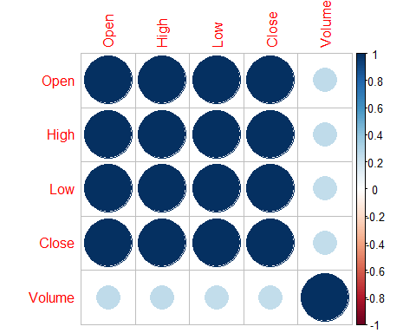
Correlation Heatmap:
The correlation plot shows that we have weak positive correlation of open high low and close variables with Volume variable.
From the correlation matrix, we can see that the closing price is highly correlated with the other papers. This is expected as the all these prices are related to each other.

Slide 9
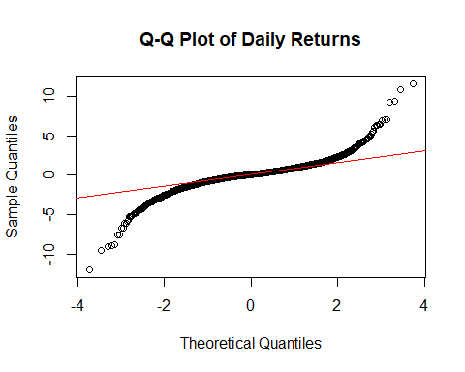
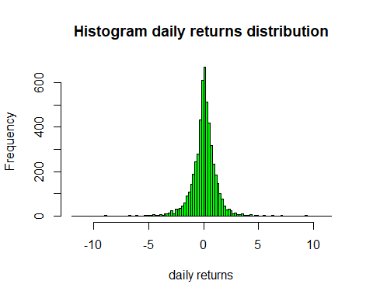
QQ plot and Histograms for daily_change:

Slide 10
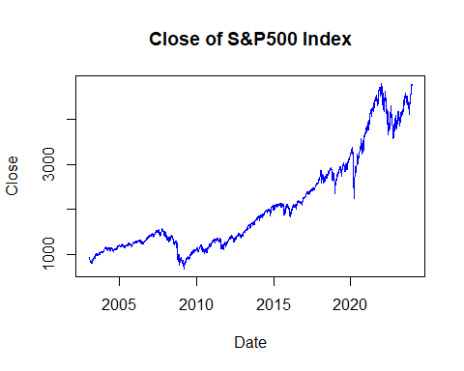
Line plot for Closing price over the time period:
The graph represents the trend of the closing price of S&P500 index from 2003 to 2023.
We can observe the overall direction of the close price for the index upwards and identify periods of significant movement or volatility.

Slide 11
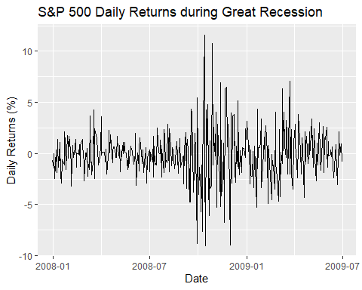
Daily Change volatility line plot: During Great Recession
As we can see the daily change value is very volatile between 2008 and 2009 which was the period of the Great Recession. The market recovered after 1403 days.

Slide 12
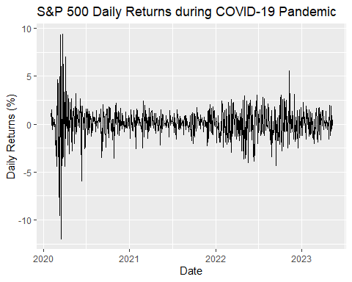
Daily Change volatility line plot: During Covid 19 pandemic
As we can see the daily change value is very volatile within the first few months of covid 19 outburst, as the market recovered within 119 days.

Slide 13
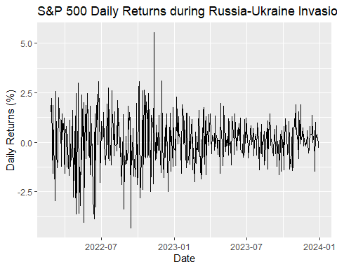
Daily Change volatility line plot: During Russia-Ukraine Invasion
The Invasion began in the year 2022 and so we can see some volatility in the few months between July of 2022 to Jan of 2023. the market recovered after 239 days.

Slide 14
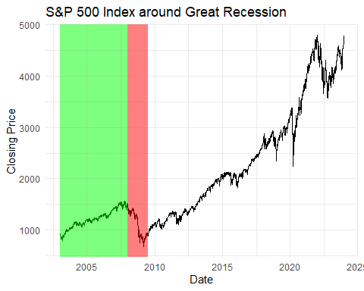
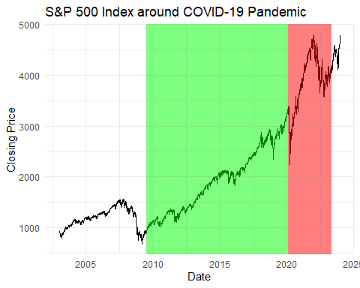
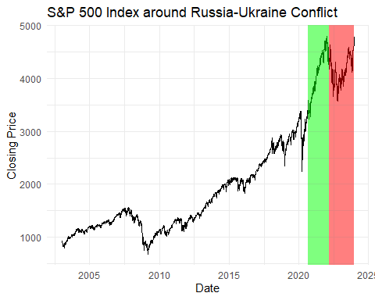
Smart Q1: What patterns emerge in financial markets, particularly in the S&P500 Index when confronted with significant events such as the Great Recession, the COVID-19 pandemic, and the Russia-Ukraine Invasion?

Slide 15
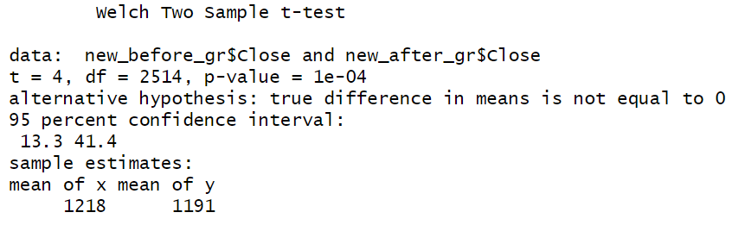
Smart Q2: How is the S&P500 Index affected by the Great Recession?
We can conclude that there is strong evidence to reject the null hypothesis as the p values is less than the level of significance 0.05 .
The test indicates a statistically significant difference in the means of the S&P 500 index closing values before and after the specified periods.

Slide 16
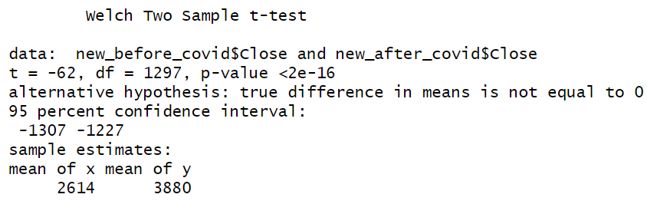
Smart Q3: How is the S&P500 Index affected by the COVID-19 pandemic?
The mean of before covid and after covid is not as expected is because the effect of covid was reduced and recovered within just 119 days which is very less compared to GR as the government got involved and helped the stock market recover faster than expected. (Check the attached article for more information.)
https://www.wsj.com/articles/the-s-p-500-sets-first-record-since-february-erasing-its-coronavirus-plunge-11597781130

Slide 17
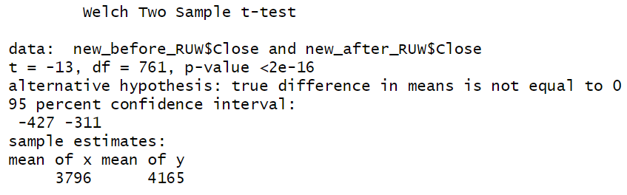
Smart Q4: How is the S&P500 Index affected by the Russia-Ukraine Invasion?
we reject the null hypothesis and conclude that there is a significant difference between both the means with the difference being 369 points.
The output is not as expected because even the after the invasion started market recovered within less than a year thus the mean after is greater than the mean before.

