Slide 1

CONTENT-BASED RECOMMENDATION SYSTEM FOR MOVIES USING NEURAL NETWORK
BRIGHT OFORI

Slide 2
INTRODUCTION
What is a Recommendation System?:
A recommendation system suggests relevant items to users based on data.
Commonly used in platforms like Netflix, Amazon, and Spotify.
Two types of recommendation systems:
Content-based: Recommends items similar to what the user has liked before.
Collaborative filtering: Recommends items based on similar user preferences.

Slide 3
Why Neural Networks?
Neural networks are capable of learning complex relationships from data.
They help to identify patterns and hidden connections between movie features such as cast, genres, description, and more.
Deep learning models, especially convolutional and recurrent neural networks, are excellent for processing and understanding textual data (e.g., plot summaries and movie descriptions).
Neural networks allow us to make accurate and personalized predictions without relying on traditional algorithms lilke k-NN or matrix factorization

Slide 4
Approach
Processing Movie Features
●Data Source: Movie dataset obtained from Kaggle. It contains 4803 rows and 22 features such as movie titles, crew, overviews, taglines, cast.
●Feature Extraction: Relevant Non numerical features where extracted, concatenated and vectorized using TF-IDF. Numerical features where also scaled with PCA
●Resulting processed Dataset is torch tensor of shape (4803,634250) which was split into training and testing data of 80:20 ratio respectively.
●Dataset vectorized and Neural Nets used to train embeddings using Pytorch
●Movies Images scraped and displayed with Gradio as UI

Slide 5
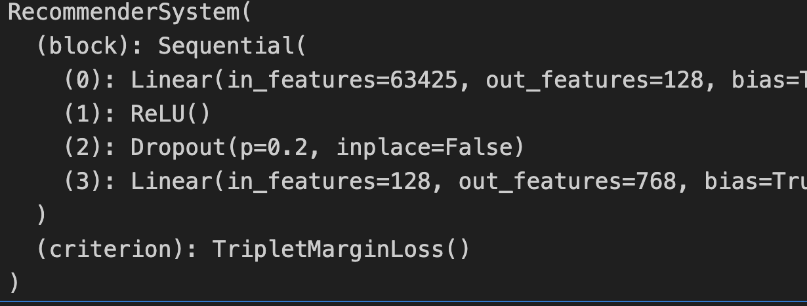
Model Architecture and Training:
Several Architecture was explored with final architecture being a feed forward neural network with a Linear Layer, Relu, Dropout and another Linear Layer.Reducing the number of layers in the neural network, potentially for efficiency or to combat overfitting.

Slide 6
Model Architecture and Training:
Gradient Clipping: A technique to prevent exploding gradients during training.
Learning Rate Scheduler: A method to adjust the learning rate during training for better convergence.
Loss Function used was Triplet Margin loss consisting of Anchor, Positive and Negative which where hard sampled from training data for best results.
The aim is for the neural network to maximize the distance between all training data similar to negative and positive samples using anchor as reference.
Training was done on 10 epochs. Embedding size was reduced to 768 from 63425

Slide 7
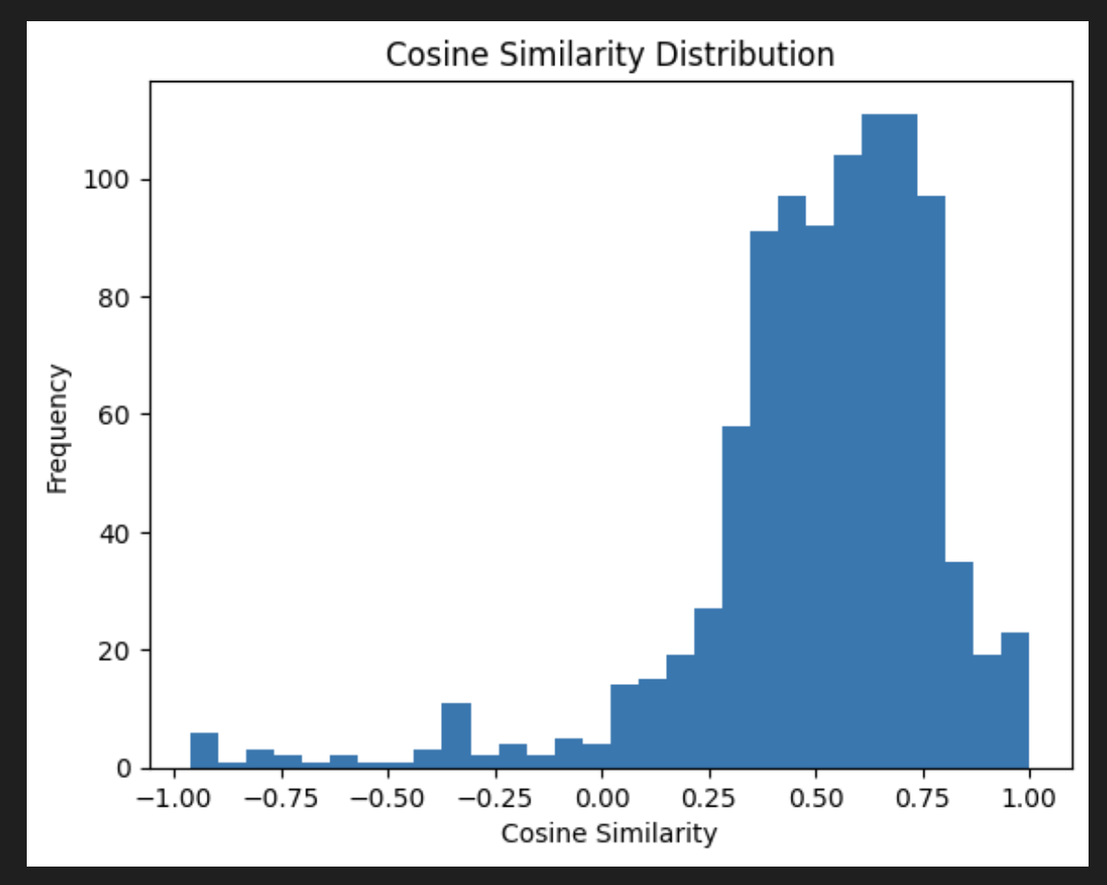
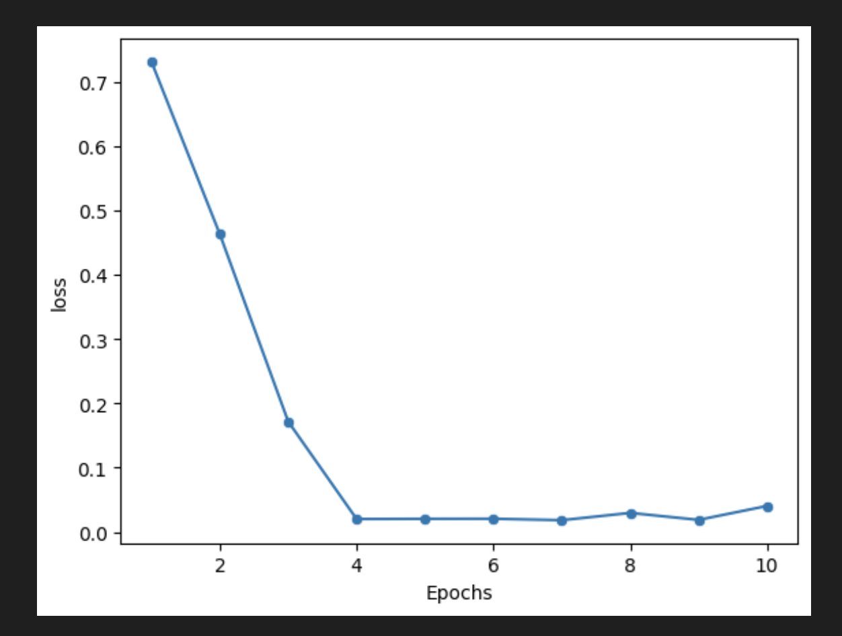
Results and Evaluation

Slide 8
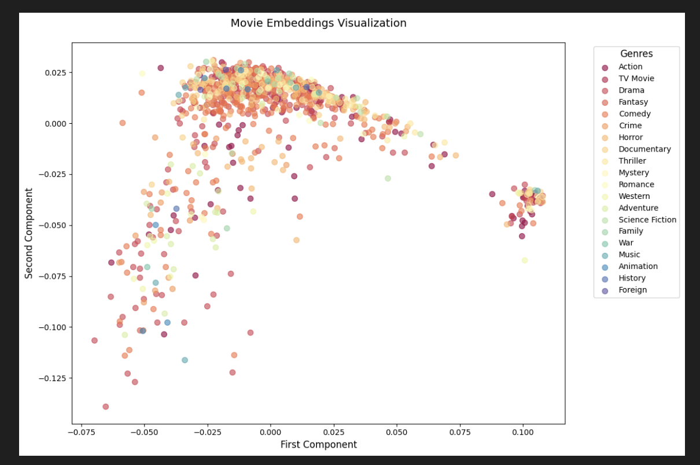
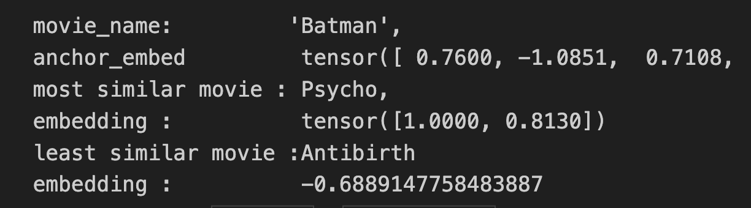
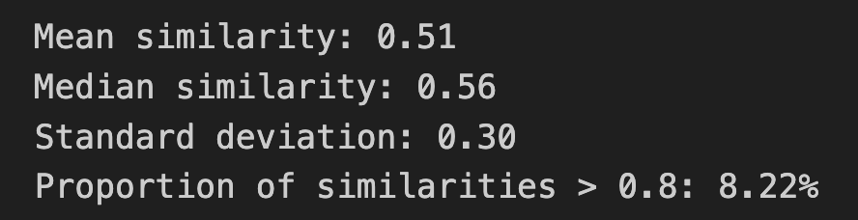
Results

Slide 9
Evaluation Framework
The model generates a list of movie recommendations based on similarity
Cosine Similarity or Euclidean Distance between movie embeddings before and after training visualized.
Movies with embeddings that are close together in vector space are considered similar.
Mean of 0.5 of similarities indicate the model did a good job can be trained to do better.

Slide 10
Challenges and Future Improvements
Data Imbalance
Cosine similarity values from the torch.topk outputs in sections through suggest a potential data imbalance issue. Values are extremely close to 1.0, implying that most movie embeddings are very similar. This could lead to poor discrimination between recommendations.
Hyperparameter Tuning-
Conducting a systematic hyperparameter search using techniques like grid search or random search. Focus on Learning Rate,Triplet Margin,Dropout Rate: Fine-tuning the dropout rate to control the level of regularization and prevent overfitting.
Explore Different Architectures
Challenge: The current model uses a relatively simple feedforward network. More complex architectures, such as convolutional neural networks (CNNs) or recurrent neural networks (RNNs), might be able to capture more intricate patterns in the data

Slide 11
Conclusion
The project aims to build a neural network-based movie recommendation system that provides personalized recommendations based on movie features.
The system utilizes a neural network model to learn from movie data and generate embeddings that represent each film. The goal is to cluster similar movies together in the embedding space, enabling accurate recommendations based on user preferences or movie similarities.

