Slide 1

THERAPY CHATBOT
Team:
Bright Ofori
Siri Gangadharaiah
Date:
12/06/2024

Slide 2
Project Overview and Objectives
This project focuses on creating a chatbot for therapy which is mainly concerned with a person’s mental health.
Experimented with different datasets and with various models to check the quality of the chatbot’s response.
Focuses on a person’s emotions and sentiments.
Being able to understand the context and have a therapeutic conversation with the person.
Experiments focus on:
  Classifying suicidal tendencies
  Conversational-based experiments

Slide 3
Suicidal Classification
Data Source: Chose a dataset from Kaggle to finetune the model.
Objective: Classify if the user’s case is suicidal or not.
Methodology:
  Text classification model using NLP’s pre-trained model BERT
  Dataset: Annotated data of conversations related to mental health
  Approach: model training, validation and then fine-tuned the model using the selected dataset
Outcome: Classifies if the case is suicidal or non-suicidal based on the person’s input

Slide 4
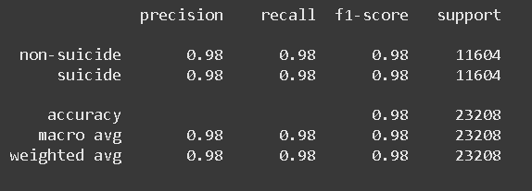
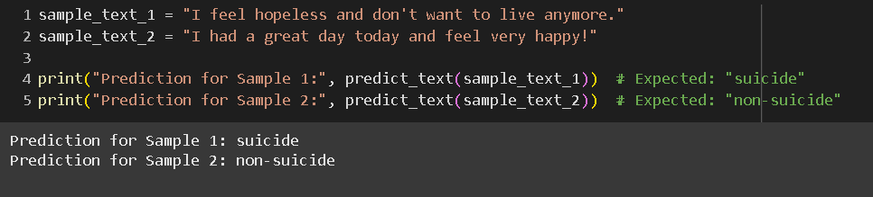
Results

Slide 5
Chatbot – For Therapeutic Conversation
Experimented with 2 models with 2 datasets
Datasets: The one dataset contains conversations between users and experienced psychologists related to mental health topics
The other dataset is labeled, with each question corresponding to a specific user (patient) and the answer provided by a therapist.
Models Used:
Model 1: Meta LLaMA 3 (3B parameters)
Model 2: Meta LLaMA 3 (8B parameters)

Slide 6
Model 1: Meta LLaMA 3 (3B parameters)
Fine-Tuning Approach: The model was fine-tuned on our custom dataset.
Trained using 3 epochs
Challenges and solutions :
  The 3B parameter size posed significant computational demands.
  To address this, the model was loaded in an 8-bit quantized format with float16 precision to reduce memory usage.
  Performance-efficient fine-tuning (PEFT) techniques were employed to optimize training on limited resources.
  Gradient clipping was applied to manage memory consumption effectively and ensure stable training.
Results: Performance was satisfactory but highlighted potential areas for improvement, particularly in terms of generalization and accuracy on complex tasks.

Slide 7
Model 2: Meta LLaMA 3 (8B parameters)
Fine-Tuning Approach: The larger 8B parameter model was fine-tuned on the same custom dataset.
Trained using 3 epochs
Challenges and solutions :
  The larger model significantly increased computational complexity and resource demands.
  Similar to Experiment 1, the model was loaded in an 8-bit quantized format with float16 precision.
  Advanced PEFT techniques were employed to handle the scale of the model.
  Gradient clipping was used to ensure memory optimization and prevent gradient explosion.
Results:
  The 8B parameter model demonstrated markedly better performance compared to the 3B model.
  Improvements were observed in:
    Accuracy on the custom dataset
    Ability to handle nuanced and complex queries

Slide 8
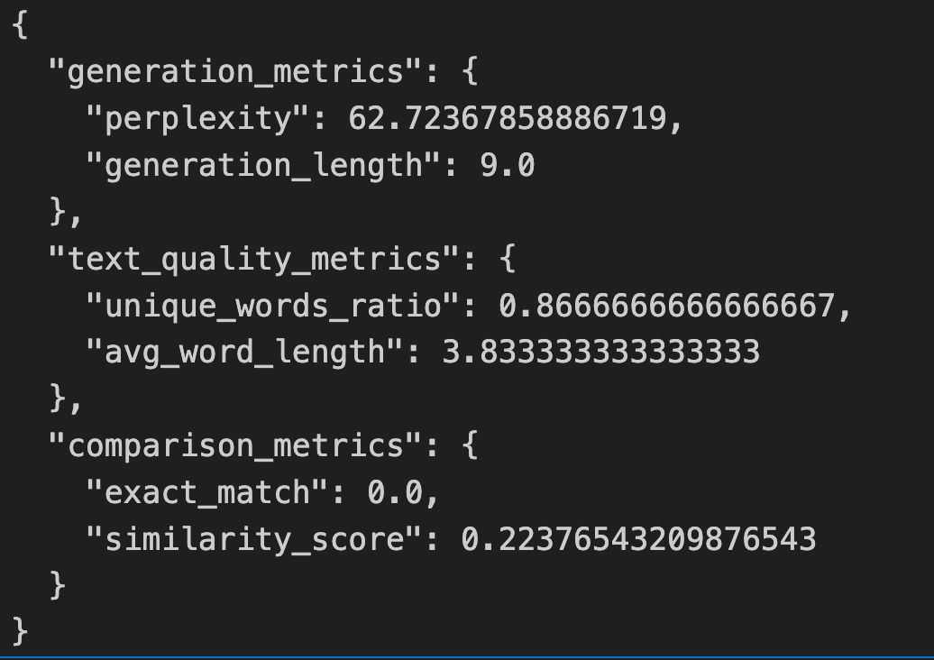
Evaluation Metrics

Slide 9
Recommendations for future work:
Fine-tuning: Augment the training data with examples of nuanced or mixed-sentiment messages to reduce false positives.
Threshold Adjustment: Apply a confidence threshold (e.g., 0.9 for LABEL_1) to minimize the overclassification of ambiguous messages as suicidal.
Hardware Utilization: Ensure GPU utilization by setting the device parameter in the pipeline to speed up inference and potentially enhance real-time applications.
Explainability: Implement interpretability techniques (e.g., SHAP or LIME) to better understand why the model flags certain messages.

Slide 10
Conclusion and Next Steps
Key Observations:
Larger models (8B parameters) have a clear advantage in terms of performance and accuracy, though they require more computational resources.
Efficient techniques like quantization, PEFT, and gradient clipping are essential to make training on large models feasible.
Next Steps:
Conduct further fine-tuning with additional epochs to explore potential gains.
Investigate parameter-efficient inference techniques to optimize real-world deployment.
Explore additional optimizations like mixed-precision training and advanced PEFT methods for scaling to even larger models.

Slide 11
Thank You!

