Slide 1
Reading files from Colab

Slide 2
Unlike idle or jupyter, we have to make lines of code to open files
Add these lines of codes at the beginning of your colab page

Slide 3
Running files with colab
Add your ipynb files to your google drive
Right-click the file and use colab to open file

Slide 4
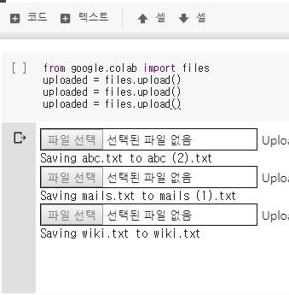

Slide 5
Adding Files
Add files to colab by clicking the folder that you will be using.

