Slide 1

Files
Lesson 7

Slide 2
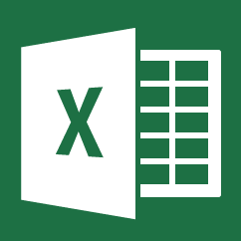


Opening a file
Python can locate a certain file with the open function
Read
Write
Append
Close
Etc.
.xlsx
.csv
.tsv
.txt
.py

Slide 3
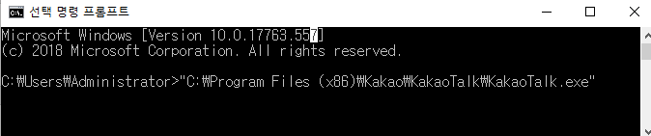
File handler
File handler is used to do something with a file within python
handler = open(file, mode)
1. Name of the function
2. Function to open a certain file
3. Name/location of a file
4. Mode of the open function

Slide 4

Modes of open()
handler = open(file, mode)
Welcome! This page is only for discussing the contents of the Main Page. It isn't for general questions unrelated to the Main Page or for the addition of content to Wikipedia articles.
“r” = for reading only
“w” = for overwriting a file
“r+” = for reading and writing
“a” = for appending to a file

Slide 5
Modes of open()
handler = open(file, mode)
Welcome! This page is only for discussing the contents of the Main Page. It isn't for general questions unrelated to the Main Page or for the addition of content to Wikipedia articles.
“r” = for reading only
“w” = for overwriting a file
“r+” = for reading and writing
“a” = for appending to a file

Slide 6
Modes of open()
handler = open(file, mode)
Welcome! This page is only for discussing the contents of the Main Page. It isn't for general questions unrelated to the Main Page or for the addition of content to Wikipedia articles.
“r” = for reading only
“w” = for overwriting a file
“r+” = for reading and writing
“a” = for appending to a file

Slide 7
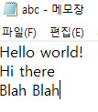


File handle sequence
abc.txt
File handle sequence
result
File handle sequence
Reads each line of file
For in = for each line in

Slide 8
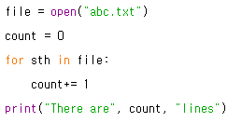
File handle sequence
Counting the number of lines in a file
Opening a file
Creating a variable ‘count’
For each line in ‘abc.txt’
Add 1 to count
Printing the result

Slide 9
#newline characters
In python, we express a change of line with ‘\n’
Ex)
Gallimimus was a theropod dinosaur that lived in what is now Mongolia about 70 million years ago, during the Late Cretaceous.
What you see on the web
How python sees the same text
Gallimimus was a theropod dinosaur that\n lived in what is now Mongolia about 70\n million years ago, during the Late/n Cretaceous.

Slide 10


#newline characters
This is applied within python as well

Slide 11
Reading a file
str_file = open(‘abcd.txt’).read()
.read() : function that converts whatever inside a txt file into a string
str_file =“whatever was inside the text file

Slide 12
Counting the number of words in a text
File handler : lets us do something to a file
len(x): returns the length of x
Can we count how many words there are in a text file?
We will be reading “wiki.txt”
len() only works on strings

Slide 13
1. open the file
2. convert the file into a string
3. get the length of the string

Slide 14

Counting the number of words in a text
File handler
Converting file with read()
Printing the length of string
= How many words are in the file?

Slide 15
Extracting only what we want
Remember the functions we learned in ‘strings’?
line.startswith()
line.endswith()
How can we get the lines with the information we want?

Slide 16
Extracting only what we want
Situation: from ‘wiki.txt’ , we only want the lines that start with ‘From’
How can we make python print the lines that start with ‘From’?
How can we print lines that do not start with ‘From’?

Slide 17
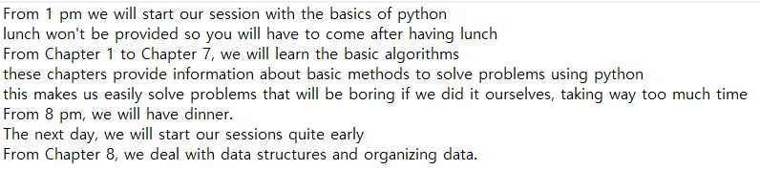
Extracting only what we want
wiki.txt

Slide 18
1. open the file! (wiki.txt)
2. for each line in the txt file
3. if the line startswith “From”
4. print

Slide 19
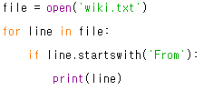
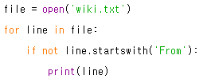
Extracting only what we want

Slide 20
Lists
Lesson 8

Slide 21
What’s a list?
A group of values put inside a single variable
Lets us call in a load of values with a single variable
Makes the code more concise, simple, easier
Format: list1 = [ a, b, c ]

Slide 22
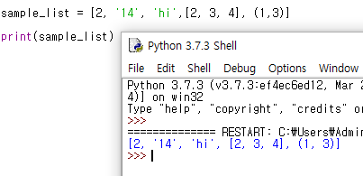
Things that can go inside a list
strings
numbers
lists
*tuples
etc

Slide 23
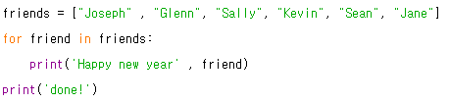
When is it used?
List is commonly used with loops
List: stores multiple values
Loops: suitable for processing multiple values

Slide 24
Try
We have a list of 5 numbers, 19, 23, 16, 27, 84
How can we create a list where each variable is five times larger than the original list?

Slide 25
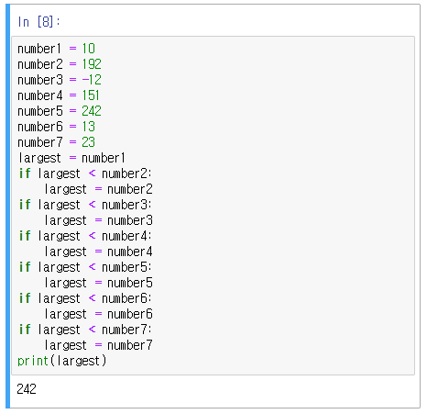
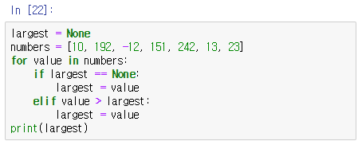
When is it used?

Slide 26
Strings vs Lists
String
List
immutable
cannot fix
len() = number of characters
string = “hello”
len(string) = 5
mutable
can fix wherever you want
len() = number of values
list = [1, 2, ‘hi’ , [2, 4, 5]]
len(list) = 4

Slide 27
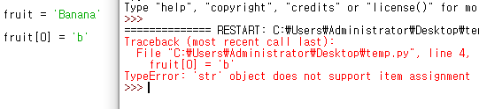
Fixing a list
Fixing a string

Slide 28
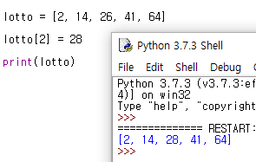
Fixing a list
Fixing a list

Slide 29

The Range Function
returns a list of numbers from 0 to a parameter
range(4) == [0, 1, 2, 3]
used with len()

Slide 30
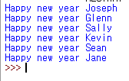
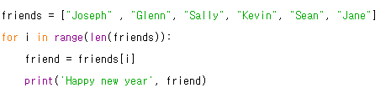
Diverse Methods for Solving a Problem

Slide 31

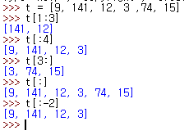
Concatenating/Slicing a list
Concatenating
Slicing
t[a:b] = from a to b

Slide 32
Methods used in Lists
Append
Count
Extend
Index
Sort
Insert
etc

Slide 33
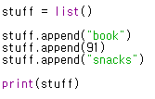
Creating a List
We can create an empty list and add elements using the append method
The appended elements go to the end of the list

Slide 34

Checking if in List
To check if a certain variable is in a list, we use in

Slide 35
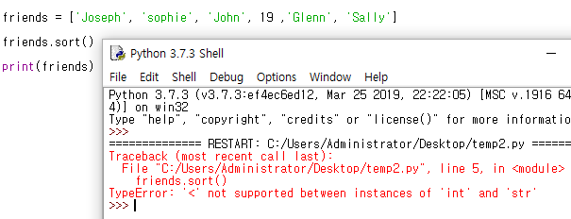
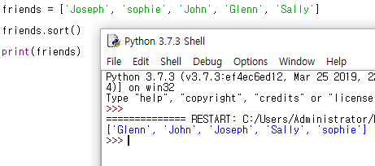
Sorting Variables
We can rearrange the order of variables
If all variables are the same type
In alphabetical / numerical order
Capital > Lower case

Slide 36
Try
Try arranging the given lists, see what happens
list1 = ['Gray', 'Purple', 'red', 'black', 'Yellow', 'green']
[4, 'hi', 15, 'ag']

Slide 37
Built-in Functions
nums = [3, 41, 12, 8, 53, 13]
Try:
len(nums) > number of variables
max(nums) > the largest number
min(nums) > the smallest number
sum(nums) > sum of numbers

Slide 38
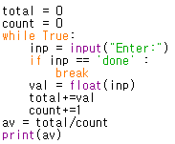
Getting the Average 1
Using all that we learned, we can make a program that gets the average

Slide 39
Getting the Average 2
Let’s make a same program using a list
len(list)
sum(list)

Slide 40
Getting the Average 2
numlist = list()
while True:
inp = input("Enter:")
if inp =='done':
break
val = float(inp)
numlist.append(val)
average = sum(numlist)/len(numlist)
print(average)

Slide 41
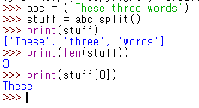
Strings & Lists
Strings and Lists are often used together

Slide 42
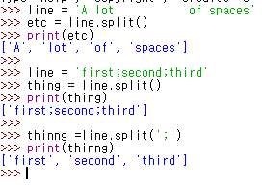
String parameters of split() : indicates where the string should be sliced

Slide 43
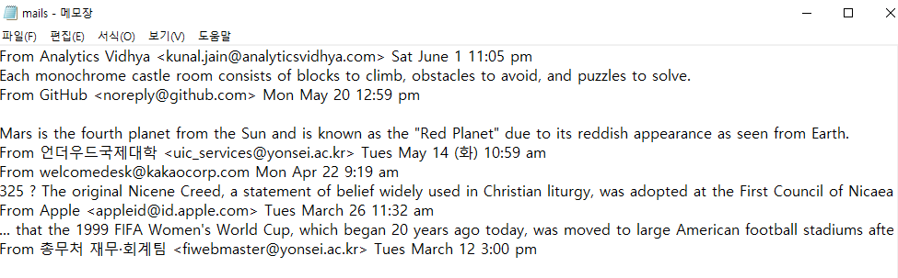
Exercise
Let’s read the file mails.txt
Remove all junk lines
Make each lines of email into a list
See from which group the mails are coming from

Slide 44


Slide 45
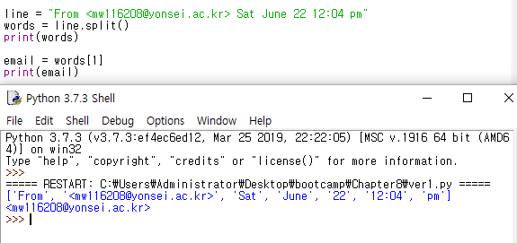

Slide 46
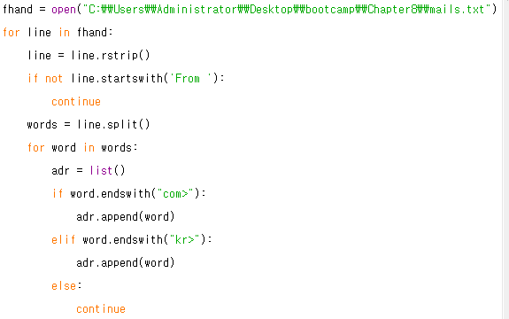

Slide 47
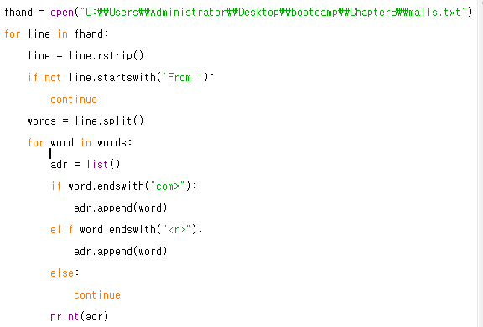

Slide 49
Try yourself
From mails.txt, get all the Months
From mails.txt, get all the hours
12:30

Slide 50
Dictionaries
Lesson 9

Slide 51
Basic Terms
Keys: variables that are used to call in Values
Values: variables that get called in by Keys

Slide 52

Lists vs Dictionaries
Organized according to the order
Indexes have to be integers
Order of values work as keys
[ a, b, c ]
List

Slide 53

Lists vs Dictionaries
Dictionary
Organized according to keys and values
Indexes can be of any type
{ key1: val1, key2:val2}
Only one value per key

Slide 54
How to use a Dictionary
Adding new Key & Value
Calling values using key
Modifying the dictionary

Slide 55


How to use a Dictionary
Adding new Key & Value
Creating and empty dictionary
Adding new keys and values (similar to append() of lists)

Slide 56

How to use a Dictionary
Calling values using key (indexing)
In lists, the order of variables work as keys
Name_of_dict[ ‘key’ ] == val

Slide 57

How to use a Dictionary
Modifying a dictionary
We can simply modify our dictionaries by rewriting the keys and values

Slide 58
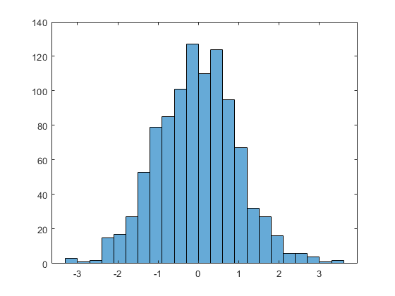
Creating a Histogram
Histogram : graph used to see the distribution of data
Need to count how many times a certain variable appears

Slide 59
Counting Data
Using dictionaries, it is possible to get the frequency of data
If a certain data appears for the first time, we can make a key for that type of data
If the data appears again, we can add 1 to the value assigned to the data

Slide 60
cow
dog
chicken
dog
dog
pig
pig

Slide 61
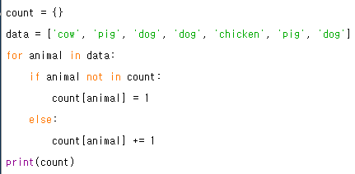
Creating an empty dict
For each variable in data
If that animal is not in the list yet
Make that animal a key with the value of 1
If it is in the list
Add 1 to the value of that key(animal)

Slide 62

The get( ) method
The lines of code for counting is used too many times
So, people made a method to do it quickly

Slide 63
The get( ) method
for animal in data:
count[animal] = count.get(animal, 0) +1
get(name of key , default value) +1

Slide 64
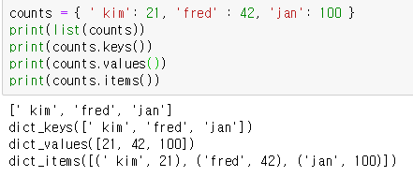
Retrieving lists of Keys and Values
We can choose if we are going to print keys, values, or both

Slide 65



‘for’ loop for dictionaries
for loop reads keys and values separately

Slide 66
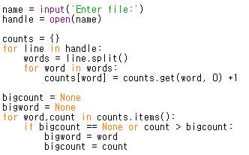

Slide 67
Try Yourself
Write the codes from the previous screen
Create a textfile, whatever the content is, and try to see which word most frequently appears

Slide 68
Tuples 10
Lesson 10

Slide 69


Tuples
Immutable lists with a round bracket
[ ] vs ( )
Almost all functions work in the same way
Except the ones that modify the list

Slide 70
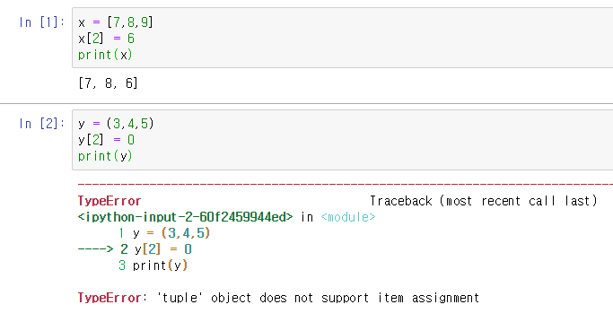

Slide 71
Why do we use Tuples?
They are more efficient than lists (for processing)
They take up less memory and perform better
Often used when storing temporary data

Slide 72
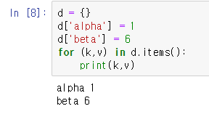


When tuples come to the left
We can assign multiple values to multiple variables when using tuples

Slide 73
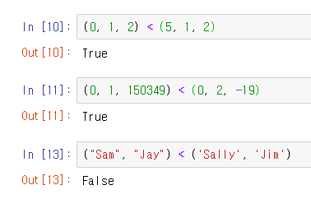
Comparing Tuples

Slide 74

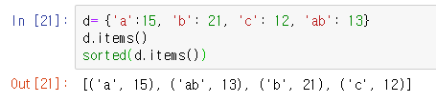
Sorting List of Tuples
List of tuples: we’ve seen it many times in dictionary
We can sort tuples to come in an alphabetical/numerical order
sorted() only sorts by keys

Slide 75
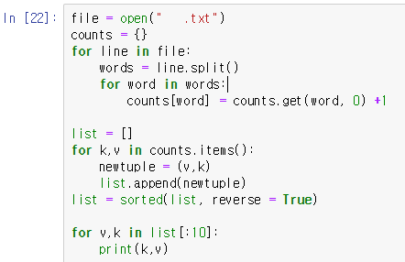
How can we sort by Values?
Flip it
Sorting in a descending order

