Slide 1
Smart Air Quality and Pollution Analytics
DATA ANALYTICS AND VISUALISATION | PHASE 1: PROBLEM IDENTIFICATION
Good
Satisfactory
Moderate
Poor
Making India’s air-quality data easy to see, compare and act on
Very Poor
Severe
Notes:
Introduce the project: a Data Analytics and Visualisation dashboard that makes India's air-quality data understandable. The coloured scale on the right previews the AQI categories used throughout the dashboard.

Slide 2



Problem Statement
People cannot easily monitor, understand and compare air pollution levels across Indian states and cities. A simple analytics dashboard is needed to visualise pollutant levels and identify trends and highly polluted areas.
Pollutants to visualise
AQI
PM2.5
PM10
NO₂
SO₂
CO
O₃
Monitor
Compare
Identify hotspots
Notes:
The core problem statement. The dashboard has to cover AQI plus six pollutants (PM2.5, PM10, NO2, SO2, CO, O3) and support three jobs: monitoring, comparing and identifying highly polluted areas.

Slide 3






Target Users
General Public
Students
Researchers
Check air quality in their city
Learn and analyse air-pollution data
Study pollution patterns and trends
Government Officials
Environmental Organizations
City Planners
Monitor levels and identify critical areas
Analyse pollution and create awareness
Support environmental planning and decisions
Notes:
Six audiences with different needs: the public wants a quick city check, students and researchers want to analyse patterns, and officials, NGOs and planners need to find critical areas and act.

Slide 4





Expected Features
AQI and pollutant trends
Pollution map
State and city comparison
Trends of AQI and all six pollutants
Colour-coded AQI by location across India
Compare air quality between regions
Highly polluted areas
AQI prediction
Monthly reports
Top 10 ranking of the worst cities
Forecast near-term AQI from past trends
Summaries of pollution levels by month
Notes:
Features follow the assignment pattern (trends, map, prediction, reports) and add comparison and hotspot ranking from the expected dashboard.

Slide 5
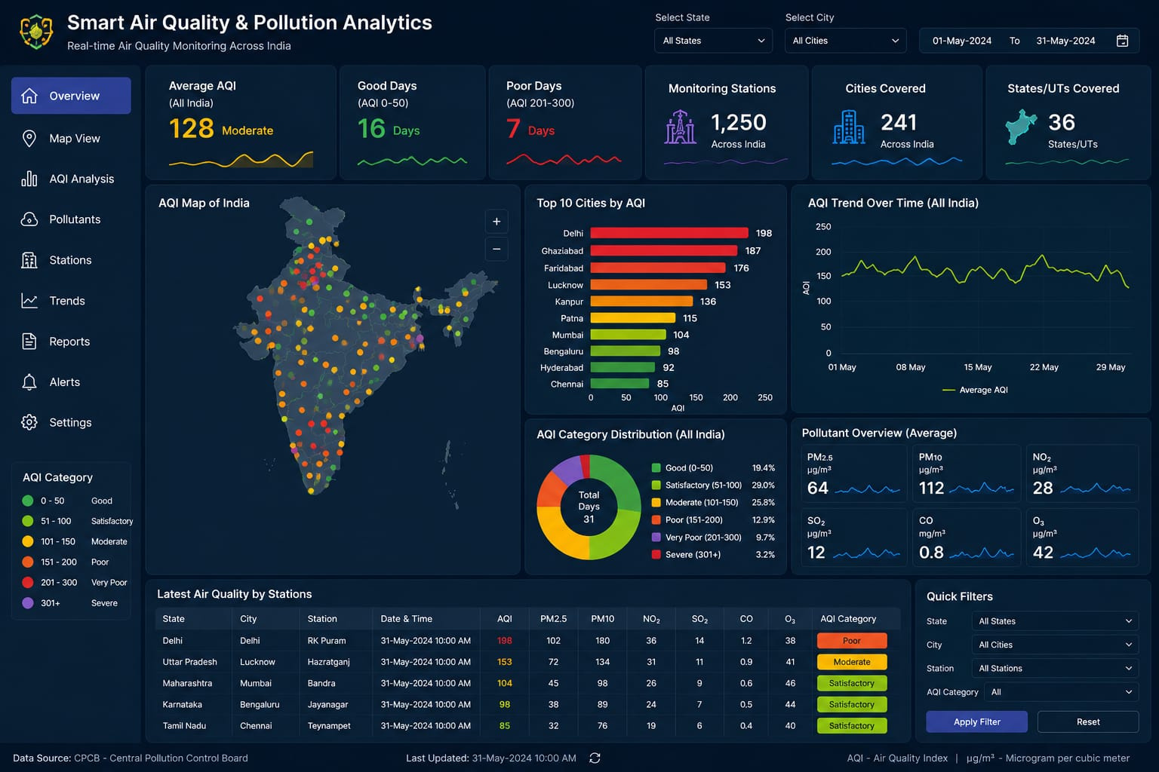
Expected Dashboard
At a glance
KPI cards for average AQI, good and poor days, and coverage
Explore
Map, city ranking, trend line and category split
Drill down
Filters by state, city, station and date range
Notes:
The target dashboard: a dark, single-screen overview with KPI cards, an India map, rankings, trends, category distribution, pollutant averages, a station table and quick filters.

Slide 6





Dashboard Components
KPI Cards
AQI Map
Top 10 Cities
Trend Line
Headline AQI numbers
Spot hotspots by location
Rank the most polluted
Track change over time
Category Donut
Pollutant Overview
Station Table
Quick Filters
Share of days per band
Average PM, NO₂, SO₂, CO, O₃
Latest reading per station
Slice by state, city, date
Notes:
Each component answers one question: how bad is it overall, where, which cities, how is it changing, which pollutant, which station, and how can I filter to my area.

Slide 7
Thank You
Questions and feedback are welcome
Smart Air Quality and Pollution Analytics
Notes:
Close and invite questions.

