Slide 1
Segregated Temporal Assembly Recurrent Networks for Weakly Supervised Multiple Action Detection
Hikvision Research Institute, China
Shanghai Jiao Tong University, China
Zhejiang University, China

Slide 2
CONTENT
1
1
2
3
4
Problem
Method
Experiments
Conclusion

Slide 3
1. Problem

Slide 4

Task of Temporal Action Localization
frame-level annotations ?
In a fully-supervised approach, the training needs
precise start time point
precise end time point
frame-level class label
time-consuming, expensive
video-level

Slide 5
video-level annotations ?
Q1. What is the ideal representations?
Background
Cricket bowling
Cricket Shot
Background
Q2. How to get the representation without frame-level annotation?
no interference of backgrounds
correlation among actions
Action assembling for separated instance-patterns
RNN for multiple instance-pattern generation

Slide 7
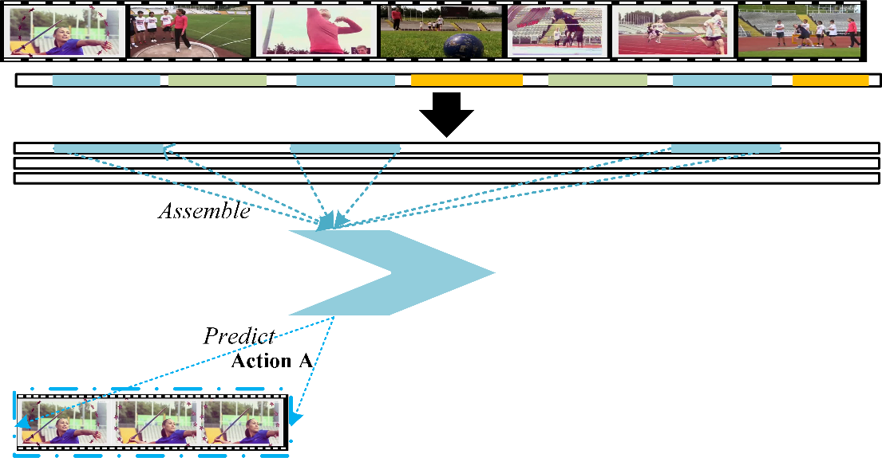

Slide 8
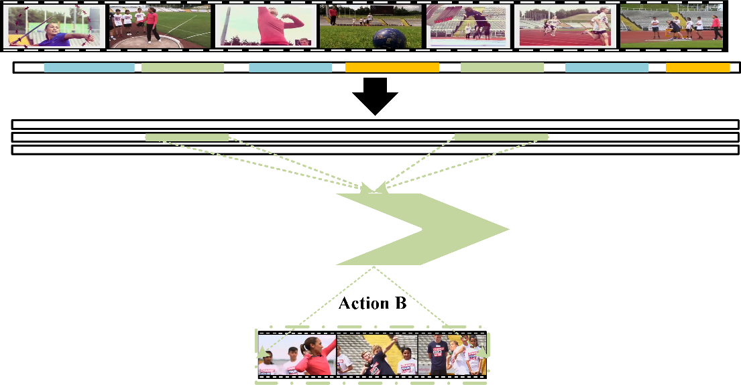

Slide 9
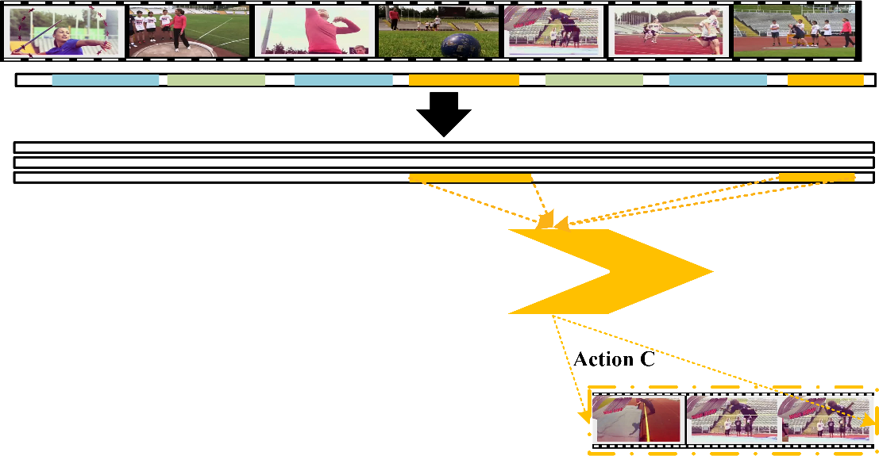

Slide 10
2. Method

Slide 11
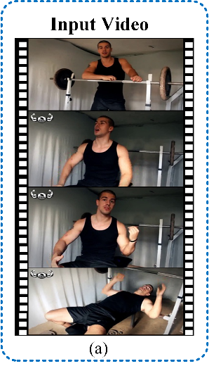

Slide 12
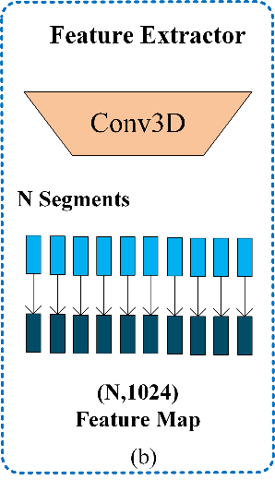

Slide 13
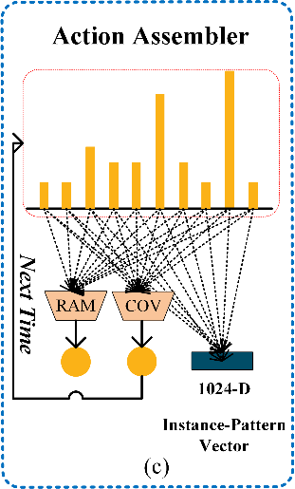

Slide 14
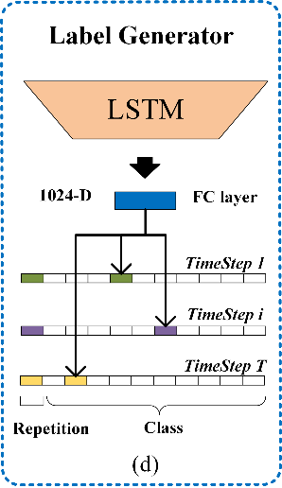

Slide 15
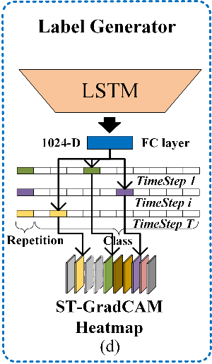

Slide 17
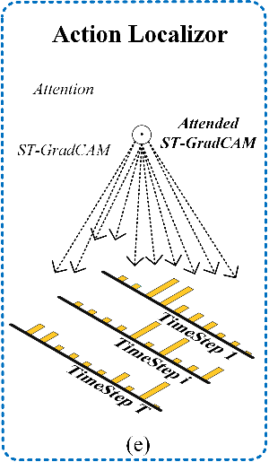
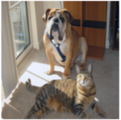
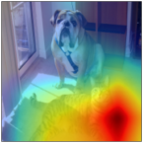





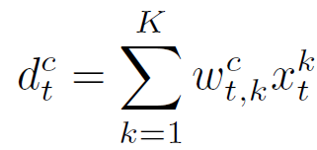
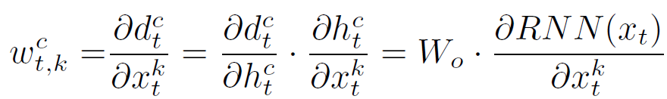
Generalization of Class Activation Mapping (CAM):
Original Image
CAM ‘Cat’
FC Layer
Feature Map
Output Distribution

Slide 18
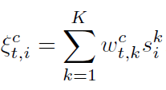

Attended
ST-GradCAM:

Slide 19
Repetition Alignment:
Frequency
3
8
1

Slide 20
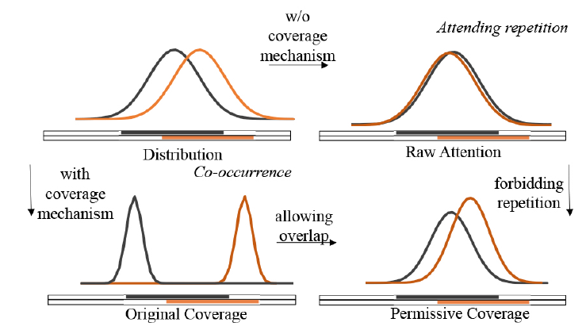
Permissive Coverage:

Slide 21
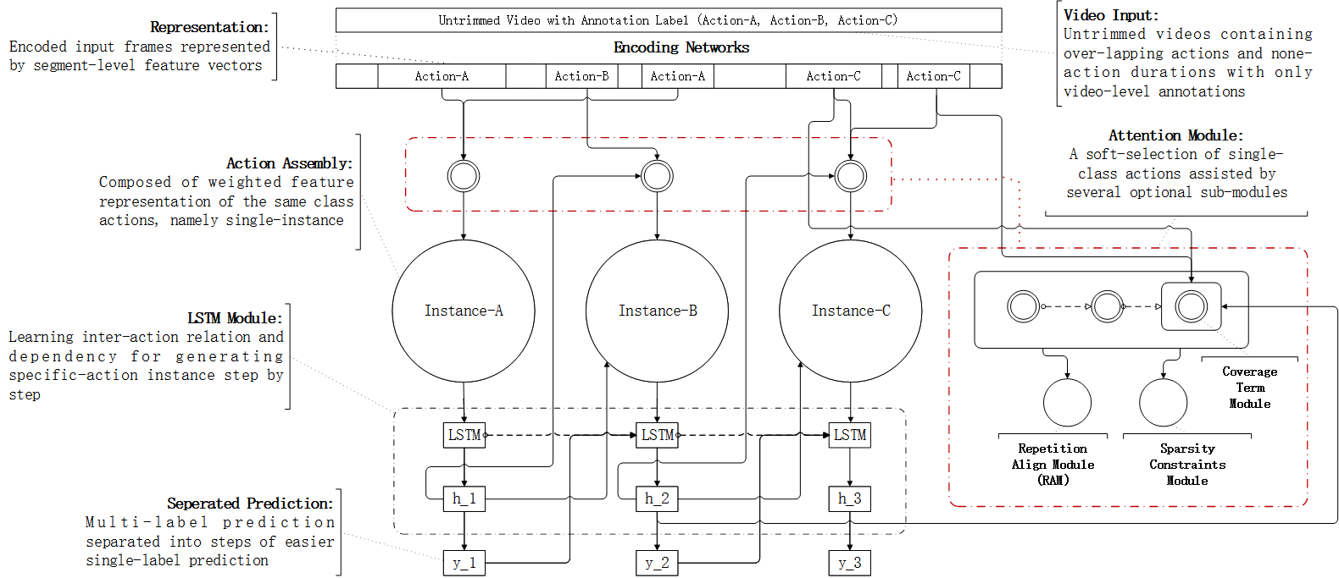
One-by-one Label Generation:

Slide 22
3. Experiment

Slide 23
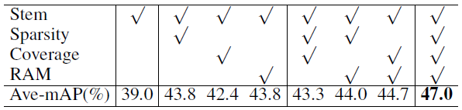
Sub-module Study:
3
8
1
RAM
COV
SPA
Table 1: Effects of sub-modules on THUMOS’14

Slide 24
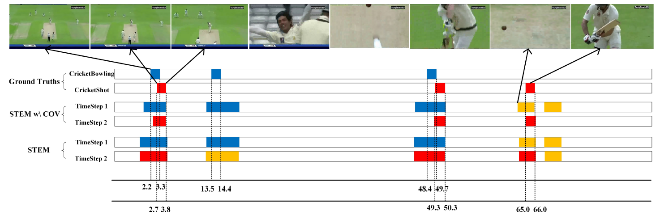
Effects of Coverage Sub-module

Slide 25
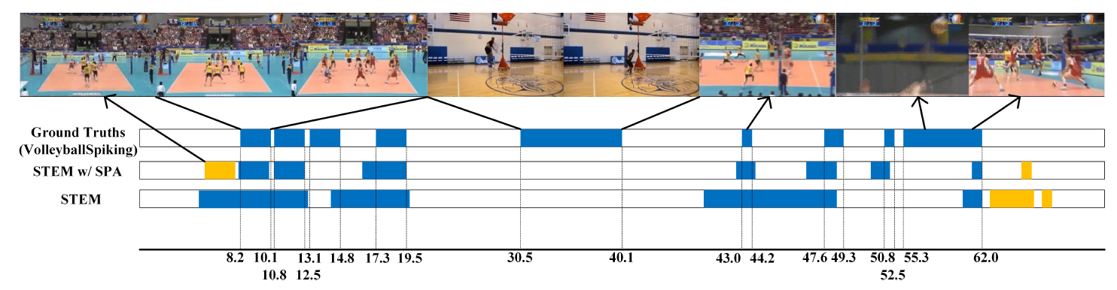
Effects of Sparsity Sub-module

Slide 26
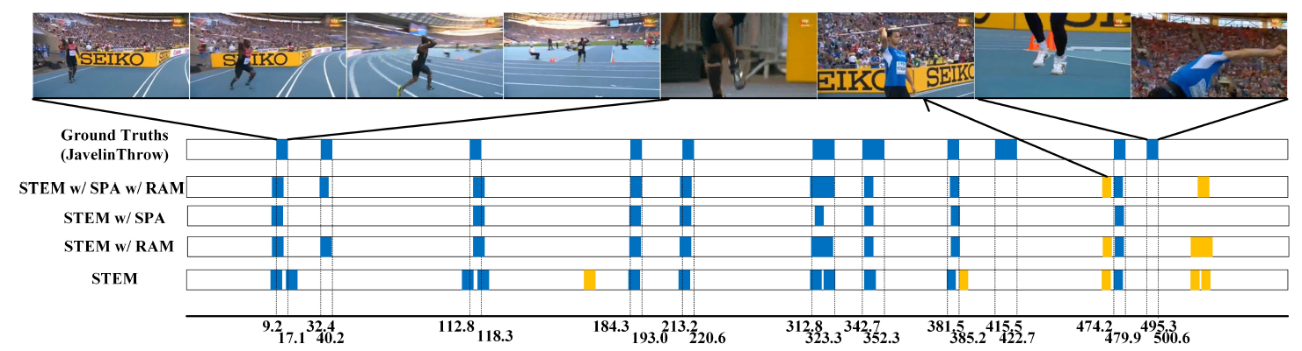
Effects of RAM Sub-module

Slide 27
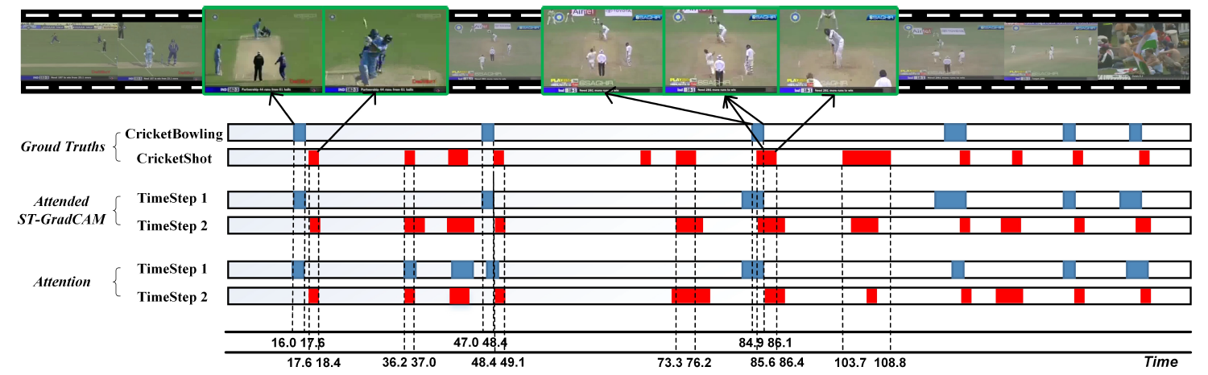
Overall Results:

Slide 28
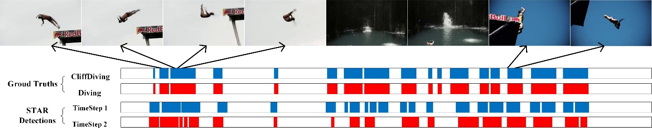
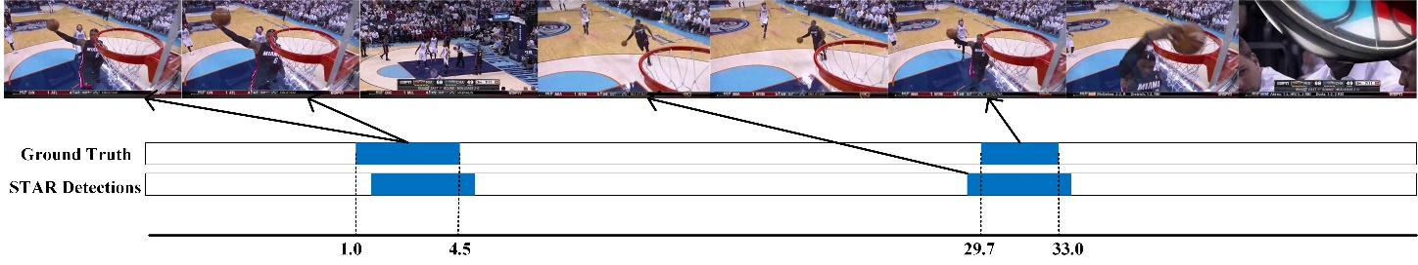

Slide 29
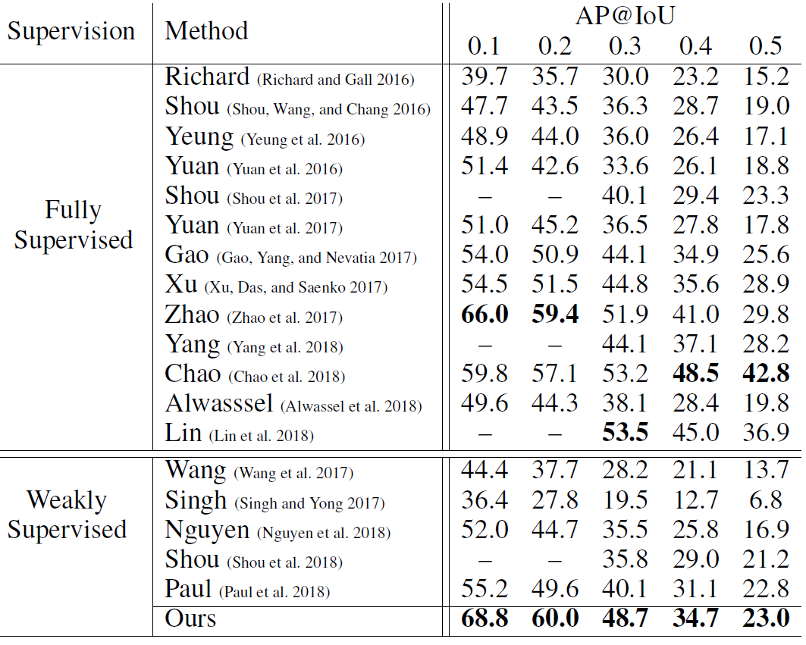
Table 2: Comparison with state-of-the-art on THUMOS’14
Notes:
STAR各指标超过公开的所有弱监督的方法
AP@IoU-0.1超过现所有的强/弱监督方法
STAR为针对多类别事件的改进，故THUMOS(左)数据集的结果更有参考价值

Slide 30
4. Conclusion

Slide 31
Conclusion:
Our STAR surpasses all the reported weakly supervised methods on both THUMOS’14 and ActivityNet v1.3.
Our STAR significantly narrows down the gap between the fully and weakly supervised methods
Future Work:
We’ll further accurate the locations of multi-actions by designing weakly supervised boundary strategies.

Slide 32
THANKS !

