Slide 1


Slide 2

Major Project-II (01CE0807), Semester 8
Review 1
(08/11/2025)
Intrusion Detection and Prevention in VANET using Federated Learning
Team ID: 8PRO_011
Team Member 1: Dev Sejpal (92200103134) (TC5)
Team Member 2: Dharmil Parekh (92200103144) (TC5)
Guided By
Internal Guide Name: Prof. Ravikumar Natrajan
Department of Computer Engineering,
Faculty of Engineering & Technology

Slide 3
Outline
Abstract
Introduction
Literature Review
Research Gap
Work Flow
Methodology
Graphs
Tools and Technologies

Slide 4
Abstract
Vehicular Ad Hoc Networks (VANETs) form the backbone of modern intelligent transportation systems, enabling real-time communication between vehicles and roadside infrastructure. However, their decentralized and highly mobile nature exposes them to numerous cyber-threats, including gray-hole attacks, spoofing, false message injection, jamming, and CAN-bus manipulation. Conventional machine-learning-based intrusion detection systems require centralized data aggregation, raising privacy concerns, scalability limitations, and high communication overhead. To address these challenges, this work proposes a Federated Learning–enabled Intrusion Detection and Prevention System (FL-IDPS) that collaboratively learns global threat patterns without sharing raw vehicular data.

Slide 5
Introduction
The rapid deployment of connected and autonomous vehicles has intensified the reliance on VANETs for safety-critical communication such as collision avoidance, cooperative sensing, and traffic optimization. Due to their open wireless communication medium, high-speed topology changes, and lack of centralized control, VANETs remain highly vulnerable to cyberattacks that compromise vehicle safety and transportation integrity. Federated Learning (FL) offers a promising alternative by enabling privacy-preserving collaborative model training across distributed vehicular nodes. In this context, this research presents an optimized FL-driven intrusion detection and prevention framework.

Slide 6
Research Gap
Although significant progress has been made in ML-based and DL-based IDS for vehicular networks most existing solutions rely on centralized training, which is incompatible with VANET privacy constraints, high mobility, and heterogeneous data distributions. Federated Learning–based IDS approaches have emerged, yet they remain limited in handling VANET-specific challenges such as non-IID data caused by varying road conditions, inconsistent driver behavior, and intermittent connectivity. Furthermore, current FL vehicular IDS solutions do not fully address real-time computation constraints. Therefore, there is a critical need for a scalable, privacy-preserving, real-time FL-based IDS that integrates cross-layer VANET features, supports continuous online learning, maintains adversarial robustness, and achieves high detection accuracy under mobility-driven non-IID data distributions.

Slide 7
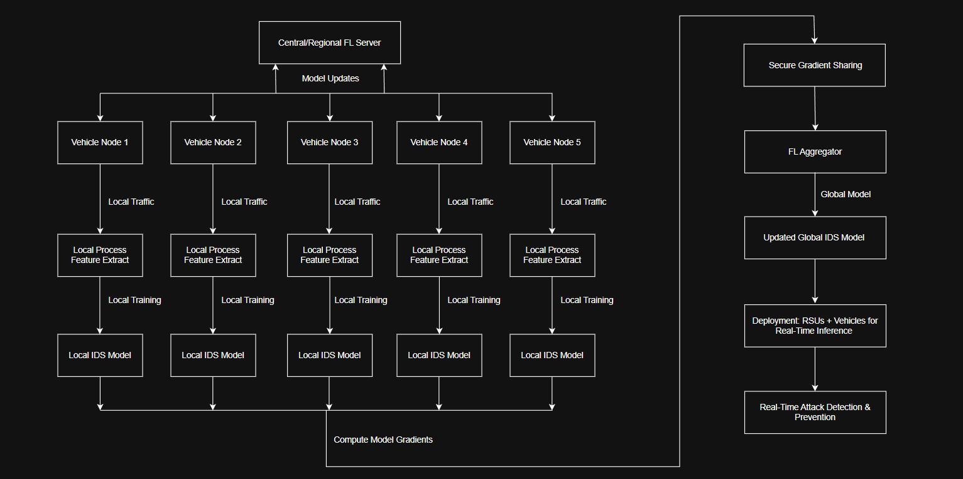
Work Flow

Slide 8
Methodologies
Collect VANET-related intrusion detection dataset
Perform data preprocessing (missing value handling, encoding, normalization)
Apply Mutual Information for feature selection
Implement centralized learning as a baseline model
Split dataset into multiple clients for federated learning
Distribute data in IID and Non-IID formats to simulate realistic VANET scenarios
Train local models on each client without sharing raw data
Aggregate client updates using FedAvg and FedProx algorithms
Iterate training over multiple communication rounds
Apply early stopping to reduce overfitting and communication cost
Evaluate models using accuracy, precision, recall, F1-score, and false positive rate
Compare centralized, IID federated, and Non-IID federated performance
Implement intrusion prevention logic (ALLOW / BLOCK actions)

Slide 9
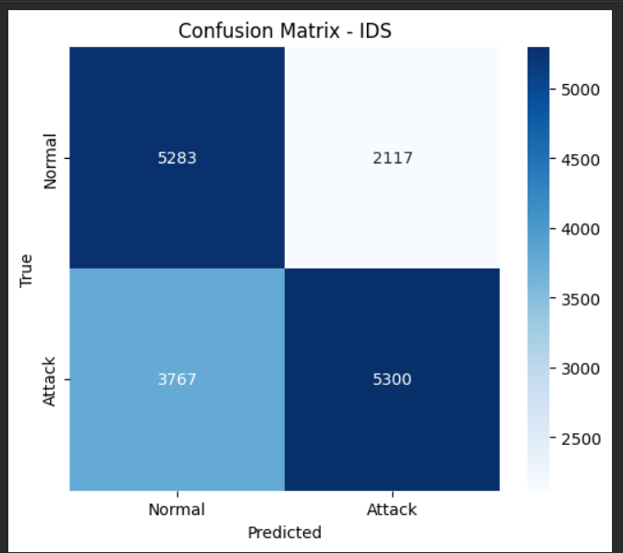
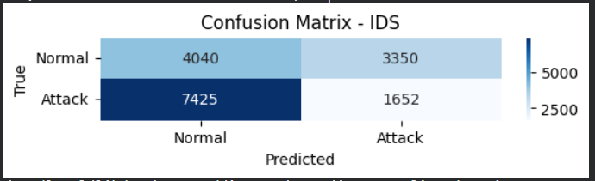
Non IID vs IID
a.) Confusion Matrix for Non IID
b.) Confusion Matrix for IID

Slide 10
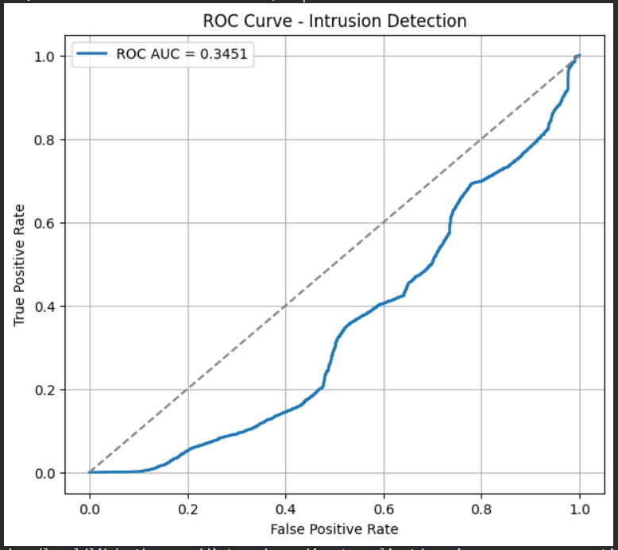
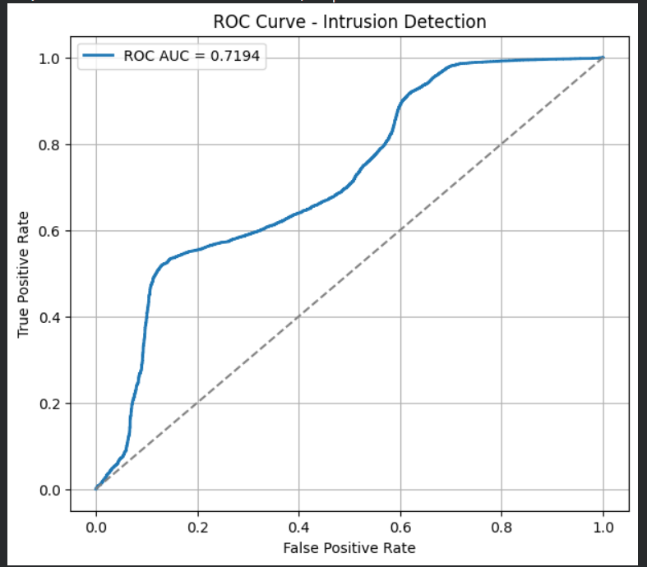
Non IID vs IID
a.) ROC Curve for Non IID
b.) ROC Curve for IID

Slide 11
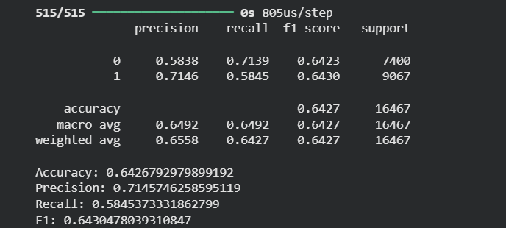
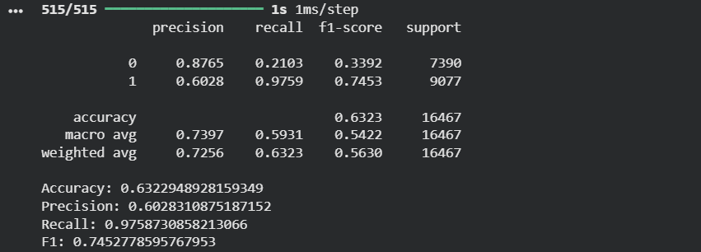
Non IID vs IID
a.) Metrices for Non IID
b.) Metrices for IID

Slide 12
Tools and Technologies
Python – Primary programming language for data processing, model development, and experimentation
Google Colaboratory – Cloud-based execution environment with GPU support
NumPy – Numerical computations and array operations
Pandas – Dataset loading, preprocessing, and result analysis
Scikit-learn –
Data normalization and encoding
Mutual Information–based feature selection
Dataset splitting (Centralized, IID, Non-IID)
Performance metric evaluation
TensorFlow / Keras (or PyTorch) – Machine learning and deep learning model implementation
Flower (FLWR) – Federated learning framework for simulating distributed vehicular clients
FedAvg & FedProx – Federated optimization algorithms for model aggregation
Matplotlib & Seaborn – Visualization of accuracy, loss, and convergence trends
CSV & Pandas DataFrames – Experimental logging and result storage

Slide 13


