Slide 1


Slide 2

Major Project-II (01CE0807), Semester 8
Review 1
(08/11/2025)
Void Voyager: Endless Space Adventure Game
Team ID: xxxxx
Team Member 1: Dev Sejpal (92200103134) (TC5)
Team Member 2: Dharmil Parekh (92200103144) (TC5)
Guided By
Internal Guide Name: Prof. Ravikumar Natrajan
Department of Computer Engineering,
Faculty of Engineering & Technology

Slide 3
Outline
Abstract
Introduction
Literature Review
Research Gap
Work Flow
Methodology
Graphs
Tools and Technologies

Slide 4
Abstract
Vehicular Ad Hoc Networks (VANETs) form the backbone of modern intelligent transportation systems, enabling real-time communication between vehicles and roadside infrastructure. However, their decentralized and highly mobile nature exposes them to numerous cyber-threats, including gray-hole attacks, spoofing, false message injection, jamming, and CAN-bus manipulation. Conventional machine-learning-based intrusion detection systems require centralized data aggregation, raising privacy concerns, scalability limitations, and high communication overhead. To address these challenges, this work proposes a Federated Learning–enabled Intrusion Detection and Prevention System (FL-IDPS) that collaboratively learns global threat patterns without sharing raw vehicular data.

Slide 5
Introduction
The rapid deployment of connected and autonomous vehicles has intensified the reliance on VANETs for safety-critical communication such as collision avoidance, cooperative sensing, and traffic optimization. Due to their open wireless communication medium, high-speed topology changes, and lack of centralized control, VANETs remain highly vulnerable to cyberattacks that compromise vehicle safety and transportation integrity. Federated Learning (FL) offers a promising alternative by enabling privacy-preserving collaborative model training across distributed vehicular nodes. In this context, this research presents an optimized FL-driven intrusion detection and prevention framework.

Slide 6
Research Gap
Although significant progress has been made in ML-based and DL-based IDS for vehicular networks most existing solutions rely on centralized training, which is incompatible with VANET privacy constraints, high mobility, and heterogeneous data distributions. Federated Learning–based IDS approaches have emerged, yet they remain limited in handling VANET-specific challenges such as non-IID data caused by varying road conditions, inconsistent driver behavior, and intermittent connectivity. Furthermore, current FL vehicular IDS solutions do not fully address real-time computation constraints. Therefore, there is a critical need for a scalable, privacy-preserving, real-time FL-based IDS that integrates cross-layer VANET features, supports continuous online learning, maintains adversarial robustness, and achieves high detection accuracy under mobility-driven non-IID data distributions.

Slide 7
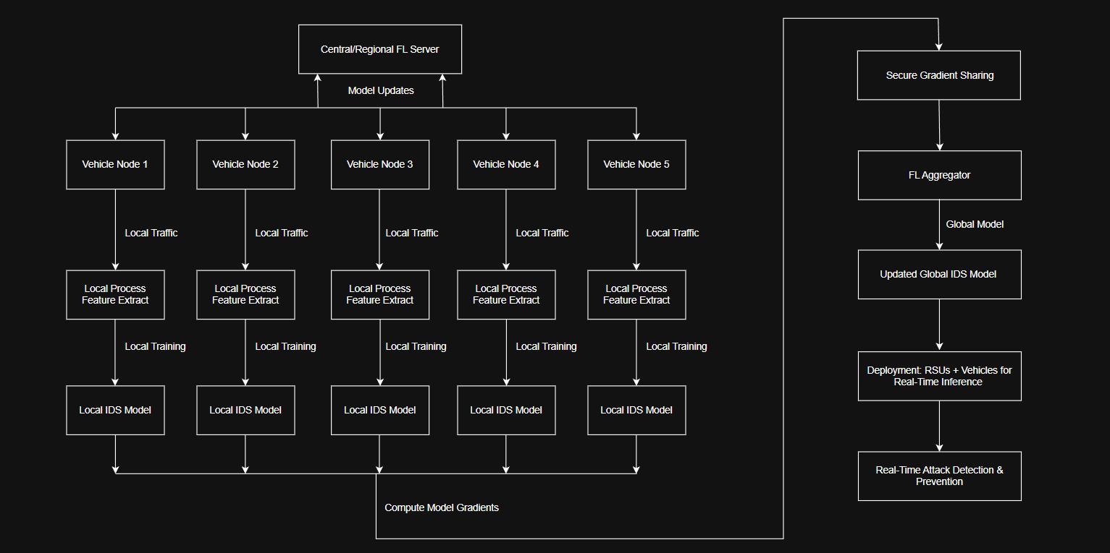
Work Flow

Slide 8
METHODOLOGIES
The proposed system employs a Federated Learning (FL)-based methodology to develop a privacy-preserving Intrusion Detection and Prevention System (IDPS) using the UNSW-NB15 dataset. The dataset is first preprocessed by loading it from Google Drive, selecting only relevant numerical features, separating the target variable, and applying normalization using the StandardScaler to ensure uniform feature distribution suitable for neural network training. After preprocessing, the dataset is partitioned into multiple subsets, each representing an independent FL client. In this decentralized setup, each client trains a local Multi-Layer Perceptron (MLPClassifier) model on its respective data portion, without sharing raw data, thereby maintaining privacy. During each communication round, the global model’s parameters are distributed to the clients, trained locally, and then the updated weights are returned.

Slide 9
METHODOLOGIES
These weights are aggregated at the central server using the Federated Averaging (FedAvg) algorithm, where model parameters from all clients are averaged layer-wise to update the global model. This iterative process continues for multiple rounds until convergence is achieved. After training, the final global FL model is evaluated on the test set to perform intrusion detection by classifying traffic as normal or attack. To enhance security operations, a rule-based intrusion prevention mechanism is integrated, where samples predicted as attacks are automatically assigned a BLOCK action, while normal traffic is ALLOWed. The system’s performance is finally evaluated using standard classification metrics such as accuracy, precision, recall, F1-score, and confusion matrix, along with IPS-level assessments such as attack blocking rate, false positives, and false negatives. This methodology ensures robust, decentralized, and privacy-preserving intrusion detection and prevention.

Slide 10
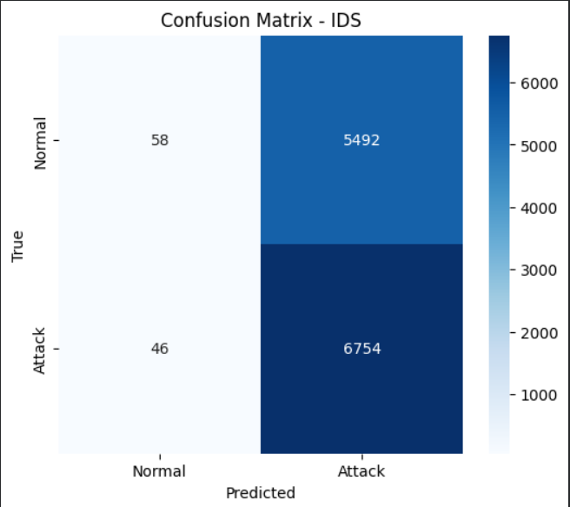
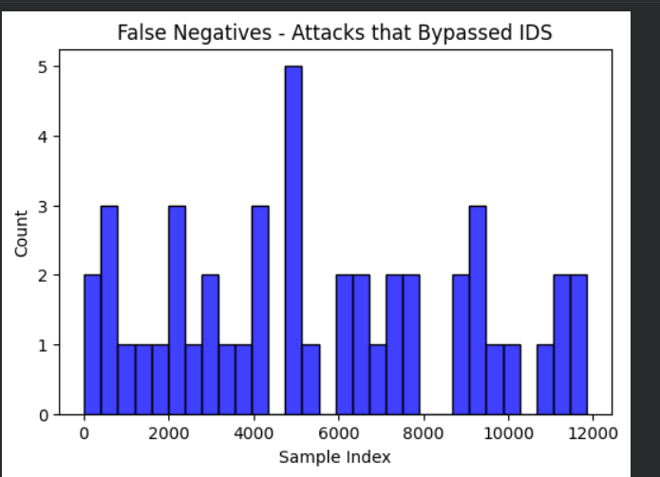
Graphs
a.) Confusion Matrix
b.) Bar Chart

Slide 11
Tools and Technologies
Google Colab
Python 3.x
Data Science Libraries : Pandas
NumPy
Scikit-learn
Machine Learning for IDS : MLPClassifier (Multi-Layer Perceptron)
StandardScaler
Visualization Tools : Matplotlib
Seaborn

Slide 12


