Slide 1
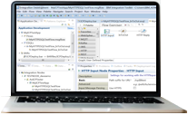
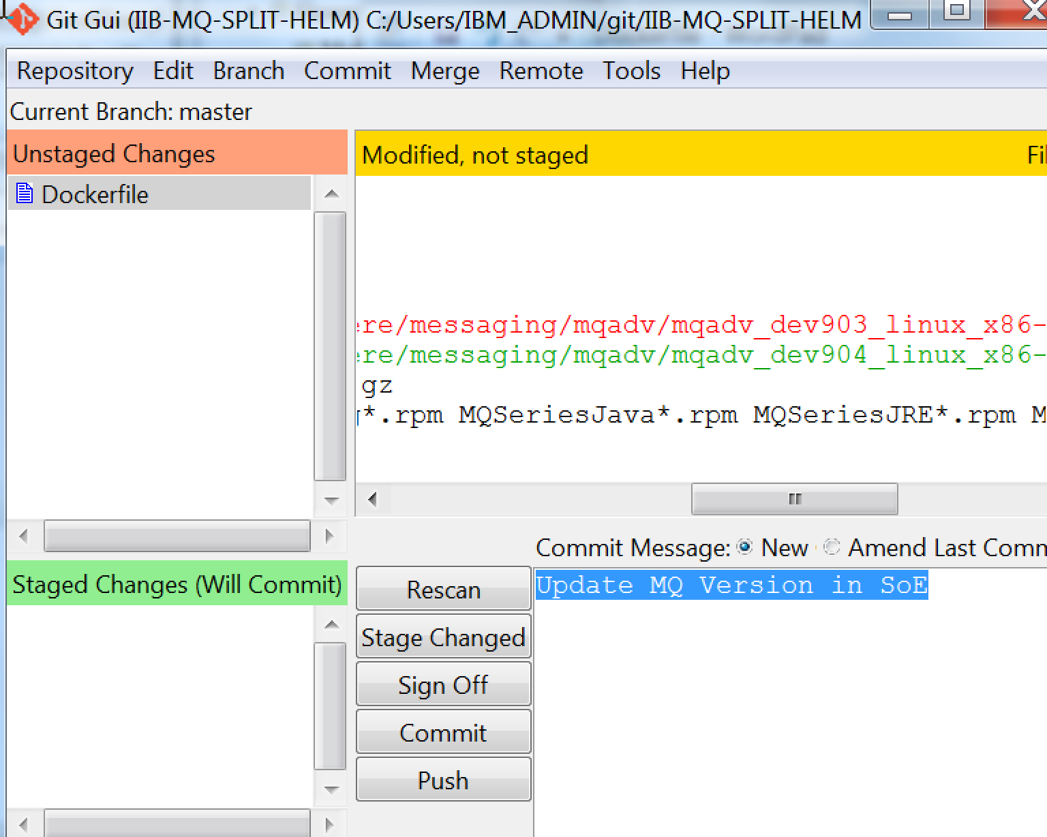
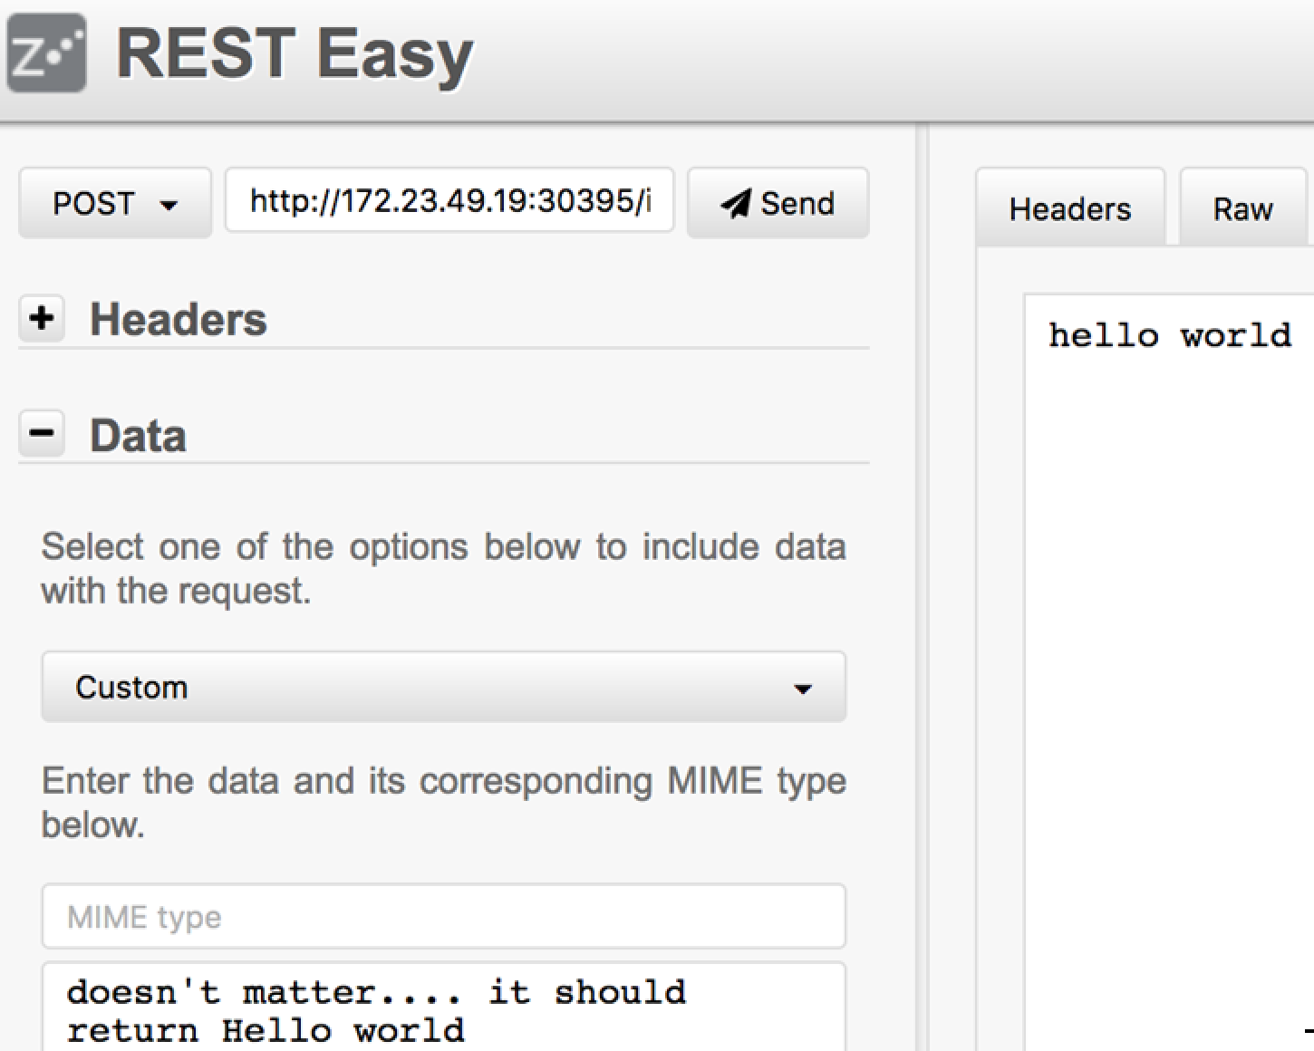




IBM Cloud Private
dockerHub
Ot4i
docker
Image
REPOSITORY
MS1 config
Helm
REGISTRY
Fixed Config
SoE Build and Updates
Deployment Packaging
MQ Clt
ACE11
MS2 config
Test Tools
Fixed Config
ubuntu
Fixed Config
SoE Image with fixed configuration, Docker file , Build Repos
MicroSrv N Docker file Helm charts with parms exposed repos
MQ Clt
MQ Clt
Public
GitHub
ACE11
ACE11
ubuntu
ubuntu
Ingress
SoE Pipe-line for SOE image build and load
WORKER NODE 1
WORKER NODE 2
MASTER NODE
Git Pull->Image Build->Load to local Repos
Build
MS1 Pipe-line for image build and deploy
Integration
Micro Service 1
Integration
Micro Service 2
Git Pull->Image Build->Load to local Repos->Build Helm Charts->Deploy
Build and Release
MS2 Pipe-line for image build and deploy
Git Pull->Image Build->Load to local Repos->Helm Install Charts->Deploy
Business Micro Service
Micro Services Application with
Two integration micro services
Two other micro services
BusinessMicro Service
Int MicroSrv 1 source repos
Int MicroSrv 2 source repos
Public
GitHub
Push MicroSrv 1.Bar
Push MicroSrv 2.bar
Log Aggregation
SoE – Standard Operating Environment for Integration containers
Fixed Configuration – Logging flows, liveliness flows, monitoring profiles
MS1 configuration – Integration Application code (Micro Service 1)
MS2 configuration – Integration Application code (Micro Service 2)
Application Micro Services (business functions)
(We are not building these business functions)
Notes:
2 * IIB Toolkit (c:\Users\IBM_ADMIN\git\IIBicpDemo and c:\temp\nodejs (reuse this one switch workspace to c:\Users\IBM_ADMIN\git\IIBicpDemoDev2)
Combined IIB/MQ SIT environment for functional socialization testing for multiple developers work
Developer 1 and Developer 2 are unit testing locally do some Developer 1 HTTPEcho changes, export BAR to the local Git Repos and push.
Follow the process in Jenkins.
Goto the Helm release deployment->pods->Check out events, once container started, check out the logs.
Goto the Helm release and service – bring up the WebUI and MQ Console (HTTPs) , Connect RFHUTILC put/get to DEV queues, Connect MQ Explorer.
Test developer 1 URL with RestEasy. See the change echo message we changed.
Test developer 2 URL with RestEasy. See the Developer 2 echo message.
Change the Developer 2 echo message in the Toolkit , export the bar and push
Goto the Helm release deployment->pods->Check out events, once container started, check out the logs.
Goto the Helm release and service bring up the WebUI
Test Developer 2 new echo message with RestEasy

Slide 2
IBM Cloud Private
dockerHub
Ot4i
docker
Image
REPOSITORY
MS1 config
Helm
REGISTRY
Fixed Config
SoE Build and Updates
Deployment Packaging
MQ Clt
ACE11
MS2 config
Test Tools
Fixed Config
ubuntu
Fixed Config
SoE Image with fixed configuration, Docker file , Build Repos
MicroSrv N Docker file Helm charts with parms exposed repos
MQ Clt
MQ Clt
Public
GitHub
ACE11
ACE11
ubuntu
ubuntu
Ingress
SoE Pipe-line for SOE image build and load
MQ Pipe-line for image build and deploy
MASTER NODE
WORKER NODE 1
WORKER NODE 2
Git Pull->Image Build->Load to local Repos
Git Pull->Image Build->Load to local Repos->Helm Install charts->Deploy
Build
MS1 Pipe-line for image build and deploy
Build and Release
Integration
Micro Service 1
Integration
Micro Service 2
Git Pull->Image Build->Load to local Repos->Build Helm Charts->Deploy
MS2 Pipe-line for image build and deploy
Build and Release
Git Pull->Image Build->Load to local Repos->Helm Install Charts->Deploy
Business Micro Service
Micro Services Application with
Two integration micro services
Two other micro services
BusinessMicro Service
Int MicroSrv 1 source repos
Int MicroSrv 2 source repos
Public
GitHub
Push MicroSrv 1.Bar
Push MicroSrv 2.bar
Log Aggregation
SoE – Standard Operating Environment for Integration containers
Fixed Configuration – Logging flows, liveliness flows, monitoring profiles
MS1 configuration – Integration Application code (Micro Service 1)
MS2 configuration – Integration Application code (Micro Service 2)
Application Micro Services (business functions)
(We are not building these business functions)
Notes:
2 * IIB Toolkit (c:\Users\IBM_ADMIN\git\IIBicpDemo and c:\temp\nodejs (reuse this one switch workspace to c:\Users\IBM_ADMIN\git\IIBicpDemoDev2)
Combined IIB/MQ SIT environment for functional socialization testing for multiple developers work
Developer 1 and Developer 2 are unit testing locally do some Developer 1 HTTPEcho changes, export BAR to the local Git Repos and push.
Follow the process in Jenkins.
Goto the Helm release deployment->pods->Check out events, once container started, check out the logs.
Goto the Helm release and service – bring up the WebUI and MQ Console (HTTPs) , Connect RFHUTILC put/get to DEV queues, Connect MQ Explorer.
Test developer 1 URL with RestEasy. See the change echo message we changed.
Test developer 2 URL with RestEasy. See the Developer 2 echo message.
Change the Developer 2 echo message in the Toolkit , export the bar and push
Goto the Helm release deployment->pods->Check out events, once container started, check out the logs.
Goto the Helm release and service bring up the WebUI
Test Developer 2 new echo message with RestEasy

Slide 3
IBM Cloud Private
dockerHub
Ot4i
docker
hub
REPOSITORY
MS1 config
REGISTRY
Fixed Config
SoE Build and Updates
Deployment Packaging
MQ Clt
Fixed Config
ACE11
MS2 config
Test Tools
MQ Clt
ubuntu
Fixed Config
SoE Image with fixed configuration, Docker file , Build Repos
MicroSrv N Docker file Helm charts with parms exposed repos
ACE11
MQ Clt
Public
GitHub
ubuntu
ACE11
ubuntu
Ingress
SoE Pipe-line for SOE image build and load
MQ Pipe-line for image build and deploy
MASTER NODE
WORKER NODE 1
WORKER NODE 2
Git Pull->Image Build->Load to local Repos
Git Pull->Image Build->Load to local Repos->Helm Install charts->Deploy
Build
MS1 Pipe-line for image build and deploy
Build and Release
Integration
Micro Service 1
Integration
Micro Service 2
Git Pull->Image Build->Load to local Repos->Build Helm Charts->Deploy
MS2 Pipe-line for image build and deploy
Build and Release
Git Pull->Image Build->Load to local Repos->Helm Install Charts->Deploy
Business Micro Service
Micro Services Application with
Two integration micro services
Two other micro services
BusinessMicro Service
Int MicroSrv 1 source repos
Int MicroSrv 2 source repos
Public
GitHub
Push MicroSrv 1.Bar
Push MicroSrv 2.bar
Log Aggregation
SoE – Standard Operating Environment for Integration containers
Fixed Configuration – Logging flows, liveliness flows, monitoring profiles
MS1 configuration – Integration Application code (Micro Service 1)
MS2 configuration – Integration Application code (Micro Service 2)
Application Micro Services (business functions)
(We are not building these business functions)
Notes:
2 * IIB Toolkit (c:\Users\IBM_ADMIN\git\IIBicpDemo and c:\temp\nodejs (reuse this one switch workspace to c:\Users\IBM_ADMIN\git\IIBicpDemoDev2)
Combined IIB/MQ SIT environment for functional socialization testing for multiple developers work
Developer 1 and Developer 2 are unit testing locally do some Developer 1 HTTPEcho changes, export BAR to the local Git Repos and push.
Follow the process in Jenkins.
Goto the Helm release deployment->pods->Check out events, once container started, check out the logs.
Goto the Helm release and service – bring up the WebUI and MQ Console (HTTPs) , Connect RFHUTILC put/get to DEV queues, Connect MQ Explorer.
Test developer 1 URL with RestEasy. See the change echo message we changed.
Test developer 2 URL with RestEasy. See the Developer 2 echo message.
Change the Developer 2 echo message in the Toolkit , export the bar and push
Goto the Helm release deployment->pods->Check out events, once container started, check out the logs.
Goto the Helm release and service bring up the WebUI
Test Developer 2 new echo message with RestEasy

Slide 4
Image names
Ace11002mqc91soe
Ace11002mqc91intms1
Ace 11002mqc91intms2

