Slide 1

Pre Workshop Routine
Install conda programs, upload data to RoarCollab, etc.
module load anaconda3
conda create --name Phylogenomics
conda activate Phylogenomics
conda install bioconda::bcftools
conda install bioconda::trimal
conda install bioconda::iqtree
https://snptoolkit.readthedocs.io/en/latest/1_How_to_Install.html
Survey: https://forms.office.com/r/CGtGrhDJL1?origin=lprLink

Slide 2

Exploring the Trees of Evolution: A Phylogenomics Workshop
Sterling Wright
February 9th, 2024
DAWG Workshop

Slide 3





EDUCATION
University of Texas at Austin
August 2012 – May 2016
BA Classical Archaeology & BS Psychology
University of Oklahoma
August 2017 – May 2019
MA Anthropology
Penn State University
August 2019 – Present
PhD Anthropology
svw5689@psu.edu
https://github.com/SterlingLWright
https://orcid.org/my-orcid?orcid=0000-0003-0526-9132

Slide 4



Key Learning Objectives
Be able to define phylogenomics and understand its basic principles
Know some of the tools and types of data used to create phylogenomic trees
Have a general understanding of a phylogenomics pipeline
Be able to carry out a phylogenomic analysis
Notes:
Let me start with a brief overview. For the first part, I am going to provide some background about the oral microbiome, giving you a sense about why we should learn more about it. From there, I will discuss my previous and current research and how they advance the ancient DNA field. After that, I will then discuss my future plans and directions, especially if given the opportunity to come to Clemson. Then finally, I will be happy to then start the Q&A session.

Slide 5
What is Phylogenetics and Phylogenomics?
Phylogenetics: the study of evolutionary relationships among biological entities
Entities may refer to species, populations, or a gene family
Phylogenomics: the use of entire genomes for the reconstruction of the evolutionary relationships of organisms
Notes:
How do we define phylogenomics?

Slide 6
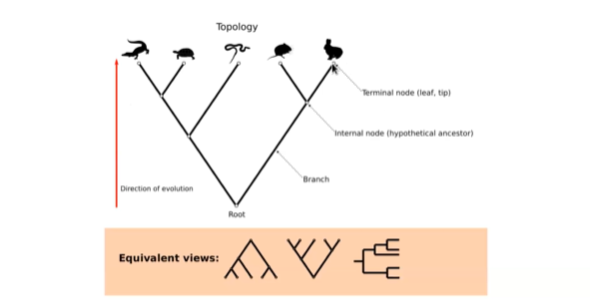
Phylogenetic trees – basic concepts
Phylogeny or a phylogenetic tree represents a hypothesis of how different biological entities relate to each other
Notes:
Let us go over some of the basic concepts of phylogenetic trees. We have terminal nodes that refer to the tips or leafs of a tree. We have internal nodes that represent a hypothetical ancestor. A branch connects ancestors or modern tips. They can reflect time. When they are rooted, they can also illustrate the direction of evolution.

Slide 7
Rooted phylogenetic trees – bifurcations and multifurcations
Polytomy: a branch point with three or more species coming off of it
Fully resolved (bifurcating)
Partially resolved (multifurcating)
Notes:
We could have bifurcating trees. We could also have patially resolved trees or multifurcating trees where we see polytomy. This is when a branch point with three or species come off it or when speciation of more than two lineages occur.

Slide 8
Monophyletic group: clade
D
E
F
G
C
B
A group of organisms sharing a common ancestor and includes all descendants
A
Notes:
A monophyletic group which can also be referred to as a clade is defined as a group of organisms that share a common ancestor. In practice, this common ancestor is referred to as the most recent common ancestor of a group of organisms, and all of its descendants. Just a few examples of a monophyletic group would be mammals or birds in which in both cases all taxa within each of this groups can be traced to a common ancestor.

Slide 9
Paraphyletic group
D
E
F
G
C
B
A group of organisms descended from a common ancestor but does not include all descendant groups
A

Slide 10
Polyphyletic group: clade
D
E
F
G
C
B
A group of organisms that that derive from more than one common ancestor; unrelated organisms descended from more than one ancestor
A
Notes:
A monophyletic group which

Slide 11
Rooted vs Unrooted trees
A
B
C
D
E
C
D
B
A
E
Rooted tree: one node at root and illustrates the direction of evolution
Unrooted tree: no predetermined root and induces no hierarchy
Notes:
There are two fundamental types of phylogenetic trees used in evolutionary biology to represent the relationships of taxa. Here are the key differences between them. In rooted trees, there is a designated root node that represents a hypothetical common ancestor from which all the nodes descend. Rooted trees explicitly indicate the direction of evolution, with branches representing evolutionary relationships and divergence from the root node. Unrooted trees do not have a designated root node; instead, they represent the relationships among taxa without specifying a common ancestor. Unrooted trees show the evolutionary relationships among taxa but do not indicate the direction of evolution or the position of a common ancestor.
Unrooted: distance between nodes should be symmetric (since the tree edges are not directed).

Slide 12
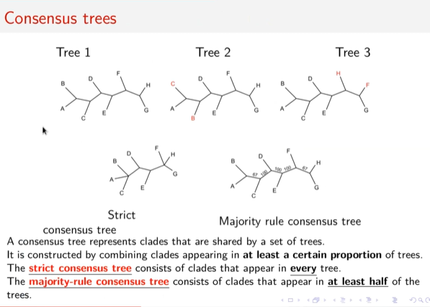
Consensus trees
Notes:
I now want to turn your attention to consensus trees. A consensus tree is a type of phylogenetic tree that represents the combined information from multiple individual trees. It is constructed by merging the topologies of these trees to identify the relationships that are supported by the majority of the individual trees. A consensus tree aims to provide a summary of the evolutionary relationships among a group of taxa while accounting for uncertainty inherent in phylogenetic inference. In this way, consensus trees identify robust relationships that are consistently recovered across multiple analyses and to assess the level of confidence in specific branches or clades within the tree.
Majority rule consensus tree: A and B is found in two of the trees and how often do we see the bipartition. Strict consensus tree: how often do clades appear in every tree.

Slide 13
Representation – Newick format rooted tree
A
B
C
D
E
(A,B)
A and B are represented as sister taxa
Notes:
There are different ways to encode trees. The Newick format is one of them. The Newick format for rooted trees is represented as a nested series of parantheses and commas. Each terminal node (leaf) in the tree corresponds to a taxon, while each internal node represents a hypothetical common ancestor.
A and B are considered sister taxa.

Slide 14
Representation – Newick format rooted tree
A
B
C
D
E
((((A,B),C),D),E);
Collapse the entire tree into text
Newick: commas separate units
Notes:
A and B are considered sister taxa.

Slide 15
Representation – Newick format unrooted tree
C
A
D
B
E
((A,B),C,(D),E);
Notes:
A and B are considered sister taxa.

Slide 16
Representation – Newick format with distances
((A:0.3,B:0.25):0.2,C:0.5);
C
A
B
0.25
0.3
0.5
Notes:
Branch lengths in rooted trees often represent the amount of evolutionary change or genetic distance between taxa.

Slide 17
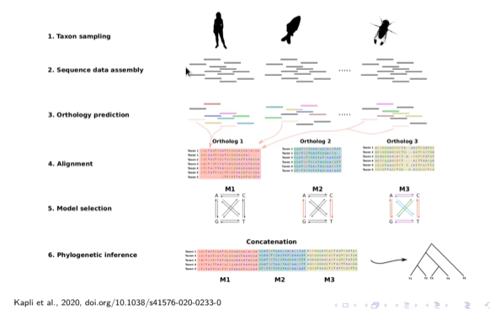
Phylogenomic Pipeline Overview

Slide 18


Data Assembly
Targeted
Two Main Sequencing Strategies
Targeted sequencing capture
Shotgun sequencing
Shotgun
Which strategy to use will depend on:
Budget
Size of genome of targeted taxa
Divergence of targeted taxa
The knowledge of the targeted genomes
The availability of other genomic resources
Eisenhofer et al. (accepted)

Slide 19
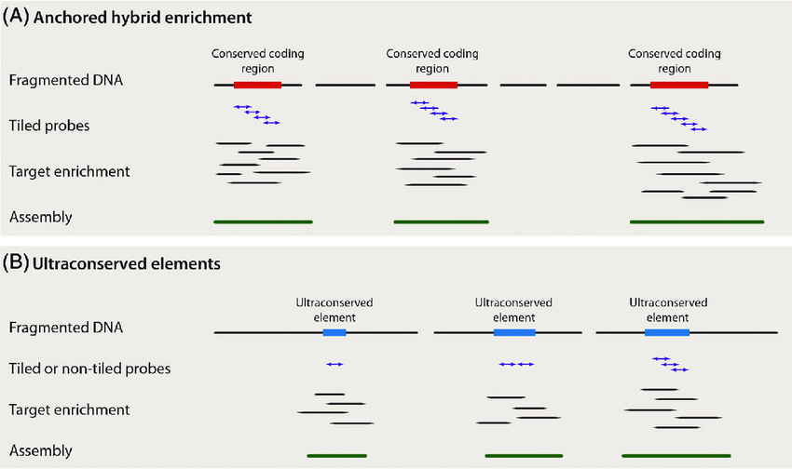
Targeted sequence capture
Ultra conserved elements: Coding and non-coding genomic regions
>95% similarity across species
Anchored hybrid enrichment: Mostly coding regions
Young and Gillung, 2019 doi.org/10.1111/syen.12406

Slide 20
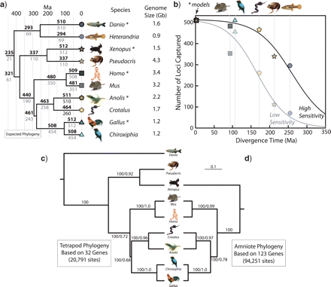
Targeted sequence capture
Anchored hybrid enrichment
Targeted 512 loci
Lemmon et al., 2012 doi.org/10.1093/sysbio/sys049
Notes:
Anchored hybrid enrichment has been widely used and effective for capturing and sequencing specific genomic regions of interest from a diverse range of species. For instance, you could potentially use this sort of approach with 16S rRNA data or another highly conserved region.

Slide 21
Shotgun sequencing
Shotgun sequencing
Transcriptome sequencing (RNA-seq): targets all transcripts of a tissue
Genome sequencing: recovers entire or parts of the genome depending on sequencing depth and genome size

Slide 22
Site-homology
Phylogenetic inference is based on homologous sites across species (i.e., sites that have the same evolutionary origin)
Ancestral species
ATG
ATG
AAG
Notes:
An important concept to understand for shotgun sequencing is site homology. Site homology refers to the concept in molecular evolution and phylogenetics where specific positions or sites in biological sequences, such as DNA or protein sequences, are considered equivalent or corresponding across different organisms or taxa due to shared ancestry. Site homology is based on the assumption that sequences with similar positions or sites in different organisms share a common evolutionary origin. These sites are inherited from a common ancestor and have been passed down through generations.

Slide 23
Pairwise Sequence Alignment - Terminology
Unaligned sequences
ATGCTTATATACAGA
CCATGGCCGAG
Aligned sequences
match
ATGCTTATATACAGA
- - - CTTATATGCAGA
mismatch
gaps
Notes:
To determine site homology, sequences from different organisms are aligned to identify regions of similarity and difference. Homologous sites are those positions in the alignment where residues (nucleotides) are believed to have descended from a common ancestral sequence. Therefore, site homology is fundamental to phylogenetic analysis, since it allows us to reconstruct evolutionary relationships among organisms based on sequence data. By identifying patterns of similarity and difference, phylogenetic trees can be constructed to depict the evolutionary history of taxa. What we have here is unaligned and aligned sequences. We identify homologous sites through sequence alignments. In pairwise alignments, two sequences are aligned against each other to identify regions of similarity. When you have aligned sequences, you can get a scoring system. Within scoring systems, you can assign values when certain positions align or don’t. You can give a match score, a mismatch score, or a gap score.

Slide 24
Pairwise Sequence Alignment - Terminology
Sequence score = +3
ATGCTTATATACAGA
- - - CTTATATGCAGA
Sequence score = +0.5
ATGCTTATATACAGA
- - C -
TTATATACAGA
Alignments will generally have gap openings, gap extensions, matches, and other parameters
The best scoring alignment should be selected
Notes:
These values can vary program to program.

Slide 25
Pairwise Sequence Alignment - Terminology
Global alignment:
Aim to align the entire length of two sequences, maximizing overall similarity
Identify overall homology between two sequences
Considers entire length of both sequences, introducing gaps
Semi-global: treats sequence ends differently
Global alignment
ATGCTTATATACAGA
-
-
-
-
-
-
-
TTATATAC
Local alignment
Local alignment:
Identify most similar regions
Useful for comparing conserved regions
ATGCTTATATACAGA
TTATATAC
Notes:
Absolutely! Global and local alignments are two different approaches used in sequence alignment, a fundamental technique in bioinformatics.
1. **Global Alignment:**
- **Objective:** The goal of global alignment is to align the entire length of two sequences, maximizing the overall similarity.
- **Usage:** It is commonly used when the sequences being compared are assumed to have a significant overall similarity and when you want to identify the overall homology between two sequences.
- **Characteristics:** It considers the entire length of both sequences, introducing gaps (insertions or deletions) as necessary to achieve the best alignment.
2. **Local Alignment:**
- **Objective:** The aim of local alignment is to identify the most similar regions between two sequences, even if the overall similarity is low.
- **Usage:** It is useful when comparing sequences that may have conserved regions embedded in non-conserved sequences or when you want to find specific domains or motifs within larger sequences.
- **Characteristics:** It identifies regions of similarity within the sequences, allowing for gaps to be introduced only in those specific regions rather than considering the entire length of the sequences.
**Example:**
Let's consider two DNA sequences:
- Sequence 1: ACGTACGTAG
- Sequence 2: ACTAGTACGT
**Global Alignment:**
```
Sequence 1: ACGTACGTAG
Sequence 2: AC--TAGTACGT
```
**Local Alignment:**
```
Sequence 1: ACGTACGTA
Sequence 2: ACGTACGTA
```
In the global alignment, we consider the entire length of both sequences and introduce gaps to align them. In the local alignment, we identify the most similar region within the sequences and align only that specific region.
In summary, global alignment is suited for comparing sequences with overall similarity, while local alignment is more suitable for identifying specific conserved regions within sequences.

Slide 26
Pairwise Sequence Alignment - Terminology
Global alignment:
Aim to align the entire length of two sequences, maximizing overall similarity
Identify overall homology between two sequences
Considers entire length of both sequences, introducing gaps
Global alignment
ATGCTTATATACAGA
-
-
-
-
-
-
-
TTATATAC
We need global or semi-global alignments for Phylogenomics!
Notes:
Absolutely! Global and local alignments are two different approaches used in sequence alignment, a fundamental technique in bioinformatics.
1. **Global Alignment:**
- **Objective:** The goal of global alignment is to align the entire length of two sequences, maximizing the overall similarity.
- **Usage:** It is commonly used when the sequences being compared are assumed to have a significant overall similarity and when you want to identify the overall homology between two sequences.
- **Characteristics:** It considers the entire length of both sequences, introducing gaps (insertions or deletions) as necessary to achieve the best alignment.
2. **Local Alignment:**
- **Objective:** The aim of local alignment is to identify the most similar regions between two sequences, even if the overall similarity is low.
- **Usage:** It is useful when comparing sequences that may have conserved regions embedded in non-conserved sequences or when you want to find specific domains or motifs within larger sequences.
- **Characteristics:** It identifies regions of similarity within the sequences, allowing for gaps to be introduced only in those specific regions rather than considering the entire length of the sequences.
**Example:**
Let's consider two DNA sequences:
- Sequence 1: ACGTACGTAG
- Sequence 2: ACTAGTACGT
**Global Alignment:**
```
Sequence 1: ACGTACGTAG
Sequence 2: AC--TAGTACGT
```
**Local Alignment:**
```
Sequence 1: ACGTACGTA
Sequence 2: ACGTACGTA
```
In the global alignment, we consider the entire length of both sequences and introduce gaps to align them. In the local alignment, we identify the most similar region within the sequences and align only that specific region.
In summary, global alignment is suited for comparing sequences with overall similarity, while local alignment is more suitable for identifying specific conserved regions within sequences.

Slide 27
Many tools can get the same job done
Many tools for alignment:
Mafft, Muscle, Clustal, Prank, FSA, and etc.
All methods work with a scoring scheme
Most would lead to a similar answer when aligning similar sequences
Most would lead to different answers when aligning divergent sequences
Rarely do you have information to help you decide on alignment accuracy

Slide 28
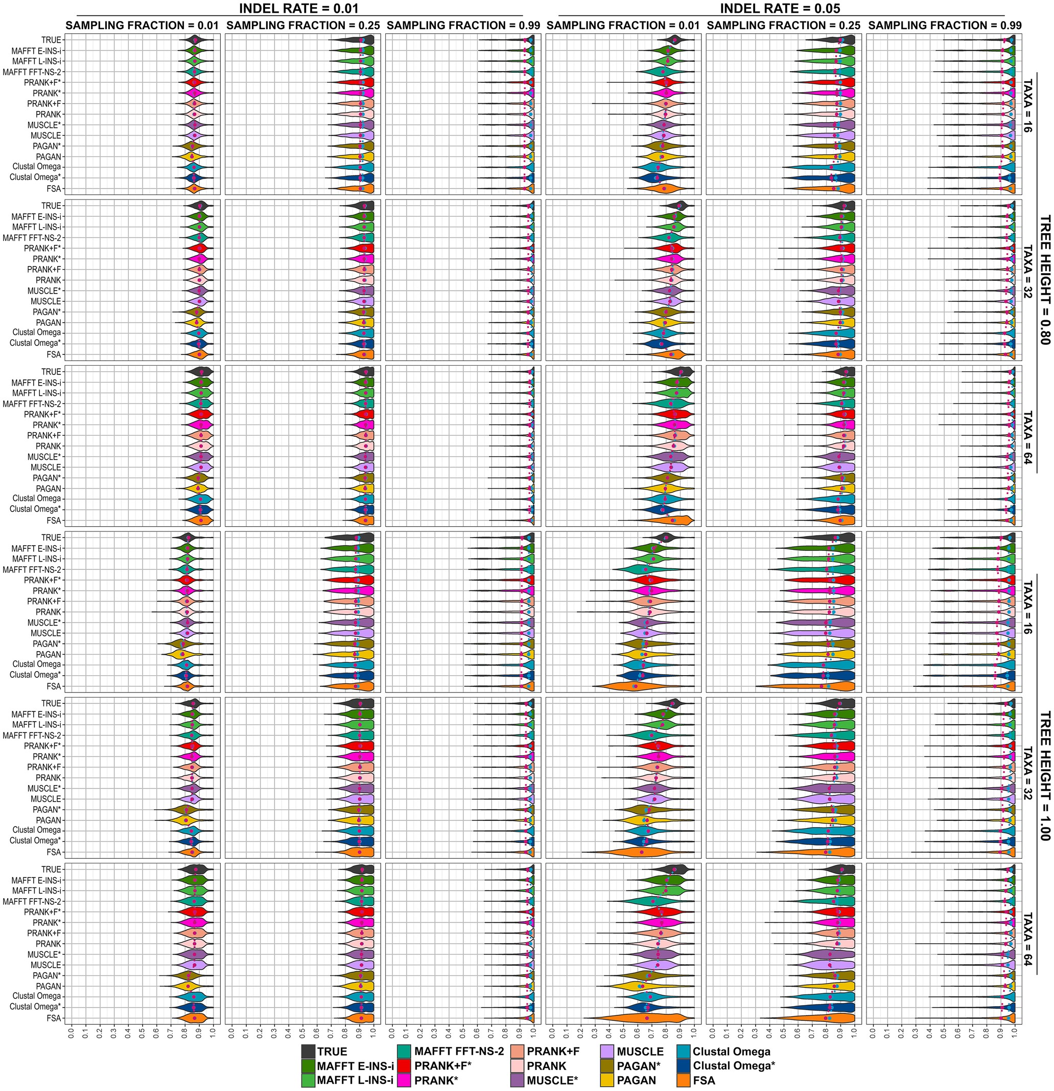

Sequence Alignment - Accuracy
Reconstruction accuracies of MSA tools for simulated scenarios under tree heights of 0.8 and 1.0.
Notes:
A study that came out in 2018 used different programs and looked at their performance. Their conclusion was that each program performed about the same. However, for more challenging relationships, we see more variation with the true alignments. They found that MAFFT was more consistent with TRUE alignments. This is why many people decide to use MAFFT.

Slide 29
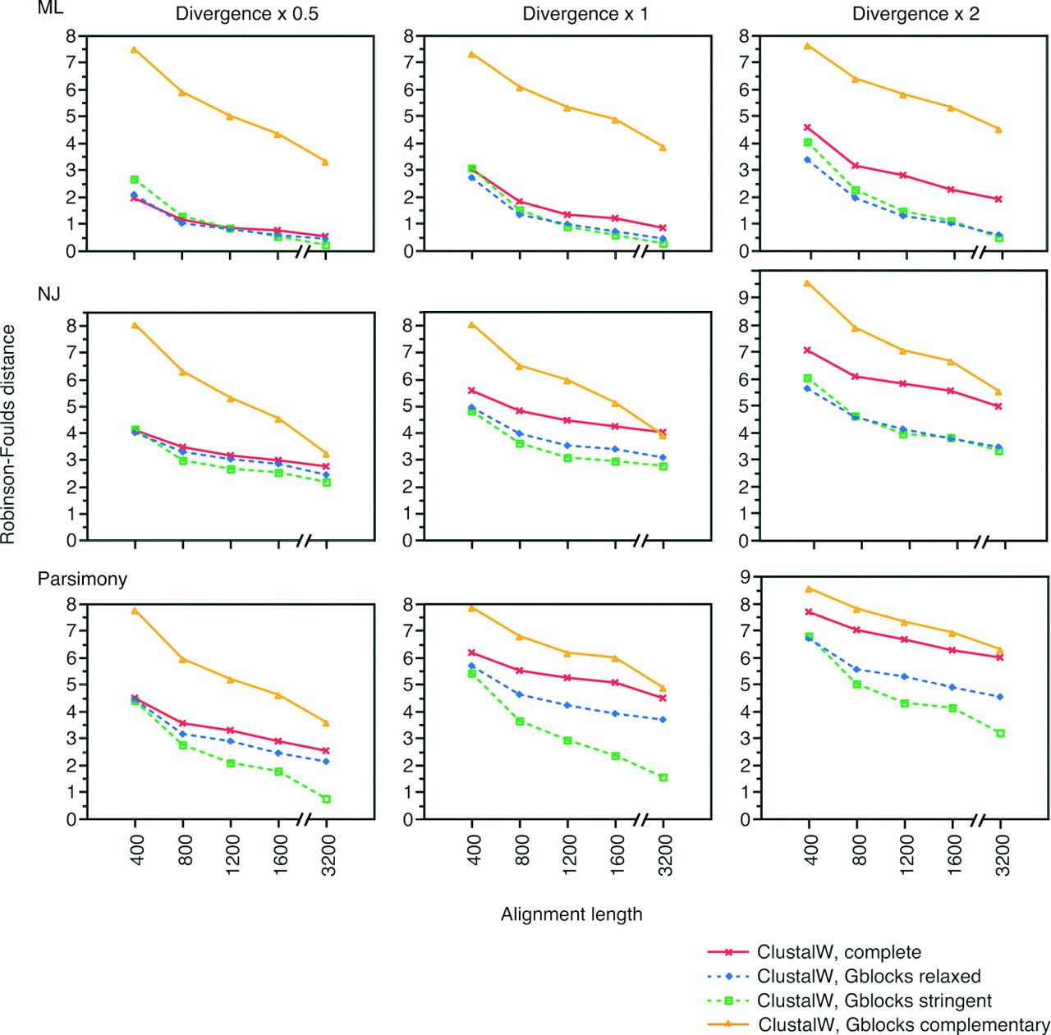
Figure: Average Robinson-Foulds distances to the real tree from the tree calculated with ClustalW complete alignments
Alignment filtering
Improving alignment quality can help when there is an increasing amount of sequence divergence
Common to filter ambiguously aligned sites using tools (e.g., Gblocks or trimal)
Unclear whether they improve phylogenetic accuracy
Syst Biol, Volume 56, Issue 4, August 2007, Pages 564–577, https://doi.org/10.1080/10635150701472164
The content of this slide may be subject to copyright: please see the slide notes for details.
Notes:
A study that came out in 2018 used different programs and looked at their performance. Their conclusion was that each program performed about the same. However, for more challenging relationships, we see more variation with the true alignments. They found that MAFFT was more consistent with TRUE alignments. This is why many people decide to use MAFFT.

Slide 30

Coding portion of the workshop

Slide 31
Coding portion of the workshop
~10 min break (also time to install programs)
Login to Roar Collab
Download the data
Make sure you have the programs installed
Install conda

Slide 32
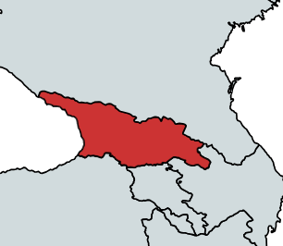
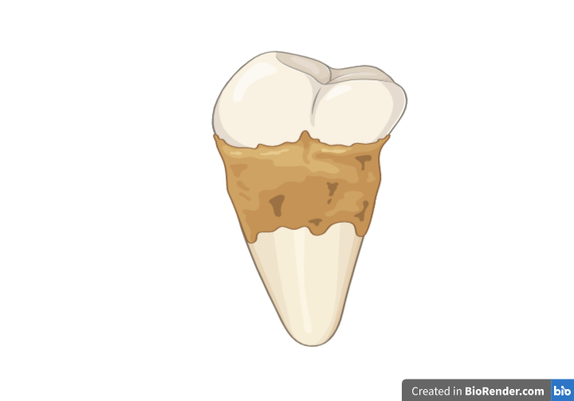
Dataset Info
Georgia
Shotgun Sequenced
Samples dating from the Bronze Age, through the Roman Imperial period, to the Middle Ages

Slide 33
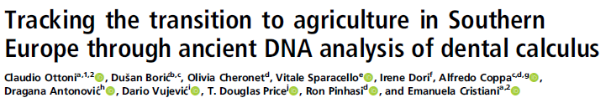
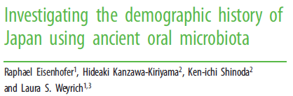
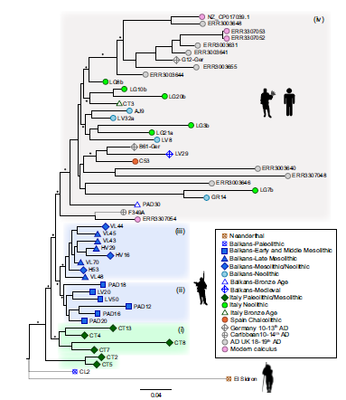
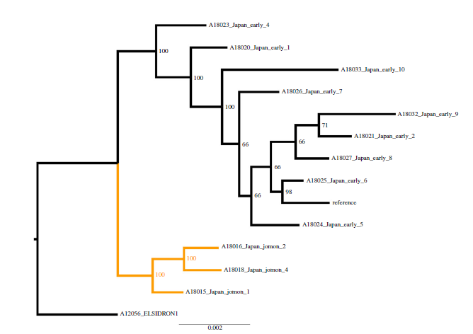
Anaerolineaceae oral taxon 439: Geographic and chronological clustering according to cultural group
Ottoni et al. (2021)
Eisenhofer et al. (2020)
Notes:
This bacterium is particularly interesting because phylogenomic comparisons for Italian, Balkans, and Japanese populations have shown that this oral microbe has a strong geographic and temporal signature. Thus, whether this microbe exhibits a similar pattern in the Georgian dataset could offer some value about whether urbanization over time has impacted its evolution.

Slide 34
Step 1: Mapping to the reference & and quality filter
BWA = Burrows-Wheeler Aligner
SAMTOOLS
Indexes the reference genome in a compressed form
BWA-MEM for long reads and higher accuracy
BWA-ALN for short reads
Needs a reference genome in FASTA format
Samples can be in FASTQ or FASTA format
Outputs a SAM/BAM files
A suite of programs for HTS data
Supports SAM/BAM formats
Can perform a variety of quality control functions
bwa_script.sh
Samtools-script.sh

Slide 35
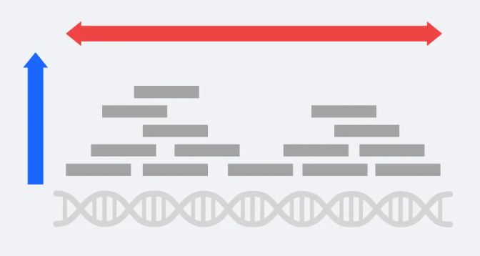
Step 2: Mapping to the reference & and quality filter
SAMTOOLS coverage
Coverage_script.sh

Slide 36
Step 3: Filtering authentic aDNA reads
PMDtools = filters to keep only reads with ancient DNA signatures
PMD_tools.sh

Slide 37
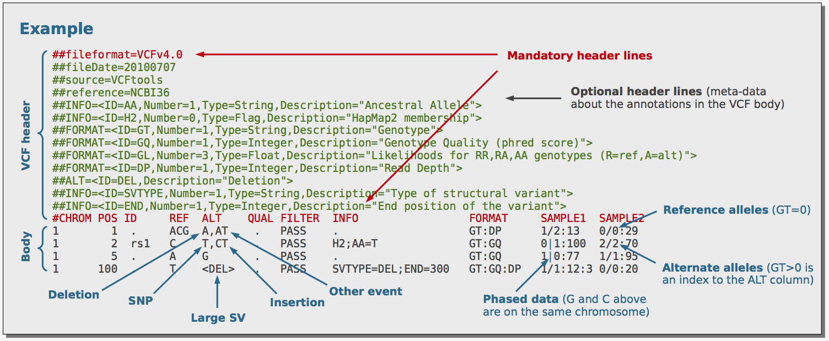
Step 4: Converting to VCF format with BCFtools
BCFtools: variant calling and manipulating files in the VCF format and its binary counterpart BCF
bcftools_tools.sh

Slide 38
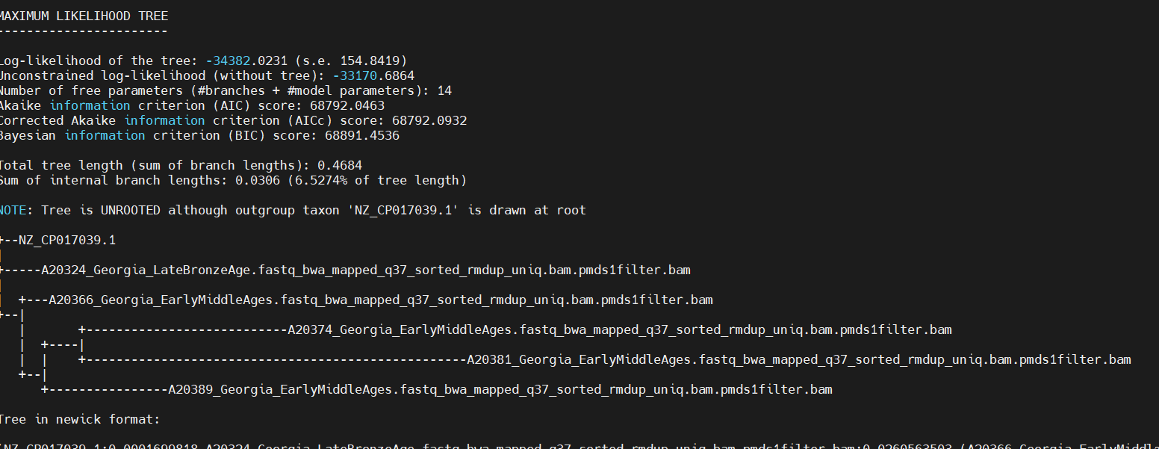

Step 5: Annotate VCF files with SNPtoolkit
SNP_Toolkit.sh
cd snpToolkit_SNPs_output_2024-*

Slide 39
Step 6: SNPTookit_Combine
SNP_TOOLKIT_COMBINE.sh
TRIMAL-script.sh
Model_Finder.sh
IQ_TREE_with_Model.sh
Screenshots

Slide 40
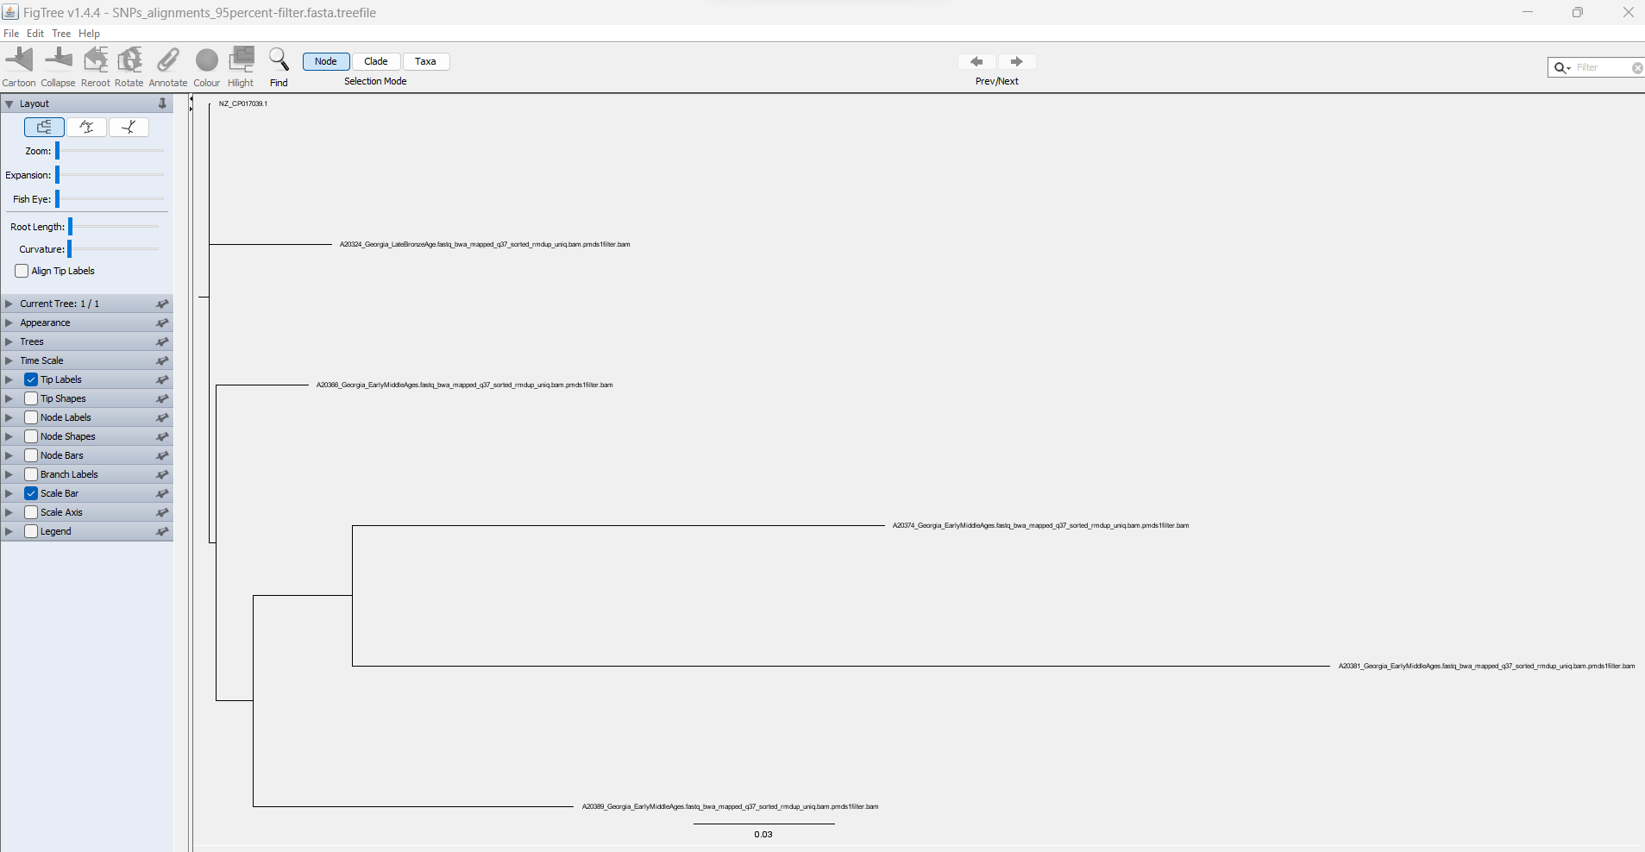
Step 7: Final Result
Open *.treefile in FigTree

Slide 41

https://forms.office.com/r/1NfPmiEAs7?origin=lprLink

