Slide 1
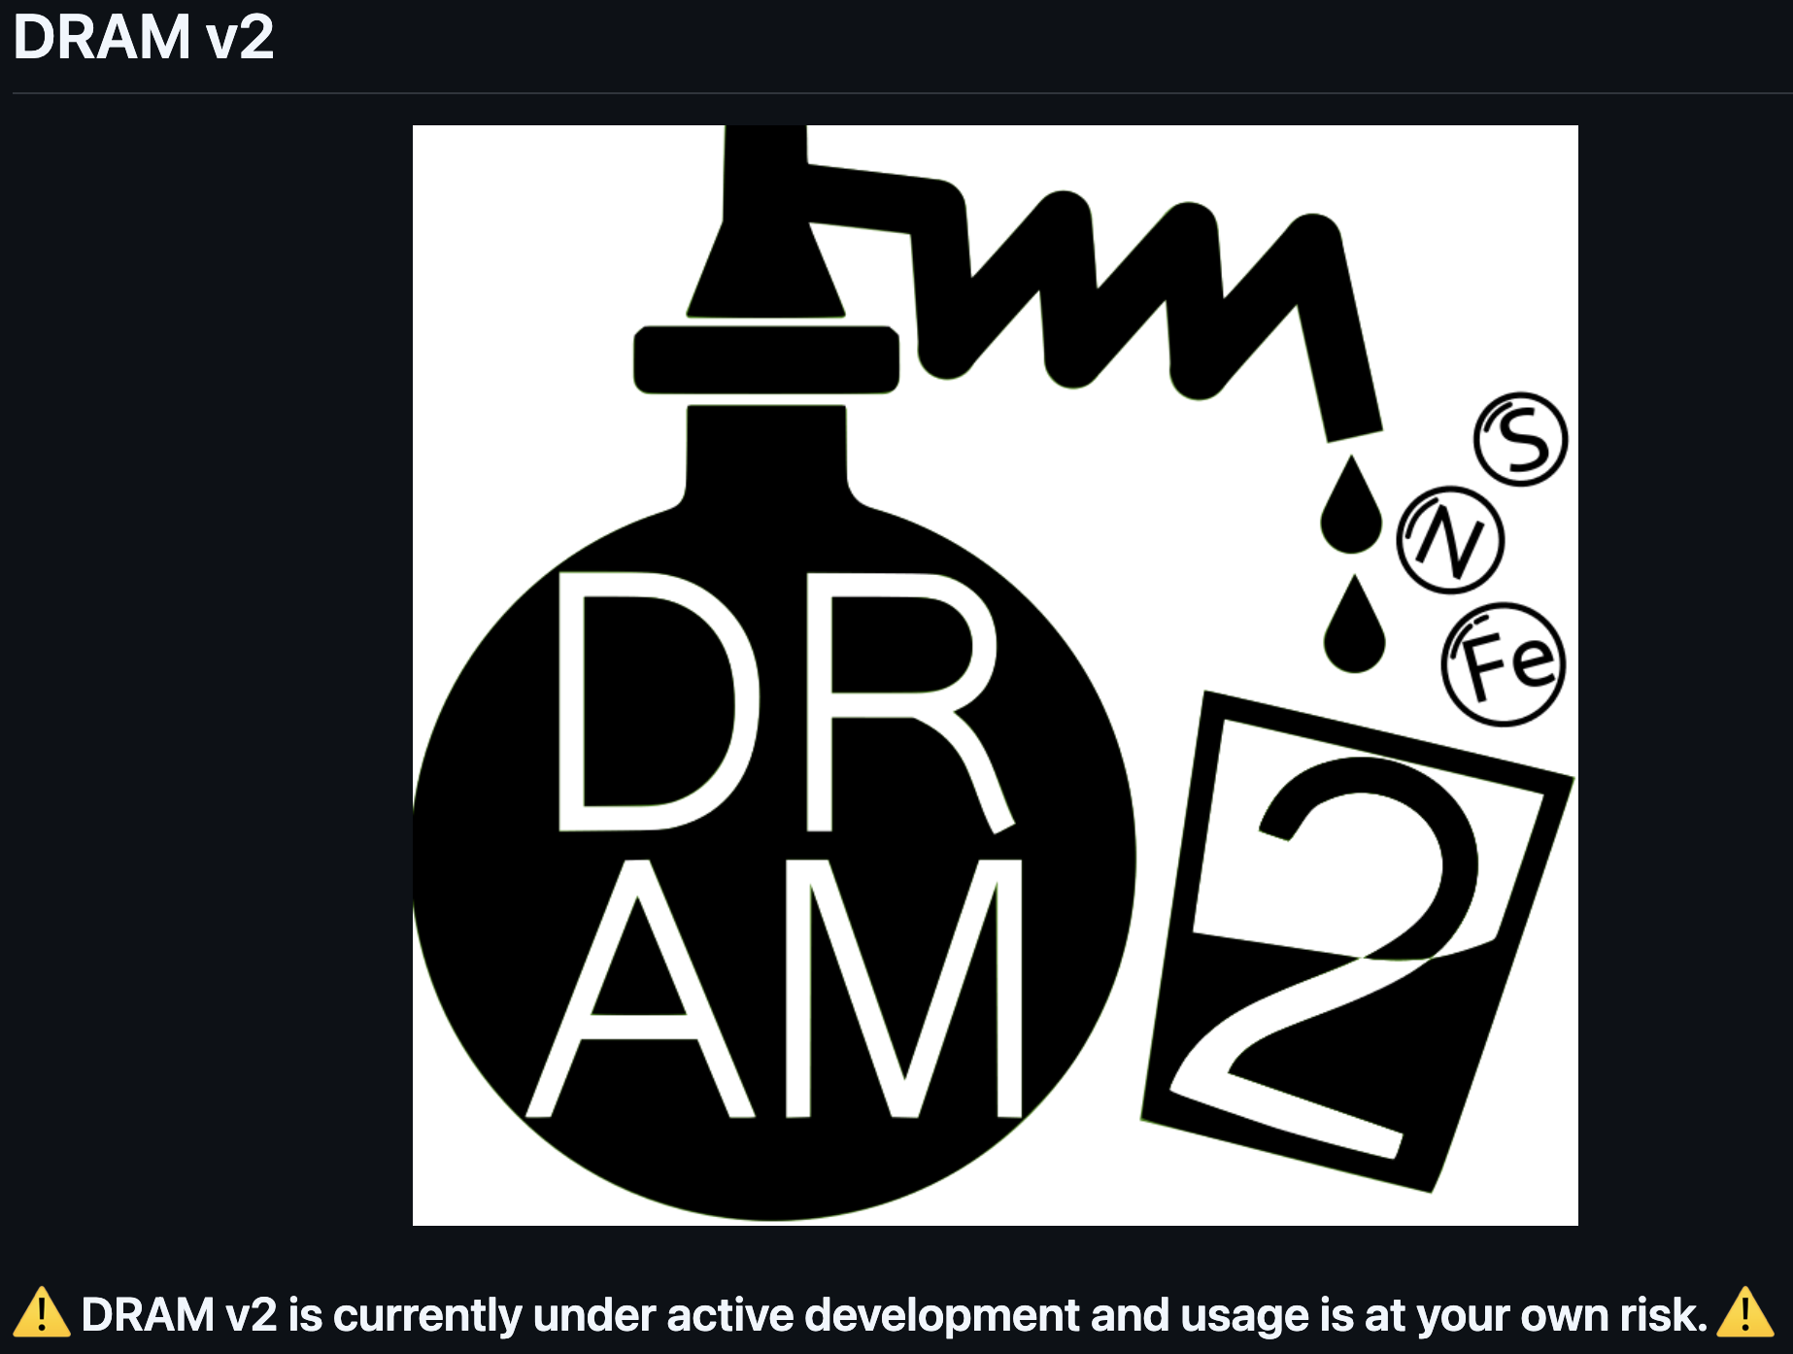
Using DRAM2 to annotate genes and metabolisms of genomes & MAGs
SP2026 DAWG Workshop #3 Ryan Trexler PhD candidate in Ecology and Biogeochemistry
Couradeau and Kaye labs
rxt92@psu.edu

Slide 2
Goals for this workshop:
What is DRAM/DRAM2?
How does DRAM work?
What’s new in DRAM2?
How can we use DRAM2 at PSU?

Slide 3
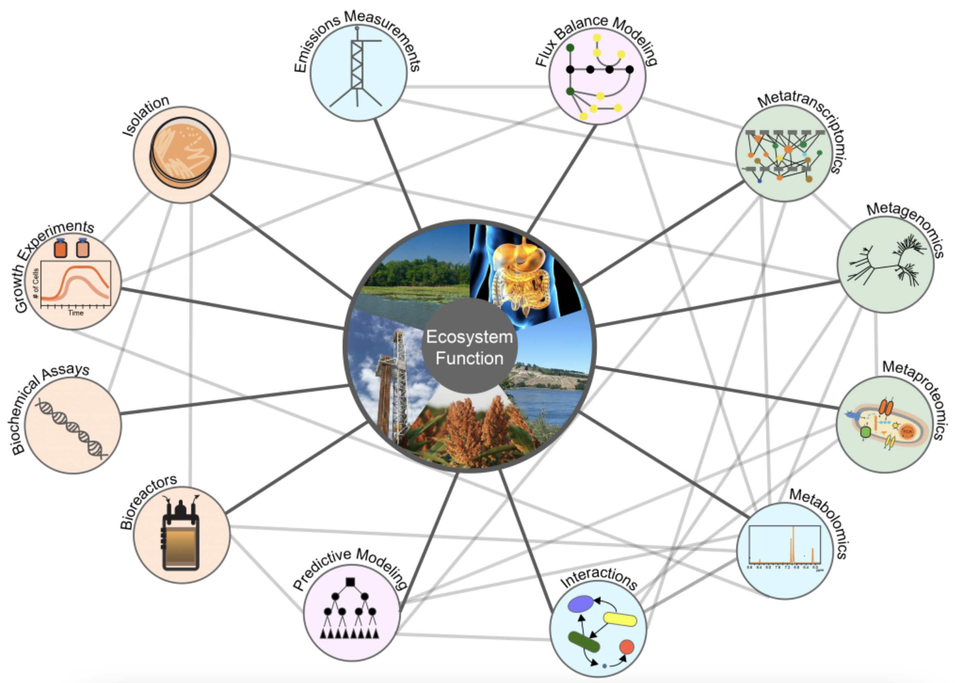
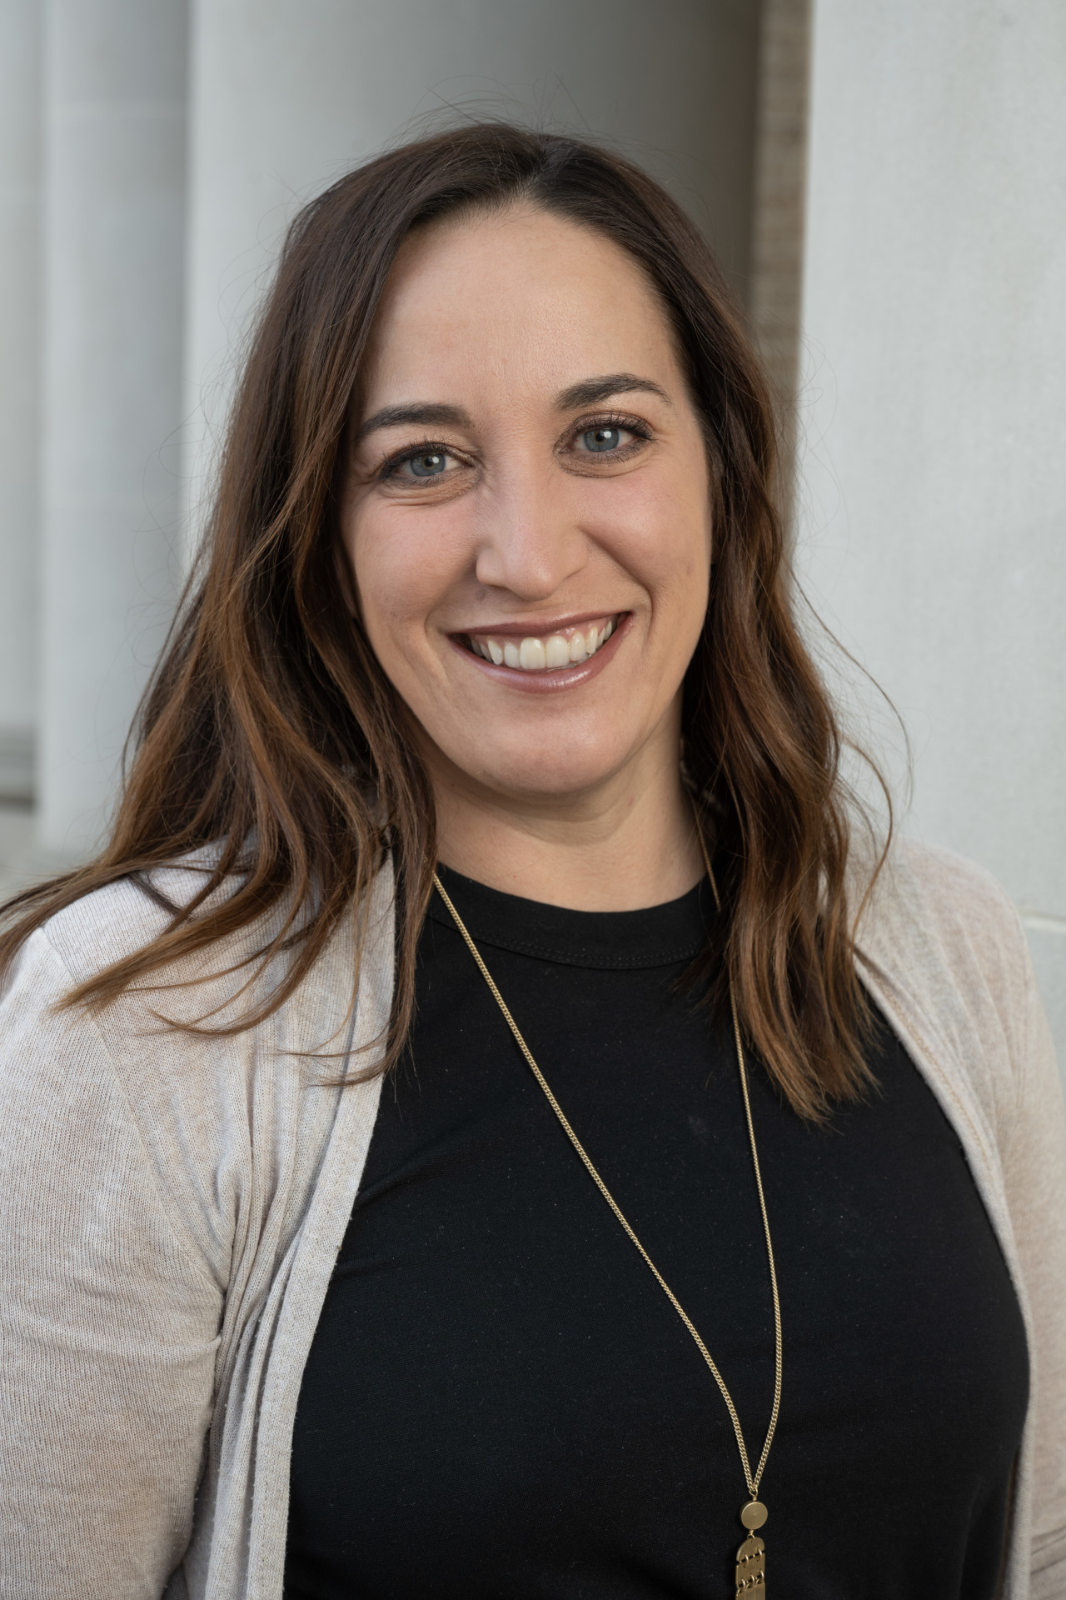
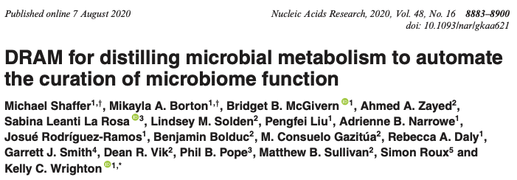
What is DRAM/DRAM2?
Distilled and Refined Annotation of Metabolism
DRAM is a genome/MAG gene annotation and summarization software focused on microbial metabolisms and traits
Kelly Wrighton

Slide 4
What is DRAM/DRAM2?
Distilled and Refined Annotation of Metabolism
DRAM is a genome/MAG gene annotation and summarization software focused on microbial metabolisms and traits
Genes
Metabolisms & traits
Metabolism 1
Metabolism 2
…
MAG 1 | Gene 1
MAG 1 | Gene 2
MAG 1
Yes
Yes
…
Set of MAGs
…
MAG 2
No
Yes
…
MAG x | Gene x
MAG 3
Yes
No
…

Slide 5
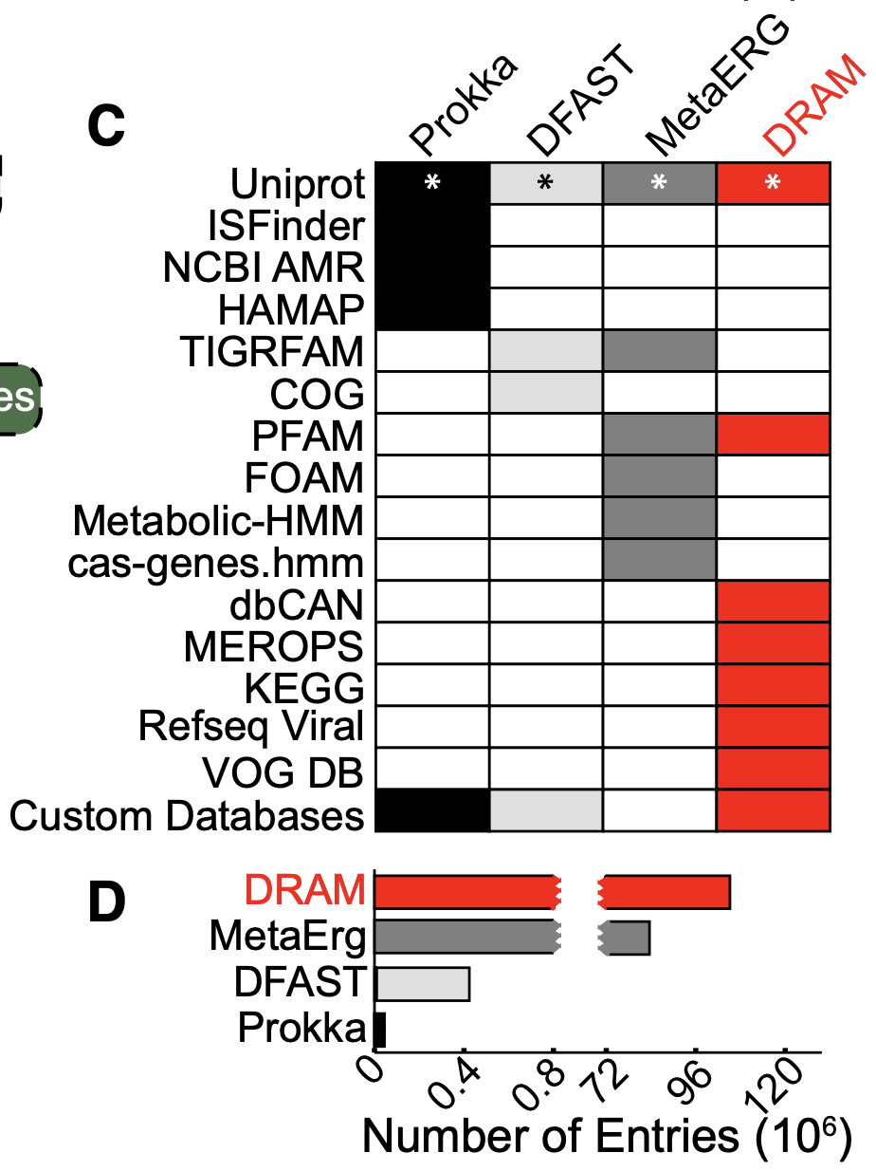
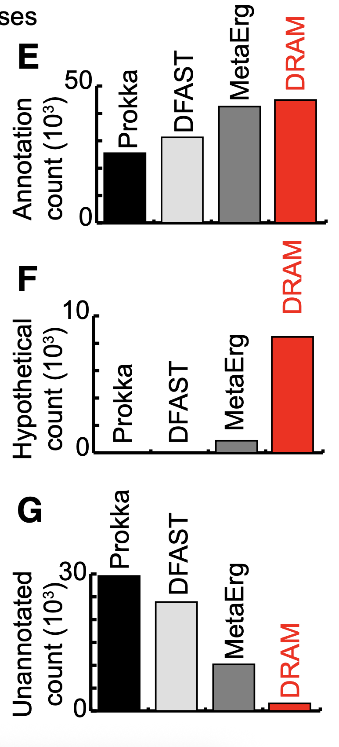
What advantages does DRAM2 offer over other annotation software?
1. DRAM/DRAM2 integrates annotations from across a suite of databases
Much larger database size compared to other software
DRAM outperforms similar annotation software
Shaffer et al 2020. NAR.
Shaffer et al 2020. NAR.

Slide 6
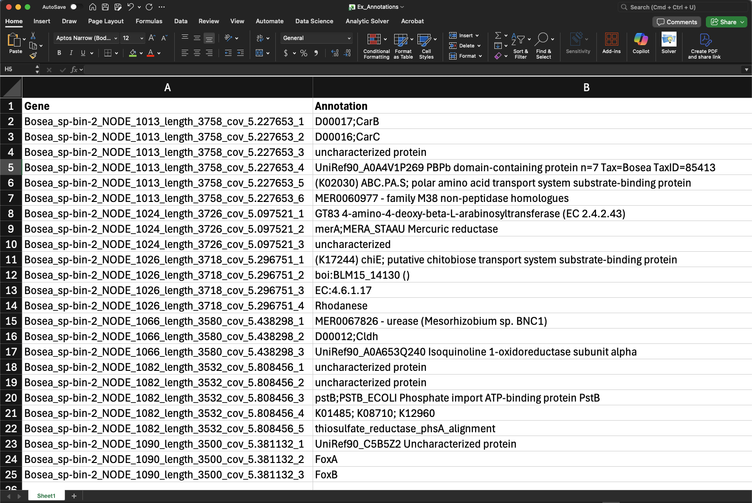
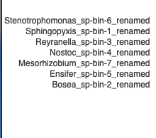
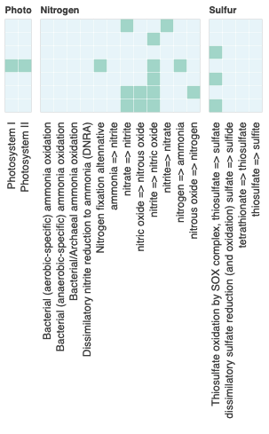


What advantages does DRAM2 offer over other annotation software?
2. DRAM/DRAM2 automates the summarization of annotation data
Manual sifting through 1000’s of genes to look for functional genes
OR..

Slide 7
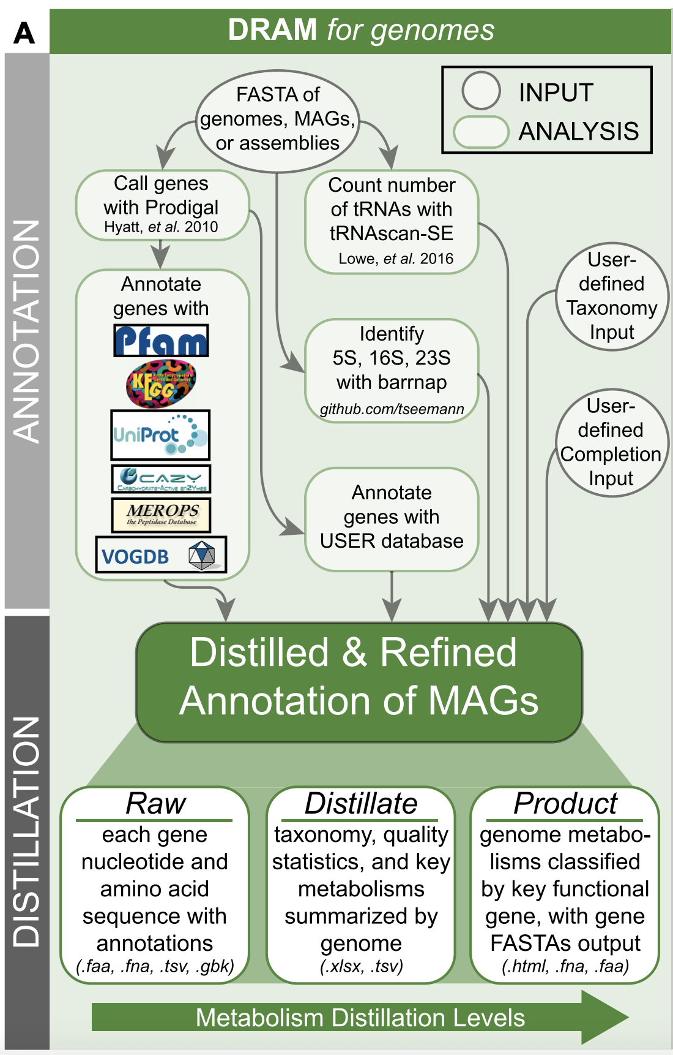
Under the hood: How does DRAM annotate?
4.) Get tRNA and rRNA genes
1.)
1.) Call genes for each MAG
5.)
5.) Read in, or create, taxonomy for MAGs using GTDB
2.)
4.)
2.) Make comparisons for each gene per database
6.)
3.)*
6.) Read in, or create, MAG quality metrics using checkM2
3.) Annotate gene with custom user-defined databases (*optional)
Flowchart from Shaffer et al 2020. NAR.

Slide 8
Under the hood: What gene databases does DRAM2 use?
- Kegg
- Pfam
- Uniref90
- Vogdb
- Refseq viral
Large, broad-coverage databases
- Merops - dbCAN
Peptidases CAZymes
Specialized, function-targeted databases
- *Camper
- *cantHYD - *Fegenie
- *Methyl - *Sulfur
Polyphenols
Hydrocarbons
Iron metabolism
Methylotrophy
Sulfur cycling genes
Plus MORE in DRAM2*
Flowchart from Shaffer et al 2020. NAR.

Slide 9
Under the hood: Annotation outputs
Additional useful information for each MAG analyzed - MMSeqs & HMM outputs
- Gene and protein sequences
- GFF files
Raw annotations
Flowchart from Shaffer et al 2020. NAR.

Slide 10
Under the hood: How does DRAM summarize?
* Now called “Summarize” and “Visualize” in DRAM2
1.) Read in compiled annotation file
1.)
2.)
3.)
3.) Summarize MAG metabolisms by functional genes
2.) Summarize MAG properties & presence of functional genes
DRAM genome summary form

Slide 11
Under the hood: Summarize outputs
Raw annotations
Metabolism summary
MAG traits
Additional useful information summarized for each MAG - Genome statistics
Flowchart from Shaffer et al 2020. NAR.

Slide 12
Under the hood: DRAM2 visualization
Metabolism summary
DRAM2-viz
HTML Heatmap

Slide 13
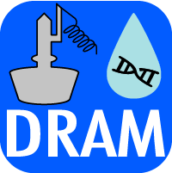
What is new in DRAM2 (beta release)
Better software and pipeline management
Easier database set-up
Nextflow implementation
Improved utility
Additional databases and metabolism summaries
New functionality
Classification of genomes/MAGs into functional guilds
Direct integration of metatranscriptome data (coming with full release)

Slide 14

Nextflow enables better HPC and analysis pipeline management
What does Nextflow do?
Defines bioinformatics pipelines as steps (process)
Manages software dependencies for each step
Executes pipeline on the HPC
Advantages
User only submits one job to the HPC
Parallelizes jobs, runs pipeline more efficiently
Handles failures and allows resuming at ‘cached’ steps
Genomes
Process 1 (call genes)
Process 2
(db1 search)
Process 3 (run tRNA-scan)
HPC Job 1
HPC Job 2
HPC Job 2
Results

Slide 15
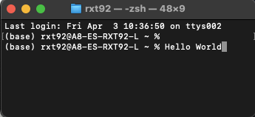
How to access DRAM2 on RoarCollab
Let’s go to the command line!
Notes:
Logging into RC Show where software and databases live - Note ohmc_collab access
Show example on how to load DRAM2 environment
Describe where analysis files are going by default (how to change this)

Slide 16

How to submit a DRAM2 job on Roar Collab
Command line submission of a DRAM2 job on RC
Notes:
Show example batch script for submission
Describe DRAM2 input, output, and flags
Describe batch script flags
Microbiome center allocation resources vs open queue vs other allocation

Slide 17

What happens when you submit a DRAM2 job?
Let’s see what’s happening when DRAM2 is running
….
Notes:
Nextflow starts jobs automatically for you
Show how you can see details of what is going on for each process
Discuss walltime expectations What happens if it gets interrupted -> restart it from where it left off (new to DRAM2)
Show example output of folders/files on terminal

Slide 18
Using DRAM(1) for metatranscriptomic data
* Direct integration of metaT data is not currently available with our DRAM2 beta install. The full DRAM2 release will integrate this functionality!
1.) Map metaT reads to MAGs 2.) Extract mapping data for reads that mapped to genes annotated by DRAM
3.) Merge mapping data and DRAM annotations in R
4). Downstream analysis

Slide 19
Targeted analysis of metabolic functions of interest

Slide 20

DRAM2 is brand new to Roar Collab and the OHMC! Help me test it
Email: Rxt92@psu.edu
Let’s put together a RC OHMC DRAM2 github repository:
https://github.com/RVTrexler/RoarCollab-OHMC-DRAM2.git
Interdisciplinary Innovation Fellowship

