Slide 1
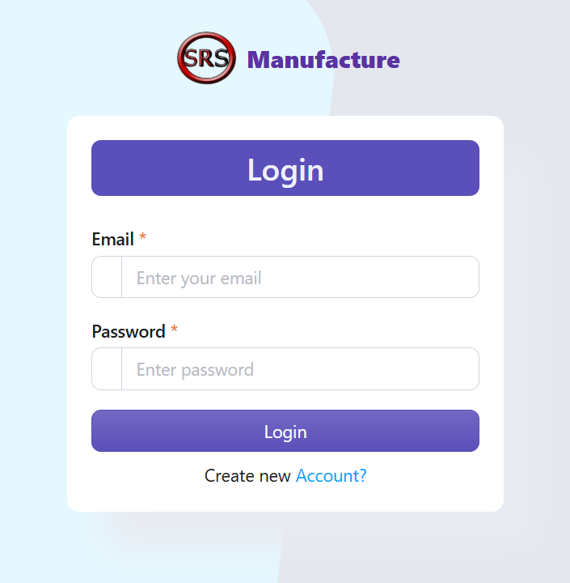


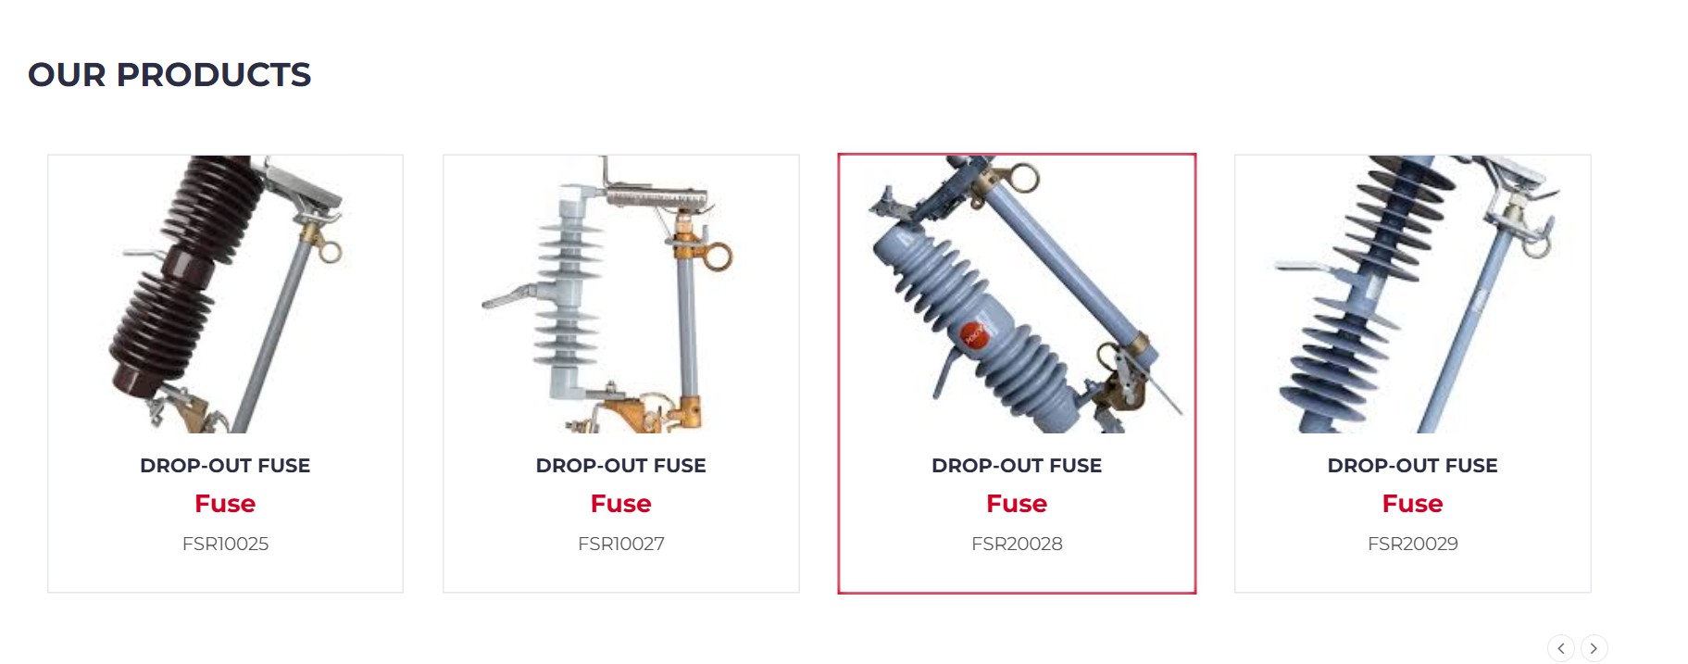

>ascascvsdaz
Login to
The SRS Manufacture
SRS Manufacture
team
SRS Manufacture
Home
SRS Manufacture
contact
SRS Manufacture
Products

Slide 2
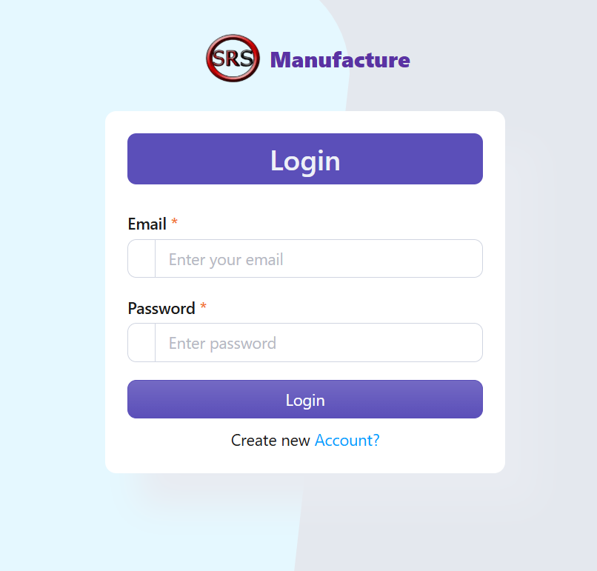

The SRS Manufacture
About
Login to
SRS Manufacture
SRS Manufacture
Products
SRS Manufacture
team
SRS Manufacture
testing

Slide 3
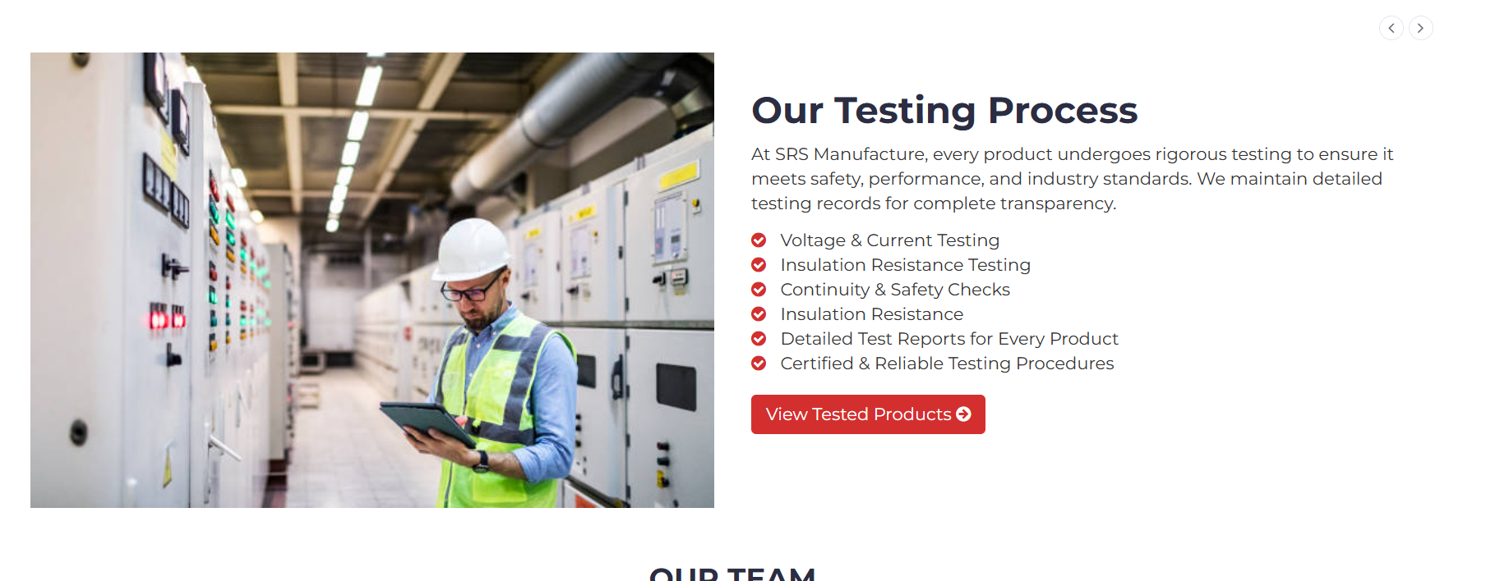
SRS Manufacture
Products
The SRS Manufacture
About
SRS Manufacture
testing
Login to
SRS Manufacture
SRS Manufacture
testimonial

Slide 4
SRS Manufacture
testing
SRS Manufacture
Products
SRS Manufacture
team
The SRS Manufacture
About
SRS Manufacture
testing

Slide 5
SRS Manufacture
Our Team
SRS Manufacture
testing
SRS Manufacture
testimonial
SRS Manufacture
Products
SRS Manufacture
contact
>

Slide 6

SRS Manufacture
testimonial
SRS Manufacture
team
SRS Manufacture
contact
SRS Manufacture
testing
SRS Manufacture
Link to admin panel

Slide 7
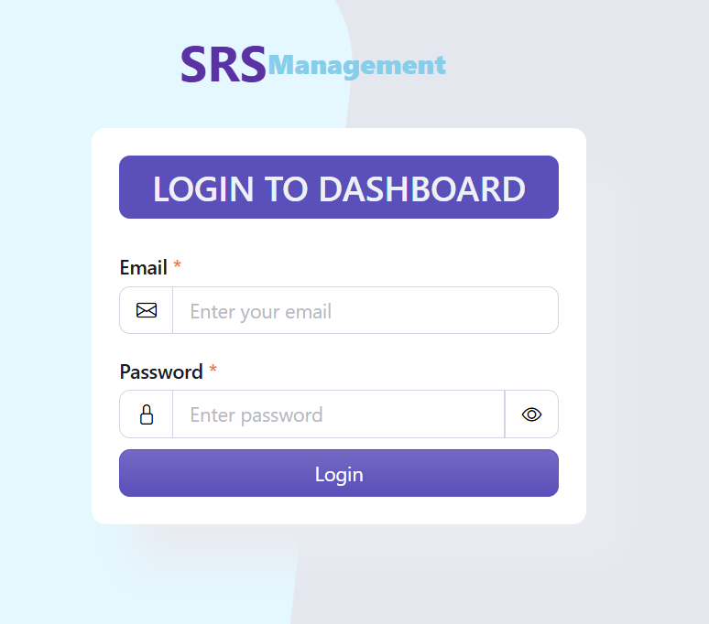
SRS Manufacture
contact
SRS Manufacture
testimonial
SRS Manufacture
Link to admin panel
SRS Manufacture
team
Login to
DASHBOARD

Slide 8
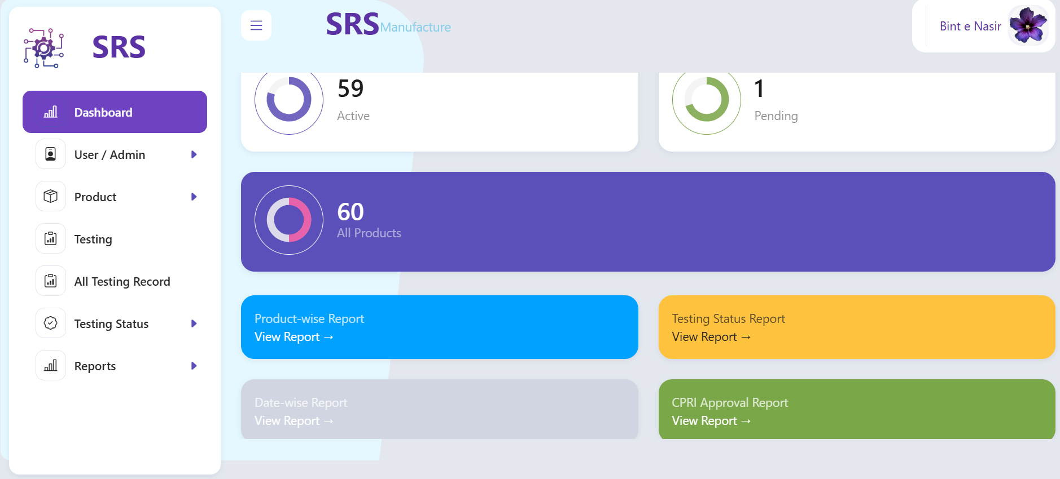
SRS Manufacture
Link to admin panel
SRS Manufacture
contact
Login to
DASHBOARD
SRS Manufacture
testimonial
DASHBOARD

Slide 9
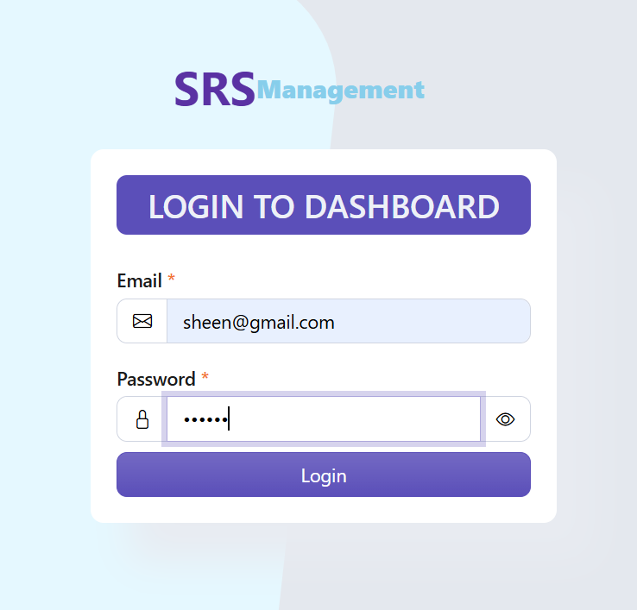
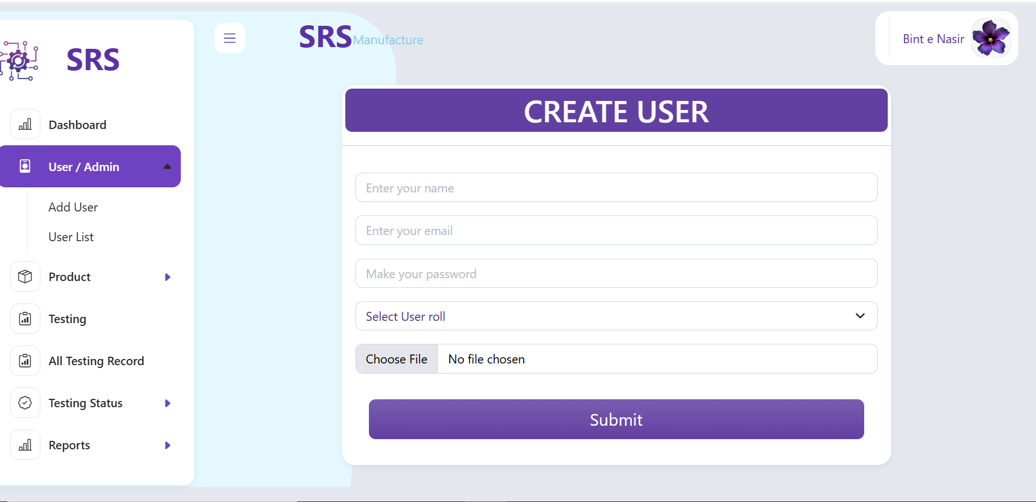
Login to
DASHBOARD
SRS Manufacture
Link to admin panel
DASHBOARD
SRS Manufacture
contact
ADD USER

Slide 10
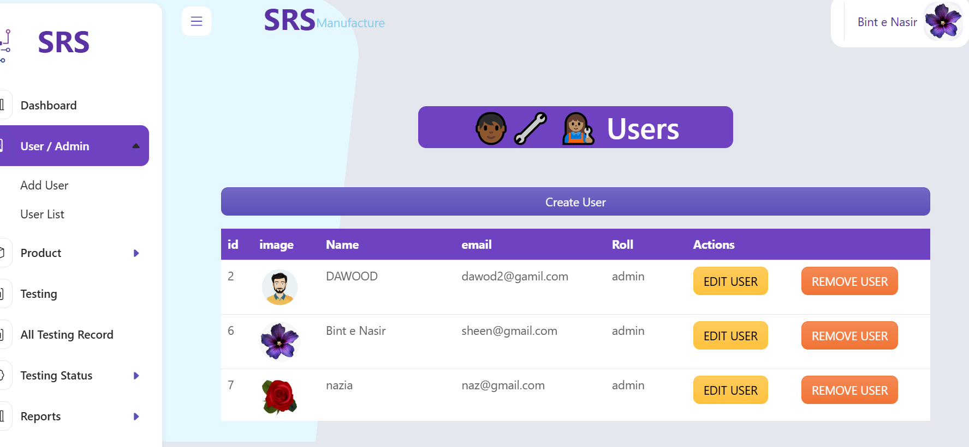
DASHBOARD
Login to
DASHBOARD
CREATE USER
SRS Manufacture
Link to admin panel
USER LIST

Slide 11
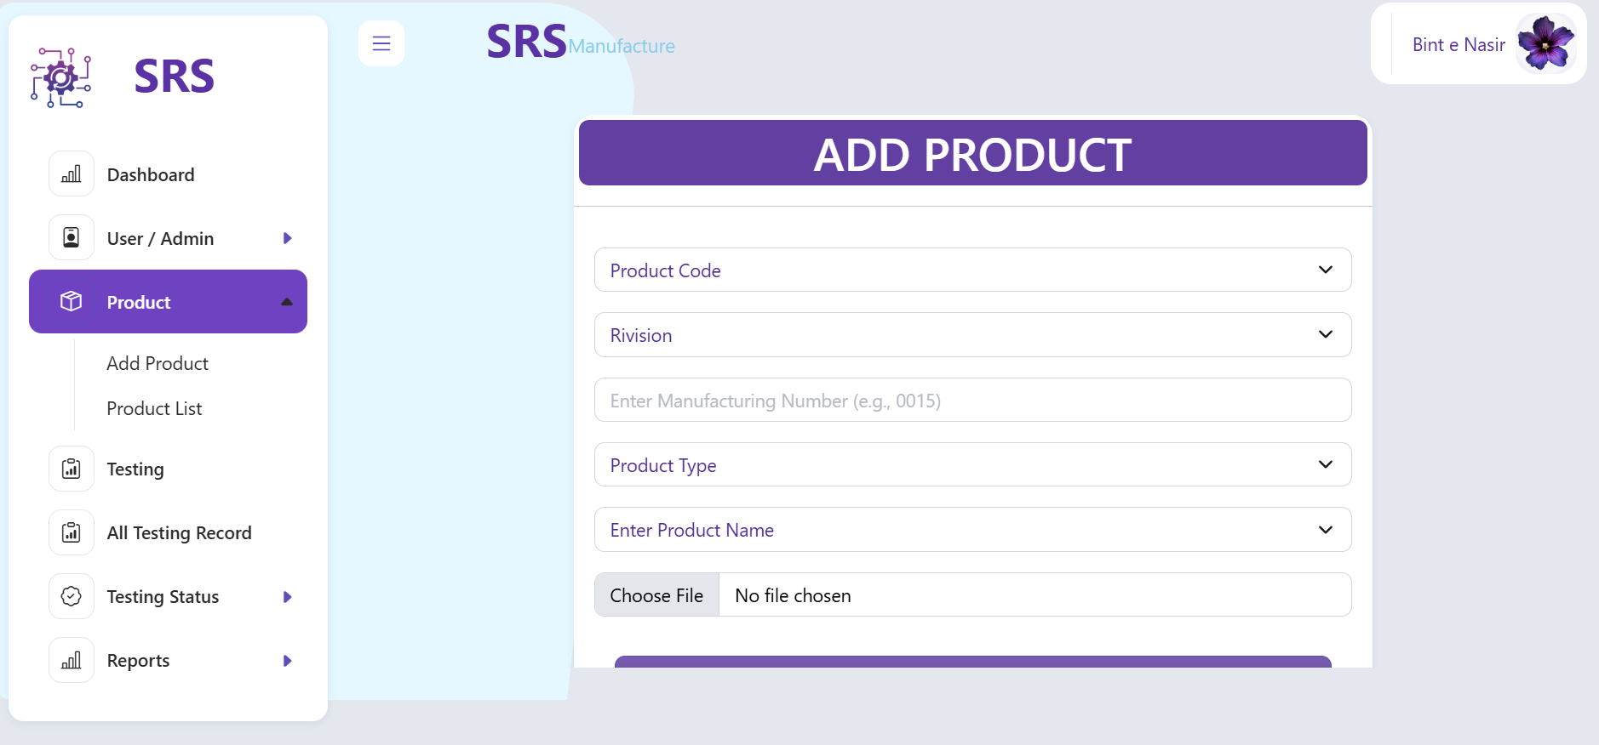
CREATE USER
USER LIST
DASHBOARD
ADD PRODUCT
Login to
DASHBOARD

Slide 12
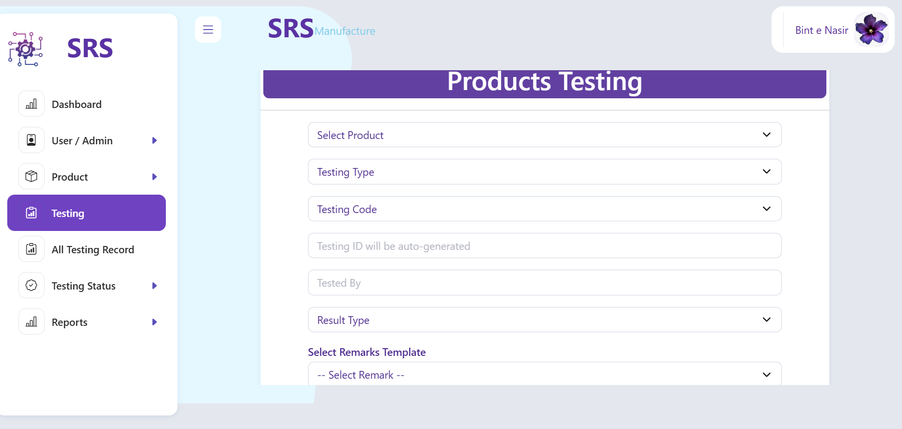
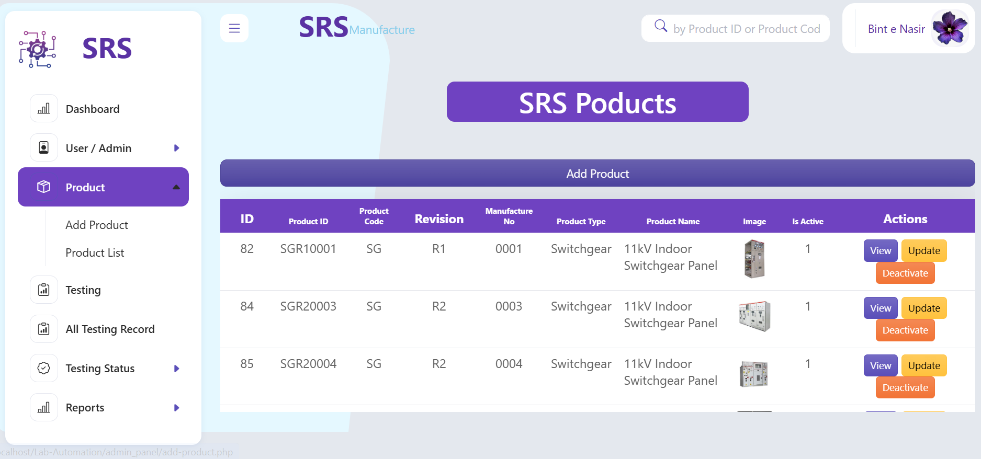
USER LIST
CREATE USER
ADD PRODUCTS
PRODUCT LIST
DASHBOARD

Slide 13
ADD PRODUCTS
USER LIST
PRODUCTS LIST
TESTING
CREATE USER

Slide 14
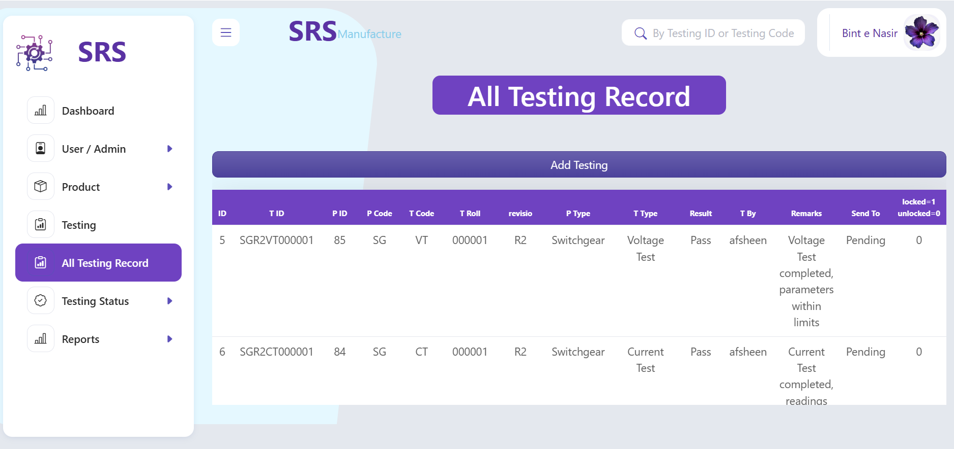
PRODUCTS LIST
ADD PRODUCTS
PRODUCT
TESTING
ALL TESTING
RECORD
USER LIST

Slide 15
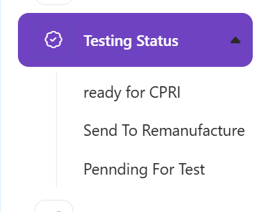
PRODUCT TESTING
PRODUCTS
LIST
ALL TESTING
RECORD
TESTING
STATUS
ADD
PRODUCTS

Slide 16
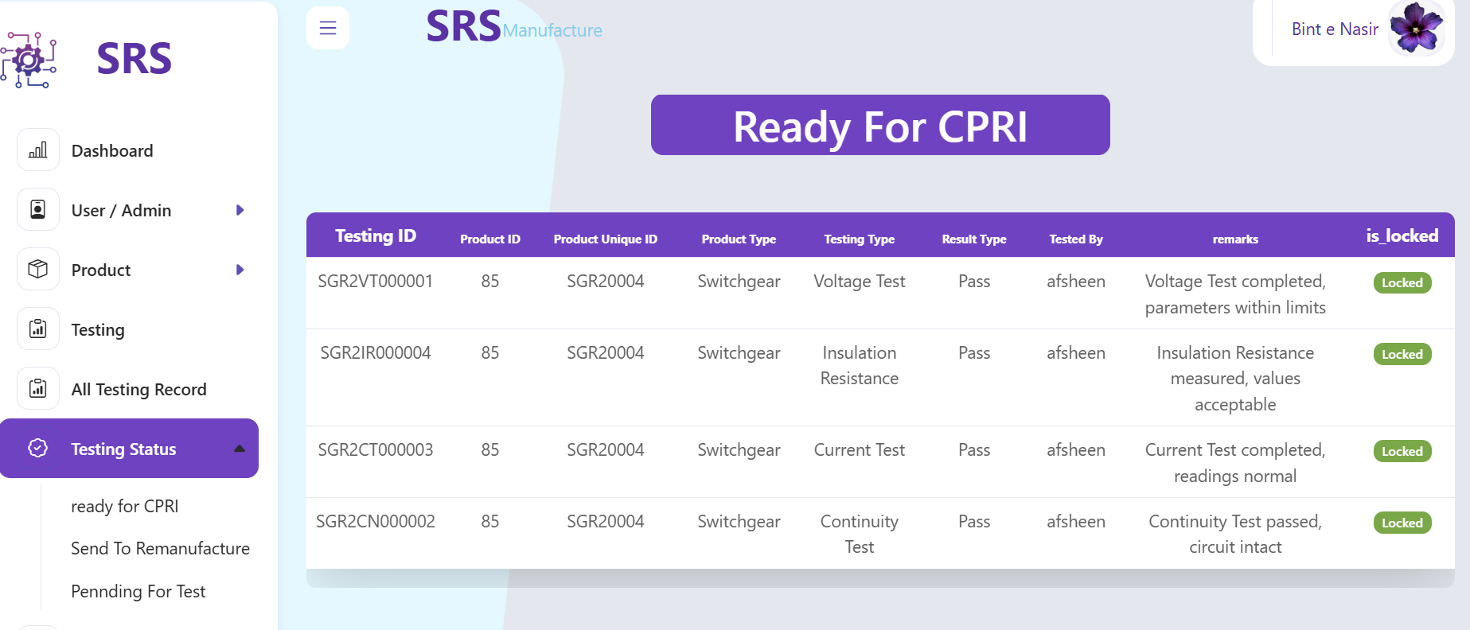
ALL TESTING
RECORD
PRODUCTS
TESTING
TESTING STATUS
SEND TO
CPRI
ADD
RODUCTS

Slide 17
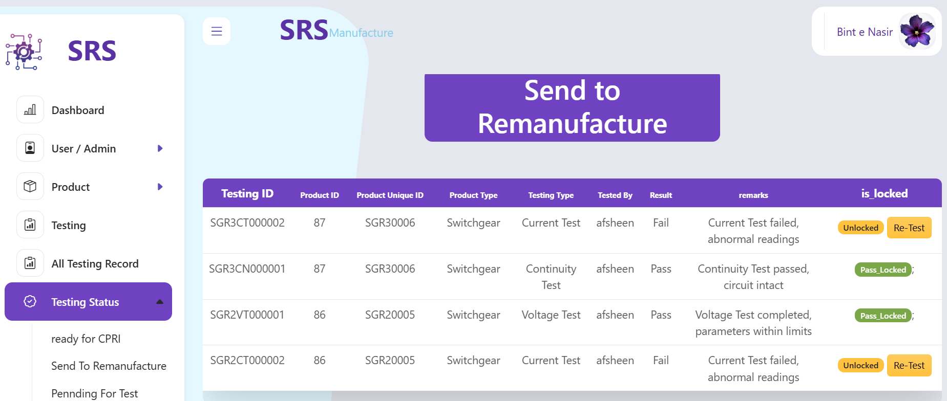
>ascascvsdaz
TESTING
STATUS
ALL TESTING
RECORD
SEND TO
CPRI
SEND TO
REMANUFACTURE
PRODUCTS
TESTING

Slide 18
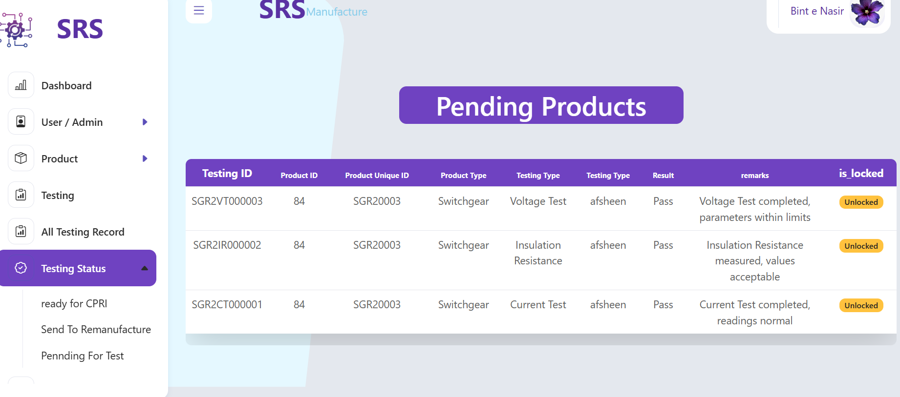
SEND TO CPRI
SEND TO
REMANUFACTURE
TESTING
STATUS
PENDING
PRODUCTS
ALL TESTING
RECORD

Slide 19
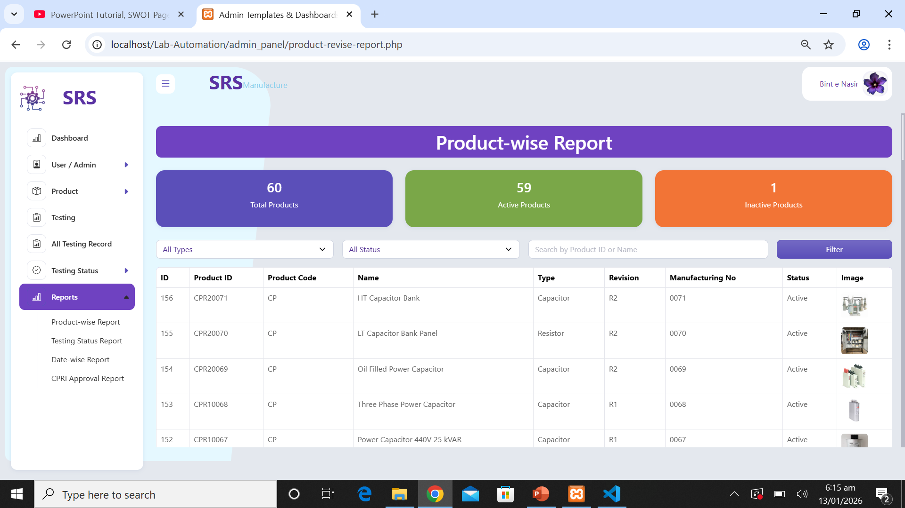
SEND TO
REMANUFACTURE
PENDING
PRODUCTS
SEND TO CPRI
Product-wise
Report
TESTING
STATUS

Slide 20
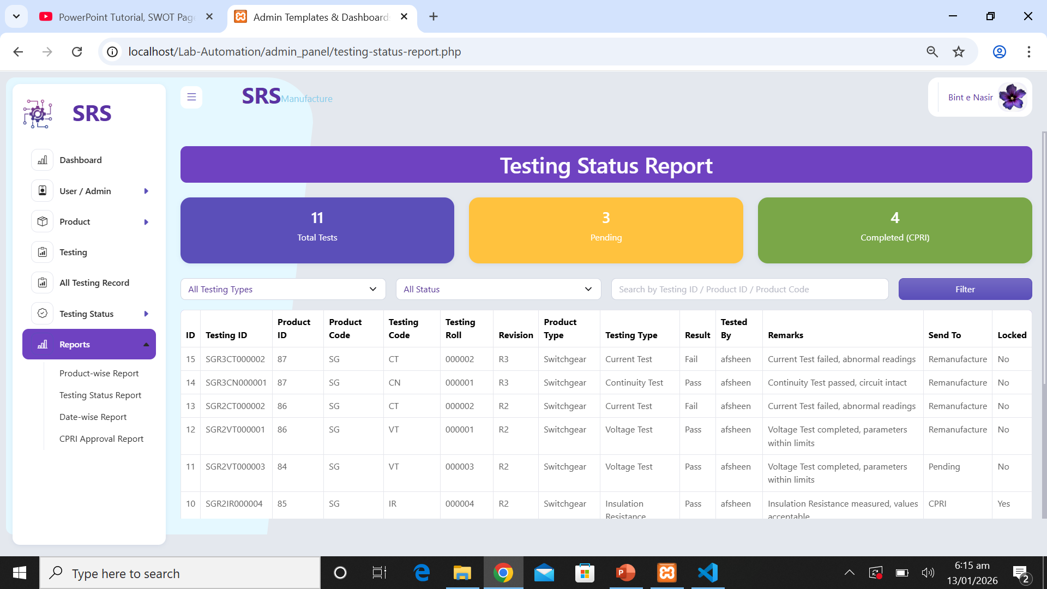
PENDING
PRODUCTS
Product-wise
Report
SEND TO REMANUFACTURE
Testing Status
Report
SEND TO CPRI

Slide 21

Product-wise
Report
Testing Status
Report
PENDING
PRODUCTS
Date-wiseTesting
Report
SEND TO REMANUFACTURE

Slide 22
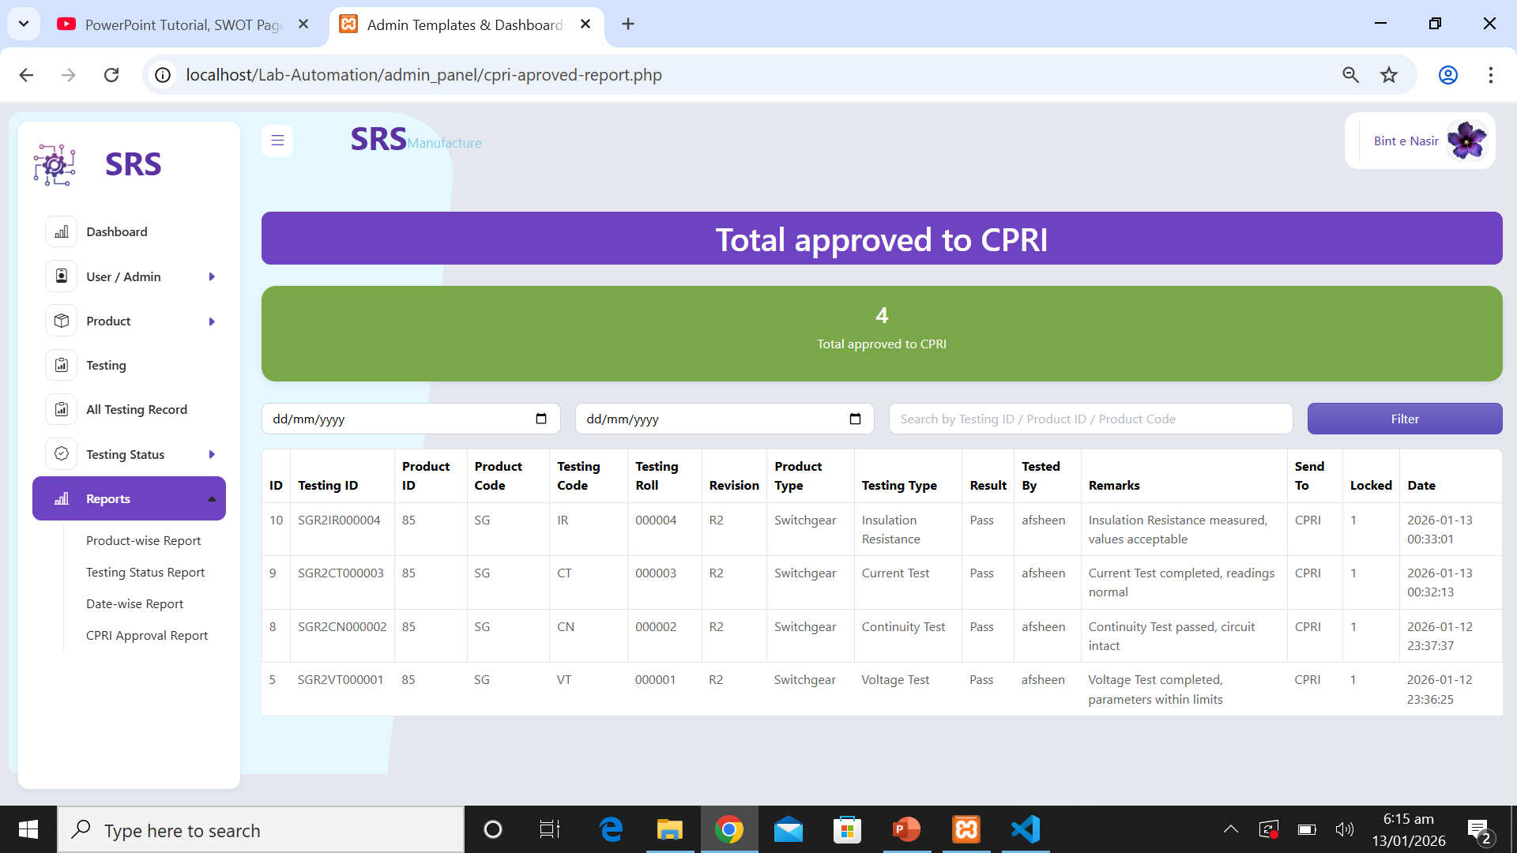
Testing Status
Report
Date-wise Testing
Report
PRODUCT-wise
Report
CPRI Approval
Report
PENDING
PRODUCTS

Slide 23
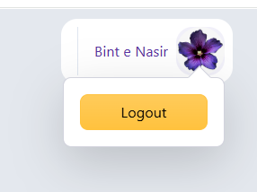
Date-wise Testing
Report
CPRI Approval
Report
Testing Status
Report
PRODUCT-wise
Report
Logout

Slide 24

CPRI Approval
Report
Logout
Date-wises
Report
Thanks for
Watching
Lab Automation
Testing Status
Report

Slide 25

Logout
Thanks for
Watching
Lab Automation
CPRI Approval
Report
Date-wises
Report

Slide 26
E-Project
DISM

