Slide 1
WEST SIDE
PROJECT

Slide 2


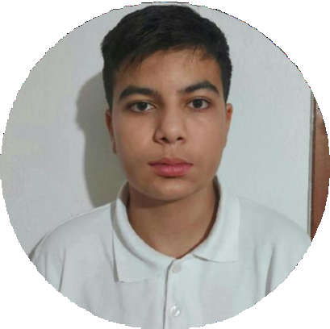
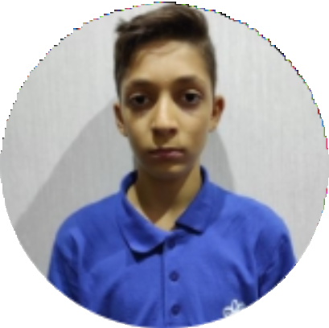
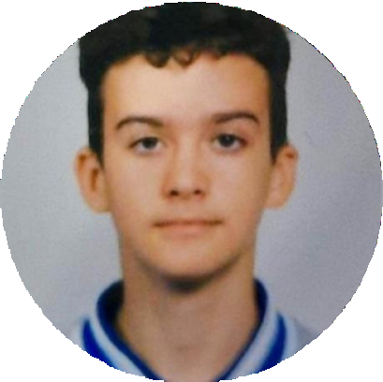
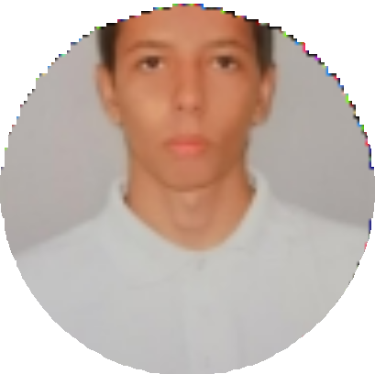
OUR TEAM
Денис Юсеин
Front-end Developer
Георги Атанасов
Back-end Developer
Даниел Бузин
Designer
Станислав Дженевиз
Scrum trainer

Slide 3
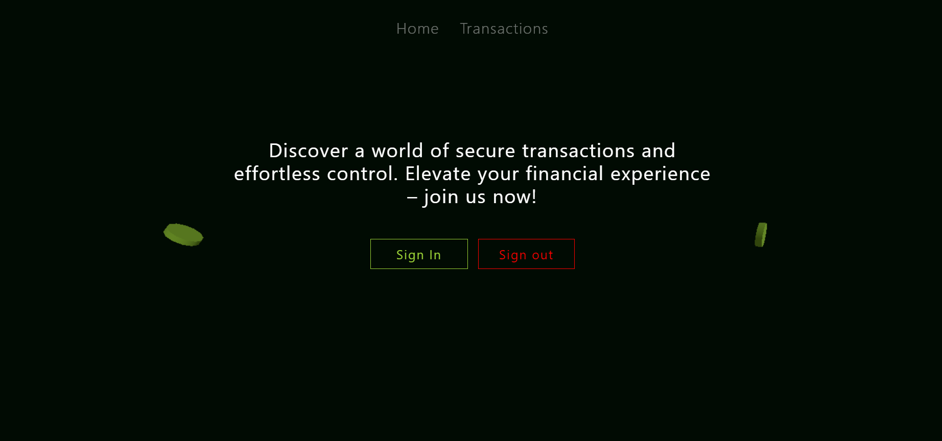
OUR IDEA

Slide 4


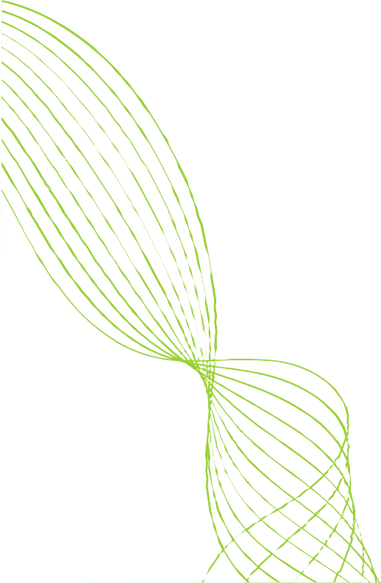
STAGES OF DEVELOPMENT
making the project
Ideas
testing the code

Slide 5







USED TECHNOLOGIES
CODE
FRAMEWORK
COMMUNIACTION
DOCUMENTATION
PRESENTATION
PLATFORM

Slide 6

LET’ S JUMP
TO THE CODE

