Slide 1












OPIUM

Slide 2








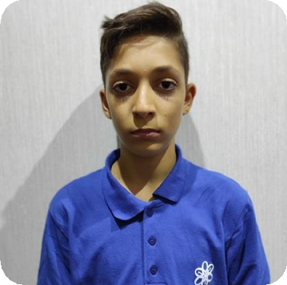

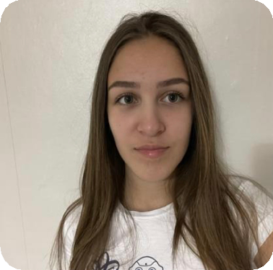
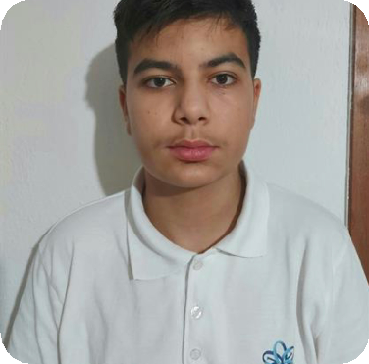
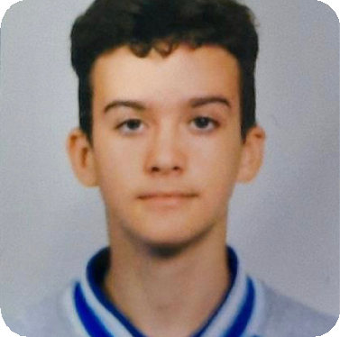


Our team
Ivayla Kuzmova Scrum trainer
Denis Yusein Frontend Dev
Georgi Atanasov Backend Dev
Daniel Busin
Designer

Slide 3








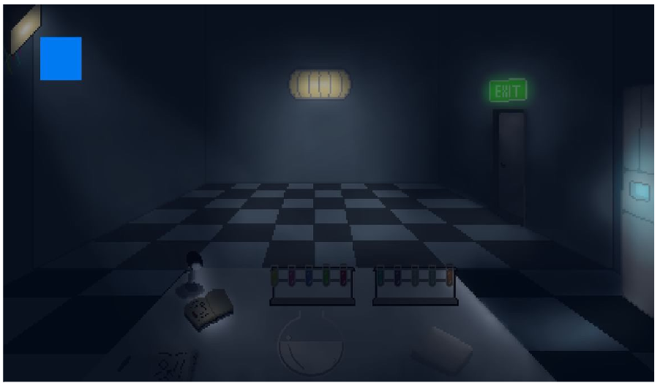




Our idea

Slide 4






Stages of development
Wrote the code
Tested the
Gave ideas
code

Slide 5
















Used technologies
CODE
LANGUAGE
COMMUNICATION
PLATFORM
PRESENTATION
DOCUMENTATION

Slide 6










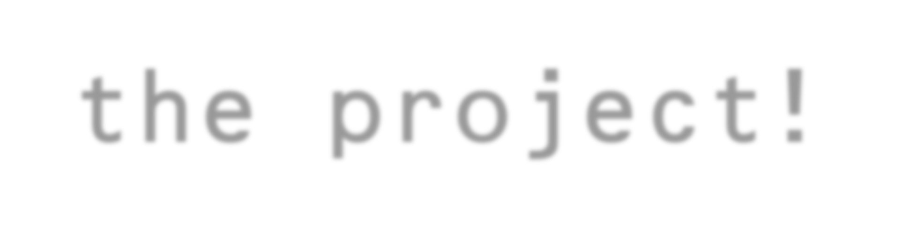






Let’s jump to
the project!
6

