Slide 1
HEART RATE ANALYSIS USING ARIMA WITH LIVE LOCATION AND AI CHATBOT
VIDYA JYOTHI INSTITUTE OF TECHNOLOGY (Autonomous)
By :
Team no:8
P.Vaishnavi-22911A3542
P.Vignesh-22911A3543
A.Santhosh-22911A3504
D.Abhishek-23915A3502
Under the guidance of:
Mrs. K.Santhipriya
Assistant Professer

Slide 2
Problem Statement
Continuous heart rate monitoring is essential for detecting cardiac abnormalities, stress levels, and fitness tracking.
Traditional heart rate measurement methods are often invasive or require clinical supervision.
This project aims to develop a real-time heart rate monitoring system using sensor data, enabling non-invasive, real-time health tracking and early detection of irregularities.

Slide 3
Abstract
This project focuses on developing an AI-driven heart rate monitoring system using real-time series data(ARIMA). The system utilizes a PPG (Photoplethysmography) sensor or an ECG sensor to collect heart rate signals. The collected data is processed using machine learning algorithms to detect patterns and anomalies. The analysis includes heart rate variability (HRV), stress detection, and potential arrhythmia identification.The proposed system can be integrated into wearable devices for continuous monitoring, providing a cost-effective and efficient health tracking solution.Real-time Heart Rate Display (BPM), AND A CHATBOT WHICH GIVE YOU A SUGGESTION ON YOUR DIET AND ALERT YOU BY SEND NOTIFICSTION AND LIVE LOCATION,Stress Level Indicator with Progress Bar,Heart Rate Trend Line Chart,Alerts for High Stress or Anomalies.

Slide 4
Literature Survey
S. No. | Title, Authors | Dataset | Methodology | Strengths | Weakness | Evaluation Metrics | Year | Research paper Link
1 | Paper -1 A Predictive Analysis of Heart Rates Using Machine Learning Techniques | Multilevel Monitoring of Activity and Sleep in Healthy people (MMASH) dataset | ARIMA Model, Machine Learning Techniques, LSTM Deep Learning Model, Regression, Regressor | Can predict future HR more accurately using accelerometer data. | The data was based on accelerometer data, which may be less accurate than HR data. | root mean squared error (RMSE) and calculating the scatter index (SI) | 2024 | A Predictive Analysis of Heart Rates Using Machine Learning Techniques – PMC
2 | Paper -2 Smart Heart Rate, Oxygen Level and Temperature values Monitoring with Things peak | Collected physiological data (Heart Rate, SpO2, Temperature) using IoT sensors integrated with ThingSpeak. | ESP8266, MAX30102 and LM35 sensors,CNN, Monitoring and Prediction | Real-time monitoring, IoT-based remote access, multi-parameter health tracking. | Limited dataset size, potential sensor inaccuracies, dependency on cloud connectivity. | Accuracy, Mean Absolute Error (MAE), Root Mean Square Error (RMSE), Response Time. | 2023 | https://doi.org/10.1089/big.2020.0159.

Slide 5
Literature Survey
3 | Paper -3 A deep learning approach for remote heart rate estimation | Wearable sensor-based heart rate and stress data. | Long Short-Term Memory (LSTM) Deep Neural Network | The LSTM network works well beyond the visible spectrum, e.g., with infrared lighting when color signals are not available.. | The study does not explicitly mention any weaknesses of the proposed method.. | Accuracy, Sensitivity, Specificity, F1-score. | 2022 | https://doi.org/10.1016/j.bspc.2021.103457
4 | Paper-4 Inertial measurement and heart-rate sensor-based dataset for geriatric fall detection using custom built wrist-worn device | BITS-2 Dataset for Fall Detection. | ARIMA Model Machine Learning Techniques LSTM Deep Learning Model Regression and Regressor | Can predict future HR more accurately using accelerometer data. | The data was based on accelerometer data, which may be less accurate than HR data. | Root Mean Squared Error (RMSE) Scatter Index (SI) | 2022 | https://doi.org/10.1016/j.dib.2023.109812

Slide 6
Literature Survey - Base paper
Paper 1: A Predictive Analysis of Heart Rates Using Machine Learning Techniques
Authors: Mattew Oyeleye, Tianhua chen , Sofya Titarenko, Grigoris Antoniou
Published by & Year: Enternational Journal of Environmental Research and Public Health 2024
This study has addressed the use of machine learning to predict HR using 24 h univariant HR time-series data generated by an accelerometer, which can be used to detect early HR risks and to monitor patients with heart disease. We used the autoregressive integrated moving average (ARIMA) model, linear regression, support vector regression (SVR), k-nearest neighbor (KNN) regressor, decision tree regressor, random forest regressor and long short-term memory (LSTM) recurrent neural network algorithm to make predictions from the HR time-series

Slide 7
Literature Survey - Base paper
Paper 2: Smart Heart Rate, Oxygen Level and Temperature values Monitoring with Things peak
Authors: Inampudi lipi, Dr.S.Ramesh, Krishna PreethamBhavirisetty, Sharmila Golla
Published by & Year: Big Data,2023
If the early symptoms of irregular functioning of the heart are ignored, the patient may suffer severe consequences in little time limit. The number of people with cardiovascular breakdown has been steadily increasing. The challenge of predicting the existence of any Coronary Heart Disease[CHD] in people refers to the task of visiting the healthcare provider, getting numerous tests, waiting for hours and wasting precious time and energy. To get out of this perilous condition and reduce the risk of heart failure, a system that can develop rules or categorize data using applicable live methodologies is required.

Slide 8
Literature Survey - Base paper
Paper 3: A deep learning approach for remote heart rate estimation
Authors: Jaramir Przbylo
Published by & Year: ScienceDirect 2022
A reliable noncontact monitoring of cardiovascular parameters with the use of videoplethysmography can be difficult, because many factors can introduce noise to the signal, e.g., subject movement and illumination changes. Thus, many signal preprocessing algorithms and VPG extraction methods have been developed to form the VPG signal and improve its quality. They usually consist of several steps, which require careful parameter selection. In contrast, in this paper, a new method of VPG signal processing based on the LSTM network is introduced. It is intended to replace the VPG signal pre- and post-processing stages, consequently reducing the number of algorithm parameters that affect the accuracy of the HR estimation.

Slide 9
Literature Survey - Base paper
Paper 4:Inertial measurement and heart-rate sensor-based dataset for geriatric fall detection using custom built wrist-worn device
Authors: Purab Nandi,K.R.Anupama,Himanish Agarwal, Krishan Patel, Vedant Bang.
Published by & Year: ScienceDirect 2022
This paper describes a dataset acquired from 41 volunteers performing 16 Activities of daily livings (ADLs) and 8 Falls repeated 5 times. This data was collected using a custom wrist-worn end device. The dataset has data collected from Inertial measurement unit (IMU) and heart-rate sensors. The end device is built using Qualcomm Snapdragon 820c System on Chip (SoC) interfaced to the sensors via Interconnect Integrated Circuit (I2C) protocol. The data was sampled for every activity at a rate of 20 Hz for the motion sensors and at a rate of 1 Hz for the heart-rate sensor. The motion sensor comprised of a triaxial accelerometer, triaxial gyroscope, triaxial magnetometer and a linear accelerometer. The heart-rate sensor was medical grade and all sensors were calibrated for the wrist -worn position.

Slide 10
Existing Systems
Threshold-Based Monitoring: Simple rule-based alerts when heart rate crosses set limits.
Machine Learning Classification: Models like SVM classify heart rates as normal or abnormal based on labeled data.
Signal Processing Techniques: Methods like FFT and Wavelet Transform analyze heart rate variability to detect irregularities.
Deep Learning: Utilizing advanced neural network architectures for complex sequence prediction and anomaly detection in heart rate patterns.
Kalman Filters: Employing statistical algorithms for real-time noise reduction and estimation of the underlying heart rate signal.

Slide 11
Existing Systems
Hidden Markov Models: Using probabilistic models to track underlying physiological states based on observed heart rate data.
Moving Average: A simple technique for smoothing out short-term fluctuations and identifying general trends in heart rate.
Clustering: Applying unsupervised learning algorithms to discover natural groupings or patterns within the heart rate data, potentially highlighting anomalies.

Slide 12
Limitations
Sensor Accuracy – Motion artifacts, poor skin contact, or environmental factors may cause false alerts or missed abnormalities.
Battery Life – Continuous monitoring and GPS tracking drain battery quickly.
Privacy Concerns – Location and health data transmission require strong encryption.
AI Misinterpretation – The chatbot may provide incorrect advice in complex cases.
Network Dependency – Functionality relies on stable internet, which may be unreliable in remote areas.
Response Delay – Delays in alerting emergency services may affect timely intervention.

Slide 13
Proposed System
The proposed system integrates PPG, ECG sensors (e.g., AD8232), and accelerometers for accurate heart rate measurement, even during physical activity.
It uses advanced signal processing to filter noise and compensate for motion artifacts, improving accuracy.
The system provides real-time monitoring through mobile apps or dashboards, with anomaly detection (e.g., arrhythmias).
Data is transmitted to cloud platforms for remote health tracking and long-term analysis.
The system also compares sensor-derived heart rate data with gold-standard ECG measurements to ensure high accuracy

Slide 14
Block diagram
Start
Collect data
Preprocess data
Extract features
Store data for long-term Monitoring (cloud/local)
Apply Machine Learning Model(if heart rate is normal-> go to step 6
If abnormal/stress detected -> Trigger alert,live location)
End
Display results (web/mobileDashboard)

Slide 15
Dataset sample
Datasets Available
Heart rate risk analysis Databases
Time series dataset(ARIMA)
Location Datasets
Chatbot Interaction Datasets
Combining Datasets
Why arima?
In this system, ARIMA is used as a time series forecasting model to analyze heart rate data collected over time. Heart rate values naturally form a sequence where past readings influence future ones. ARIMA helps predict expected heart rate values and detect anomalies when real-time heart rates deviate sharply from predictions.

Slide 16
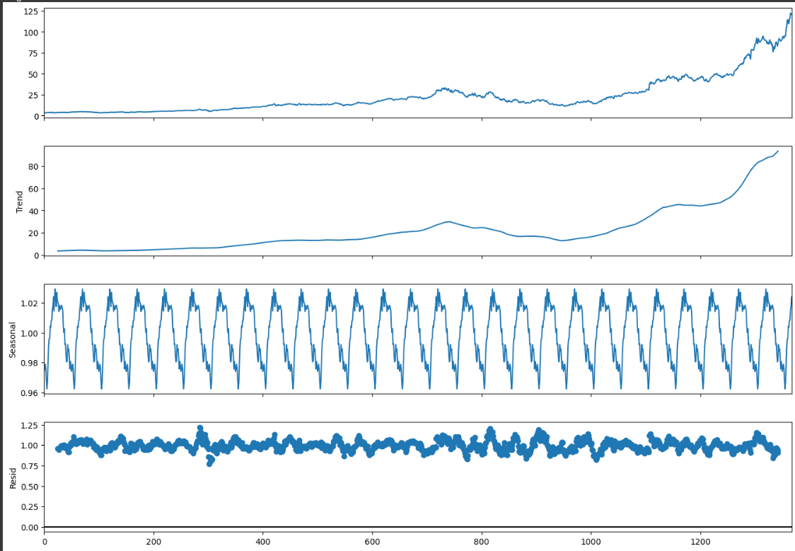
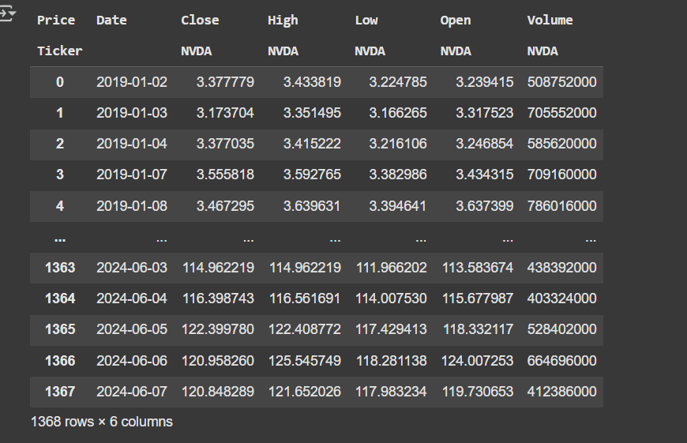
Dataset sample and model graph

Slide 17
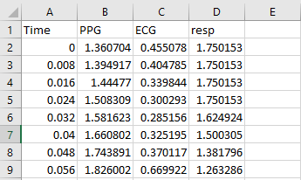
Methodologies
1. Heart Rate Data Collection
Use a mobile app or IoT device that continuously collects heart rate data from the user.

Slide 18
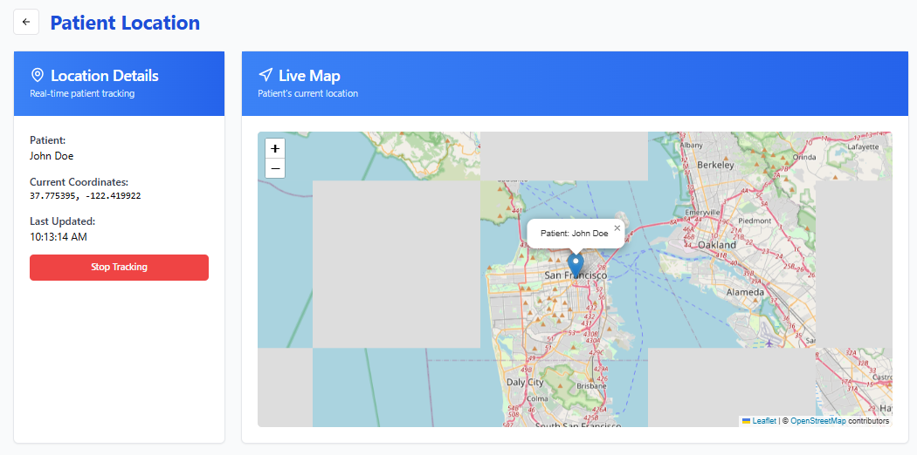
Methodologies
3. Live Location Tracking
Integrate GPS tracking in the mobile app.
4. Security and Compliance:
Encrypt all health and location data (use HTTPS, database encryption).

Slide 19
Methodologies
2. ARIMA Model for Heart Rate Analysis
Build and train an ARIMA model on time-series heart rate data.
Use the model to predict normal patterns and detect anomalies (like sudden spikes, drops, irregular rhythms).

Slide 20
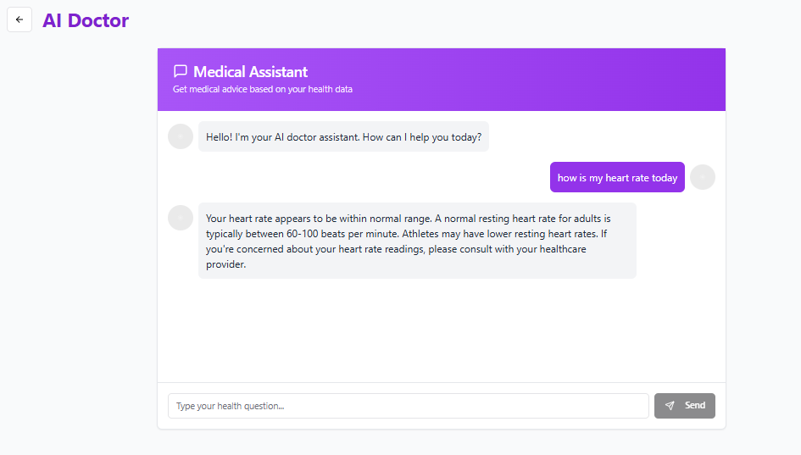
Methodologies
5. AI Chatbot for Medical Advice
Build or integrate an AI chatbot (using something like Dialogflow, Rasa, or a custom GPT-based model).

Slide 21
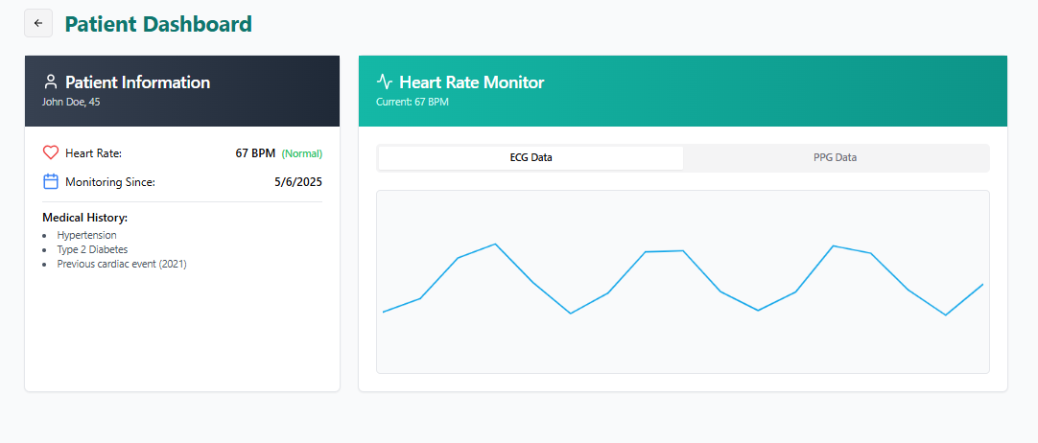
Methodologies
6. Cloud Storage and Backend Server
Set up a backend server (AWS, Azure, Firebase, etc.) to:
  Store heart rate data securely.
  Store GPS location logs.
Backend also retrains or fine-tunes the ARIMA model based on new data over time.

Slide 22
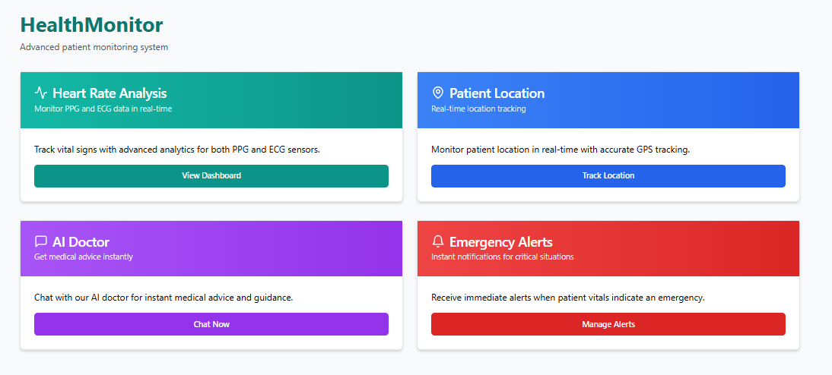
Methodologies
7. Mobile App / Web Dashboard
Build a user-friendly mobile app (Flutter, React Native) or web dashboard (React, Vue) that shows:
  Real-time heart rate graphs.
  Location on a map.
  Chatbot access.

Slide 23
Implementation
1.Data Ingestion & Preparation:
Gather: Heart rate (ECG/PPG), GPS location, chatbot user input.
Clean: Filter sensor noise, align timestamps, handle missing data, normalize values.
2. Heart Rate Insights:
Extract: HRV metrics (SDNN, RMSSD), heart rate trends/fluctuations.
Detect: Anomalies (arrhythmias) via algorithms (e.g., Pan-Tompkins, Isolation Forest).
3. Location Intelligence:
Process: Smooth GPS trajectories, calculate speed/acceleration.
Infer: Activity (walking, running) from location/sensor data.

Slide 24
Implementation
4. AI Chatbot Interaction:
Develop: NLP-powered chatbot (e.g., Transformer models).
Train: On medical/health knowledge.
Integrate: With heart rate and location analysis.
5. Contextual Data Fusion:
Merge: Heart rate, location, chatbot data.
Analyze: Relationships between data streams.
Generate: Contextual insights (e.g., "Heart rate spike during run at X location").
6. Actionable Output:
Alert: Users to potential health risks.
Visualize: Data and analysis in a user-friendly

Slide 25
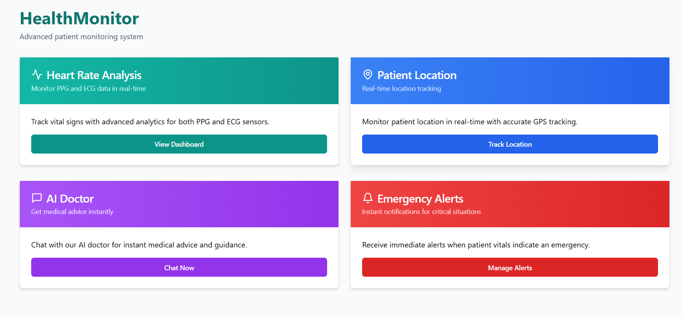
Implementation

Slide 26
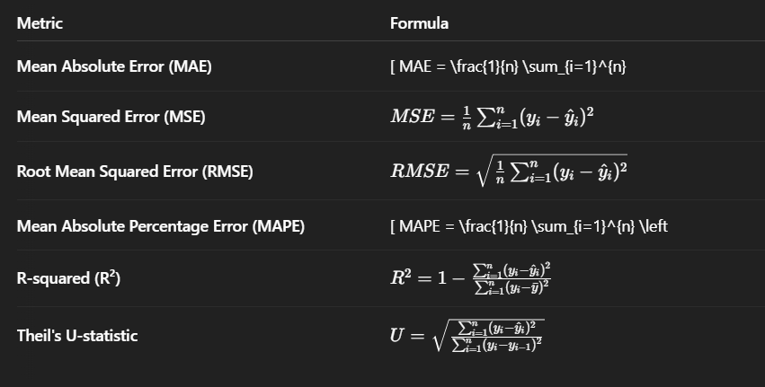
Formulas

Slide 27
Performance Metrics
Component | Metrics | Values
ARIMA Model | MAE, RMSE, MAPE, Precision, Recall, F1 Score
Live Location | Update Latency, Location Accuracy
AI Chatbot | Intent Accuracy, Response Time, Fallback Rate, User Satisfaction
Overall System | Uptime, Alert Delivery Time, Data Transmission Success

Slide 28
conclusion
Feature | Proposed System | Existing System
Predictive Analytics | Uses ARIMA modeling to predict future heart rate trends based on historical data. | Typically provides current or historical heart rate data with no predictions.
Contextual Insights | Integrates live location tracking and activity data for more accurate heart rate analysis. | Does not provide contextual insights based on location or activity.
AI Integration | AI chatbot offers personalized health advice and real-time data interpretation. | Lacks AI capabilities for personalized recommendations or insights.
Emergency Alerts | Triggers real-time emergency alerts based on heart rate abnormalities, integrating location data. | Limited alert functionality, often not integrated with location data.
Data Integration | Combines heart rate, location, and other contextual data for a comprehensive health profile. | Typically collects isolated data (e.g., heart rate) without additional context.
Proactive Monitoring | Enables proactive health management by forecasting heart rate trends and providing alerts. | Primarily provides reactive monitoring of heart rate, with limited forecasting.

Slide 29
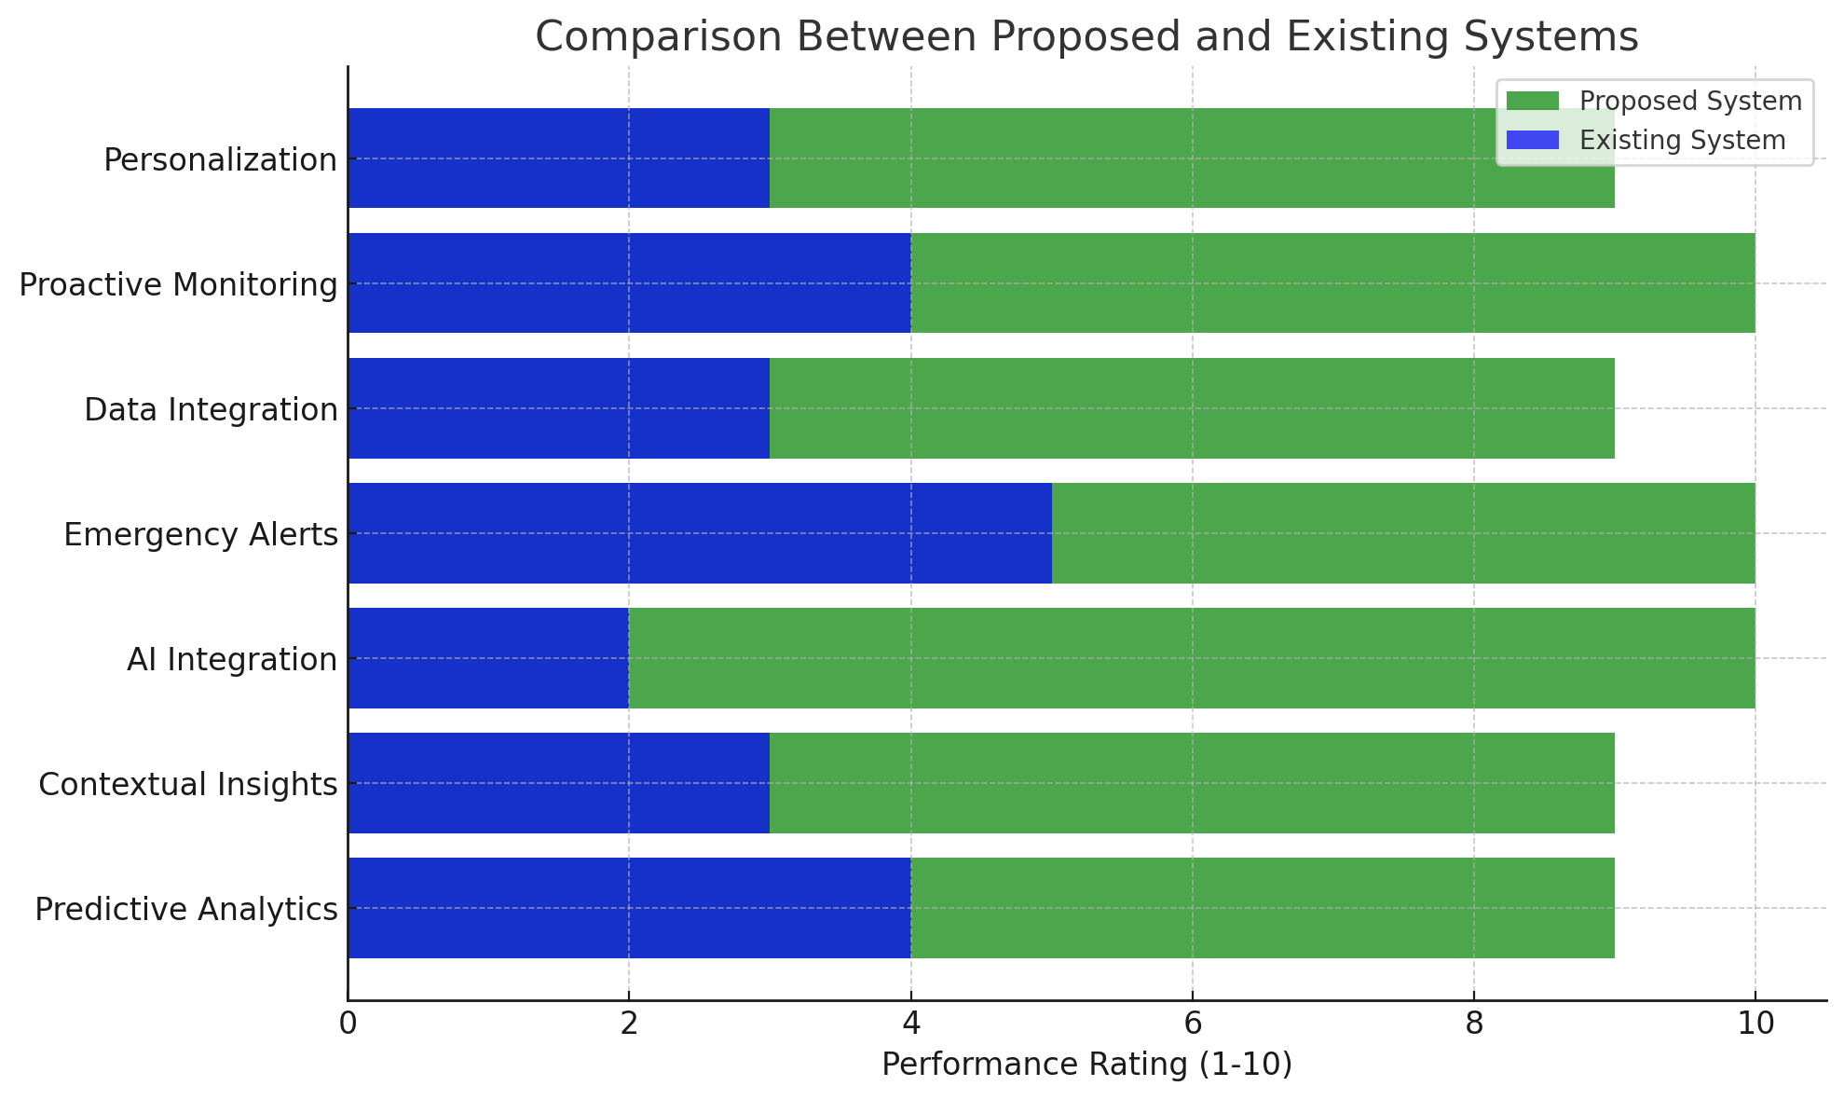
Conclusion

Slide 30
Future scope
Personalized Recommendations: AI-driven health & fitness plans.
Predictive Analytics: Early risk detection & trend analysis.
Telemedicine Integration: Remote consultations & data sharing.
Advanced Activity: Context-aware activity classification.
Mental Health: Stress monitoring & AI support.
Enhanced Chatbot: Personalized coaching & medical knowledge.
Expanded Sensors: Multi-sensor data fusion (BP, sleep, etc.).
Gamification: User engagement & community building.
Edge Computing: On-device processing for speed & privacy.

Slide 31
VIDYA JYOTHI INSTITUTE OF TECHNOLOGY (Autonomous)
THANK YOU

