Slide 1
Looking for accommodation in London
Capstone Project for IBM Data Science Professional Certificate
David Andrés

Slide 2
Business problem
Which is the most recommended location for living if you want to study at Middlesex University in London?
Key considerations:
The accommodation needs to be close to the university, but not too far from the city centre.
Supermarkets and cafes in the neighbourhood will also be taken into consideration.
Being a student the rent is a key factor to bear in mind. A one bedroom house or flat is preferred.

Slide 3
Data
Postcodes information
Geographical coordinates
Average rent
Distance to Middlesex University
Distance to London City Centre
Number of supermarkets
Number of cafés

Slide 4
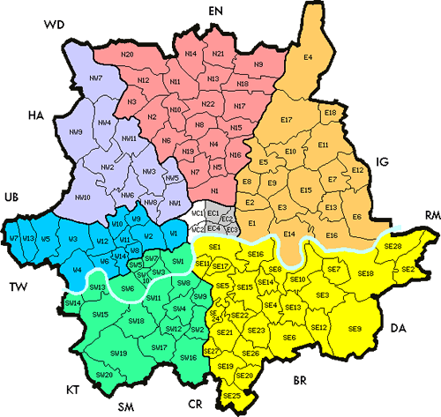
Areas considered
Postcodes considered:
W
NW
N
E

Slide 5
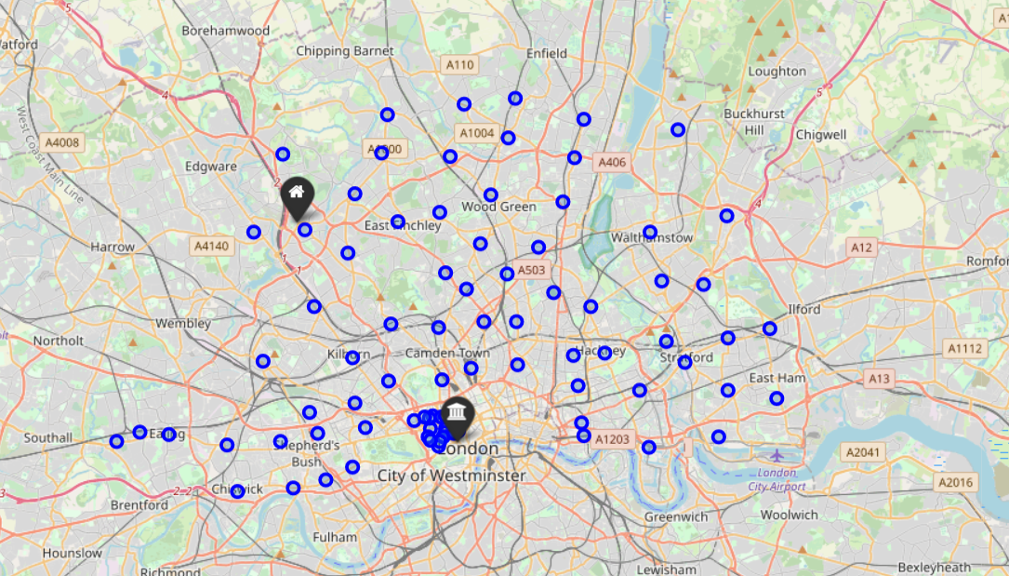
Selected areas

Slide 6
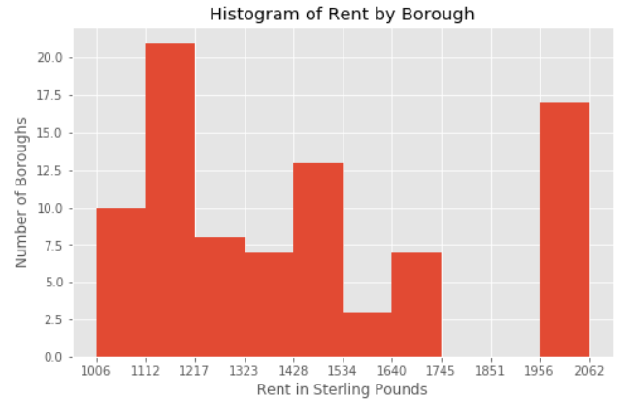
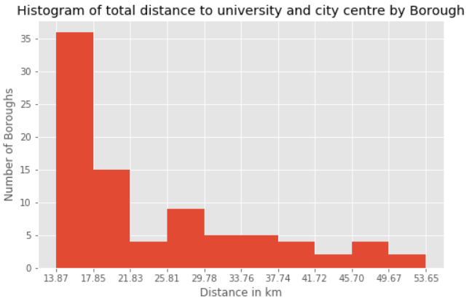
Exploratory Data Analysis
Two main categories:
Affordable rents from 1000 to 1500 GBP
Very expensive rents around 2000 GBP
The majority of the considered neighbourhoods require a maximum displacement distance of 20 km.

Slide 7
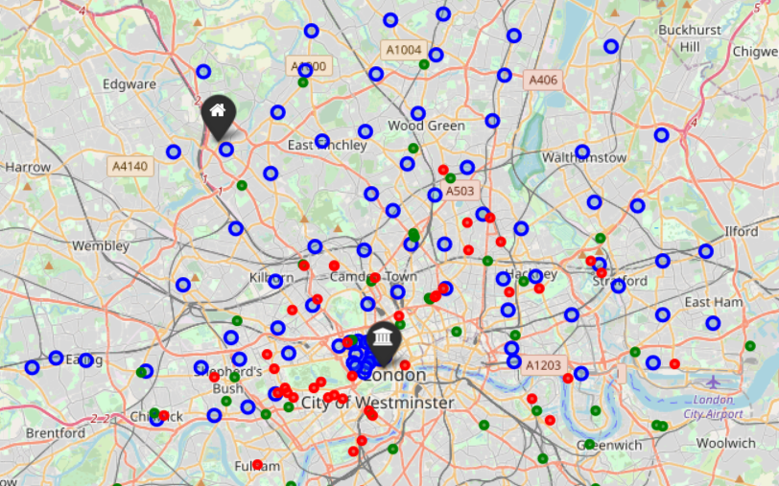
Cafés and Supermarkets
Neighbourhoods
Supermarkets
Cafés

Slide 8
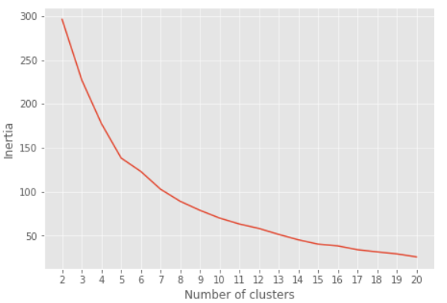
K-Means model
A K-Means clustering model was selected with a K parameter equal to 6.
Elbow

Slide 9
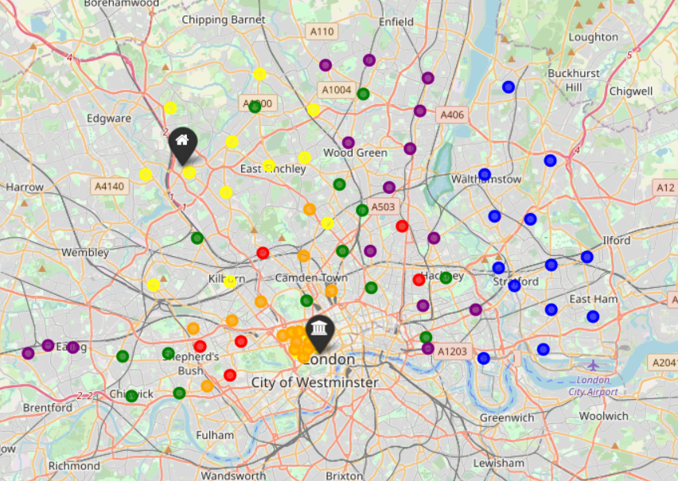
Results

Slide 10
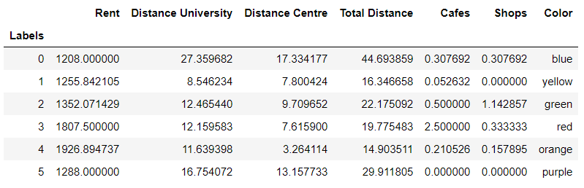
Results

Slide 11
Interpretation of results
Label 0 (blue): lowest rent, but far from university and city centre. Also a medium number of cafes and shops.
Label 1 (yellow): second lowest rent, shortest distance to university and short distance to city centre. No supermarkets in the area and very low number of cafes.
Label 2 (green): affordable rents, medium distance to university and city centre. Good number of cafes and supermarkets.
Label 3 (red): expensive area, medium distance to university but close to city centre. A great number of cafes and medium number of supermarkets.
Label 4 (orange): very expensive area, located in city centre, medium distance to university. A medium number of cafes and medium-low number of supermarkets.
Label 5 (purple): cheap rents, far from both university and city centre. No cafes or shops.

Slide 12
Conclusions
The most suitable regions assuming that a low rent is desired are:
If the main priority is being close to university, then the user should choose the yellow regions (1).
If on the contrary the number of cafes and supermarkets is relevant, the user should go for the green regions (2).

