Slide 1
﻿Ｇ Ｕ Ｐ Ｓ Ｌ Ａ
Gpu-based User Programmable Sqauare Lattice Automata

Slide 2
﻿Ｉｎｔｒｏ
CA – Cellular Automata
(many simple finite state machines that only interact with their neighbours)
SLA – Square Lattice Automata
(CA on a 2D array)
Let's make some SLA models
and visualise them as animation!

Slide 3
﻿Ｐｒｏｊｅｃｔ Ｇｏａｌｓ
Toolkit for building CA simulations
CLI visualisation generator
Sample CA models

Slide 4
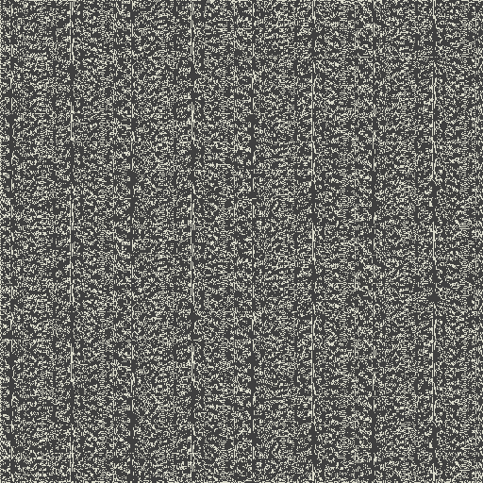
﻿Ｓｏ．．． ｗｈａｔ ｃａｎ Ｉ ｅｘｐｅｃｔ？
Large GIFs like this.

Slide 5
The Application
That was gupsla-gif in action
A plain Visual C++ project to connect
  The user via command line flags
  The CUDA project gupsla
  Lecram’s gifenc C library
Of course #2 is the star of the show

Slide 6
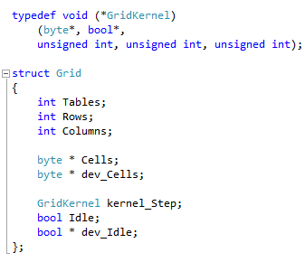
The Library
Made of several CU, H and CUH files
H: public API for non-CUDA
CUH: CUDA-based extension interface
grid.cu: Grid struct, it’s methods/kernels

Slide 7
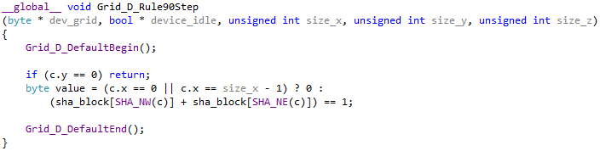
Implementation
Grid_Create: allocate table on host and device
Grid_Step: prepare and launch grid->kernel_Step
kernel_Step
  Contains the step logic
  Written by the library user
  The macros and __forceinline__ functions in grid.cuh do all of the groundwork so it’s very short.

Slide 8
Small Steps
Each cell is processed separately (no loops)
Sqare blocks
  Block size and size of sha_block depends on available shared memory (cudaGetDeviceProperties)
sha_block: cells in block + Moore neighbourhood
Helpers inside kernel_Step
  Calculate coordinates and sizes
  Fill in sha_block
  Update detection

Slide 9
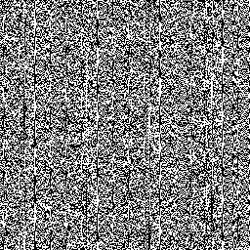
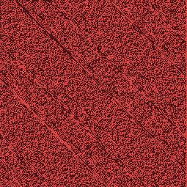

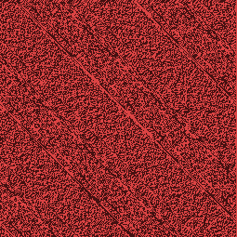
I love macros
2D arrays are hard to follow
  it gets worse if you embed them into each other
So I rewrote the whole thing with a lot of macro use to re-label everything...
My eyes!
I just wanted some
diagonal lines...

Slide 10
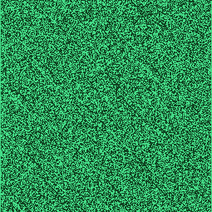
Much better!

