Slide 1



147 Estimating Tool
Proof of Concept (PoC) & Initial Works

Slide 2
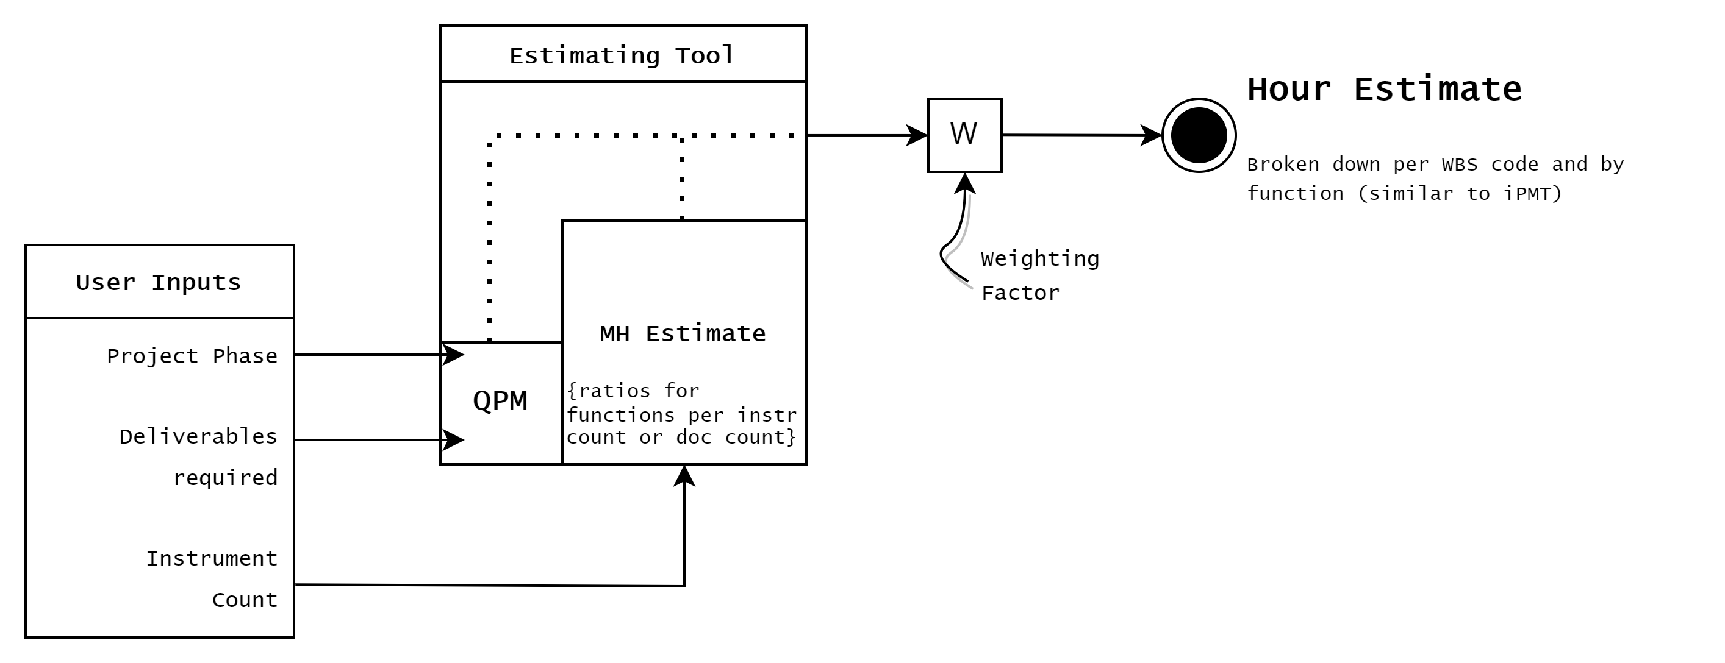
wat is het doel?

Slide 3
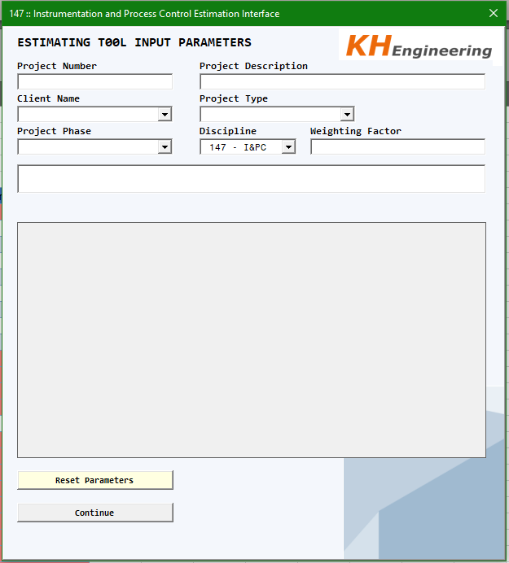
START SCREEN
Input limited to 6 Numeric characters
Default discipline code set to 147
Basic Project Information
Comboboxes for;
Clients,
Project Phases {FEL1-4},
Project Type {Brown/Greenfield}
Discipline Codes

Slide 4
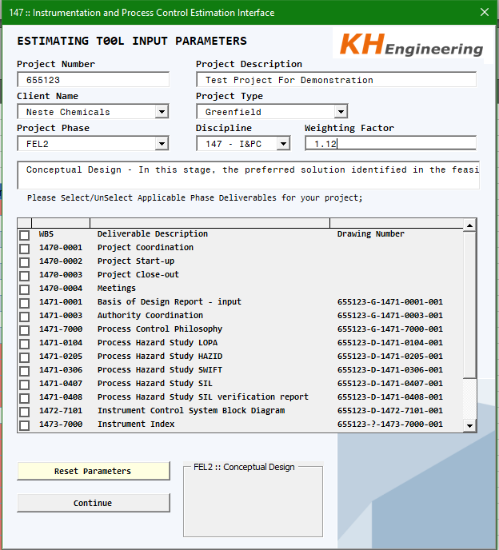
Basic Info Populated
Input limited to 6 Numeric characters
Drawing numbers generated as per provided project number
Brief phase description and general expectations provided
(in Nederlands ook)
Deliverables Presented are specific to the discipline and project phase, as defined in the Quality Plan Matrix

Slide 5
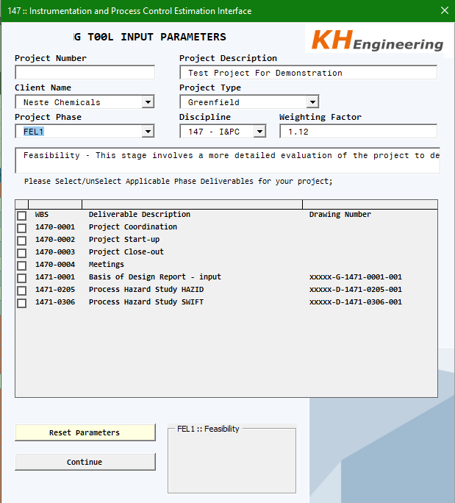
Basic Info Populated
If NO project number
Is selected, generic numbers will be generated (as per QPM)
No project number
Input limited to 6 Numeric characters

Slide 6
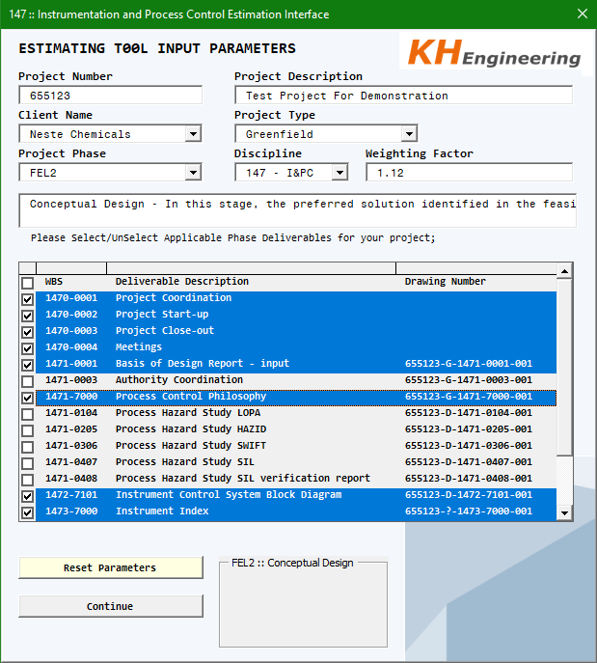
User Interaction
By holding Shift/Ctrl + Left click, the user can select and unselect the required deliverables that are particular to their project
Choices are highlighted in blue and stored for later processing

Slide 7
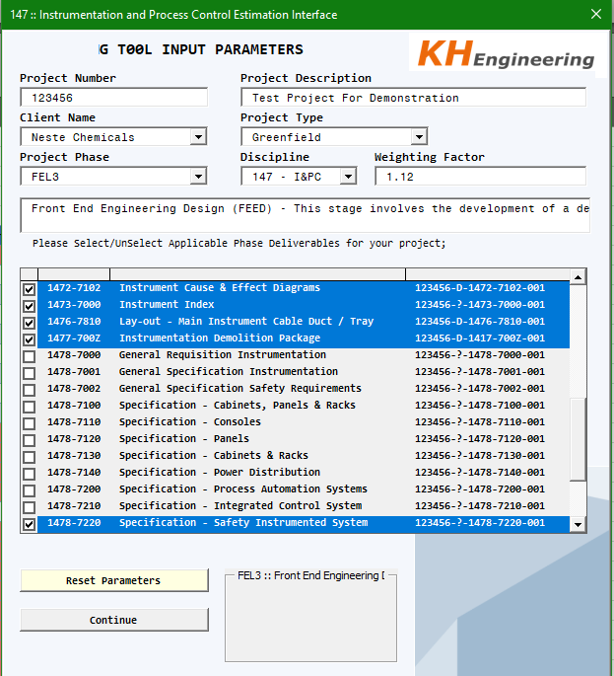
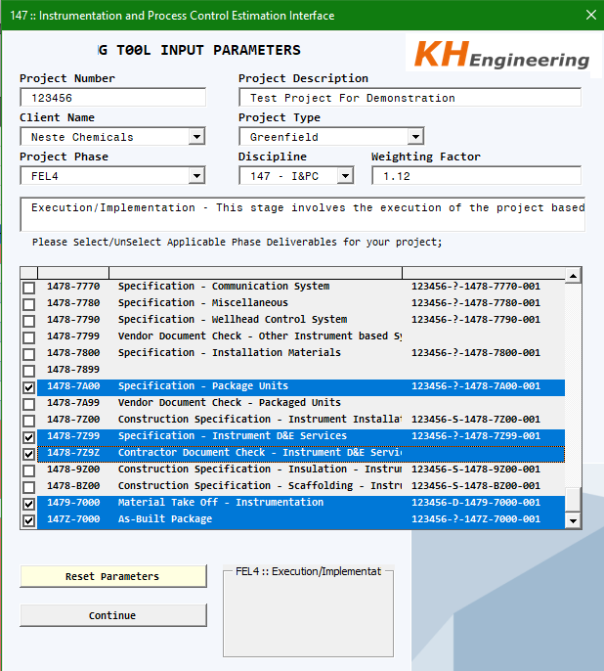
User Interaction
FEL3
FEL4
User can dynamically change the project phase, example screenshots provided below.
Note varying project data/deliverables (Highlighted)

Slide 8
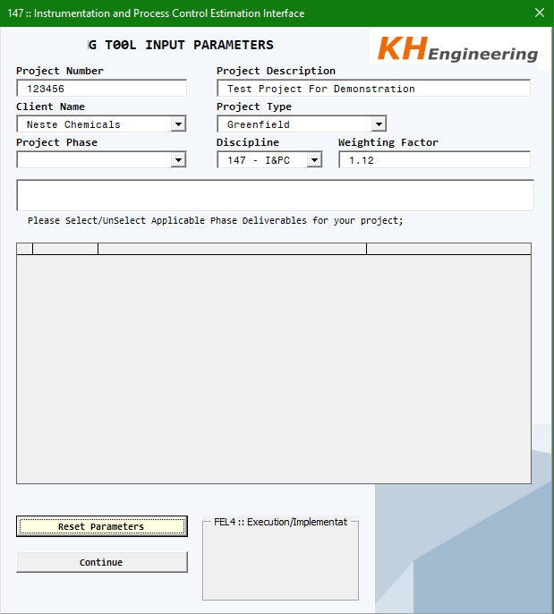
User Interation
Pressing the ‘Reset Parameters’
Button will clear the selection and project phase, some metadata will remain

Slide 9
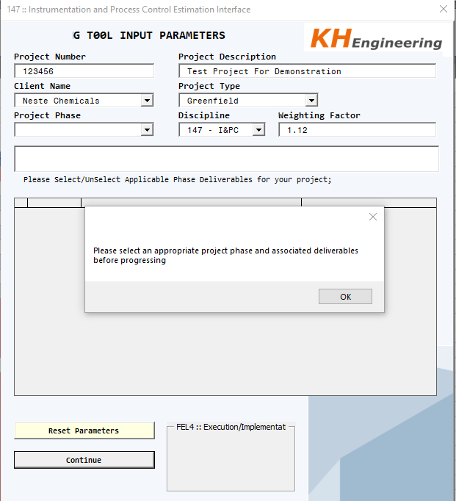
Basic Error Detection
e.g. you cannot progress without selecting deliverables

Slide 10
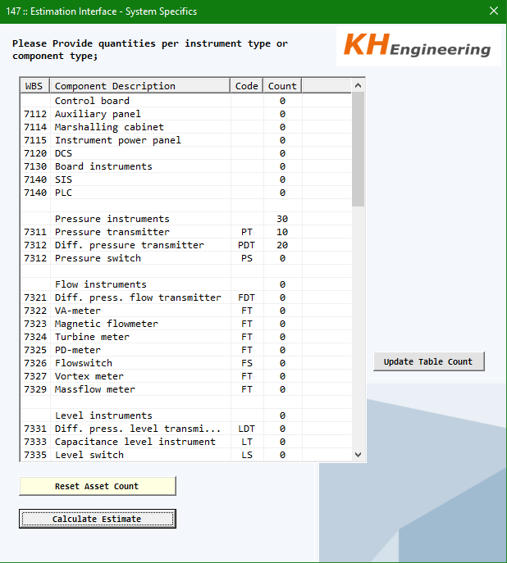
DETAIL SCREEN
If sufficient project data is provided, users can access the next page by pressing ‘Continue’
System specifics (particular to the discipline) are presented for editing, to provide further input for the estimate
Only this column
Is Editable

Slide 11
Next Steps
Take inputs and perform calculation against provided mapping (sample extract below)
Sub WBS | Sub WBS Description | Normtype | DD | SD | E | SE
1470-0001 | (Updated) Activity Control Chart | 1mh/week |  |  |  | 1
1470-0001 | (Updated) Manpower Resource Charts | 1% of total MH |  |  |  | 0.01
1470-0004 | Meetings, control etc. | 13% of total MH |  |  |  | 0.13
n.v.t. | DEDD (study of project) | # of el. instr., JB, cab. etc. |  | 1 | 1
n.v.t. | DEDD (study of project) | set-up DEDD (study of project) |  | 8 | 8
1471-7001 | Instrumentation Control Narratives | # of control tags |  |  | 2
1471-7001 | Instrumentation Control Narratives | set-up control narratives |  |  | 4
1471-7002 | Instrumentation Safeguarding Narratives | # of safeguarding tags |  |  | 2
1471-7002 | Instrumentation Safeguarding Narratives | set-up safety narratives |  |  | 4
1471-00002 | Design Basis Report / SOW instr. | # of instruments |  |  | 1
1471-00002 | Design Basis Report / SOW instr. | set-up basis report / SOW instr. |  |  | 4
1471-0408 | SIL classification | # of safety instruments (sensor + FE) |  |  | 1
1471-0408 | SIL classification | set-up SIL classification |  |  | 2
1471-5000 | Review documents other disciplines (Mach) | # instruments on tanks |  |  | 0.25
1471-6000 | Review documents other disciplines (piping) | # of in/on-line instruments |  |  | 0.25
1471-6000 | Review documents other disciplines | handling (# of drawings) other disciplines |  |  | 0.3
1471-Z000 | Review documents other disciplines (Civil) | # of interface with civil |  |  | 1
1471-Z001 | Discipline review | 2,5 % of total MH |  | 0.025 | 0.025
1471-Z002 | Review with other disciplines | 1% of total MH |  | 0.01 | 0.01
1472-0000 | P & ID's / UFD's | # of instruments | 0.3 |  | 0.3
1472-0000 | P & ID's / UFD's | handling (# of drawings) P&Ids/UFDs | 0.35 |  | 0.35
1472-0000 | P & ID's / UFD's (D&R) | # of instruments (D&R) |  |  | 0.2
1472-0000 | P & ID's / UFD's (D&R) | handling (# of drawings) P&Ids/UFDs (D&R) |  |  | 0.35
1472-7102 | Interlock diagram / matrix | # of interlock I/O | 0.15 |  | 0.5
1472-7102 | Interlock diagram / matrix | handling (# of drawings) interlock | 0.35 |  | 0.35
e.g. for a project with 50 instruments, a total hour count of [50*1] + 4 = 54 should be generated for a Design Basis Report/SoW {1471-0002}

Slide 12
NEXT STEPS
Generate and format final Estimate report in Excel Format
Only selected deliverables presented
Listed by WBS
Hour Totals provided per function stipulated by MH estimate mapping

Slide 13
Future Improvements
User Inputs are accounted for
Mapping/inputs require modification and enhancement to improve estimate accuracy
E.g. extend inputs for number of documents {e.g. multiple loops drawings}
Extend inputs for tool usage {ElecDes, SPI, AutoCAD} and map impact on hours
Manual inputs for deliverables allowed? (exception cases)
Move away from VBA/C# and Excel architecture {local, static spreadsheets or databases}
Generate a Deliverable List to assist project teams in aligning with the estimated documents
Integration with BettywebBlocks/Sharepoint
Possibility for online tool
Integration with Sharepoint can ensure most recent version of the QPM and MH estimates are being utilized
Integration with iPMT – although estimate would need to be updated/checked before finalized in iPMT {this integration should not be automatic}

