Slide 1


Load Balancing & Failover (RAC)
RAC负载均衡和失效接管

Slide 2

About ACOUG
ACOUG: All China Oracle User Group
http://acoug.org

Slide 3
About Me
Kamus
http://www.dbform.com
Oracle -> Enmou

Slide 4
与技术无关
将技术作为艺术对待
以兴奋的状态面对知识

Slide 5
Load Balancing
负载均衡

Slide 6
Load Balancing
Client-side Load Balancing
Connection Balancing = client-side connect-time LB
Server-side Load Balancing
Listener Balacing = server-side connect-time LB
Runtime Service Balancing = runtime connection load balancing

Slide 7
Client-side Load Balancing
TNSNAMES.ORA :
RACDB =
(DESCRIPTION =
(ADDRESS_LIST =
(ADDRESS = (PROTOCOL = TCP)(HOST = vip1)(PORT = 1521))
(ADDRESS = (PROTOCOL = TCP)(HOST = vip2)(PORT = 1521))
(ADDRESS = (PROTOCOL = TCP)(HOST = vip3)(PORT = 1521))
(LOAD_BALANCE = yes)
)
(CONNECT_DATA =
(SERVICE_NAME = racdb)
)
)
Notes:
与数据库实例无关，与监听有关
与数据库真实负载无关
连接之后不会再次rebalancing
既然是Client端的负载均衡，那么也就是不需要在数据库服务器端配置任何参数，完全由客户端机器上的tnsnames.ora文件中对于TNS的配置来决定，实际上也就是LOAD_BALANCE参数。
以上配置等同于：
RACDB =
(DESCRIPTION =
(ADDRESS_LIST =
(ADDRESS = (PROTOCOL = TCP)(HOST = vip1)(PORT = 1521))
(ADDRESS = (PROTOCOL = TCP)(HOST = vip2)(PORT = 1521))
(ADDRESS = (PROTOCOL = TCP)(HOST = vip3)(PORT = 1521))
(LOAD_BALANCE = yes)
(FAILOVER = yes)
)
(CONNECT_DATA =
(SERVICE_NAME = racdb)
)
)
如果在TNS配置时使用的是ADDRESS_LIST语法，那么必须显示设置LOAD_BALANCE = yes，默认值LOAD_BALANCE = no（而默认FAILOVER = yes）。

Slide 8
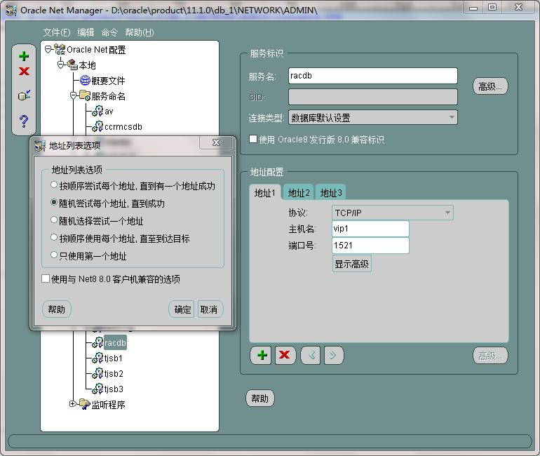
Client-side Load Balancing
netmgr
Notes:
(LOAD_BALANCE = yes)指示SQLNet随机选择ADDRESS_LIST列表中的任意一个监听，将客户端请求发送到此监听上，通过这种方法来实现负载平衡。
如果 (LOAD_BALANCE = no)那么将会按照ADDRESS_LIST列表中的顺序选择监听，只要这个监听能够正常连接那么就使用该监听。
因此在某些负载平衡的解决方案中会使用(LOAD_BALANCE = no)但是在多个客户端或者应用服务器端配置顺序不同的ADDRESS_LIST，以此来实现人为的负载平衡。

Slide 9
Server-side Load Balancing
Listener (Connection) Balancing
Oracle9i and Higher
Service Balancing
Only on Oracle10gR2 and Higher

Slide 10
Listener Balancing
sql> ALTER system SET REMOTE_LISTENER='LISTENERS_RAC' scope=BOTH;
TNSNAMES.ORA :
LISTENERS_RAC =
(ADDRESS_LIST =
(ADDRESS = (PROTOCOL = TCP)(HOST = vip1)(PORT = 1521))
(ADDRESS = (PROTOCOL = TCP)(HOST = vip2)(PORT = 1521))
(ADDRESS = (PROTOCOL = TCP)(HOST = vip3)(PORT = 1521))
)
Notes:
要实现server side load balance要求监听能够知道在整个RAC环境中的各节点负载情况，节点负载情况是由PMON进程来定期更新的，而要让PMON进程能够通知其它节点自己节点的负载情况则需要设置数据库初始化参数REMOTE_LISTENER。PMON更新的时间间隔最小是1分钟。
当某个实例的监听收到客户端连接请求，将会统筹考虑RAC环境中各个节点的负载情况，然后将该连接传递到具有最小负载的节点的最小负载实例上。
Server side load balancing (by the listener) redirects connections by default depending on the RunQ length of each of the instances. This is great for short lived connections. Terrible for persistent connections or login storms. Do not use this method for connections from connection pools or applicaton servers .

Slide 11
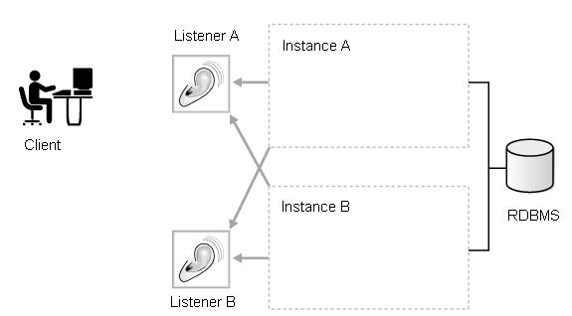
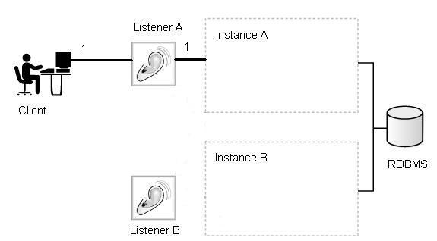
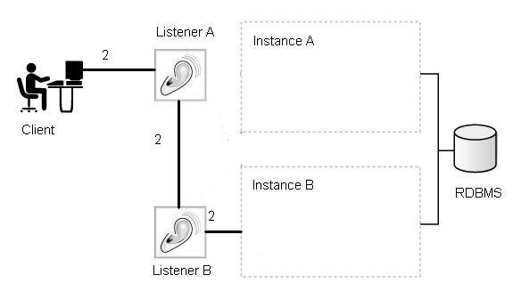
Listener Balancing
Notes:
Instance_A is locally registered with Listener_A and remotely registered with Listener_B. Instance_B is registered locally with Listener_B and remotely with Listener_A.
Client connection #1 goes to Listener_A. Based on load information provided by PMON, Listener_A routes the incoming client to the locally registered instance, Instance_A.
Listener_A.log:
13-FEB-2004 11:05:02 * (CONNECT_DATA=(SERVER=DEDICATED)(SERVICE_NAME=prod) (CID=(PROGRAM=)(HOST=clienthost)(USER=oracle))) * (ADDRESS=(PROTOCOL=tcp)(HOST=10.10.10.10)(PORT=20108)) * establish * prod * 0
client connection #2 goes to Listener_A. With updated load information provided by PMON, Listener_A routes the client to the remotely registered instance, Instance_B.
Listener_A.log:
13-FEB-2004 11:05:02 * (CONNECT_DATA=(SERVER=DEDICATED)(SERVICE_NAME=prod) (CID=(PROGRAM=)(HOST=clienthost)(USER=oracle))) * (ADDRESS=(PROTOCOL=tcp)(HOST=10.10.10.10)(PORT=20108)) * establish * prod * 0
Listener_B.log:
13-FEB-2004 11:05:02 * (CONNECT_DATA=(SERVER=DEDICATED)(SERVICE_NAME=prod) (CID=(PROGRAM=)(HOST=clienthost)(USER=oracle))(INSTANCE_NAME=Instance_B)) * (ADDRESS=(PROTOCOL=tcp)(HOST=10.10.10.10)(PORT=20110)) * establish * prod *

Slide 12
Listener Balancing
Listener Log
Oracle10g: $ORACLE_HOME/log
Oracle11g: diagnostic_dest/diag/tnslsnr/<hostname>/listener/trace
Service Register
18-11月-2009 11:54:07 * service_register * orcl11g * 0
Service Update
18-11月-2009 11:54:13 * service_update * orcl11g * 0

Slide 13
Listener Balancing
V$SERVICEMETRIC
GOODNESS
DELTA
Notes:
在10gR2版本之后，节点和实例的负载计算通过lbscore来完成.这样可以改善Call Storm场景下负载不均衡的现象。
可以通在sqlnet.ora文件中添加监听的trace（TRACE_LEVEL_LISTENER = 16）来获取lbscore的产生情况。
lbscore由两个动态值决定：”goodness” 和 “delta”，这两个值均由PMON来定期更新，计算公式如下： Lbscore = Goodness (Received from PMON update) Delta = New Delta (Received from PMON update)
在PMON定期更新的间隔，应对于每个新连接的建立，监听会自己更新Lbscore，计算公式是： Listener Lbscore = Lbscore(previous) + Listener Delta

Slide 14
Load Based & Session Based
PREFER_LEAST_LOADED_NODE_
Undocumented parameter on Oracle 9.2.0.3 and higher
Defaults to “ON”
PREFER_LEAST_LOADED_NODE_<LISTENER_NAME>=OFF
<LISTENER_NAME> = listener_nodename
After 10gR2, set the CLB_GOAL on the service
Notes:
Subject: Load Balancing Doesn't Balance the Number of Sessions Across All the Available Nodes
Doc ID: 262298.1
Beginning with Oracle 9.2.0.3, there is a undocumented listener.ora parameter: PREFER_LEAST_LOADED_NODE_listener_name=OFF where listener_name is the actual name of the cluster remote listener. The parameter defaults to "ON", but can be changed to "OFF". When this parameter is set to "OFF", instance-based "session count" load balancing will be used as the primary factor (PMON reports the number of session licenses used as the instance load). The listener increments this load with every served connection request between updates from PMON. When two instances have the same instance load, the instance with the least "node" load will be favored; otherwise, the instance with the least instance load will be favored. When the parameter is "ON" (the default), then connections are routed to the node with the lowest NODE load rather than the lowest session count, as explain above. NOTE: The patchset must be applied to the database server for this parameter to work, not the client. In other words, the RDBMS must be patched to 9.2.0.3 or higher, but the clients can remain at version 9.2.0.1.

Slide 15
Service Balancing
Powerful automatic workload management
Define PREFERRED instances
Define AVAILABLE instances
Runtime load balancing
Opposite to Connect time load balancing
srvctl add service -d orcl -s orclcluster -r "orcl1,orcl2" -a "orcl3,orcl4"
Notes:
srvctl add service -d orcl -s orclcluster -r "orcl1,orcl2" -a "orcl3,orcl4"
To manage workloads, you can define services that you assign to a particular application or to a subset of an application's operations. You can also group work by type under services. For example, online users can be a service while batch processing can be another and reporting can be yet another service type.
Oracle recommends that all users who share a service have the same service level requirements. You can define specific characteristics for services and each service can be a separate unit of work. There are many options that you can take advantage of when using services. Although you do not have to implement these options, using them helps optimize application performance.
When you define a service, you define which instances normally support that service. These are known as the PREFERRED instances. You can also define other instances to support a service if the service's preferred instance fails. These are known as AVAILABLE instances.

Slide 16
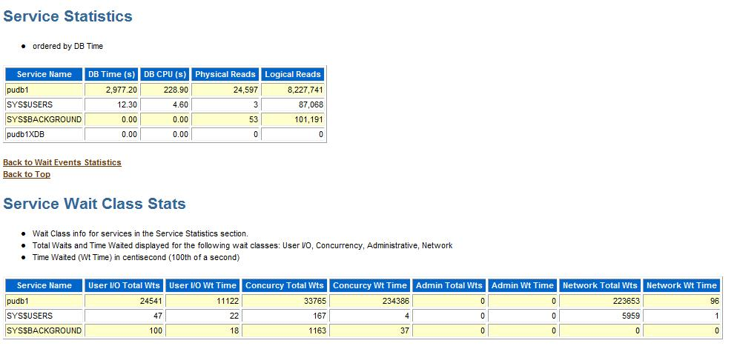
Service Statistics

Slide 17
Fast Application Notification (FAN)
Fast Connection Failover(FCF)
This is the ability of Oracle Clients to provide rapid failover of connections by subscribing to FAN events.
FAN events are published using ONS and an Oracle Streams Advanced Queuing.
ONS: JDBC
AQ: OCI & ODP.NET clients
Automate fail back by using FAN callouts
Notes:
FAN has two methods for publishing events to clients, the Oracle Notification Service (ONS), which is used by Java Database Connectivity (JDBC) clients including the Oracle Application Server 10g, and Oracle Streams, Advanced Queueing which is used by Oracle Call Interface (OCI) and Oracle Data Provider for .NET (ODP.NET) clients. When using Advanced Queueing, you must enable the service to use the queue by setting AQ_HA_NOTIFICATIONS to true.
You can take advantage of FAN events in the following three ways:
1. Your application can use FAN without programmatic changes if you use an integrated Oracle client. The integrated clients for FAN events include Oracle Database 10g JDBC (Oracle Database 10g Release 2 is required for load balancing), Oracle Database 10g Release 2 ODP.NET, and Oracle Database 10g Release 2 OCI. This includes applications that use TAF.
2. Applications can use FAN programmatically by using the ONS Application Programming Interface (API) to subscribe to FAN events and to execute event handling actions upon the receipt of an event.
3. You can implement FAN with server-side callouts on your database tier.
Using Fast Application Notification Callouts
To use FAN callouts, place an executable in the directory $CRS_home/racg/usrco on every node that runs Oracle Clusterware. If you are using scripts, then set the shell as the first line of the executable.
The following is an example file for the $CRS_home/racg/usrco/callout.sh callout:
#! /bin/ksh
FAN_LOGFILE= [your path name]/admin/log/`hostname`_uptime.log
echo $* "reported="`date` >> $FAN_LOGFILE &
The following output is from the previous example:
NODE VERSION=1.0 host=sun880-2 incarn=23 status=nodedown reason= timestamp=08-Oct-2004 04:02:14 reported=Fri Oct 8 04:02:14 PDT 2004

Slide 18
Load Balancing Advisory
Oracle10gR2 and Above
Allows listeners to distribute connection requests to best instances.
How to enable
EXECUTE DBMS_SERVICE.MODIFY_SERVICE (
service_name => 'OE' - ,
goal => DBMS_SERVICE.GOAL_SERVICE_TIME - ,
clb_goal => DBMS_SERVICE.CLB_GOAL_SHORT);
Notes:
How do I enable the load balancing advisory?
The load balancing advisory requires the use of services and Oracle Net connection load balancing. To enable it, on the server: set a goal (service_time or throughput, and set CLB_GOAL=SHORT ) on your service. For client, you must be using the connection pool. For JDBC, enable the datasource parameter FastConnectionFailoverEnabled. For ODP.NET enable the datasource parameter Load Balancing=true.

Slide 19
DBMS_SERVICE.MODIFY_SERVICE
GOAL Type | Value | Description
GOAL_NONE | 0 | Load Balancing Advisory is disabled
GOAL_SERVICE_TIME | 1 | Load Balancing Advisory is enabled
GOAL_THROUGHPUT | 2 | Load Balancing Advisory is enabled
CLB GOAL Type | Value | Description
CLB_GOAL_SHORT | 1 | Connection load balancing uses Load Balancing Advisory based on GOAL Type
CLB_GOAL_LONG | 2 | Balances the number of connections per instance using session count per service
Notes:
goal => DBMS_SERVICE.GOAL_SERVICE_TIME | GOAL_THROUGHPUT | GOAL_NONE
GOAL_SERVICE_TIME | GOAL_THROUGHPUT : Load Balancing Advisory is enabled
GOAL_NONE: Load Balancing Advisory is disabled
What are my options for setting the Load Balancing Advisory GOAL on a Service?
The load balancing advisory is enabled by setting the GOAL on your service either through PL/SQL DBMS_SERVICE package or EM DBControl Clustered Database Services page. There are 3 options for GOAL: None – Default setting, turn off advisory THROUGHPUT – Load balancing advisory is based on the rate that work is completed in the service. Work requests are directed based on throughput. This should be used when the work in a service completes at homogenous rates. An example is a trading system where work requests are similar lengths. SERVICE_TIME – Load balancing advisory data is based on elapsed time for work done in the service. Work requests are directed based on response time. This should be used when the work in a service completes at various rates. An example is as internet shopping system where work requests are various lengths Note: If using GOAL, you should set CLB_GOAL=SHORT
clb_goal => dbms_service.CLB_GOAL_SHORT | CLB_GOAL_LONG
CLB_GOAL_SHORT: Connection load balancing uses Load Balancing Advisory, when Load Balancing Advisory is enabled (either goal_service_time or goal_throughput). When GOAL=NONE (no load balancing advisory), connection load balancing uses an abridged advice based on CPU utilization.
CLB_GOAL_LONG: Balances the number of connections per instance using session count per service. This setting is recommended for applications with long connections such as forms.

Slide 20
GV$SERVICEMETRIC
Measured in 5 sec , 1 min intervals
CALLSPERSEC
DBTIMEPERSEC

Slide 21
Load Balancing Issues
Metalink Note: 364855.1
Subject: RAC Connection Redirected To Wrong Host/IP ORA-12545
ORA-01017 when orapwd file not identical
ORA-12545: Connect failed because target host or object does not exist
ORA-01017: invalid username/password; logon denied
Notes:
Case1:
D:\Temp>sqlplus system/oracle@racdb
SQL*Plus: Release 10.2.0.3.0 - Production on Sat May 19 15:34:07 2007
Copyright (c) 1982, 2006, Oracle. All Rights Reserved.
ERROR:
ORA-12545: Connect failed because target host or object does not exist
Enter user-name:
Workaround:
alter system set LOCAL_LISTENER="(ADDRESS=(PROTOCOL=TCP)(HOST=<VIP_address>)(PORT=1521))" scope=both sid='instance_name';
Or only use Client-side connection balancing:
alter system set remote_listener='' scope=both;
Case2:
在使用客户端连接RAC服务时，间歇性报“ORA-01017: invalid username/password; logon denied”错误。
经检查，如果使用普通数据库用户连接数据库，每次连接都会成功。
但是如果使用sysdba用户，因为客户端连接使用load balance方式，每次连接到VIP1时，可以正常登陆，但是连接到VIP2实例上则会报ORA-01017错误。
判断为节点2上的orapw密码文件与数据库中SYS用户的密码不相符。
解决方法：
在VIP2实例中重新设置SYS用户密码，将会自动更新VIP2主机上的orapw文件。
SQL> ALTER USER SYS INDETIFIED BY oracle;
重新设置完毕以后，错误解决。

Slide 22
Failover
失效接管

Slide 23
Failover
Client-side Failover
Connect Time Failover
Transparent Application Failover (TAF)
Serer-side Failover
Transparent Application Failover(TAF) with Service

Slide 24
Client-side Failover
Connect Time Failover
Tnsnames Parameter: FAILOVER
(failover=on) is default for ADDRESS_LISTs, DESCRIPTION_LISTs

Slide 25
Client-side Connect Time Failover
RACDB =
(DESCRIPTION =
(ADDRESS_LIST =
(ADDRESS = (PROTOCOL = TCP)(HOST = vip1)(PORT = 1521))
(ADDRESS = (PROTOCOL = TCP)(HOST = vip2)(PORT = 1521))
(ADDRESS = (PROTOCOL = TCP)(HOST = vip3)(PORT = 1521))
)
(CONNECT_DATA =
(SERVICE_NAME = racdb)
)
)

Slide 26
Client-side Failover
TAF
Tnsnames Parameter: FAILOVER_MODE
Feature of the Oracle Call Interface (OCI) driver at client side
Must modify tnsnames.ora manually

Slide 27
Client-side TAF
RACDB =
(DESCRIPTION =
(ADDRESS_LIST =
(ADDRESS = (PROTOCOL = TCP)(HOST = vip1)(PORT = 1521))
(ADDRESS = (PROTOCOL = TCP)(HOST = vip2)(PORT = 1521))
(ADDRESS = (PROTOCOL = TCP)(HOST = vip3)(PORT = 1521))
(ADDRESS = (PROTOCOL = TCP)(HOST = vip4)(PORT = 1521))
(LOAD_BALANCE = yes)
)
(CONNECT_DATA =
(SERVICE_NAME = racdb)
(FAILOVER_MODE=
(TYPE=SELECT)
(METHOD=BASIC))
)
)
Notes:
测试TAF
1. 本机的tnsnames.ora设置为：
INTERTOL =
(DESCRIPTION =
(ADDRESS_LIST =
(ADDRESS = (PROTOCOL = TCP)(HOST = 10.37.3.201)(PORT = 1521))
(ADDRESS = (PROTOCOL = TCP)(HOST = 10.37.3.202)(PORT = 1521))
(ADDRESS = (PROTOCOL = TCP)(HOST = 10.37.3.203)(PORT = 1521))
(ADDRESS = (PROTOCOL = TCP)(HOST = 10.37.3.204)(PORT = 1521))
(LOAD_BALANCE = yes)
)
(CONNECT_DATA =
(SERVICE_NAME = intertol)
(FAILOVER_MODE=
(TYPE=SELECT)
(METHOD=BASIC))
)
)
2. 客户端连入SQLPLUS，检查v$session视图，确认TAF特性已经启用。
D:\Temp>sqlplus system/oracle@intertol
SQL*Plus: Release 11.1.0.7.0 - Production on Mon Jul 27 13:46:59 2009
Copyright (c) 1982, 2008, Oracle. All rights reserved.
Connected to:
Oracle Database 10g Enterprise Edition Release 10.2.0.4.0 - 64bit Production
With the Partitioning, Real Application Clusters, Data Mining and Real Application Testing options
SQL> SELECT SID FROM V$MYSTAT WHERE ROWNUM=1;
SID
----------
1613
SQL> SELECT MACHINE, FAILOVER_TYPE, FAILOVER_METHOD, FAILED_OVER
2 FROM V$SESSION WHERE SID=1613;
MACHINE FAILOVER_TYPE FAILOVER_M FAI
------------------------------ ------------- ---------- ---
WORKGROUP\KAMUS-LAPTOP SELECT BASIC NO
3. 确认当前会话连入的实例
SQL> select INSTANCE_NAME from v$instance;
INSTANCE_NAME
----------------
intertol2
4. 创建一张大表，用于之后可以实现较长时间的select
SQL> create table t_test tablespace users as select * from dba_objects ;
Table created.
SQL> select count(*) from t_test;
COUNT(*)
----------
11778
5. 开始测试，执行select语句之后立刻shutdown abort掉实例2
在select语句经过短时间等待之后又继续回显检索结果了，可见TAF测试成功。
检索视图来验证。
会话ID已经发生了变化
SQL> SELECT SID FROM V$MYSTAT WHERE ROWNUM=1;
SID
----------
1618
FAILED_OVER字段也已经显示为YES
SQL> SELECT MACHINE, FAILOVER_TYPE, FAILOVER_METHOD, FAILED_OVER
2 FROM V$SESSION WHERE SID=1618;
MACHINE FAILOVER_TYPE FAILOVER_M FAI
------------------------------ ------------- ---------- ---
WORKGROUP\KAMUS-LAPTOP SELECT BASIC YES
连入的实例也已经变为intertol4
SQL> select INSTANCE_NAME from v$instance;
INSTANCE_NAME
----------------
intertol4
当前的crs已经数据库情况：
[oracle@dbserver1 ~]$ crs_stat -t
Name Type Target State Host
------------------------------------------------------------
ora....R1.lsnr application ONLINE ONLINE dbserver1
ora....er1.gsd application ONLINE ONLINE dbserver1
ora....er1.ons application ONLINE ONLINE dbserver1
ora....er1.vip application ONLINE ONLINE dbserver1
ora....R2.lsnr application ONLINE ONLINE dbserver2
ora....er2.gsd application ONLINE ONLINE dbserver2
ora....er2.ons application ONLINE ONLINE dbserver2
ora....er2.vip application ONLINE ONLINE dbserver2
ora....R3.lsnr application ONLINE ONLINE dbserver3
ora....er3.gsd application ONLINE ONLINE dbserver3
ora....er3.ons application ONLINE ONLINE dbserver3
ora....er3.vip application ONLINE ONLINE dbserver3
ora....R4.lsnr application ONLINE ONLINE dbserver4
ora....er4.gsd application ONLINE ONLINE dbserver4
ora....er4.ons application ONLINE ONLINE dbserver4
ora....er4.vip application ONLINE ONLINE dbserver4
ora....rtol.db application ONLINE ONLINE dbserver1
ora....l1.inst application ONLINE ONLINE dbserver1
ora....l2.inst application OFFLINE OFFLINE
ora....l3.inst application ONLINE ONLINE dbserver3
ora....l4.inst application ONLINE ONLINE dbserver4

Slide 28
Server-side TAF
Use dbms_service.modify_service
srvctl add service -d orcl -s orclcluster -r "orcl1,orcl2”-P BASIC
sql>execute dbms_service.modify_service (service_name => 'orclcluster', goal => DBMS_SERVICE.GOAL_SERVICE_TIME, clb_goal => dbms_service.CLB_GOAL_SHORT, failover_method => dbms_service.FAILOVER_METHOD_BASIC, failover_type => dbms_service.FAILOVER_TYPE_SESSION, failover_retries => 20 , failover_delay => 5, aq_ha_notifications => true );
Notes:
/home/oracle>srvctl add service -d orcl -s orclcluster -r "orcl1,orcl2" -P BASIC
-P TAF_policy
The TAF policy (NONE, BASIC, or PRECONNECT). The BASIC and PRECONNECT settings affect the content of the TNS string that Oracle generates.
/home/oracle>srvctl start service -d orcl -s orclcluster /home/oracle> srvctl config service -d orcl orclcluster PREF: orcl1 orcl2 AVAIL: /home/oracle> srvctl status service -d orcl Service orclcluster is running on instance(s) orcl1, orcl2 sql> connect / as sysdba Connected. sql> select name,service_id from dba_services where name = 'orclcluster'; NAME SERVICE_ID ------------------------------------------ ---------- orclcluster 7 sql>select * from dba_services where service_id = 7; SERVICE_ID 7 NAME orclcluster NAME_HASH 1662857396 NETWORK_NAME orclcluster CREATION_DATE 38973.79669 CREATION_DATE_HASH 199340272 FAILOVER_METHOD FAILOVER_TYPE FAILOVER_RETRIES FAILOVER_DELAY MIN_CARDINALITY MAX_CARDINALITY GOAL NONE DTP N ENABLED NO AQ_HA_NOTIFICATIONS NO CLB_GOAL LONG sql>execute dbms_service.modify_service (service_name => 'orclcluster', goal => DBMS_SERVICE.GOAL_SERVICE_TIME, clb_goal => dbms_service.CLB_GOAL_SHORT, failover_method => dbms_service.FAILOVER_METHOD_BASIC, failover_type => dbms_service.FAILOVER_TYPE_SESSION, failover_retries => 20 , failover_delay => 5, aq_ha_notifications => true ); Note: Above command should be in one line
sql>select * from dba_services where service_id = 7; SERVICE_ID 7 NAME orclcluster NAME_HASH 1662857396 NETWORK_NAME orclcluster CREATION_DATE 38973.79669 CREATION_DATE_HASH 199340272 FAILOVER_METHOD BASIC FAILOVER_TYPE SESSION FAILOVER_RETRIES 20 FAILOVER_DELAY 5 MIN_CARDINALITY MAX_CARDINALITY GOAL SERVICE_TIME DTP N ENABLED NO AQ_HA_NOTIFICATIONS YES CLB_GOAL SHORT
Client-side tnsnames.ora:
RACDB =
(DESCRIPTION =
(ADDRESS_LIST =
(ADDRESS = (PROTOCOL = TCP)(HOST = vip1)(PORT = 1521))
(ADDRESS = (PROTOCOL = TCP)(HOST = vip2)(PORT = 1521))
(ADDRESS = (PROTOCOL = TCP)(HOST = vip3)(PORT = 1521))
)
(CONNECT_DATA =
(SERVICE_NAME = orclcluster)
)
)

Slide 29
Server-side TAF
Only BASIC method is supported with server side TAF (which is to say, PRECONNECT is not supported).
Both the client and server must be 10.2 and aq_ha_notifications must be set to true for the service.
Only server side service settings

Slide 30
Failover Issues
ORA-01034 with GLOBAL_DBNAME
SID_LIST_LISTENER_PROD2 =
(SID_LIST =
(SID_DESC =
(GLOBAL_DBNAME=prod)
(ORACLE_HOME = /oracle/product/9.2)
(SID_NAME = prod2)
)
)
Notes:
ecprod2*prod2-/oracle >srvctl stop instance -d prod -i prod2
ecprod2*prod2-/oracle >lsnrctl status LISTENER_PROD2
LSNRCTL for HPUX: Version 9.2.0.8.0 - Production on 17-NOV-2009 20:51:51
Copyright (c) 1991, 2006, Oracle Corporation. All rights reserved.
Connecting to (DESCRIPTION=(ADDRESS=(PROTOCOL=TCP)(HOST=ecprod2db)(PORT=1521)))
STATUS of the LISTENER
------------------------
Alias LISTENER_PROD2
Version TNSLSNR for HPUX: Version 9.2.0.8.0 - Production
Start Date 16-NOV-2009 18:25:37
Uptime 1 days 2 hr. 26 min. 14 sec
Trace Level off
Security OFF
SNMP OFF
Listener Parameter File /oracle/product/9.2/network/admin/listener.ora
Listener Log File /oracle/product/9.2/network/log/listener_prod2.log
Listening Endpoints Summary...
(DESCRIPTION=(ADDRESS=(PROTOCOL=tcp)(HOST=11.201.3.139)(PORT=1521)))
Services Summary...
Service "prod" has 1 instance(s).
Instance "prod2", status UNKNOWN, has 1 handler(s) for this service...
The command completed successfully
PROD =
(DESCRIPTION =
(ADDRESS_LIST =
(ADDRESS = (PROTOCOL = TCP)(HOST = 11.201.3.139)(PORT = 1521))
(ADDRESS = (PROTOCOL = TCP)(HOST = 11.201.3.131)(PORT = 1521))
(LOAD_BALANCE = yes)
)
(CONNECT_DATA =
(SERVICE_NAME = prod)
(FAILOVER_MODE=
(TYPE=SELECT)
(METHOD=BASIC))
)
)
$ sqlplus system/oracle@prod
SQL*Plus: Release 9.2.0.8.0 - Production on Tue Nov 17 20:52:09 2009
Copyright (c) 1982, 2002, Oracle Corporation. All rights reserved.
ERROR:
ORA-01034: ORACLE not available
ORA-27101: shared memory realm does not exist
HPUX-ia64 Error: 2: No such file or directory
$ sqlplus system/oracle@prod
SQL*Plus: Release 9.2.0.8.0 - Production on Tue Nov 17 20:53:58 2009
Copyright (c) 1982, 2002, Oracle Corporation. All rights reserved.
Connected to:
Oracle9i Enterprise Edition Release 9.2.0.8.0 - 64bit Production
With the Partitioning and Real Application Clusters options
JServer Release 9.2.0.8.0 - Production
SQL> select instance_name from v$instance;
INSTANCE_NAME
----------------
prod1
SQL>
将
SID_LIST_LISTENER_PROD2 =
(SID_LIST =
(SID_DESC =
(GLOBAL_DBNAME=prod)
(ORACLE_HOME = /oracle/product/9.2)
(SID_NAME = prod2)
)
)
修改为
SID_LIST_LISTENER_PROD2 =
(SID_LIST =
(SID_DESC =
(ORACLE_HOME = /oracle/product/9.2)
(SID_NAME = prod2)
)
)
去除GLOBAL_DBNAME之后，failover正常。
GLOBAL_DBNAME
Purpose
Use the parameter GLOBAL_DBNAME to identify the database service.
While processing a client connection request, the listener tries to match the value of this parameter with the value of the SERVICE_NAME parameter in the client connect descriptor.
If the client connect descriptor uses the SID parameter, then the listener does not attempt to map the values.
This parameter is primarily intended for configurations with Oracle8 release 8.0 or Oracle7 databases
(where dynamic service registration is not supported for dedicated servers).
This parameter may also be required for use with Oracle9i and Oracle8i database services by some configurations and management tools.

