Slide 1


恩墨科技 成就所托
www.eNMOU.com

Slide 2
深 入 解 析 Oracle -数据库架构设计与性能优化实践
盖国强 (eygle)
北京恩墨科技
Mobile:13911812803
MSN: eygle@hotmail.com
Site : www.eygle.com
Mail: eygle@eygle.com

Slide 3








Who am I
10+ 年 Oracle数据库经验
北京恩墨科技有限公司 创始人
ITPUB论坛超级版主
Oracle ACE 总监
博客站点: www.eygle.com
公司站点: www.enmou.com
成长于网络、回馈于网络 www.acoug.org
2004
2005
2006
2007
2008
2009

Slide 4
企业面临的数据现状
海量的数据累积
不断增长的存储与IO压力
统计与运算的性能衰减
扩展能力的瓶颈

Slide 5
（一）充分了解你的数据

Slide 6
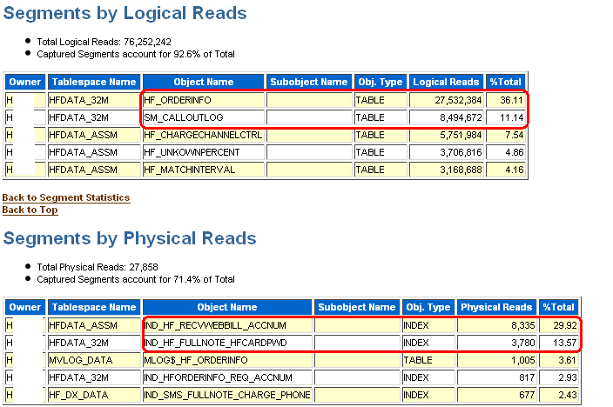
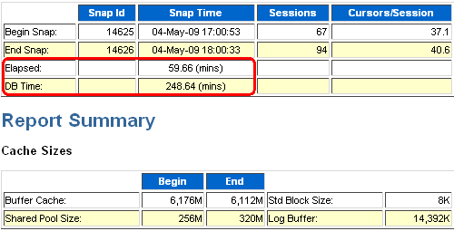
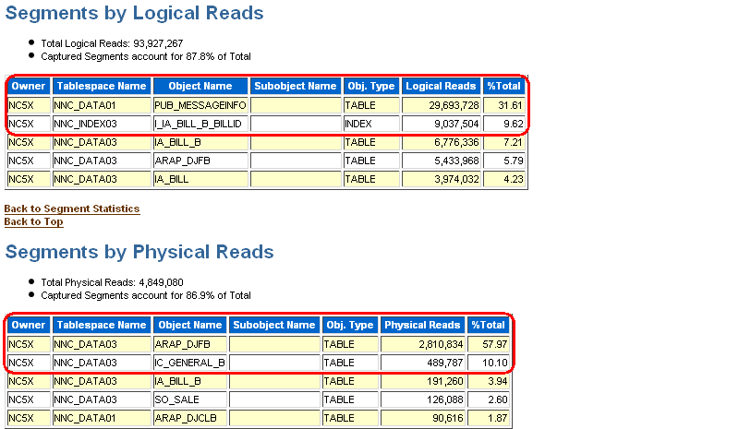
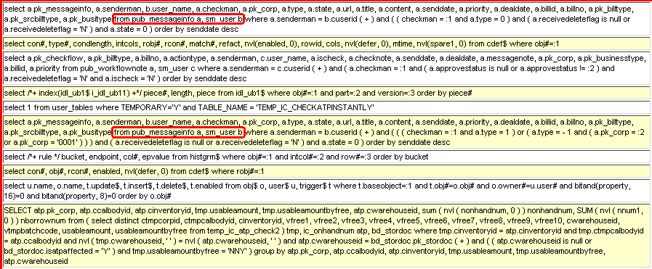
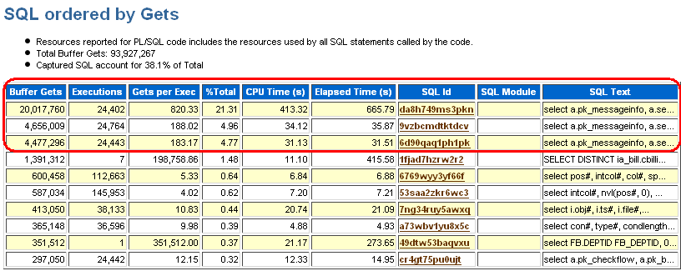
架构设计:了解数据访问频度
高频表的存储与优化

Slide 7
（二）制定数据缓存与归档机制

Slide 8
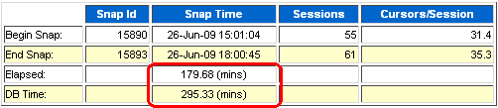
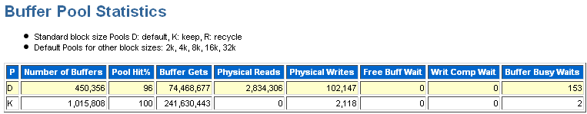
缓存为王:Default / Keep Cache
Auto-tuned
Keep
Recycle
nK Buffer cache
Default
F
E
Working set 1
Working set 2
B
E
D
A
C
F
F
C
…
C
A
D
D
B
A
LRU
CKPTs
LRU
CKPTs
Buffer cache

Slide 9
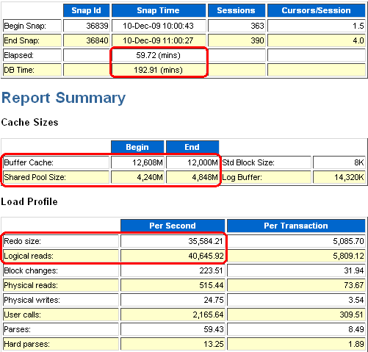
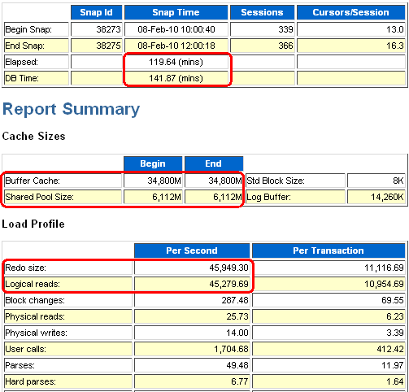
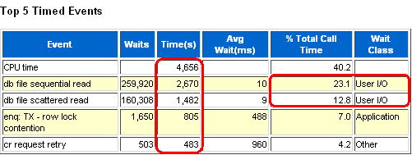
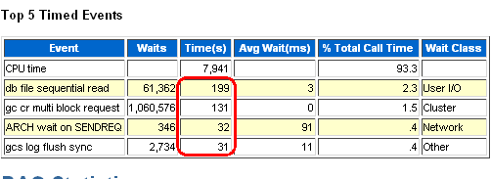
缓存为王:Default Cache

Slide 10
（三）学习Oracle的设计理念

Slide 11
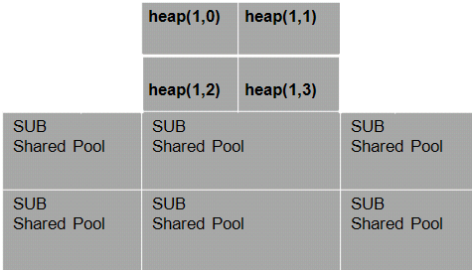
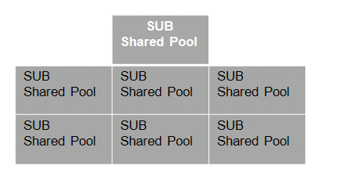
架构设计:拆分与分割
Oracle的内存管理演进

Slide 12
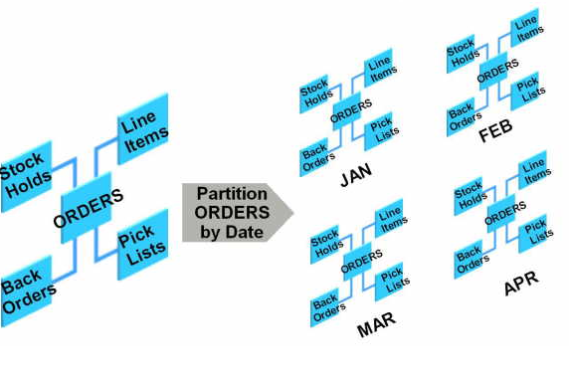
架构设计：分表、分区、分库

Slide 13
Oracle11g:Result Cache
Result Cache又可以分为
Server Result Cache
Client Result Cache
Shared Pool
Server Result
Cache
SQL> select /*+ result_cache */ count(*) from eygle;
COUNT(*)
----------
15993
Statistics
----------------------------------------------------------
0 recursive calls
0 db block gets
0 consistent gets
0 physical reads
0 redo size
420 bytes sent via SQL*Net to client
416 bytes received via SQL*Net from client
2 SQL*Net roundtrips to/from client
0 sorts (memory)
0 sorts (disk)
1 rows processed
Library
Cache
Data Dictionary Cache

Slide 14
（四）在瓶颈之处寻找突破

Slide 15











Cache为王：Flash Cache 支持
4. User Process reads blocks from SGA (copied from Flash Cache if not in SGA)
Extended Buffer Cache
Hot Data
Warm Data
16 GB SGA Memory
3. Clean blocks moved to Flash Cache based on LRU*
120 GB Flash Cache
1. Blocks read into buffer cache
2. Dirty blocks flushed to disk
Cold Data
360 GB Magnetic Disks
* Headers for Flash Cached blocks kept in SGA

Slide 16

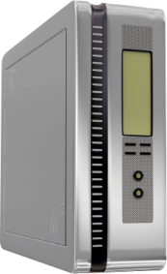
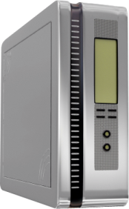


Oracle In Memory Database Cache Offload Data processing to Middle Tier resources
Business
Applications
Business
Applications
Data cached in application memory
Synchronized with Oracle Database
Fast, consistent response times
High transaction throughput
Scale out with In-Memory cached Grid
Standard Oracle Interfaces
SQL, PL/SQL, OCI
Cached tables
Cached tables

Slide 17
（五）精心设计每一个资源消耗

Slide 18
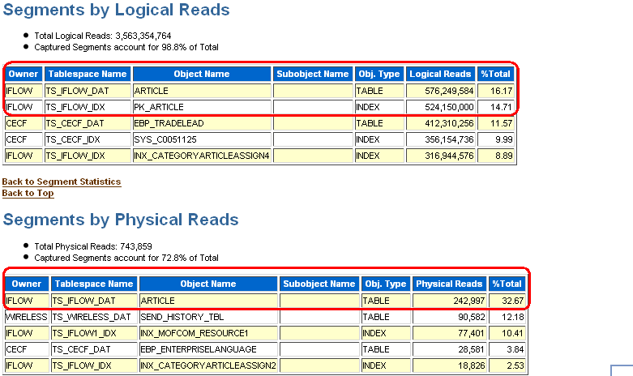
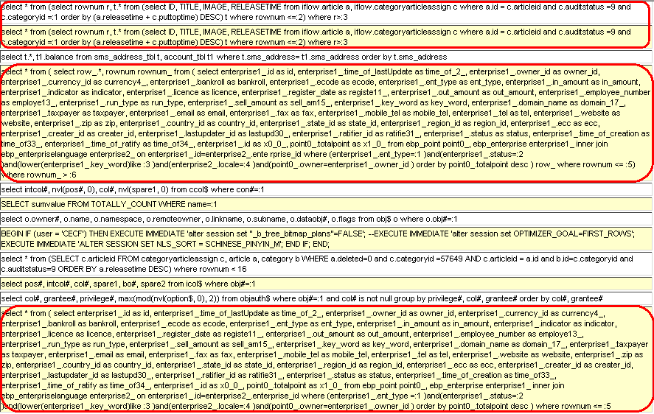
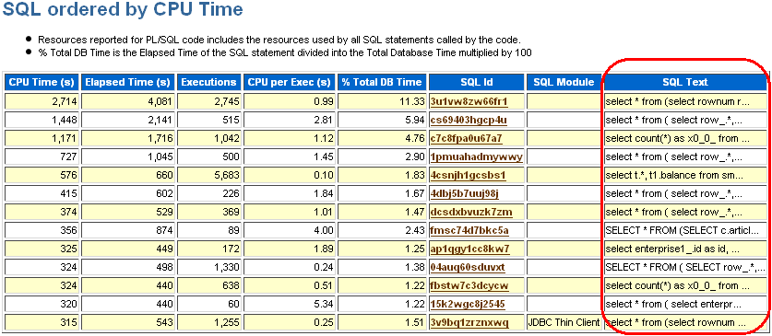
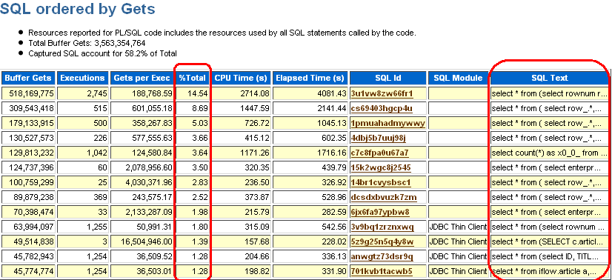
数据库的使命：读、写与展示

Slide 19
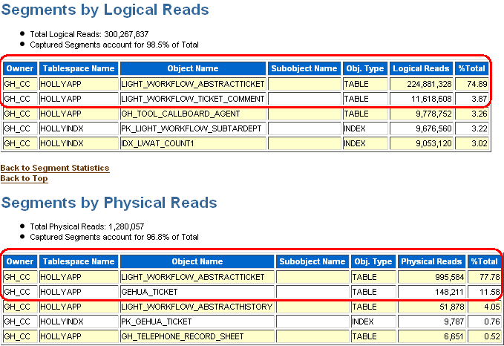
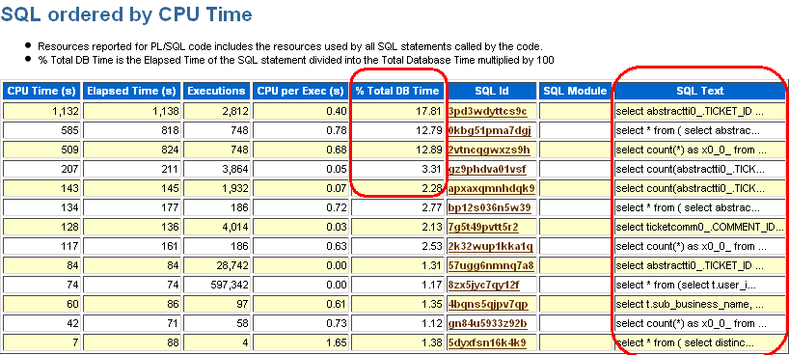
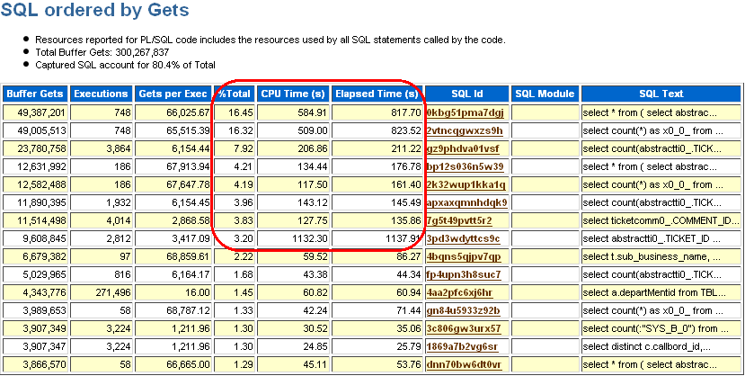
数据库的使命：读、写与展示

Slide 20
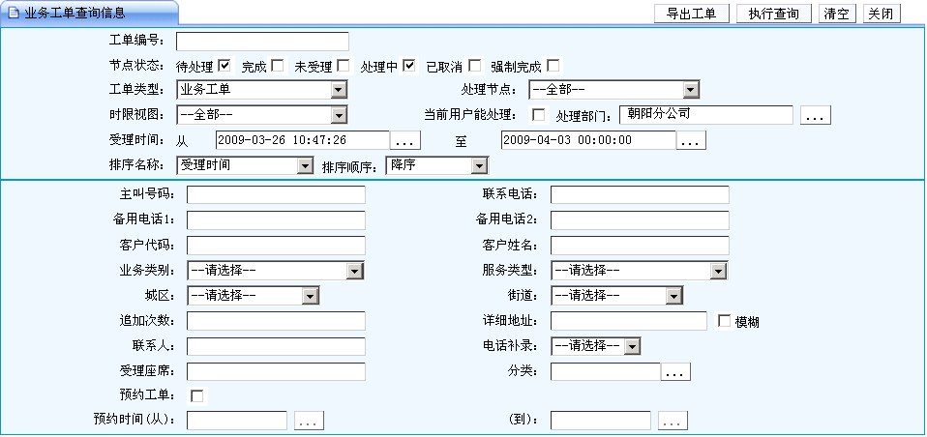
矛与盾的抉择：灵活性与性能

Slide 21
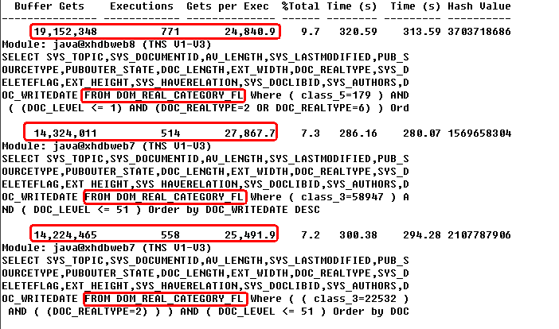

架构设计：排序与翻页

Slide 22
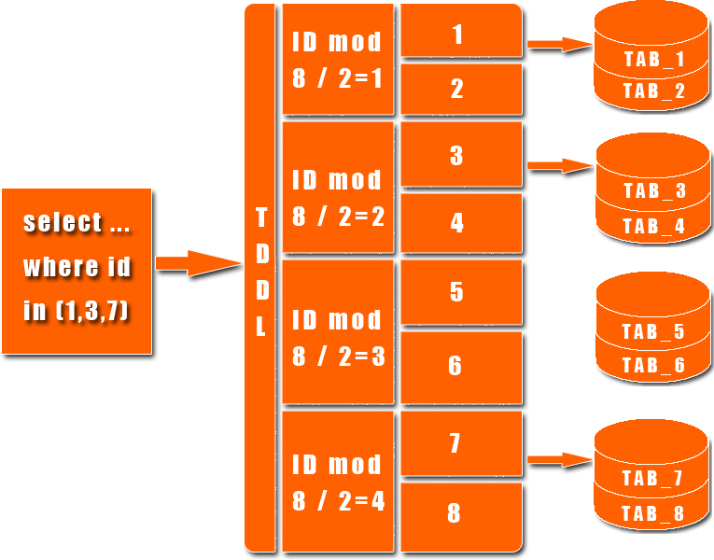
架构设计：Scale UP / OUT
水平扩展构架体系
Scale out的解决方案
对业务基本透明
可动态扩展
支持任何数据库
未来支持多主结构
坏掉任何一个主库，不影响业务
未来支持压力动态均衡
数据可以动态分布
可以方便的扩展/减少数据库主机、
（引自 陈吉平 淘宝网架构介绍）
解决单库天花板问题

Slide 23

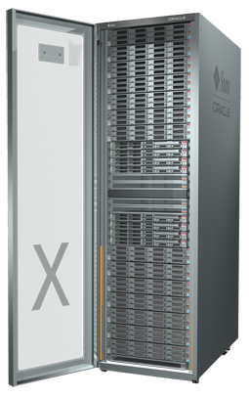
Sun Oracle Database Machine Get on the Grid Faster - OLTP & Data Warehousing
Oracle Database Server Grid
8 Database Servers
64 Cores
400 GB DRAM
Exadata Storage Server Grid
14 Storage Servers
5TB Smart Flash Cache
336 TB Disk Storage
Unified Server/Storage Network
40 Gb/sec Infiniband Links
880 Gb/sec Aggregate Throughput
Completely Fault Tolerant
Notes:
23

Slide 24




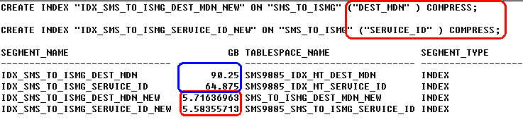
Significantly Reduce Storage Usage Advanced OLTP Compression
Compress large application tables
Transaction processing, data warehousing
Compress all data types
Structured and unstructured data types
Improve query performance
Cascade storage savings throughout data center
Up To
4X
Compression
Notes:
24

Slide 25

Sun Oracle Exadata Storage Server Hybrid Columnar Compression
Data stored by column and then compressed
Useful for data that is bulk loaded or moved
Query mode for data warehousing
Typical 10X compression ratios
Scans improve accordingly
Archival mode for old data
Typical 15- 50X compression ratios
Up To
50X

Slide 26


恩墨科技 成就所托
www.eNMOU.com

