Slide 1
Hadoop
Chapter2
Mapreduce (Map + Reduce)
Map Reduce
Distribute the processing of data on your cluster Divides your data into partitions that are MAPPED (transformed) and Reduced (aggregated by mapper and reducer functions you define)

Slide 2

Hadoop
Chapter2
How many movies did each user rate in the MovieLens data set ?

Slide 3
Hadoop
Chapter2
How MapReduce works: Mapping
Input Data
Mapper
Key-Value
Mapper converts raw source data into Key/value pairs

Slide 4
Hadoop
Chapter2
How MapReduce works: Mapping
User ID | Movie ID | Rating | TimeStamp
User User User User User User | Movie ID Movie ID Movie ID Movie ID Movie ID Movie ID | Rating Rating Rating Rating Rating Rating | 0192092 0192092 0192092 0192092 0192092 0192092
Mapper
1: 242, 2: 302, 1: 306, 2: 345, 3:443

Slide 5
Hadoop
Chapter2
Mapreduce sorts and groups the Mapped Dta (“Shufle and Sort”)
1: 242, 2: 302, 1: 306, 2: 345, 3:443
1: 242,306, 2: 302, 345, 3:443
Len(moves)
1:2, 2: 2, 3:1

Slide 6
Hadoop
Chapter2
User ID | Movie ID | Rating | TimeStamp
User User User User User User | Movie ID Movie ID Movie ID Movie ID Movie ID Movie ID | Rating Rating Rating Rating Rating Rating | 0192092 0192092 0192092 0192092 0192092 0192092
Mapper
1: 242, 2: 302, 1: 306, 2: 345, 3:443
Shuffle and sort
1: 242,306, 2: 302, 345, 3:443
Reducer
Len(moves) / 1:2, 2: 2, 3:1

Slide 7
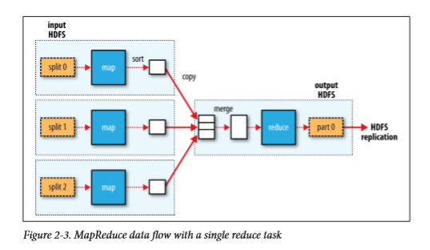
Hadoop
Chapter2
Weather Dataset
Reducer
Max(temp by year)

