Slide 1
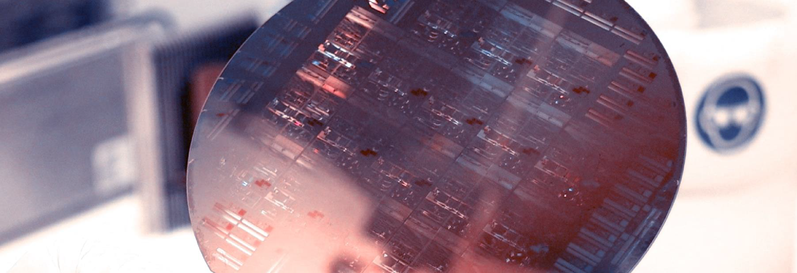
Lab Book 0.3. Ring Resonator concepts
Student:

Slide 2
Instructions
General
SCRIPTS AND WORKFLOW
1. Fork / clone the repository: https://github.com/cccanvas-upv/pic-upv-lab0.git
2. Open the repository in VS Code with WSL; run uv sync if needed.
3. Select the project .venv as your Jupyter kernel.
4. Run 030_RING_RESONATOR_Student.ipynb in sequence.
5. Paste the requested plots and fill in your results in this LabBook.

Slide 3
LO.1 – Effective and Group Index Analysis
Mode solver sweep: 1500–1600 nm (11 wavelengths), fundamental TE-like mode
Paste n_eff(λ) plot here
Paste n_g(λ) plot here
At 1550 nm: n_eff = ______________ n_g = ______________
Explain the difference between effective and group indices. Comment on their wavelength dependence.
LAB 0.3. RING RESONATORS
3

Slide 4
LO.2 – Ring Resonator Spectral Response
Interpolate n_eff(λ), then calculate the through-port spectrum of an all-pass ring (R = 10 µm; a = y = 0.90).
Paste n_eff interpolation plot
Paste ring transmission spectrum
List the resonance wavelengths and estimate the FSR near 1550 nm.
Explain why transmission reaches a minimum at resonance and approaches unity off resonance.
LAB 0.3. RING RESONATORS
4

Slide 5
LO.3.1 – Influence of Coupling
Exercise 1 · Fix R = 10 µm and a = 0.90. Compare y = 0.99, 0.90 and 0.70.
Paste the three overlaid transmission spectra
y | Regime
0.99 | Undercoupled
0.90 | Critical
0.70 | Overcoupled
Which condition produces the deepest dip? Why does critical coupling ideally suppress through-port transmission?
Comments: compare resonance depth and linewidth for the three cases.
LAB 0.3. RING RESONATORS
5

Slide 6
LO.3.1 – Influence of Optical Losses
Exercise 2 · Fix R = 10 µm and y = 0.90. Compare a = 0.99, 0.90 and 0.75.
Paste the three overlaid transmission spectra
a | Coupling regime
0.99 | Overcoupled
0.90 | Critical
0.75 | Undercoupled
Questions:
How does increasing the propagation loss affect the resonance depth?
Which configuration satisfies the critical coupling condition?
Can increasing the internal losses produce a deeper resonance? Explain why.
LAB 0.3. RING RESONATORS
6

Slide 7
LO.3.2 – Ring Radius and FSR
Exercise 3 · Fix a = y = 0.90; compare radii R = 5, 10 and 20 µm.
Paste the three overlaid transmission spectra
R (µm) | Sim. FSR | Theory FSR
5
10
20
Questions:
How does the FSR change when the ring radius increases?
Explain physically why the FSR depends on the ring circumference.
Why is the FSR not exactly constant across the wavelength range?
LAB 0.3. RING RESONATORS
7

Slide 8
LO.3.3 – Resonance Linewidth
Exercise 4 · Ring A: a = y = 0.90; Ring B: a = y = 0.99. Both have R = 10 µm.
Paste full spectra (1500–1600 nm)
Paste zoom near 1550 nm
Estimate the FWHM graphically at half the dip depth (T ≈ 0.5). No extra simulations required.
LAB 0.3. RING RESONATORS
8

Slide 9
LO.3.3 – Finesse, Q-factor and Applications
Use the FSR from Exercise 3 and the visually estimated FWHM from Exercise 4.
Parameter | Ring A | Ring B
Resonance wavelength (nm)
FSR (nm)
Estimated FWHM (nm)
Finesse
Loaded Q-factor
Discussion.
1. Which ring has a narrower resonance and higher Q? Why?
2. Which is preferable for detecting small resonance shifts in sensing?
3. Is a narrower resonance always better for WDM filtering? Discuss bandwidth and stability.
LAB 0.3. RING RESONATORS
9

