Slide 1

Lab Book 1.0. Waveguides
Student:

Slide 2
Instructions
General
SCRIPTS
From GitHub →
  Fork the repo: cccanvas-upv/pic-upv-lab1
  Clone the repo using VSCode
Run the Jupyter Notebook:
  WAVEGUIDES_Student.ipynb
W (width)
W (width)
Core
Core
h_core
h
(height)
Cladding
Cladding
Slab
h_slab
deep waveguide
shallow waveguide

Slide 3
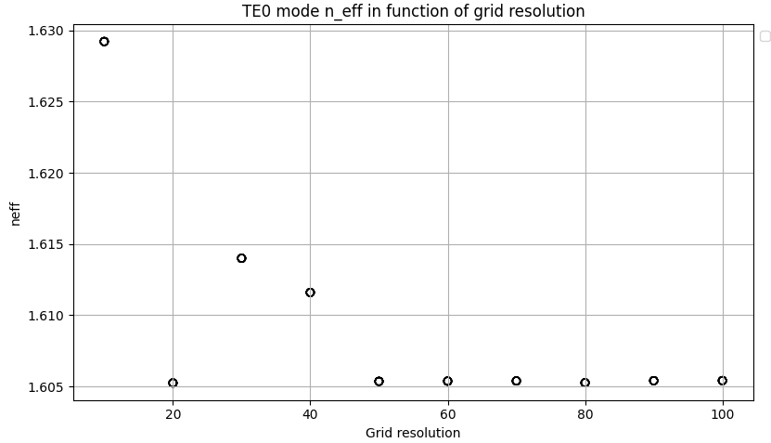
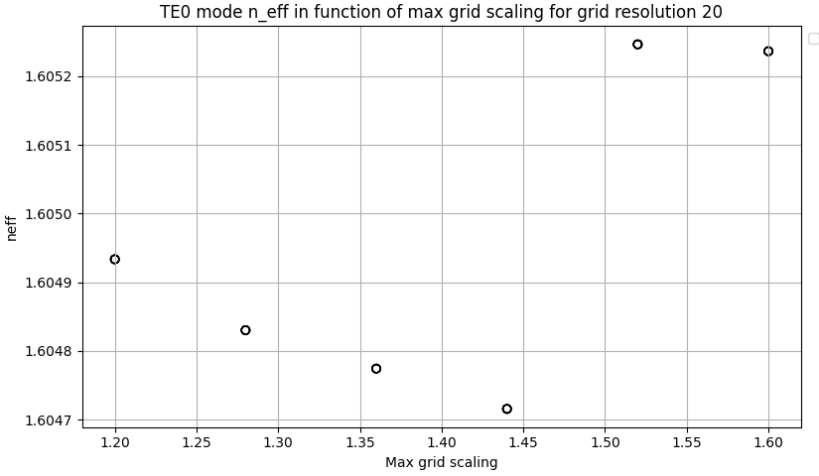
Learning outcome #1 – Convergence tests
DE waveguide, w = 1.2 µm, neff_TE0, wvl 1.55 µm.
As we can see on the left, from grid > 50 the solution converges. However, for grid = 20 we also get a convergent solution with a reduced value so the computation time will be lower. For that reason, we will choose that value. If we would choose for example, grid = 30, the neff solution would be more sensible to the value of max grid scaling. However, for the value of 20, we can see on the right that we have more robust solution with a range (1.2-1.5) where neff goes to the convergent value. In this case, as 1.2-1.4 grid scaling don’t have a big computation time difference, we will choose 1.4 as the value

Slide 4
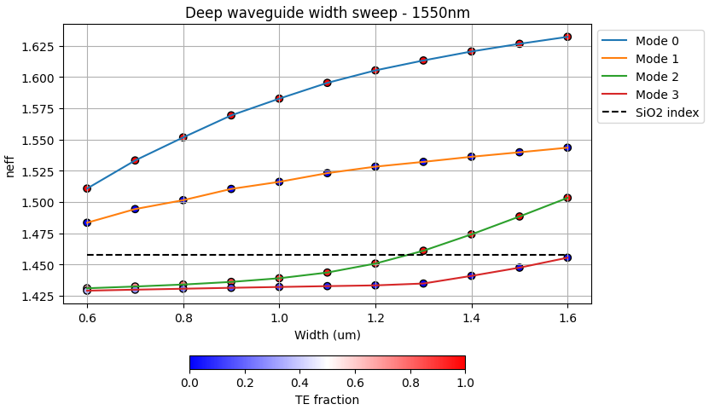
Learning outcome #2 – Width dependence
Width 0.6 - 1.6 µm (step 0.1 µm) – Wavelength 1.55 µm
For this wavelength, thickness and width range the waveguide will be single mode for TM polarization. However, from 1.2/1.3 width we will start to have a second TE mode so the fiber stops to be monomode

Slide 5
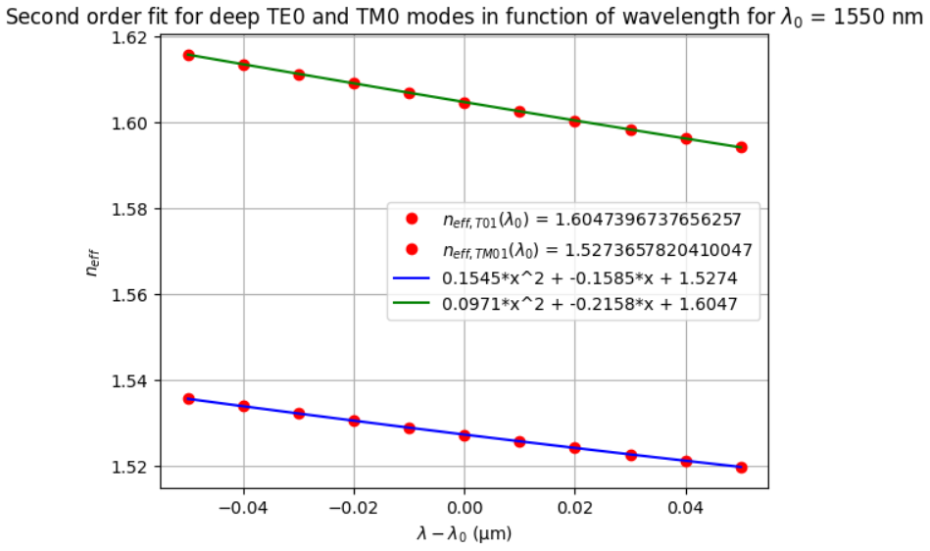
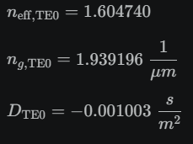
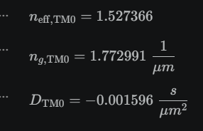


Learning outcome #3 – Waveguide compact model
Let’s model the waveguide using a second order polynomial:
$$n_{eff}\left(λ\right)=n_{1}+n_{2}\left(λ−λ_{0}\right)+n_{3}{\left(λ−λ_{0}\right)}^{2}$$
shallow waveguide
neff_TE0 vs $λ$ with the second-degree polynomial fit
& neff_TM0 vs $λ$ with the second-degree polynomial fit
slab: 150nm
Find the second-degree polynomial coefficients and relate them with the group index and the dispersion parameter. $\left\{\begin{aligned}n_{eff}=n_{1} \\ n_{g}=n_{1}−n_{2}λ_{0} \\ D=−\frac{2λ_{0}n_{3}}{c}\left[\frac{s^{2}}{m}\right]\end{aligned}\right.$
Comment on the results found for the TE0 and TM0 for both deep and shallow waveguides.
Deep

Slide 6
Learning outcome #4 – Bend waveguide radius vs. loss – deep
Find neff_TE0 for wvl 1.55 µm, width 1.0 µm for R=25,50,75,100, 125,150 µm
deep waveguide
Paste dB/90º neff_TE0 & neff_TM0 vs R
$α\left[\frac{dB}{90°}\right]=$ $R\frac{π}{2}α\left[\frac{dB}{µm}\right]$
Comment results, which is the safe radius, consider safe means less than 0.1 dB/90º.

Slide 7

Thank you

