Slide 1
Module 3: Microsoft Azure Storage
Module Overview
Notes:
This module discusses the following topics:
Section 1: Storage Features
Section 2: Storage Security
Section 3: Blob Storage
Section 4: Table Storage
Section 5: Queue Storage
Section 6: Azure Files
Section 7: Premium Storage
Section 8: Content Delivery Network
After this module you will be able to:
Objective
Objective
Objective
Slide Objectives
Introduce the topics that will be covered in this session
[EDITOR] Zain:
Wednesday, January 29, 2014 Please validate the lesson listing.

Slide 2
Agenda
Section 1: Storage Features
Section 2: Storage Security
Section 3: Blob Storage
Section 4: Table Storage
Section 5: Queue Storage
Section 6: Azure Files
Section 7: Premium Storage
Section 8: Content Delivery Network

Slide 3
Module 3: Microsoft Azure Storage
Section 1: Storage Features

Slide 4
Understanding Storage
Storage in the cloud
Scalable, durable, and available
Anywhere, anytime access
Only pay for what the service uses
Exposed via RESTful Web services:
Use from Azure compute
Use from anywhere on the internet
Notes:
Slide Objectives
Define the Azure Storage and the benefits that this service provides
Speaker Notes
The Azure storage services provide storage for binary and text data, messages, and structured data in Azure.
Scalable
Durable
Available
Cost
Representational State Transfer (REST)
Geo-redundant storage provides the highest level of storage durability by seamlessly replicating your data to a secondary location within the same region.
Locally redundant storage provides highly durable and available storage within a single location.
Microsoft monitors the service, provides patches, handles scaling, and does the other work needed to keep the service available.

Slide 5
Azure Standard Storage Account
Can CDN-enable an account
Blobs delivered via 24 global Content Delivery Network (CDN) nodes
Can co-locate a storage account with a compute account
Explicitly or using affinity groups
Accounts have two independent 512-bit shared secret keys
500 TB per account
10 storage accounts per subscription (default)
Notes:
Slide Objective
Understand an Azure storage account
Speaker Notes
The Azure CDN offers developers a global solution for delivering high-bandwidth content by caching blobs and static content of compute instances at physical nodes in the United States, Europe, Asia, Australia and South America
An Azure subscription contains storage accounts
Can explicitly geo-locate to a sub-region or set affinity with other services
Can enable CDN at the account level (means that public containers will be retrievable via the CDN URL)
500 TB per account means a lot of storage for low cost
Notes
You should change the access keys to your storage account periodically to help keep your storage connections more secure. Two access keys are assigned to allow you to maintain connections to the storage account using one access key while you regenerate the other access key.
[EDITOR] Zain:
Friday, January 31, 2014 This content is repeated from the previous slide. Kindly validate this.
[EDITOR] Oct 28, 2015
As per geo-political guidelines --when used to refer to the countries of the South American continent as well as Mexico and Central America.
Replace with "Latin America"
Refer http://gpweb/Compliance/PoliCheck/TermInfo.aspx?LCID=9&TermID=80253

Slide 6
Storage Features
Local redundant storage (LRS)
Zone Redundant – block blobs only, no metrics
Geo-replication (Geo Redundant storage)
“Read access - Geo Redundant Storage” (RA - GRS)
Storage analytics
Logs: Provide trace of executed requests for your storage accounts
Metrics: Provide summary of key capacity and request statistics for Blobs, Tables, and Queues
Notes:
Slide Objectives
Explain the new features of Azure storage
Value Prop
Recently added features provide increased functionality and value to Azure storage
Speaker Notes
Shared Access Signatures (SAS) (signed URLs) for tables and queues: Similar to the SAS feature that was previously available for blobs, this allows account owners to issue URL access to specific resources such as tables, table ranges, queues, blobs and containers while specifying granular sets of permissions. In addition, there are minor improvements to SAS for blobs
Expanded blob copy: For blobs, we now support copying blobs between the storage accounts and copy blob (even within accounts) is performed as an asynchronous operation. This is available in the new version, but will only work if the destination storage account was created on or after June 7, 2012. In addition, Copy Blob operations within the same account will continue to work for all accounts
Improved blob leasing: Leasing is now available for blob containers, and allows infinite lease duration. In addition, lease durations between 15-60 seconds are also supported. Changing the lease ID (to rotate the lease ID across your components) is now supported
Introducing locally redundant storage: Storage users are now able to turn off geo-replication by selecting Locally Redundant Storage (LRS). LRS provides highly durable and available storage within a single location (sub-region)
Zone Redundant - http://blogs.msdn.com/b/windowsazurestorage/archive/2014/08/01/introducing-zone-redundant-storage.aspx . ZRS fits between LRS and GRS in terms of durability and price. ZRS stores 3 replicas of your data across 2 to 3 facilities. It is designed to keep all 3 replicas within in a single region, but may span across two regions. ZRS currently only supports block blobs. ZRS allows customers to store blob at a higher durability than a single facility can provide with LRS. ZRS accounts do not have metrics or logging capability enabled at this time.
Read Access - Geo Redundant Storage (RA-GRS): For a GRS storage account, we now have introduced in limited preview the ability to turn on read only access to a storage account’s data in the secondary region. Since replication to the secondary region is done asynchronously, this provides an eventual consistent version of the data to read from
http://blogs.msdn.com/b/windowsazurestorage/archive/2013/12/11/introducing-read-access-geo-replicated-storage-ra-grs-for-windows-azure-storage.aspx
Choosing Geo Redundant Storage (GRS) or locally redundant storage: By default, storage accounts are configured for GRS, meaning that Table and Blob data is replicated both within the primary location and also to a location hundreds of miles away (geo-replication). As detailed in this blog post, using LRS may be preferable in certain scenarios, and is available at a 23-34% discount compared to GRS. The price of GRS remains unchanged
Configuration of storage analytics: While our analytics features (metrics and logging) have been available since last summer, configuring them required the user to call the REST Application Programming Interface (API). In the new Microsoft Azure Management Portal, users can easily configure these features
Monitoring storage metrics: Storage users can now also monitor any desired set of metrics tracked in your account via the Management Portal

Slide 7
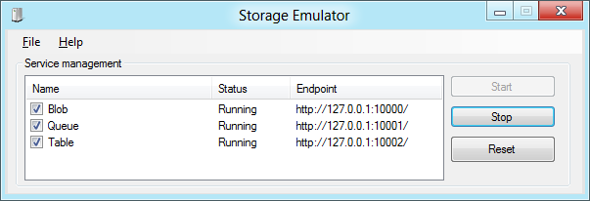
Storage in the Compute Emulator
Provides a local mock storage
Emulates storage in the cloud
Allows offline development
Requires SQL Server 2008 Express / SQL Server 2005 Express or later
There are some differences between Azure Storage and the Storage Emulator
Refer http://msdn.microsoft.com/en-us/gg433135
A good approach for developers:
To test pre-deployment, push storage to the cloud first
Use Dev Fabric for compute connect to cloud-hosted storage
Finally, move compute to the cloud
Notes:
Slide Objective
Understand the Development Storage Service
Speaker Notes
Client side simulator of storage in the cloud
Allows completely disconnected (e.g., while travelling on a plane) development of Azure apps
Can consume like cloud storage—from compute emulator, from another application running locally
Is locked down so that it cannot be called from off the box
If you need this capability run a reverse proxy on the dev machine
Can use CSRun to start and stop service. This will be explained in detail later (on day three).
Uses a single fixed account. The account name and key are always the same
Anyone memorized the Account key yet? Eby8vd…..
Notes
The Azure Software Development Kit (SDK) development environment includes development storage, a utility that simulates the Blob, Queue, and Table services available in the cloud. If you are building a hosted service that employs storage services or writing any external application that calls storage services, you can test locally against development storage.
The development storage utility provides a user interface to view the status of the local storage services and to start, stop, and reset them.
This topic contains the following subtopics:

Slide 8
Storage Libraries in Many Languages
C# / .NET
Python 0.9.0
Ruby 0.6.2
Perl
JavaScript (Node)
Java SDK 2.0
PHP 0.4.0
Erlang
Common LISP
Objective-C
C#/Visual Basic on Windows Phone 7
Node.js 0.4.2
Android 0.4.1
C++ - 1.0
Notes:
Slide Objectives
Explain the different Storage Libraries and languages that can be used to work with Azure Storage
Value Prop
Programmatic access to the Blob, Queue, and Table services is available via the Azure client libraries and the Azure storage services REST API
Speaker Notes
Azure is an open cloud platform that allows you to quickly build, deploy and manage applications across a global network of Microsoft-managed data centers. You can build applications using any language, tool or framework.

Slide 9
Module 3: Microsoft Azure Storage
Section 2: Storage Security

Slide 10
Storage Security
Azure Storage provides simple security for calls to storage service
HTTPS endpoint
Digitally sign requests for privileged operations
Two 512-bit symmetric keys per storage account
Can be regenerated independently
More granular security via Shared Access Signatures (SAS)
Notes:
Slide Objective
Describe security principles
Speaker Notes
Simple shared secret security
Can use HTTP or HTTPS to access
Use HTTP for public content
Use HTTPS for secure content (that is to say, where using es or SAS)
Two 512 bit keys
Keys used to sign private requests
Two keys supports rolling of keys
E.g., if one key is compromised, you can use the second key while first is regenerated
More on SASs later in this module
[EDITOR] Zain:
Friday, January 31, 2014
Not sure what ‘es’ is. Kindly clarify.
For more information on Security on day three, see:
http://social.msdn.microsoft.com/Forums/en-US/windowsazure/thread/1e023e8d-0ff9-472e-bcc1-05400a41466c
http://blogs.msdn.com/b/usisvde/archive/2010/05/21/best-practices-for-data-storage-security-on-windows-azure.aspx

Slide 11
Shared Access Signatures
Fine grain access rights to blobs and containers
Sign URL with storage key—permit elevated rights
Revocation:
Use short time periods and re-issue
Use container-level policy that can be deleted
Two broad approaches:
Ad hoc
Policy-based
Notes:
Slide Objective
Introduce SAS
Speaker Notes
SAS provide access rights to containers and blobs at a more granular level than by simply setting a container’s permissions
Grant users access to a specific blob or to any blob within a specified container for a specified period of time
Specify what operations a user may perform on a blob that is accessible via a SAS
Use HTTPS to protect the signature (it is like a short dated password)
Two approaches:
Ad hoc—Use for very short dated single use scenarios
Policy-based—Use for longer dated revocable permission sets
Always endeavour to use least permission set possible
Notes
For more information, see:
http://msdn.microsoft.com/en-us/library/ee395415.aspx

Slide 12
Ad Hoc Signatures
Create short-dated SAS
Signedresource blob or container
AccessPolicy Start, Expiry, and Permissions
Signature HMAC-SHA256 of above fields
Use case
Single use URLs
For example, provide URL to Silverlight client for upload to container
http://...blob.../pics/image.jpg? sr=c&st=2009-02-09T08:20Z&se=2009-02-10T08:30Z&sp=w &sig= dD80ihBh5jfNpymO5Hg1IdiJIEvHcJpCMiCMnN%2fRnbI%3d
Notes:
Slide Objective
Understand Ad hoc SAS
Speaker Notes
Ad hoc—Use for very short dated single use scenarios
Include all permissions and expiry in the signed URL
Can only revoke by deleting the blob or waiting for expiry
Use very short dated URLs
Notes
For more information, see:
http://msdn.microsoft.com/en-us/library/ee395415.aspx

Slide 13
Policy-Based Signatures
Create container-level policy
Specify StartTime, ExpiryTime, and Permissions
Create SAS URL
Signedresource blob or container
Signedidentifier optional pointer to container policy
Signature HMAC-SHA256 of above fields
Use case
Providing revocable permissions to certain users/groups
To revoke: Delete or update container policy
http://...blob.../pics/image.jpg? sr=c&si=MyUploadPolicyForUserID12345 &sig=dD80ihBh5jfNpymO5Hg1IdiJIEvHcJpCMiCMnN%2fRnbI%3d
Notes:
Slide Objective
Understand Ad hoc SAS
Speaker Notes
Policy-based
Points to a Container-level policy
User where want a longer dated permission with ability to revoke
Include all permissions and expiry in the signed URL
Can only revoke by deleting the blob or waiting for expiry
Use very short dated URLs
Notes
For more information, see:
http://msdn.microsoft.com/en-us/library/ee395415.aspx
[EDITOR] Zain:
Friday, January 31, 2014 This sentence is unclear. Kindly clarify.

Slide 14
Client Side Encryption
Encryption via the ‘envelope’ technique using Cipher Block Chaining (CBC) mode with Advanced Encryption Standard (AES)
Blobs
Supports encryption of whole blobs only
Must use UploadFrom methods or OpenWrite method
The wrapped CEK and some additional encryption metadata are then stored as blob metadata along with the encrypted blob on the service
Downloading an encrypted blob involves retrieving the content of the entire blob using the DownloadTo*/BlobReadStream methods
All blob types supported
Queues
Since queue messages can be of any format, the client library defines a custom format that includes the Initialization Vector (IV) and the encrypted content encryption key (CEK) in the message text
Notes:
https://azure.microsoft.com/en-us/documentation/articles/storage-client-side-encryption/

Slide 15
Client Side Encryption (continued)
Tables
Supports encryption of entity properties for insert and replace operations
Due to these additional reserved properties required for encryption, users may now have only 250 custom properties instead of 252. The total size of the entity must be less than 1 MB
Only string properties can be encrypted

Slide 16
Blob Encryption Service: Sample Code
// Create the IKey used for encryption.
RsaKey key = new RsaKey("private:key1" /* key identifier */);
// Create the encryption policy to be used for upload and download.
BlobEncryptionPolicy policy = new BlobEncryptionPolicy(key, null);
// Set the encryption policy on the request options.
BlobRequestOptions options = new BlobRequestOptions() { EncryptionPolicy = policy };
// Upload the encrypted contents to the blob.
blob.UploadFromStream(stream, size, null, options, null);
// Download and decrypt the encrypted contents from the blob.
MemoryStream outputStream = new MemoryStream();
blob.DownloadToStream(outputStream, null, options, null);

Slide 17
Azure Storage Abstractions
Blob
Simple named files along with metadata for the file
Queues
Reliable storage and delivery of messages for an application
Tables
Structured storage. A table is a set of entities; an entity is a set of properties
Azure Files
Server Message Block (SMB) storage with drive mapping capability. Based on blob storage (includes tech support)
Notes:
Slide Objectives
Understand each of the storage types at a high level
Speaker Notes
The Azure storage services provide storage for binary and text data, messages, and structured data in Azure. The storage services include:
The Blob service, for storing binary and text data
The Queue service, for storing messages that may be accessed by a client
The Table service, for structured storage for non-relational data
Azure Files, for mounting an New Technology File System (NTFS) volume accessible to code running in your Azure service
Programmatic access to the Blob, Queue, and Table services is available via the Azure Managed Library and the Storage services REST API.
For more information, see:
http://blogs.msdn.com/b/windowsazurestorage/archive/2010/03/28/windows-azure-storage-resources.aspx

Slide 18
Module 3: Microsoft Azure Storage
Section 3: Blob Storage

Slide 19
Blob Storage Concepts
http://<account>.blob.core.windows.net/<container>/<blobname>
Account
Container
Blob
Pages/Blocks
PIC01.JPG
images
Block/Page
PIC02.JPG
contoso
Block/Page
videos
VID1.AVI
Notes:
Slide Objectives
Understand the hierarchy of Blob storage
Speaker Notes
The Blob service provides storage for entities, such as binary files and text files
The REST API for the Blob service exposes two resources:
Containers
Blobs
A container is a set of blobs; every blob must belong to a container
The Blob service defines two types of blobs:
Block blobs—optimized for streaming
Page blobs—optimized for random read/write operations and which provide the ability to write to a range of bytes in a blob
Blobs can be read by calling the Get Blob operation. A client may read the entire blob, or an arbitrary range of bytes
Block blobs less than or equal to 64 MB in size can be uploaded by calling the Put Blob operation
Block blobs larger than 64 MB must be uploaded as a set of blocks, each of which must be less than or equal to 4 MB in size
Page blobs are created and initialized with a maximum size with a call to Put Blob
To write content to a page blob, you call the Put Page operation. The maximum size currently supported for a page blob is 1 TB
Using the REST API for the Blob service, developers can create a hierarchical namespace similar to a file system. Blob names may encode a hierarchy by using a configurable path separator. For example, the blob names MyGroup/MyBlob1 and MyGroup/MyBlob2 imply a virtual level of organization for blobs. The enumeration operation for blobs supports traversing the virtual hierarchy in a manner similar to that of a file system, so that you can return a set of blobs that are organized beneath a group. For example, you can enumerate all blobs organized under MyGroup/.

Slide 20
Blob Details
Main Web service operations
PutBlob
GetBlob
DeleteBlob
CopyBlob
SnapshotBlob
LeaseBlob
Associate metadata with blob
Standard HTTP metadata/headers (Cache-Control, Content-Encoding, Content-Type, etc.)
Metadata is <name, value> pairs, up to 8 KB per blob
Either as a part of PutBlob or independently
Blob always accessed by name
Can include ‘/‘ or other delimiter in name for example, /<container>/myblobs/blob.jpg
Notes:
Slide Objectives
Understand the hierarchy of Blob storage
Speaker Notes
Put Blob—creates a new blob or replaces an existing blob within a container
Get Blob—reads or downloads a blob from the system, including its metadata and properties
Delete Blob—deletes a blob
Copy Blob—copies a source blob to a destination blob within the same storage account
SnapShot Blob—the Snapshot Blob operation creates a read-only snapshot of a blob
Lease Blob—establishes an exclusive one-minute write lock on a blob. To write to a locked blob, a client must provide a lease ID
Using the REST API for the Blob service, developers can create a hierarchical namespace similar to a file system
Blob names may encode a hierarchy by using a configurable path separator. For example, the blob names MyGroup/MyBlob1 and MyGroup/MyBlob2 imply a virtual level of organization for blobs
The enumeration operation for blobs supports traversing the virtual hierarchy in a manner similar to that of a file system, so that you can return a set of blobs that are organized beneath a group
For example, you can enumerate all blobs organized under MyGroup/
Notes
The Blob service provides storage for entities, such as binary files and text files. The REST API for the Blob service exposes two resources:
Containers
Blobs
A container is a set of blobs; every blob must belong to a container. The Blob service defines two types of blobs:
Block blobs, which are optimized for streaming. This type of blob is the only blob type available with versions prior to 2009-09-19
Page blobs, which are optimized for random read/write operations and which provide the ability to write to a range of bytes in a blob. Page blobs are available only with version 2009-09-19
Containers and blobs support user-defined metadata in the form of name-value pairs specified as headers on a request operation.
Using the REST API for the Blob service, developers can create a hierarchical namespace similar to a file system. Blob names may encode a hierarchy by using a configurable path separator. For example, the blob names MyGroup/MyBlob1 and MyGroup/MyBlob2 imply a virtual level of organization for blobs. The enumeration operation for blobs supports traversing the virtual hierarchy in a manner similar to that of a file system, so that you can return a set of blobs that are organized beneath a group. For example, you can enumerate all blobs organized under MyGroup/.
A block blob may be created in one of two ways.
Block blobs less than or equal to 64 MB in size can be uploaded by calling the Put Blob operation
Block blobs larger than 64 MB must be uploaded as a set of blocks, each of which must be less than or equal to 4 MB in size
A set of successfully uploaded blocks can be assembled in a specified order into a single contiguous blob by calling Put Block List. The maximum size currently supported for a block blob is 200 GB.
Page blobs are created and initialized with a maximum size with a call to Put Blob. To write content to a page blob, you call the Put Page operation. The maximum size currently supported for a page blob is 1 TB.
Blobs support conditional update operations that may be useful for concurrency control and efficient uploading.
Blobs can be read by calling the Get Blob operation. A client may read the entire blob, or an arbitrary range of bytes.
[EDITOR] Zain:
Friday, January 31, 2014
This content is the same as the last paragraph on the previous notes page. With the only difference being, the content here is bulleted

Slide 21
Blob Containers
Multiple containers per account
Special $root container
Blob container
A container holds a set of blobs
Set access policies at the container level
Associate metadata with container
List the blobs in a container
Including blob metadata and MD5 message digest algorithm
No search/query, that is to say, no WHERE MetadataValue = ?
Blobs throughput
Effectively in partition of 1 partition key
Target of 60 MB/s per blob
Notes:
Slide Objective
Understand containers
Speaker Notes
Account can contain unlimited number of containers
Root container is useful when serving Silverlight and flash out of Blob storage. May need to store Cross-domain access policy files in root of the domain
Metadata is up to 8 KB of name value pairs per container
Notes
A root container serves as a default container for your storage account. A storage account may have one root container. The root container must be explicitly created and must be named $root.
A blob stored in the root container may be addressed without referencing the root container name, so that a blob can be addressed at the top level of the storage account hierarchy. For example, you can now reference a blob that resides in the root container in the following manner:
For more information, see:
http://msdn.microsoft.com/en-us/library/dd179361.aspx
http://msdn.microsoft.com/en-us/library/ee395424.aspx
[EDITOR] Zain:
Friday, January 31, 2014 This content is incomplete.

Slide 22
Two Types of Blobs Under the Hood
Block blob
Targeted at streaming workloads or individual file uploads
Each blob consists of a sequence of blocks
Each block is identified by a Block ID
Size limit of 200 GB per blob
Optimistic concurrency via Entity Tags (ETags)
Page blob
Targeted at random read/write workloads
Each blob consists of an array of pages
Each page is identified by its offset from the start of the blob
Size limit of 1 TB per blob
Optimistic or pessimistic (locking) concurrency via leases
Append blob
All writes to append blob and added sequentially to the end of the blob
Ideal for logging scenarios
Size limit 200 GB per blob
Notes:
Slide Objective
Understand the different blob types
Speaker Notes
Block blobs are comprised of blocks, each of which is identified by a block ID
You create or modify a block blob by uploading a set of blocks and committing them by their block IDs
If you are uploading a block blob that is no more than 64 MB in size, you can also upload it in its entirety with a single Put Blob operation
When you upload a block to Azure using the Put Block operation, it is associated with the specified block blob, but it does not become a part of the blob until you call the Put Block List operation and include the block's ID
The block remains in an uncommitted state until it is specifically committed. Writing to a block blob is thus always a two-step process
Each block can be a maximum of 4 MB in size. The maximum size for a block blob in version 2009-09-19 is 200 GB, or up to 50,000 blocks
Page blobs are a collection of pages
A page is a range of data that is identified by its offset from the start of the blob
To create a page blob, initialize the page blob by calling Put Blob and specifying its maximum size
To add content to or update a page blob, call the Put Page operation to modify a page or range of pages by specifying an offset and range. All pages must align 512-byte page boundaries
Unlike writes to block blobs, writes to page blobs happen in-place and are immediately committed to the blob
The maximum size for a page blob is 1 TB
A page written to a page blob may be up to 1 TB in size but will typically be much smaller

Slide 23
Module 3: Microsoft Azure Storage
Section 4: Table Storage

Slide 24
Table Details
Create, Query, Delete
Tables can have metadata
Not an Relational Database Management System (RDBMS) Table
Insert
Update
Merge – Partial update
Replace – Update entire entity
Upsert
Delete
Query
Entity Group Transactions
Multiple CUD Operations in a single atomic transaction
Entities
Notes:
Slide Objectives
Understand Tables
Speaker Notes
Within a storage account, a developer may create named tables
Tables store data as entities
An entity is a collection of named properties and their values, similar to a row
Tables are partitioned to support load balancing across storage nodes
Each table has as its first property a partition key that specifies the partition an entity belongs to
The second property is a row key that identifies an entity within a given partition
The combination of the partition key and the row key forms a primary key that identifies each entity uniquely within the table
The Table service does not enforce any schema
A developer may select to implement and enforce a schema on the client-side
Notes
For more information, see:
http://msdn.microsoft.com/en-us/library/dd573356.aspx

Slide 25
Table Storage Concepts
Account
Table
Entity
Name =…
Email = …
customers
Name =…
EMailAdd=
contoso
Photo ID =…
Date =…
photos
Photo ID =…
Date =…
Notes:
Slide Objectives
Understand Tables
Speaker Notes
The Table service provides structured storage in the form of tables
The Table service supports a REST API that is compliant with the ADO.NET Data Services REST API
Developers may also use the .NET Client Library for ADO.NET data services to access the Table service
Notes
For more information, see:
http://msdn.microsoft.com/en-us/library/dd573356.aspx

Slide 26
Entity Properties
Entity can have up to 255 properties
Up to 1 MB per entity
Mandatory Properties for every entity
PartitionKey and RowKey (only indexed properties)
Uniquely identifies an entity
Defines the sort order
Timestamp
Optimistic concurrency
Exposed as an HTTP ETag
No fixed schema for other properties
Each property is stored as a <name, typed value> pair
No schema stored for a table
Properties can be the standard .NET types
String, binary, bool, DateTime, GUID, int, int64, and double
Notes:
Slide Objectives
Understand Tables and Entities
Speaker Notes
Tables store data as entities
An entity is a collection of named properties and their values, similar to a row—not an Relational Database Management System (RDBMS) though
Tables are partitioned to support load balancing across storage nodes
Each table has as its first property, a partition key that specifies the partition an entity belongs to
The second property is a row key that identifies an entity within a given partition
The combination of the partition key and the row key forms a primary key that identifies each entity uniquely within the table
The Table service does not enforce any schema
A developer may choose to implement and enforce a schema on the client-side
Notes
For more information, see:
http://msdn.microsoft.com/en-us/library/dd573356.aspx
http://msdn.microsoft.com/en-us/library/dd179338.aspx

Slide 27
No Fixed Schema
 | FIRST | LAST | BIRTHDATE
 | Wade | Wegner | 2/2/1981
 | Nathan | Totten | 3/15/1965
 | Nick | Harris | May 1, 1976
FAV SPORT
Canoeing
Notes:
Slide Objectives
Understand Flexible Entities
Speaker Notes
Tables store data as entities
A table can contain entities of any shape and there is no:
Fixed schema
Schema checking
There is no strong typing—note that BIRTHDATE is stored as both a datetime value and as a string
Not that we can add additional columns
Notes
For more information, see:
http://msdn.microsoft.com/en-us/library/dd573356.aspx

Slide 28
Querying
?$filter=Last eq ‘Wegner’
 | FIRST | LAST | BIRTHDATE
 | Wade | Wegner | 2/2/1981
 | Nathan | Totten | 3/15/1965
 | Nick | Harris | May 1, 1976
Notes:
Slide Objectives
Understand the Basic Query Syntax
Speaker Notes
Tables store data as entities
Querying is as per the ADO.NET data services specification: http://msdn.microsoft.com/en-us/library/cc668784.aspx
Should endeavour to always include the partition key to limit scope of query—partitions always served by a single storage node
Notes
[EDITOR] Zain:
Friday, January 31, 2014 Please verify. The link does not respond.
For more information, see:
http://msdn.microsoft.com/en-us/library/dd573356.aspx

Slide 29
Purpose of the Partition Key
Entity Locality
Entities in the same partition will be stored together
Efficient querying and cache locality
Endeavour to include partition key in all queries
Entity Group Transactions
Atomic multiple Insert/Update/Delete in same partition in a single transaction
Table Scalability
Target throughput—500 tps/partition, several thousand tps/account
Azure monitors the usage patterns of partitions
Automatically load balance partitions
Each partition can be served by a different storage node
Scale to meet the traffic needs of your table
Notes:
Slide Objectives
Understand the partition key
Speaker Notes
Tables are partitioned to support load balancing across storage nodes
A table's entities are organized by partition
A partition is a consecutive range of entities possessing the same partition key value
The partition key is a unique identifier for the partition within a given table, specified by the PartitionKey property
The partition key forms the first part of an entity's unique identifier within the table
The partition key may be a string value up to 1 KB in size
You must include the PartitionKey property in every insert, update, and delete operation
Notes
For more information, see:
http://msdn.microsoft.com/en-us/library/dd573356.aspx
http://blogs.msdn.com/b/windowsazurestorage/archive/2010/05/07/understanding-the-scalability-availability-durability-and-billing-of-windows-azure-storage.aspx
http://blogs.msdn.com/b/windowsazurestorage/archive/2010/05/10/windows-azure-storage-abstractions-and-their-scalability-targets.aspx

Slide 30
Partitions and Partition Ranges
PartitionKey (Category) | RowKey (Title) | Timestamp | MODELYEAR
Bikes | Super Duper Cycle | … | 2009
Bikes | Quick Cycle 200 Deluxe | … | 2007
… | … | … | …
Canoes | Whitewater | … | 2009
Canoes | Flatwater | … | 2006
PartitionKey (Category) | RowKey (Title) | Timestamp | MODELYEAR
Bikes | Super Duper Cycle | … | 2009
Bikes | Quick Cycle 200 Deluxe | … | 2007
… | … | … | …
Canoes | Whitewater | … | 2009
Canoes | Flatwater | … | 2006
Rafts | 14 ft Super Tourer | … | 1999
… | … | … | …
Skis | Fabrikam Back Trackers | … | 2009
… | … | … | …
Tents | Super Palace | … | 2008
Server A
Table = Products
[MinKey - Canoes)
Server A
Table = Products
PartitionKey (Category) | RowKey (Title) | Timestamp | MODELYEAR
Rafts | 14ft Super Tourer | … | 1999
… | … | … | …
Skis | Fabrikam Back Trackers | … | 2009
… | … | … | …
Tents | Super Palace | … | 2008
Server B
Table = Products
[Canoes - MaxKey)
Notes:
Slide Objectives
Understand Partition Ranges
Speaker Notes
Do not use unique partition key values for your entities—each entity will then belong to its own partition
Range partitions group entities that have sequentially, unique partition key values to improve the performance of range queries
Without range partitions, a range query will need to cross partition boundaries or server boundaries, which can decrease the performance of the query

Slide 31
Module 3: Microsoft Azure Storage
Section 5: Queue Storage

Slide 32
Queue Storage
Account
Queue
Message
customer ID order ID http://…
adventureworks
order processing
customer ID order ID http://…
Notes:
Slide Objectives
Understand Queues
Speaker Notes
The Queue service provides reliable, persistent messaging within and between services. The REST API for the Queue service exposes the two resources:
Queues
Messages
Notes
For more information, see:
http://msdn.microsoft.com/en-us/library/dd573356.aspx

Slide 33
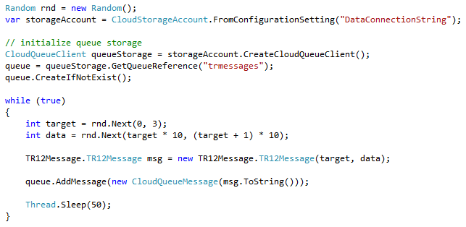
Queue Storage (continued)
Simple asynchronous dispatch queue
No limit to queue length (subject to storage limit)
64 KB per message
List queues—list queues in account
SAS Security
HTTP/REST queue operations
CreateQueue
DeleteQueue
Get/Set Metadata
Clear Messages
HTTP/REST message operations
PutMessage—adds a message to the queue
GetMessages—reads one or more messages and hides them
PeekMessages—reads one or more messages without hiding them
DeleteMessage—permanently deletes messages from queue
Add Message to Queue (C#)
Notes:
For more information, see:
http://www.microsoft.com/windowsazure/Whitepapers/QueueStorage/

Slide 34
Queue Storage Reliability
Guarantee delivery/processing of messages (two-step consumption)
Worker de-queues message, and it is marked as Invisible for a specified Invisibility Time
Worker deletes message when finished processing
If worker role crashes, message becomes visible for another worker to process
Remember to handle poison messages, remove messages if de-queue count is above the threshold
P₂
1
1
C₁
1. GetMessage(Q, 30 s)→ msg 1
5. C₁ crashed
4
0
3
0
2
1
1
1
1
2
1
1
3
1
2
Producers
Consumers
2
1
C₂
P₁
2. GetMessage(Q, 30 s) → msg 2
3. C2 consumed msg 2
4. DeleteMessage(Q, msg 2)
7. GetMessage(Q, 30 s) → msg 1
6. msg1 visible 30 s after Dequeue
Notes:
Slide Objectives
Understand the value of Queues
Speaker Notes
Queues allow the apparent performance of app to be improved
Work can be buffered in queue and performed later
Allows simple async communications between the roles
For more information, see:
http://blogs.msdn.com/b/eugeniop/archive/2010/05/11/windows-azure-guidance-the-get-delete-pattern-for-reading-messages-from-queues.aspx

Slide 35
Module 3: Microsoft Azure Storage
Section 6: Azure Files

Slide 36
Azure Files
Files – A PaaS solution to a network share in cloud
SMB 2.1 and SMB 3.0 support on shares
Enables “lift and shift” of applications
Applications use native operating system APIs to access files
Enables on-premises applications to use a file share in Azure with encryption—must open port 445 (outbound)
REST interface to access files access from anywhere
Notes:
https://azure.microsoft.com/en-us/blog/azure-file-storage-now-generally-available/
https://azure.microsoft.com/en-us/documentation/articles/storage-dotnet-how-to-use-files/

Slide 37
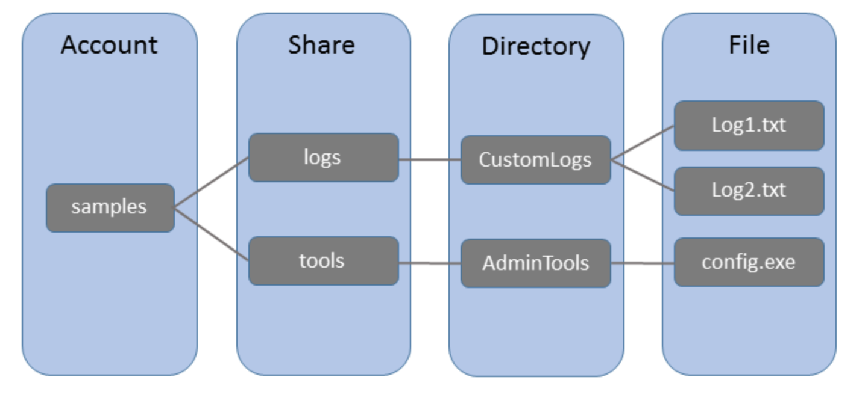
Azure Files Concepts
A share can have multiple directories
All directories and files must be created in a parent share
An account can contain an unlimited number of shares, and a share can store an unlimited number of files, up to the capacity limits of the storage account

Slide 38
Azure Files - Scenarios
Share data across virtual machines and applications
Multiple writers, multiple readers using standard file system semantics
Share settings throughout services
Virtual machines can read settings and files from a common, shared location. These virtual machines can be updated externally via REST.
Dev/Test/Debug
Very useful to have a shared location for installing applications, setting up virtual machines, running tools, and keeping notes while developing, testing, and debugging cloud services.

Slide 39
Website Served From Azure File Share
…
Load Balancer
Azure Virtual Machine
Azure Virtual Machine
SMB 3.0
Azure File Share
Notes:
In this scenario, we have an Azure website (could be Azure Website, Azure web roles, or IaaS VMs) that are load balanced. The VMs themselves, in whatever form they are, can use standard SMB 2.1 capability to Access Azure file shares

Slide 40
Azure Files - SMB 2.1 and SMB 3.0 Protocol
Enables moving on-premises applications that rely on shared file storage to Azure
Azure virtual machines can “net use” to a share
Natively supported by operating system APIs, libraries, and tools
Windows (CreateFile, ReadFile, WriteFile, …)
CRTs (fopen, fread, fwrite, …)
.NET (FileStream.Read, FileStream.Write, …) and many more
Supports standard file system semantics
Move and rename files and directories
Read-only, write through, overlapped
Change notifications

Slide 41
Recently Added Features
Copy File – server side copy of a blob or file to a destination file within the Storage account or across different Storage accounts
Abort Copy File – abort a pending copy file operation
File share size quota – limit the size of file shares
Get File Properties – returns all user-defined metadata, standard HTTP properties, and system properties for the file. It does not return the content of the file
Set File Properties – set system properties on the file
CORS Support – allow browser access using Set File Properties, Get File Properties, and Preflight File Request
Get Share Stats – get usage data for a file share.
Shared Access Signatures – provide SAS based access to file shares and files with REST APIs.
Get Share ACL and Set Share ACL –shared access policies on a share for use with REST APIs.

Slide 42
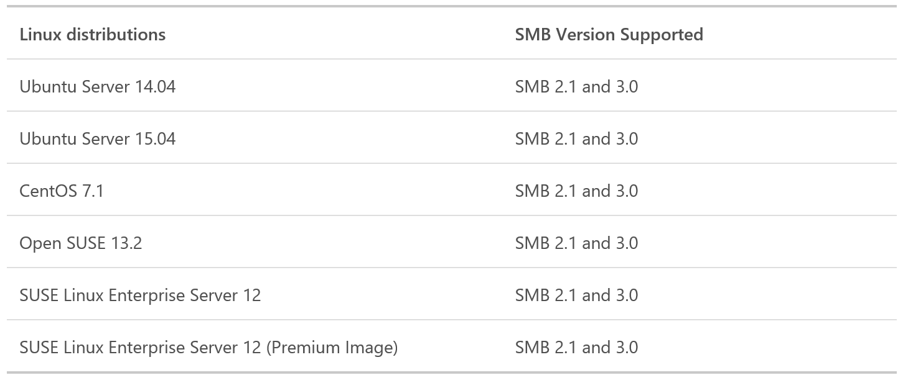
Azure Files – Linux Client Operating System Support
Linux SMB client does not support encryption
Mounting from Linux still requires the client to be in the same Azure region as the file share.
Notes:
Linux https://azure.microsoft.com/en-us/documentation/articles/storage-how-to-use-files-linux/

Slide 43
Azure Files: Getting Started
Request a token
Users are usually auto approved
Redeem token
Create new storage account in the approved subscription
Create share (using PowerShell)
Put files into share (azcopy)
Connect to share from virtual machine
Notes:
To get this to work the storage account and share is best to be created with PowerShell. Since you already have to be in PowerShell anyway to create the share, best to do it all from there

Slide 44
Module 3: Microsoft Azure Storage
Section 7: Premium Storage

Slide 45
Azure Premium Storage
Premium storage account can be created via the Azure Preview Portal, Azure PowerShell or the Service Management REST API
Supports only Azure Page Blobs that are used to hold persistent disks
Available in the following regions - West US, East US 2, West Europe, East China, Southeast Asia and West Japan
Only support Locally Redundant Storage (LRS)
Must use DS-Series or GS-Series disks for virtual machines
Cannot be mapped to a custom domain
Storage analytics not currently supported
No support for Block blobs, Azure Files, Azure Tables or Azure Queues
Notes:
http://azure.microsoft.com/en-us/documentation/articles/storage-premium-storage-preview-portal/#scale
http://azure.microsoft.com/en-us/documentation/articles/storage-premium-storage-preview-portal/
Using Blob Service operations
http://msdn.microsoft.com/en-us/library/dn889922.aspx

Slide 46
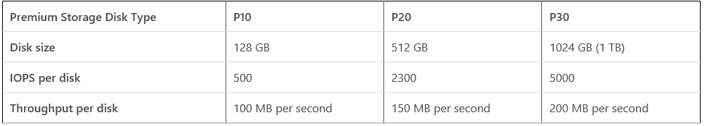
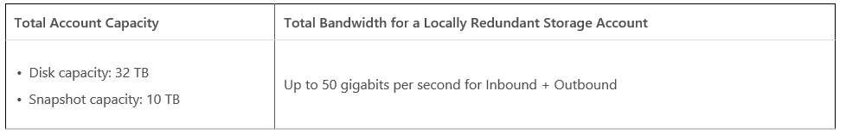
Azure Premium Storage Scalability
Three types of Premium Storage disks
Scalability Targets
Notes:
First Table
When you provision a disk against a Premium Storage account, how much input/output operations per second (IOPS) and throughput (bandwidth) it can get depends on the size of the disk. Currently, there are three types of Premium Storage disks: P10, P20, and P30. Each one has specific limits for IOPS and throughput as specified in the following table:
Premium Storage Disk TypeP10P20P30Disk size128 GB512 GB1024 GB (1 TB)IOPS per disk 50023005000Throughput per disk100 MB per second150 MB per second 200 MB per second Azure maps the disk size (rounded up) to the nearest Premium Storage Disk option as specified in the table. For example, a disk of size 100 GB is classified as a P10 option and can perform up to 500 IO units per second, and with up to 100 MB per second throughput. Similarly, a disk of size 400 GB is classified as a P20 option, and can perform up to 2300 IO units per second and up to 150 MB per second throughput.
The input/output (I/O) unit size is 256 KB. If the data being transferred is less than 256 KB, it is considered a single I/O unit. The larger I/O sizes are counted as multiple I/Os of size 256 KB. For example, 1100 KB I/O is counted as five I/O units.
The throughput limit includes both reads and writes to the disk. For example, the sum of reads and writes should be smaller or equal to 100 MB per second for a P10 disk. Similarly, a single P10 disk can have either 100 MB per second of reads or 100 MB per second of writes, or 60 MB per second of reads with 40 MB per second of writes as an example.
When you create your disks in Azure, select the most appropriate Premium Storage disk offering based on the needs of your application in terms of capacity, performance, scalability, and peak loads.
Second table:
Total Account CapacityTotal Bandwidth for a Locally Redundant Storage AccountDisk capacity: 32 TB
Snapshot capacity: 10 TB
Up to 50 gigabits per second for Inbound + OutboundInbound refers to all data (requests) being sent to a storage account.
Outbound refers to all data (responses) being received from a storage account.
Storage scalability targets
http://msdn.microsoft.com/library/dn249410.aspx

Slide 47
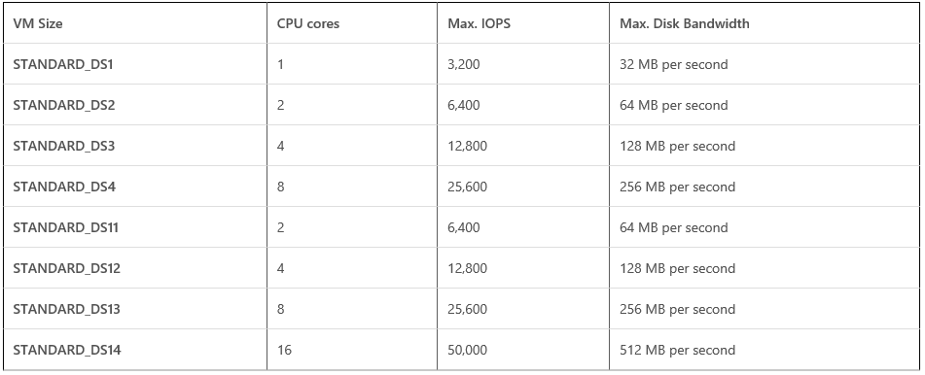
Premium Storage – Disk Traffic (only)
Notes:
Make sure that there is sufficient bandwidth available on your VM to drive the disk traffic. For example, a STANDARD_DS1 VM has 32 MB per second dedicated bandwidth available for Premium Storage disk traffic. That means, a P10 Premium Storage disk attached to this VM can only go up to 32 MB per second but not up to 100 MB per second that the P10 disk can provide. Similarly, a STANDARD_DS13 VM can go up to 256 MB per second across all disks. Currently, the largest VM on DS-series is STANDARD_DS14 and it can provide up to 512 MB per second across all disks.
Note that these limits are for disk traffic alone, not including cache-hits and network traffic. There is a separate bandwidth available for VM network traffic, which is different from the dedicated bandwidth for Premium Storage disks. The following table lists the current maximum IOPS and throughput (bandwidth) values per DS-series VM across all the disks attached to the VM

Slide 48
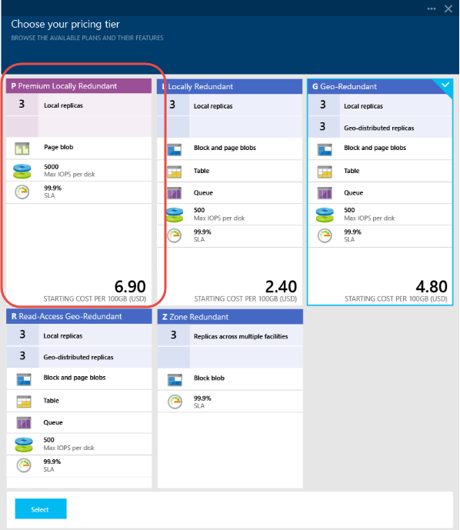
Creating a Premium Storage account
Notes:
In this screenshot, we show a Premium storage account being created through the preview portal.

Slide 49
Module 3: Microsoft Azure Storage
Section 8: Content Delivery Network

Slide 50
Content Delivery Network (CDN)
High-bandwidth global blob content delivery
31 locations globally (US, Europe, Asia, Australia and South America), and growing
Same experience for users—irrespective of how far they are from the geo-location where the storage account is hosted
Blob service URL vs. CDN URL:
Azure Blob URL: http://<StorageAccount>.blob.core.windows.net/
CDN URL: http://<id>.vo.msecnd.net/
Custom Domain Name for CDN: http://cdn.contoso.com/
Notes:
Slide Objectives
Understand basic concept of a CDN
Understand at a high level how CDN works
Speaker Notes
The Azure CDN provides an edge nodes around the world
Data stored in CDN enabled storage accounts is retrieved from the origin storage container and cached at each edge node in a lazy load fashion
Azure customers have control over how long data is cached for
CDN has 18 locations globally (United States, Europe, Asia, Australia and South America ) and continues to expand
The benefit of using a CDN is better performance and user experience for users who are farther from the source of the content stored in the Azure Blob service
Azure CDN provides worldwide high-bandwidth access to serve content for popular events
Notes
For more information, see:
http://blogs.msdn.com/b/windowsazure/archive/2009/11/05/introducing-the-windows-azure-content-delivery-network.aspx

Slide 51


CDN (continued)
GET
http://guid01.vo.msecnd.net/images/pic.1jpg
Edge Location
To enable CDN:
Register for CDN via Dev Portal
Set container images to public
404
Edge Location
Edge Location
TTL
Content Delivery Network
http://sally.blob.core.windows.net/
⬅➔
http://guid01.vo.msecnd.net/
pic1.jpg
Windows Azure Blob Service
pic1.jpg
pic1.jpg
http://sally.blob.core.windows.net/images/pic1.jpg
Notes:
Slide Objective
Understand how to enable CDN
Value Prop
The Azure CDN offers developers a global solution for delivering high-bandwidth content that is hosted in Azure
Speaker Notes
Log into the Microsoft Azure Management Portal.
In the navigation pane, click Hosted Services, Storage Accounts and CDN.
In the navigation pane, click CDN.
On the ribbon, click New Endpoint. This will open the Create a New CDN Endpoint window.
On the Create a New CDN Endpoint window select a subscription from the Choose a Subscription drop-down menu to enable CDN.
Select the source of the CDN content from the Choose a content provider drop-down menu.
If you need to use HTTPS connections, select HTTPS.
If you are caching content from a hosted service and you are using query strings to specify the content to be retrieved, select Query Strings.
Click Create.
The content source URL will display Source URL for the CDN Endpoint. This is the URL from which the CDN will retrieve the cached content.
Once you enable CDN access to a storage account or hosted service, all publicly available objects are eligible for CDN edge caching.
If you modify an object that is currently cached in the CDN, the new content will not be available via the CDN until the CDN refreshes its content when the cached content time-to-live period expires.

Slide 52


