Slide 1
HL7 Virtual FHIR Connectathon 28
Clinical Reasoning Track Sharing Clinical Knowledge
Bryn Rhodes

Slide 2
Knowledge Representation

Slide 3
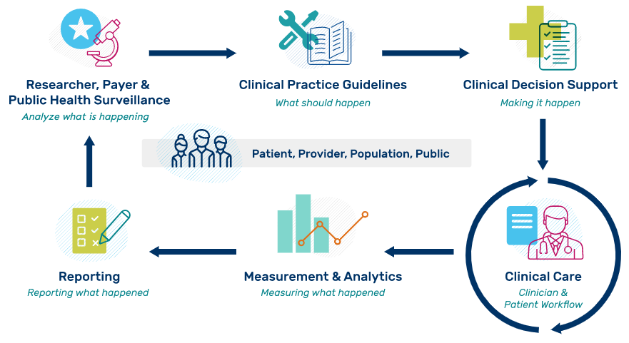
Quality Improvement Ecosystem
Notes:
The image highlights the ideal iterative flow of evidence-based information from research to clinical practice and measurement to evaluate clinical performance and outcomes for healthcare organizations. Please note that while it is depicted in a linear fashion, the process is often interactive between stakeholders and phases as well as iterative.

Slide 4


Quality Improvement Ecosystem
LEGEND: Sponsoring HL7 Workgroups
Clinical Decision Support (CDS)
Clinical Quality Information (CQI) Public Health (PH) Cross Group Projects (CGP)
EBM
CPG IG
US Core
CDS Hooks
CQL
QI Core
CR
US PH
MedMorph
eCR
DEQM
QM IG
Notes:
The image highlights the ideal iterative flow of evidence-based information from research to clinical practice and measurement to evaluate clinical performance and outcomes for healthcare organizations. Please note that while it is depicted in a linear fashion, the process is often interactive between stakeholders and phases as well as iterative.

Slide 5

Why?
Reduce the development effort required for clinical systems to support evolving standards of care
Notes:
Has many facets
Reduce duplicate effort while supporting innovation
Reduce inconsistency while supporting settings-specific factors
Reduce accidental complexity so we can focus on essential complexity
Takes many forms
Guidelines, interventions, measures, documentation templates, order sets, flow sheets, SMART apps, CDS services
Some principles
Declarative vs Imperative (i.e. "what" not "how")
Separation of Concerns
Various types of Independence
History of computing is a history of raising the level of abstraction
No Silver Bullet!

Slide 6
How?
Enable precise and unambiguous sharing of clinical knowledge

Slide 7
Translating Knowledge to Execution
Knowledge Level | Description | Example
L1 | Narrative | Guideline for a specific disease that is written in the format of a peer-reviewed journal article
L2 | Semi-structured | Flow diagram, decision tree, or other similar format that describes recommendations for implementation (HUMAN READABLE)
L3 | Structured | Standards-compliant specification encoding logic with data model(s), terminology/code sets, value sets that is ready to be implemented (COMPUTER/MACHINE READABLE)
L4 | Executable | CDS implemented and used in a local execution environment (e.g., CDS that is live in an electronic health record (EHR) production system) or available via web services
Adapted from: Boxwala, AA, et al.. A multi-layered framework for disseminating knowledge for computer-based decision support. J Am Med Inform Assoc 2011(18) i132-i139.

Slide 8
Types of Interoperability
Data
Knowledge
Lexical
Syntactic
Semantic
Logical
Process
Notes:
Lexical -> Format, character encoding, protocol, infrastructure
Syntactic -> Structure
Semantic -> Meaning
Logical -> Expressions/Computation
Process -> Workflow/Orchestration

Slide 9
Components of Sharing Logic
Logic
Value > 100
Encounter
Medication
Observation
Model
Terms
SNOMED-CT
LOINC
RxNorm
Definitions:
SNOMED CT – Systematized Nomenclature of Medicine – Clinical Terms
LOINC – Logical Observation Identifiers Names and Codes

Slide 10
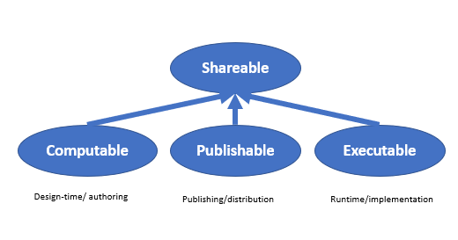
Knowledge Capabilities
http://hl7.org/fhir/uv/cpg/profiles.html#artifact-profiles

Slide 11
Running Example
NOTE: This recommendation was updated in May of 2021; the updates have not been considered here yet
The U.S. Preventive Services Task Force (2016) recommends screening for colorectal cancer starting at age 50 years and continuing until age 75 years. This is a Grade A recommendation (U.S. Preventive Services Task Force, 2016).
Appropriate screenings are defined by any one of the following:
Colonoscopy (every 10 years)
Flexible sigmoidoscopy (every 5 years)
Fecal occult blood test (annually)
FIT-DNA (every 3 years)
Computed tomographic colonography (every 5 years)
https://www.uspreventiveservicestaskforce.org/uspstf/recommendation/colorectal-cancer-screening

Slide 12
Sharing Terminology

Slide 13


Slide 14
CodeSystem
Represents a single system of coded concepts
Also called terminology, ontology, or vocabulary
Not intended for distribution, rather as a description of the code system and it’s properties. May contain content, but not necessarily (or maybe partially)
May be enumerated, or may have a formal grammar, or both
Can be validated
It’s always possible to tell, given a specific code, whether it is a member of that system
Can have associated properties
Hierarchies and grouping

Slide 15
ValueSet
Represents a collection of codes from one or more systems
Can have a definition and/or expansion
Definition
Instructions for how to build the contents of the value set (i.e. membership criteria)
Expansion
Explicit listing of the members of the value set

Slide 16
Value Set Definition
Intensional
Definition in terms of expressive criteria
code 73211009 | Diabetes mellitus (disorder) | and all child codes, recursively
Extensional
Enumeration of codes
73211009 | Diabetes mellitus (disorder)
46635009 | Diabetes mellitus type 1 (disorder)
31321000119102 | Diabetes mellitus type 1 without retinopathy (disorder)
...

Slide 17
ValueSet Expansion
Computable
Executable
SNOMED CT:20200301
Value Set (definition)
Value Set (expansion)
SNOMED CT:20200901
Value Set (expansion)
SNOMED CT:20210301
Value Set (expansion)

Slide 18
Artifact ValueSet Usage
SNOMED CT:20200301
Value Set (definition)
Value Set (expansion)
SNOMED CT:20200901
Value Set (expansion)
SNOMED CT:20210301
Value Set (expansion)
Measure (draft)
Measure (active)
Authoring (January 2021)
Publication (May 2021)

Slide 19
Artifact ValueSet Usage
SNOMED CT
Value Set (definition)
Value Set (expansion)
SNOMED CT:20200301
Value Set (expansion)
SNOMED CT:20200901
Value Set (expansion)
SNOMED CT:20210301
Value Set (expansion)
Value Set (expansion)
SNOMED CT:20210901
SNOMED CT:20220301
Measure (draft)
Measure (active)
Measure v2 (draft)
Measure v2 (active)
Authoring (January 2021)
Publication (May 2021)
Implementation (2022)
Authoring (January 2022)
Publication (May 2022)

Slide 20
SNOMED CT
Value Set (definition)
Value Set (expansion)
SNOMED CT:20200301
Value Set (expansion)
SNOMED CT:20200901
Value Set (expansion)
SNOMED CT:20210301
Value Set (expansion)
Value Set (expansion)
SNOMED CT:20210901
SNOMED CT:20220301
Measure (draft)
Measure (active)
Measure v2 (draft)
Measure v2 (active)
Authoring (January 2021)
Publication (May 2021)
Implementation (2022)
Authoring (January 2022)
Publication (May 2022)

Slide 21
Option 1: Pin code system version in the ValueSet
SNOMED CT
Value Set (definition)
Value Set (expansion)
SNOMED CT:20200301
Value Set (expansion)
SNOMED CT:20200901
Value Set (expansion)
SNOMED CT:20210301
Value Set (expansion)
Value Set (expansion)
SNOMED CT:20210901
SNOMED CT:20220301
Measure (draft)
Measure (active)
Measure v2 (draft)
Measure v2 (active)
Authoring (January 2021)
Publication (May 2021)
Implementation (2022)
Authoring (January 2022)
Publication (May 2022)
Means a new “version” of the ValueSet, even though nothing really changed
Creates significant maintenance of ValueSets, and limits the resulting ValueSet reusability
Means artifacts would have to reference specific versions of the ValueSet
Creating significant maintenance of ValueSet version information in artifacts

Slide 22
Option 2: Pin code system and value set version in the Measure
SNOMED CT
Value Set (definition)
Value Set (expansion)
SNOMED CT:20200301
Value Set (expansion)
SNOMED CT:20200901
Value Set (expansion)
SNOMED CT:20210301
Value Set (expansion)
Value Set (expansion)
SNOMED CT:20210901
SNOMED CT:20220301
Measure (draft)
Measure (active)
Measure v2 (draft)
Measure v2 (active)
Authoring (January 2021)
Publication (May 2021)
Implementation (2022)
Authoring (January 2022)
Publication (May 2022)
Means a new “version” of the Artifact, even though nothing really changed
Creates significant maintenance of Artifacts, and limits the resulting Artifact reusability

Slide 23
Option 3: Version Manifest
SNOMED CT
Value Set (definition)
Value Set (expansion)
SNOMED CT:20200301
Value Set (expansion)
SNOMED CT:20200901
SNOMED CT:20210301
Value Set (expansion)
SNOMED CT:20210901
Value Set (expansion)
SNOMED CT:20220301
Value Set (expansion)
Manifest (draft)
Manifest (active)
Manifest v2 (draft)
Manifest v2 (release)
Measure (draft)
Measure (active)
Measure v2 (draft)
Measure v2 (active)
Authoring (January 2021)
Publication (May 2021)
Implementation (2022)
Authoring (January 2022)
Publication (May 2022)
Specify the versions of artifacts and dependencies in a separate “manifest” artifact, independent of the ValueSet and Artifact
Supports including the same artifacts and value sets in multiple “manifests”
Means that neither ValueSets nor Artifact need to version just to support terminology changes

Slide 24
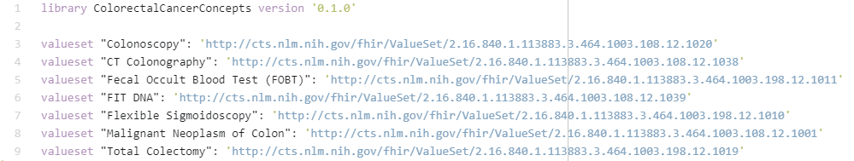
Colorectal Cancer Concepts

Slide 25
Sharing Data Elements

Slide 26
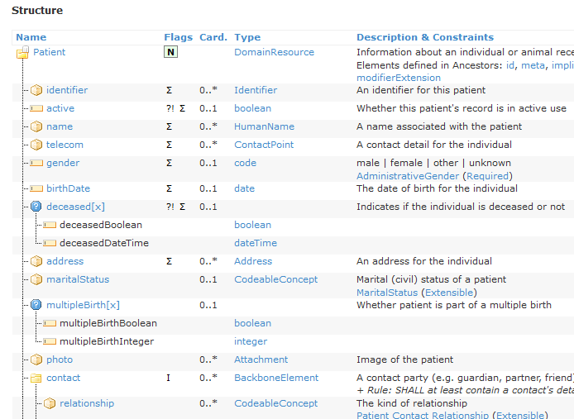
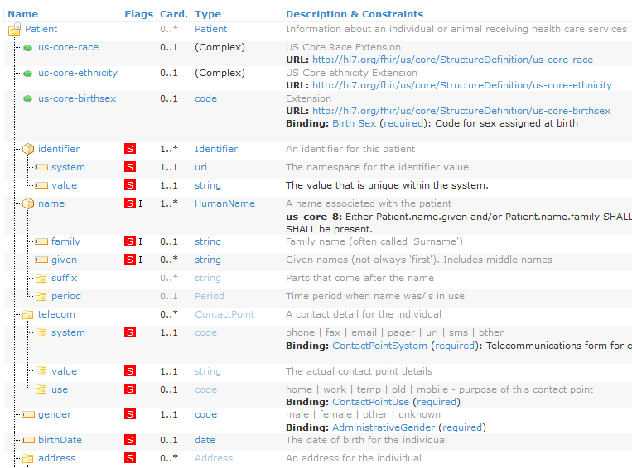
StructureDefinition
Resource
Profile

Slide 27
Data Elements in FHIR
Resources/profiles are made up of any number of elements
Each elements describes
name
type(s)
constraints (cardinality, invariants about value, etc)
binding (reference to a ValueSet)
Definitions, independent of:
Specific patient
Location
Time
Largely, related information

Slide 28

Example Data Element
Uses FHIR as a Data Model (i.e. expressed in terms of FHIR Resource)
References terminology (via the Concepts library)
Establishes expectations for values (i.e. invariants)

Slide 29
Data Element Contextualization
To apply the data element, typically needs to be contextualized
Can be contextualized in different ways
A particular patient (or encounter, or procedure, etc.)
Context in CQL
Temporally (to a point in time, or a period of time)
A location (or setting)
A user
A relationship (i.e. for a related encounter or procedure)
Others...

Slide 30

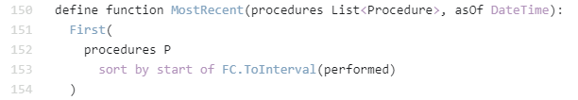
For example...

Slide 31
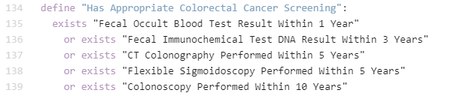
Complex Data Element

Slide 32
Sharing via Implementation Guides

Slide 33


















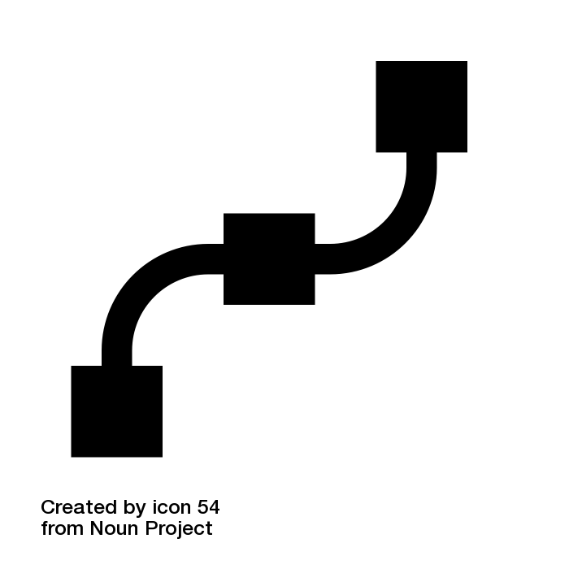



eCQM ProgramS
CDC Opioid Prescribing
WHO FP
WHO STI
WHO ANC
Content IGs
HEDIS
MME Calculation
WHO CORE
Model IGs
Specification IGs
IPS
US Core
QI Core
DEQM
QM
SDC
CPG-on-FHIR
EBM-on-FHIR
Foundation
Conformance
Administration
Clinical
Reasoning
FHIRPath
CQL
CDS Hooks
SMART
Notes:
FHIR-based Knowledge Representation Specifications
This diagram depicts 4 categories of specifications, with representative examples of each category, illustrating how the various pieces can be used together to deliver shareable clinical reasoning artifacts such as quality measures and decision support rules.
Along the bottom of the diagram are the foundational standards, including FHIR, with the 5 layers of Foundation, Conformance, Administration, Clinical, and Reasoning, as well as expression language and integration standards including FHIRPath, Clinical Quality Language, CDS Hooks, and SMART-on-FHIR.
In the middle left are the Model Implementation Guides, typically derived from Administration and Clinical resources such as Patient, Encounter, and MedicationRequest. Model IGs are typically built to address a broad range of use cases, focused on a particular target realm or domain.
In the middle right are the Specification Implementation Guides, which derive from the FHIR Clinical Reasoning resources to provide implementation guidance and conformance requirements for the creation, distribution, evaluation, and maintenance of shareable clinical knowledge. For example, the Quality Measure IG provides guidance on and conformance requirements for the use of the FHIR Measure and Library resources to create and share clinical quality measures, Data Exchange for Quality Measures (DEQM) provides guidance for reporting quality measures, and the Clinical Practice Guidelines IG (CPG-on-FHIR) demonstrates how to build shareable computable guideline content.
And finally, at the top of the diagram, the Content Implementation Guides are FHIR Implementation Guides, but not necessarily balloted as HL7 standards, rather these use the FHIR publication toolchain to support authoring and distribution, but the content is stewarded by separate authorities such as quality agencies and guideline developers; groups that have their own governance and maintenance policies. For example, the HEDIS IG contains HEDIS quality measures expressed using FHIR Measure and Library resources, and conforming to the Quality Measure IG profiles, while the CDC Opioid Prescribing IG and WHO Antenatal Care IGs contain decision support content to streamline guideline implementation. The content IGs conform to the specification IGs, and typically make use of the model IGs to define content focused on a particular realm.
The Foundation layer of FHIR defines the core data exchange protocol. The Conformance layer defines how resources, profiles, and terminologies are represented and used. The Administration layer defines individuals, locations, organizations, and encounters. The Clinical layer defines clinical information such as observations, medications, procedures, and orders. And the Reasoning layer provides definitional artifacts like plan and activity definitions, libraries, and measures.
FHIRPath is a simple, yet powerful, model-independent expression language that is used extensively throughout FHIR to describe paths to elements on resources, and define invariants on profiles.
CQL is a superset of FHIRPath that provides an author-friendly format for the description of clinical logic, as well as a machine-friendly format for processing the logic.
CDS Hooks is an HL7 standard specification for integrating decision support services with clinical systems. It is primarily focused on provide-facing remote decision support within an EMR.
SMART-on-FHIR is an HL7 standard specification for integrating clinical applications into EMRs using FHIR.
International Patient Summary (IPS) is a set of internationally applicable FHIR profiles used to share patient information across international boundaries. As a result, it forms an excellent foundation for expressing universally applicable content guidelines such as the WHO Antenatal Care (WHO ANC).
US Core is a set of profiles focused on enabling exchange of the US Clinical Data for Interoperability (US CDI), and is supported by a broad range of EMR vendors within the US.
QI Core is a set of profiles that derives from US Core to enable quality improvement use cases such as quality measurement and decision support within the US.

Slide 34
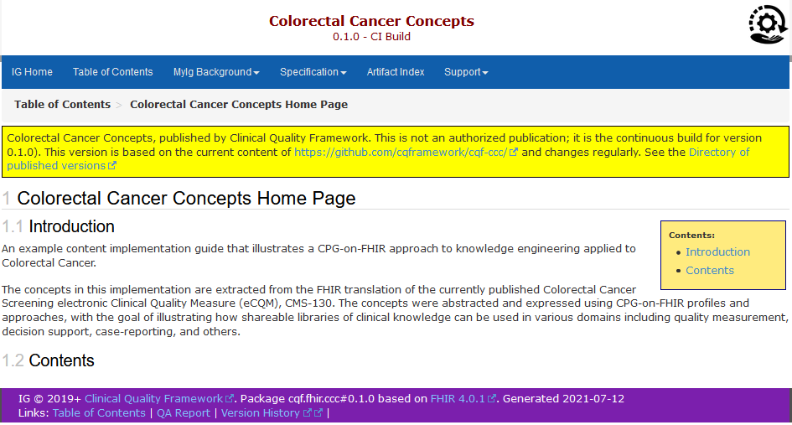
Colorectal Cancer Concepts
http://build.fhir.org/ig/cqframework/cqf-ccc/

Slide 35
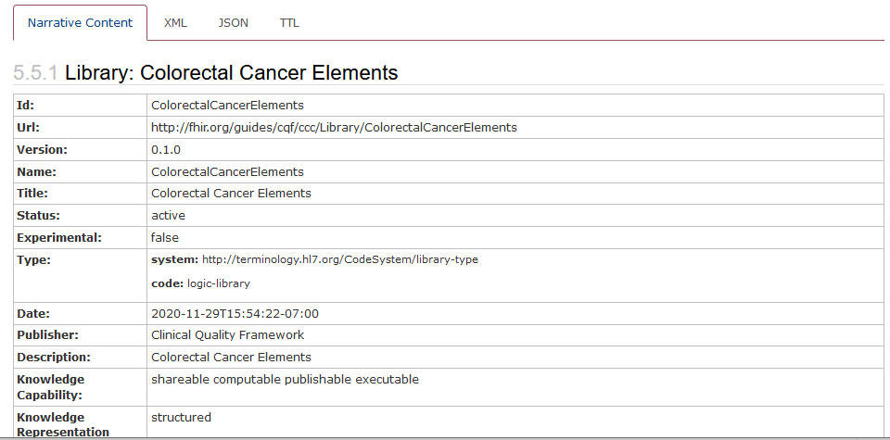
Logic Libraries
http://build.fhir.org/ig/cqframework/cqf-ccc/Library-ColorectalCancerElements.html

Slide 36
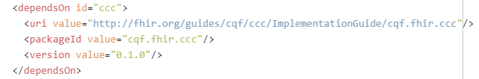
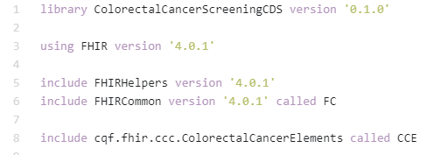
FHIR Publishing Ecosystem

Slide 37
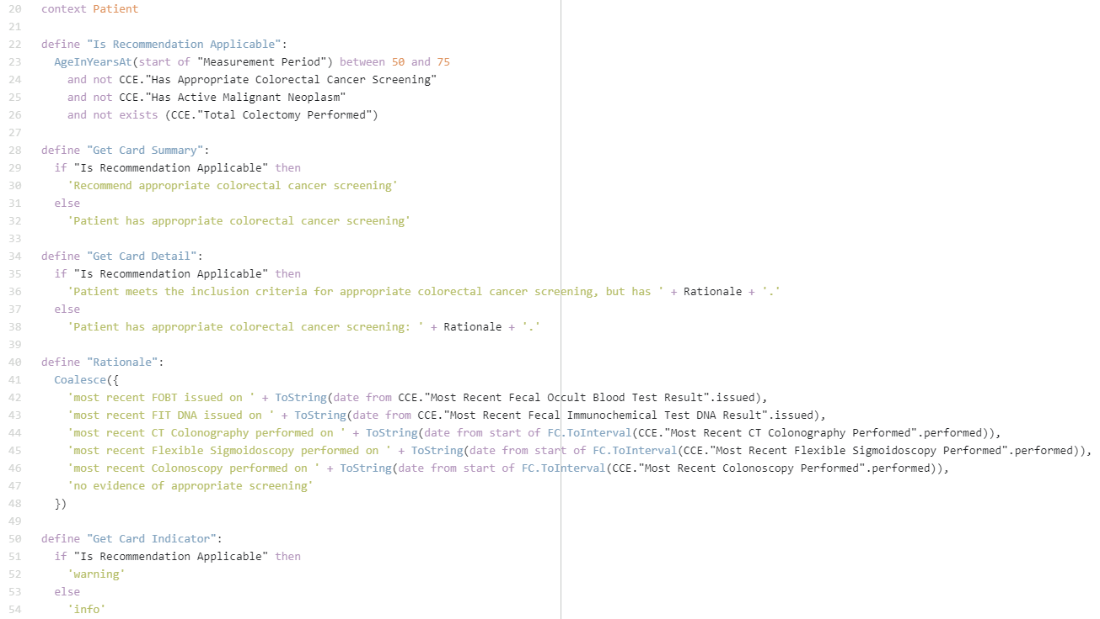
ColorectalCancerScreeningCDS
https://github.com/cqframework/cqf-ccc/blob/master/input/cql/ColorectalCancerScreeningCDS.cql

Slide 38
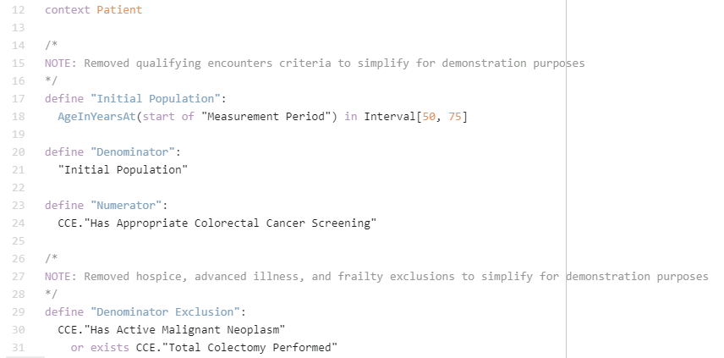
ColorectalCancerScreeningCQM
https://github.com/cqframework/cqf-ccc/blob/master/input/cql/ColorectalCancerScreeningCQM.cql

Slide 39
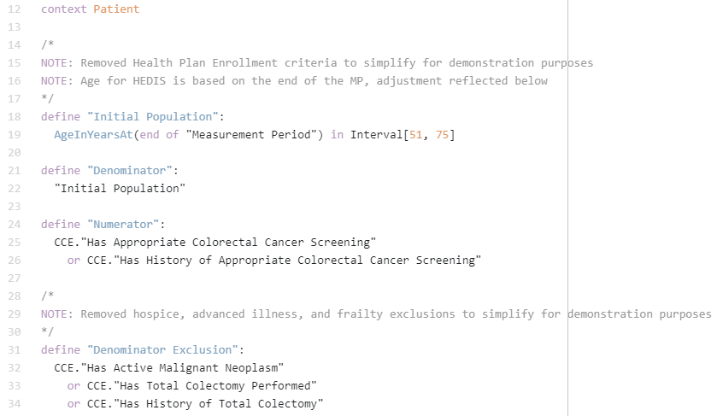
ColorectalCancerScreeningHEDIS
https://github.com/cqframework/cqf-ccc/blob/master/input/cql/ColorectalCancerScreeningHEDIS.cql

Slide 40
Sharing via Repository Services

Slide 41
Sharing via Services
Authoring
Publishing
Evaluation
Guideline Development
Decision Support Services
Terminology Service(s) (e.g. VSAC)
Measure Developers
Measure Evaluation Services
Decision Support Authors
Knowledge Repository(s)
(e.g. CDS Connect)
EHRs
Quality Improvement Agencies
SMART Apps
Professional Societies
Backend Services Applications
...
...

Slide 42
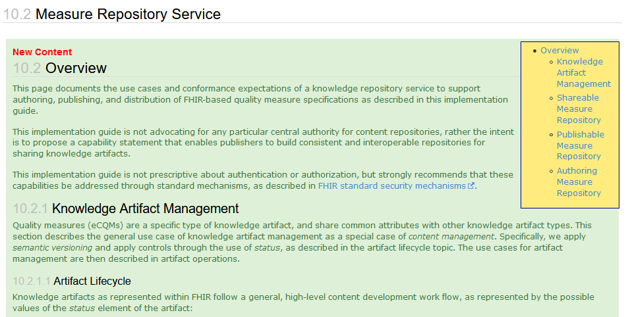
Knowledge Repository
Artifact Lifecycle
Artifact Identity
Versioning
Operations
Capabilities
http://hl7.org/fhir/us/cqfmeasures/2021May/measure-repository-service.html

Slide 43
Packaging
Bundling an artifact for use in a particular context and including its components and dependencies
Capabilities – Computable/Publishable/Executable
Components/Dependencies

Slide 44
Asset Collections
FHIR “asset-collection” library type
Allows collections of related artifacts to be described, together with parameters for how they should be used in particular contexts
Other names for this concept:
Version Manifest (in package management)
Expansion Profile (at the highest level)
Quality Program and Quality Program Release

Slide 45
Data Requirements
Determining the data and dependency requirements for a particular element, artifact (or collection of elements/artifacts)
$data-requirements
Type or instance; on Library, Measure, or PlanDefinition
Returns a “module-definition” Library with
parameter definitions (in/out)
dependencies (on CodeSystem, ValueSet, or Library)
direct-reference code usages
data requirements (resource type and code/date filters)
logic definitions (source expressions for referenced content)

Slide 46
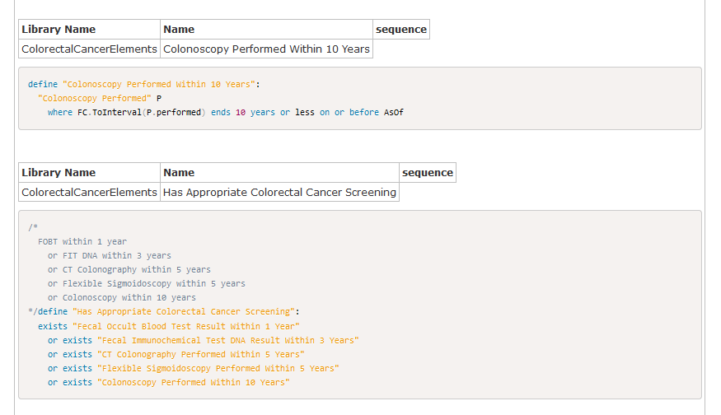
Measure Narrative, for example
http://build.fhir.org/ig/cqframework/cqf-ccc/Measure-ColorectalCancerScreeningCQM.html

Slide 47


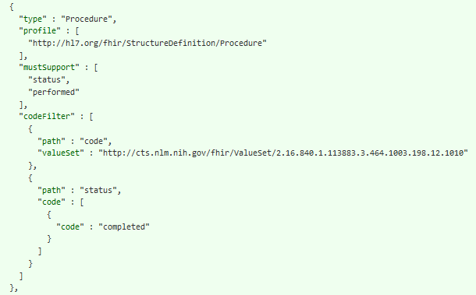
Data Requirements Example

Slide 48
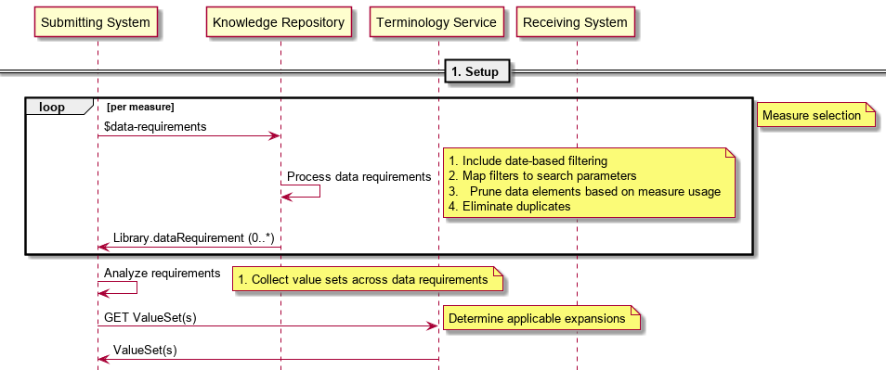
Artifact Setup

Slide 49
Key Takeaways
Isolate terminology dependencies
i.e. define a Concepts library
Take versioned dependencies carefully
Don’t take versioned dependencies on valuesets and codesystems, delegate that version-binding to a manifest
Define context independent data elements
Consider how data elements will be contextualized for use

Slide 50
Demonstrations

Slide 51
Knowledge Authoring
http://build.fhir.org/ig/cqframework/cqf-ccc/index.html

Slide 52
Quality Reporting
https://cds-sandbox.alphora.com/cqf-ruler-r4/fhir/Measure/ColorectalCancerScreeningCQM/$evaluate-measure?patient=denom-EXM130&periodStart=2019-01-01&periodEnd=2019-12-31
https://cds-sandbox.alphora.com/cqf-ruler-r4/fhir/Measure/ColorectalCancerScreeningCQM/$evaluate-measure?patient=numer-EXM130&periodStart=2019-01-01&periodEnd=2019-12-31

Slide 53
CDS Hooks
http://sandbox.cds-hooks.org/

Slide 54
Gaps in Care

Slide 55
QUESTIONS?

